Slide 1


Check Point 1
Stocks Prediction Project
Workshop in Data Science
Team 003 - Itay Mutzafi, Moran Zaks , Shaked Schnarch
Notes:
Moran
Good afternoon. We are Itay Mutzafi, Moran Zaks, and Shaked Schnarch
Our first option is in the financial markets: Stocks Prediction. The task is a Supervised Binary Classification on noisy time-series data.
Our second option is in Neuroscience: Detecting Autism Patterns in Brain Signals.
We will now dive into the first option: Stocks Prediction.

Slide 2


Project Status
Evaluation
16.12 - 5.1
26.10 - 24.11
24.11 - 8.12
9.12 - 15.12
6.1 - 20.1
Business Understanding
Data Preparation
Model Selection
Finishers
24.11-21.12
21.12 - 5.1
Updated dates
Planned dates

Slide 3
Project Status - Finished Missions
Init Repo
Fetch Data
EDA
Project Scope – 4 stocks
Evaluation Metrics
Evaluation Functions
Data Preparation
Evaluation

Slide 4
Project Status – What’s Next
Data Cleaning
Feature Engineering (Yahoo!) – Days to report
Sentiment Analysis (News)
Test – Train split
Run Random Forest
Run Regression Model
Data Preparation
80% has been done, new deadline – 21.12
2 weeks of delay
Model Selection

Slide 5
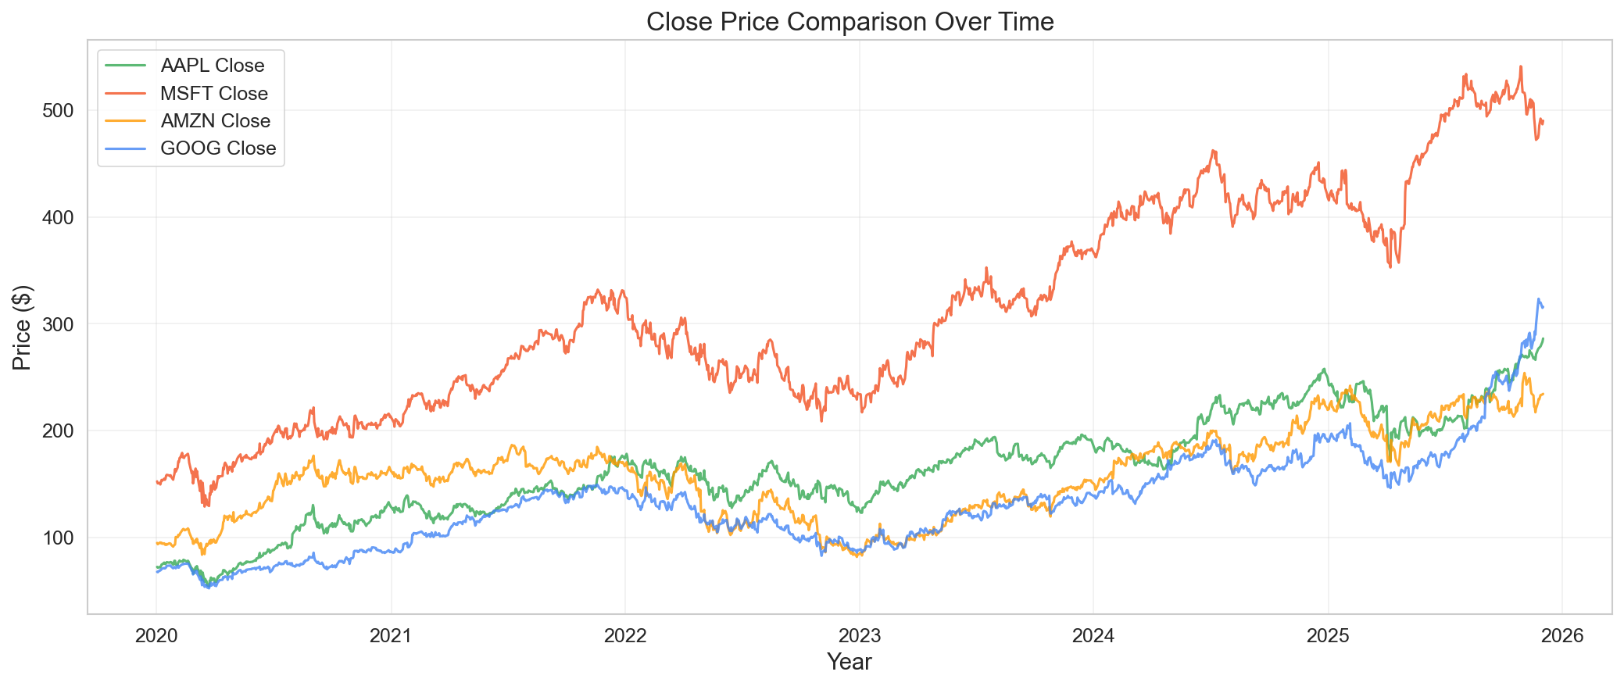
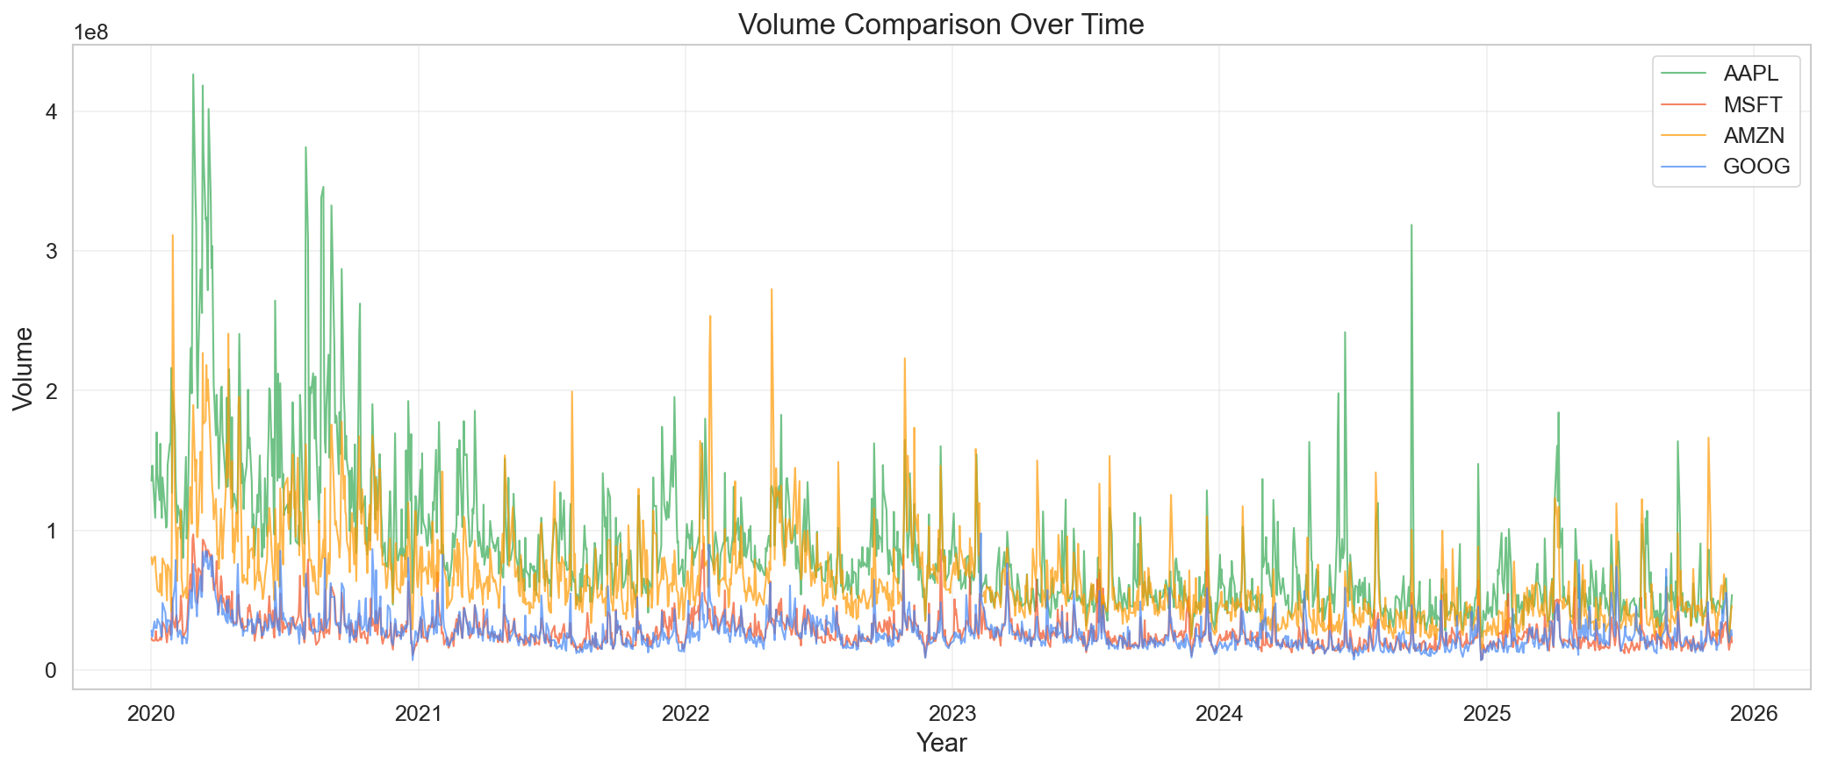
Yahoo! – EDA General

Slide 6
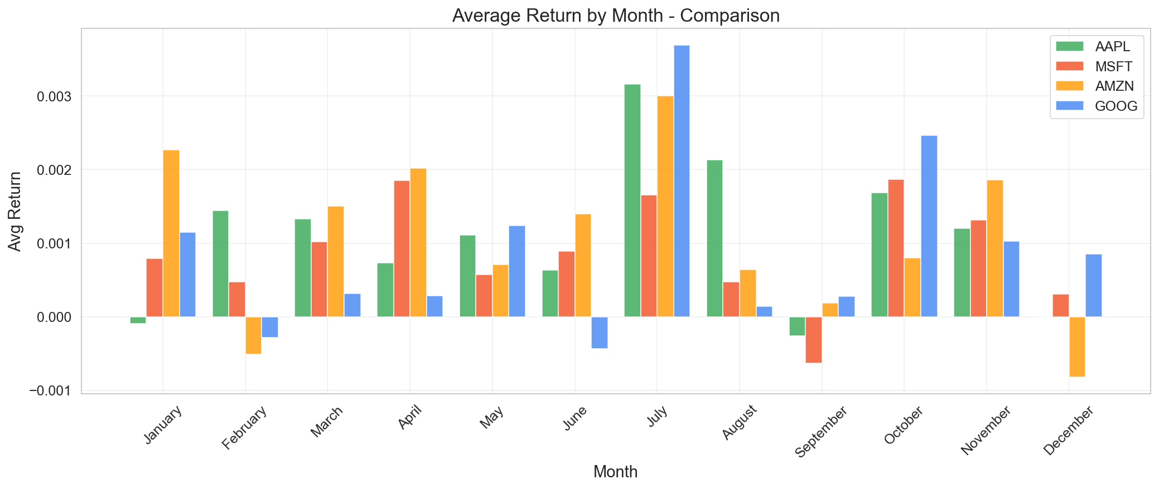
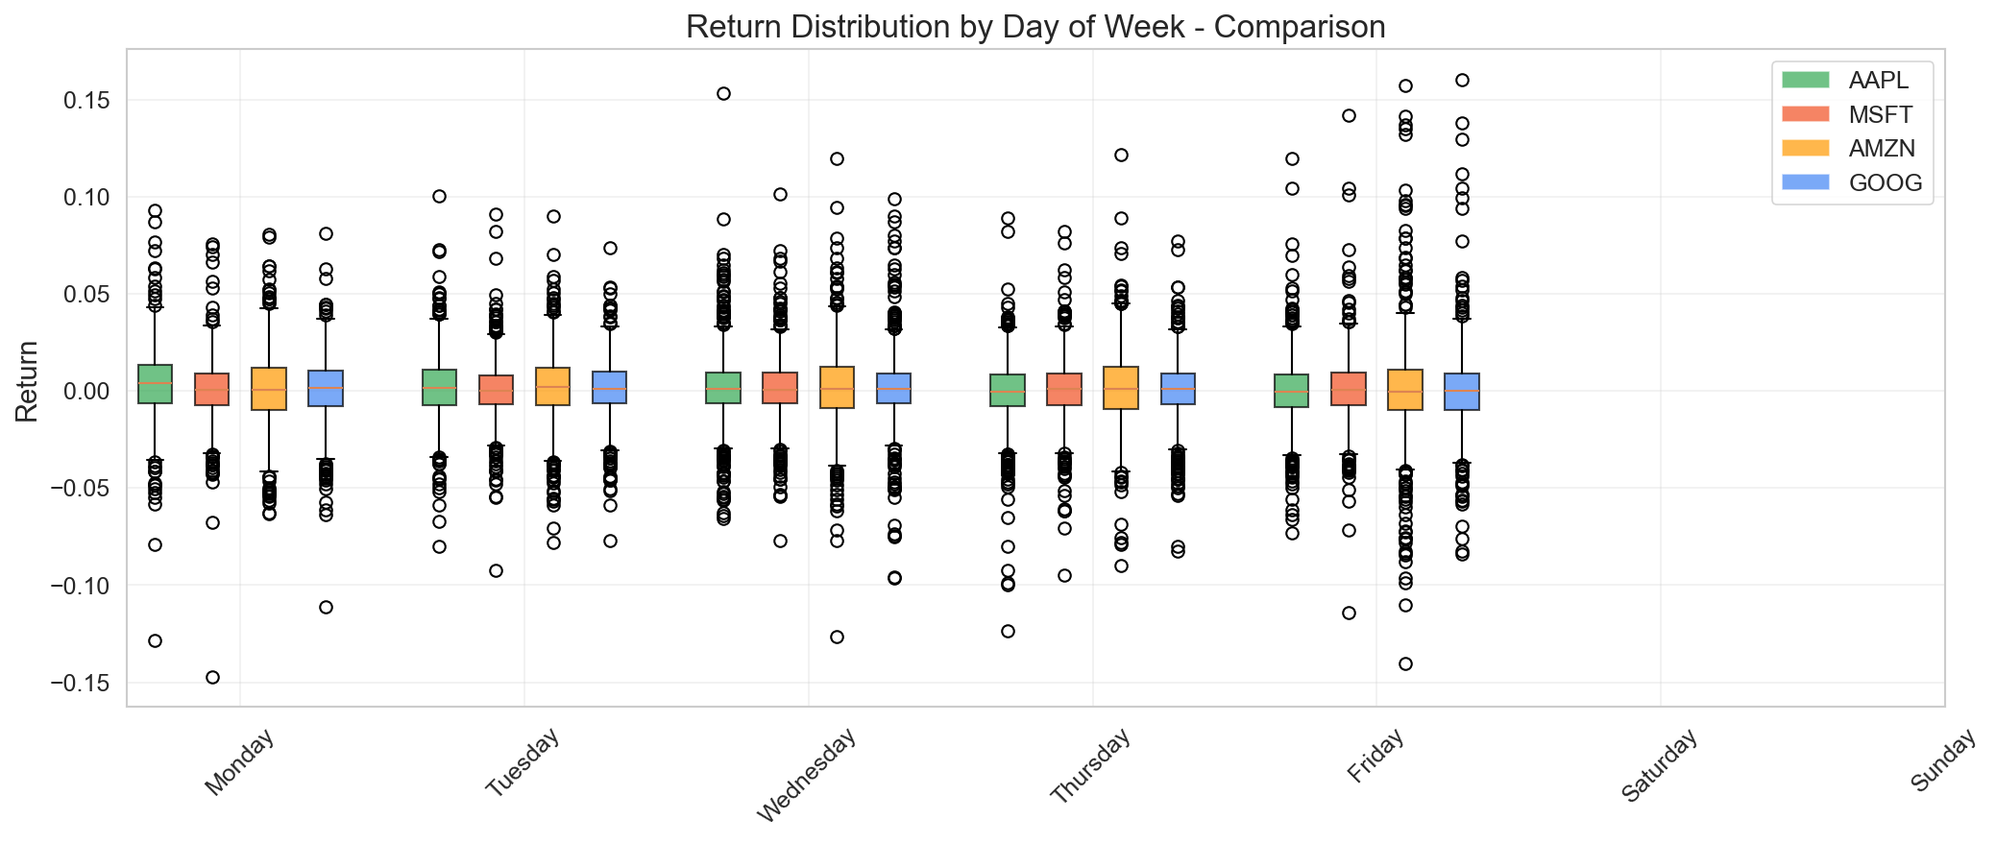
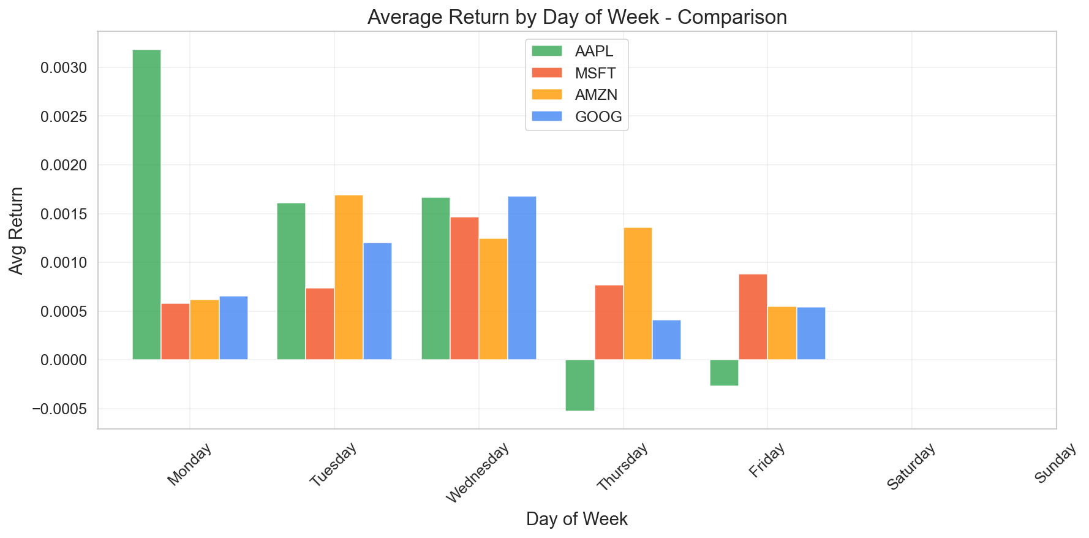
Return - Seasonality

Slide 7
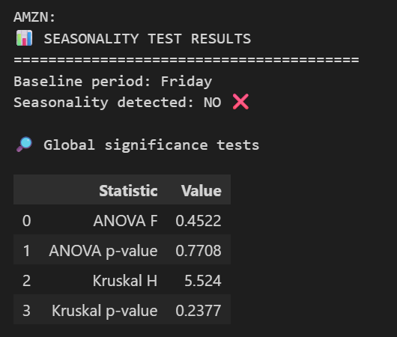
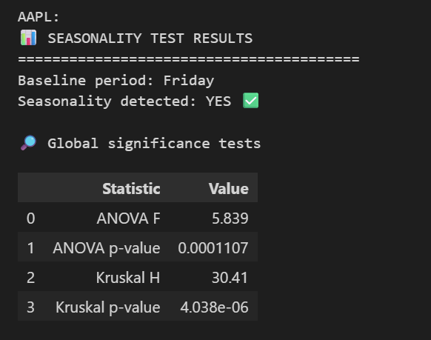
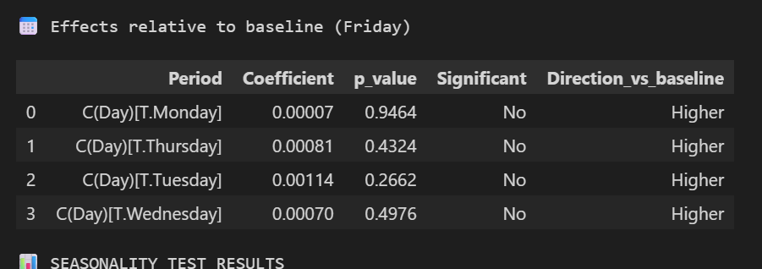
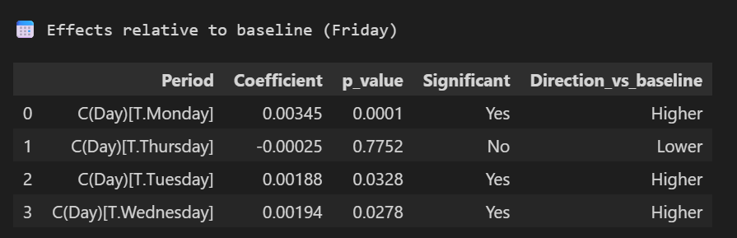
Seasonality – Significant Test
Notes:
Only in Apple it was signficant

Slide 8
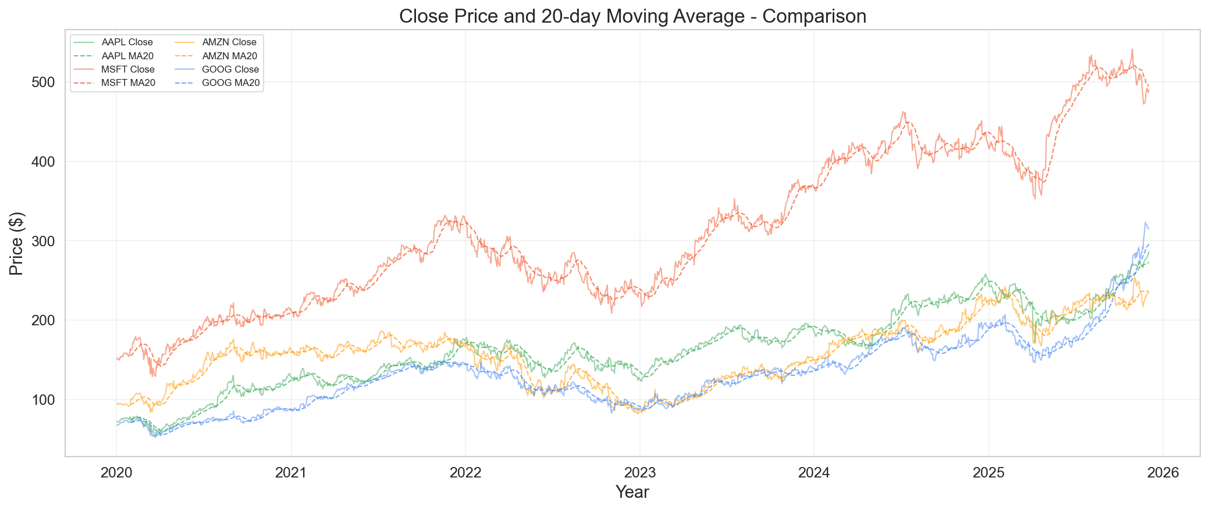
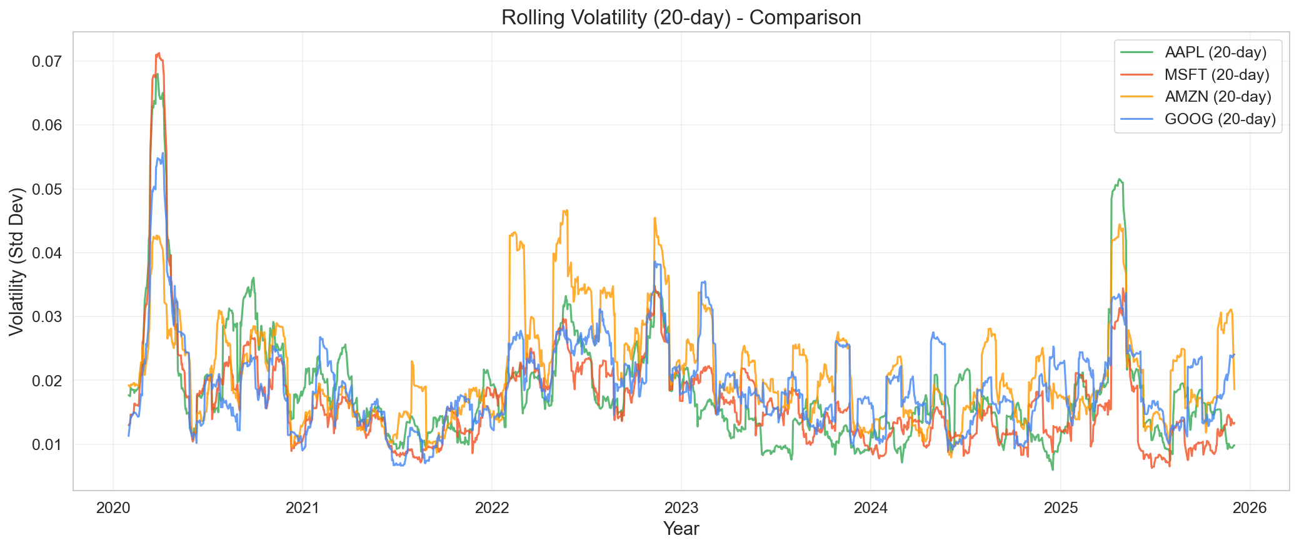
EDA - Engineered Features
Notes:
Volatility – Standard Deviation of returns in the last X days.
Moving Average – the average of the closing price in the last X days.

Slide 9
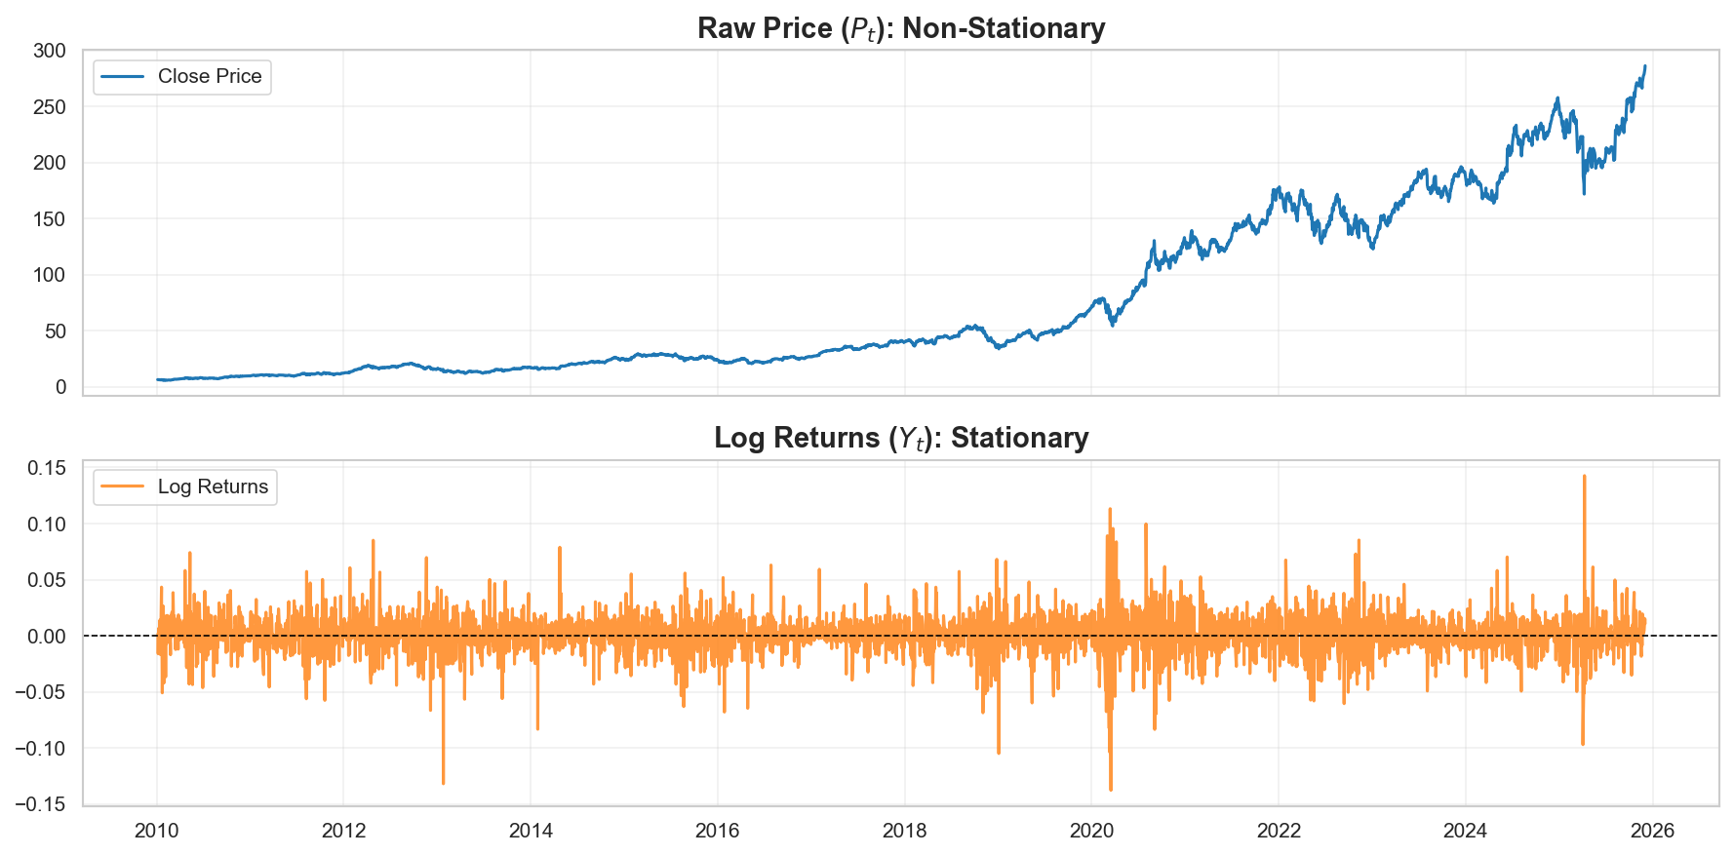
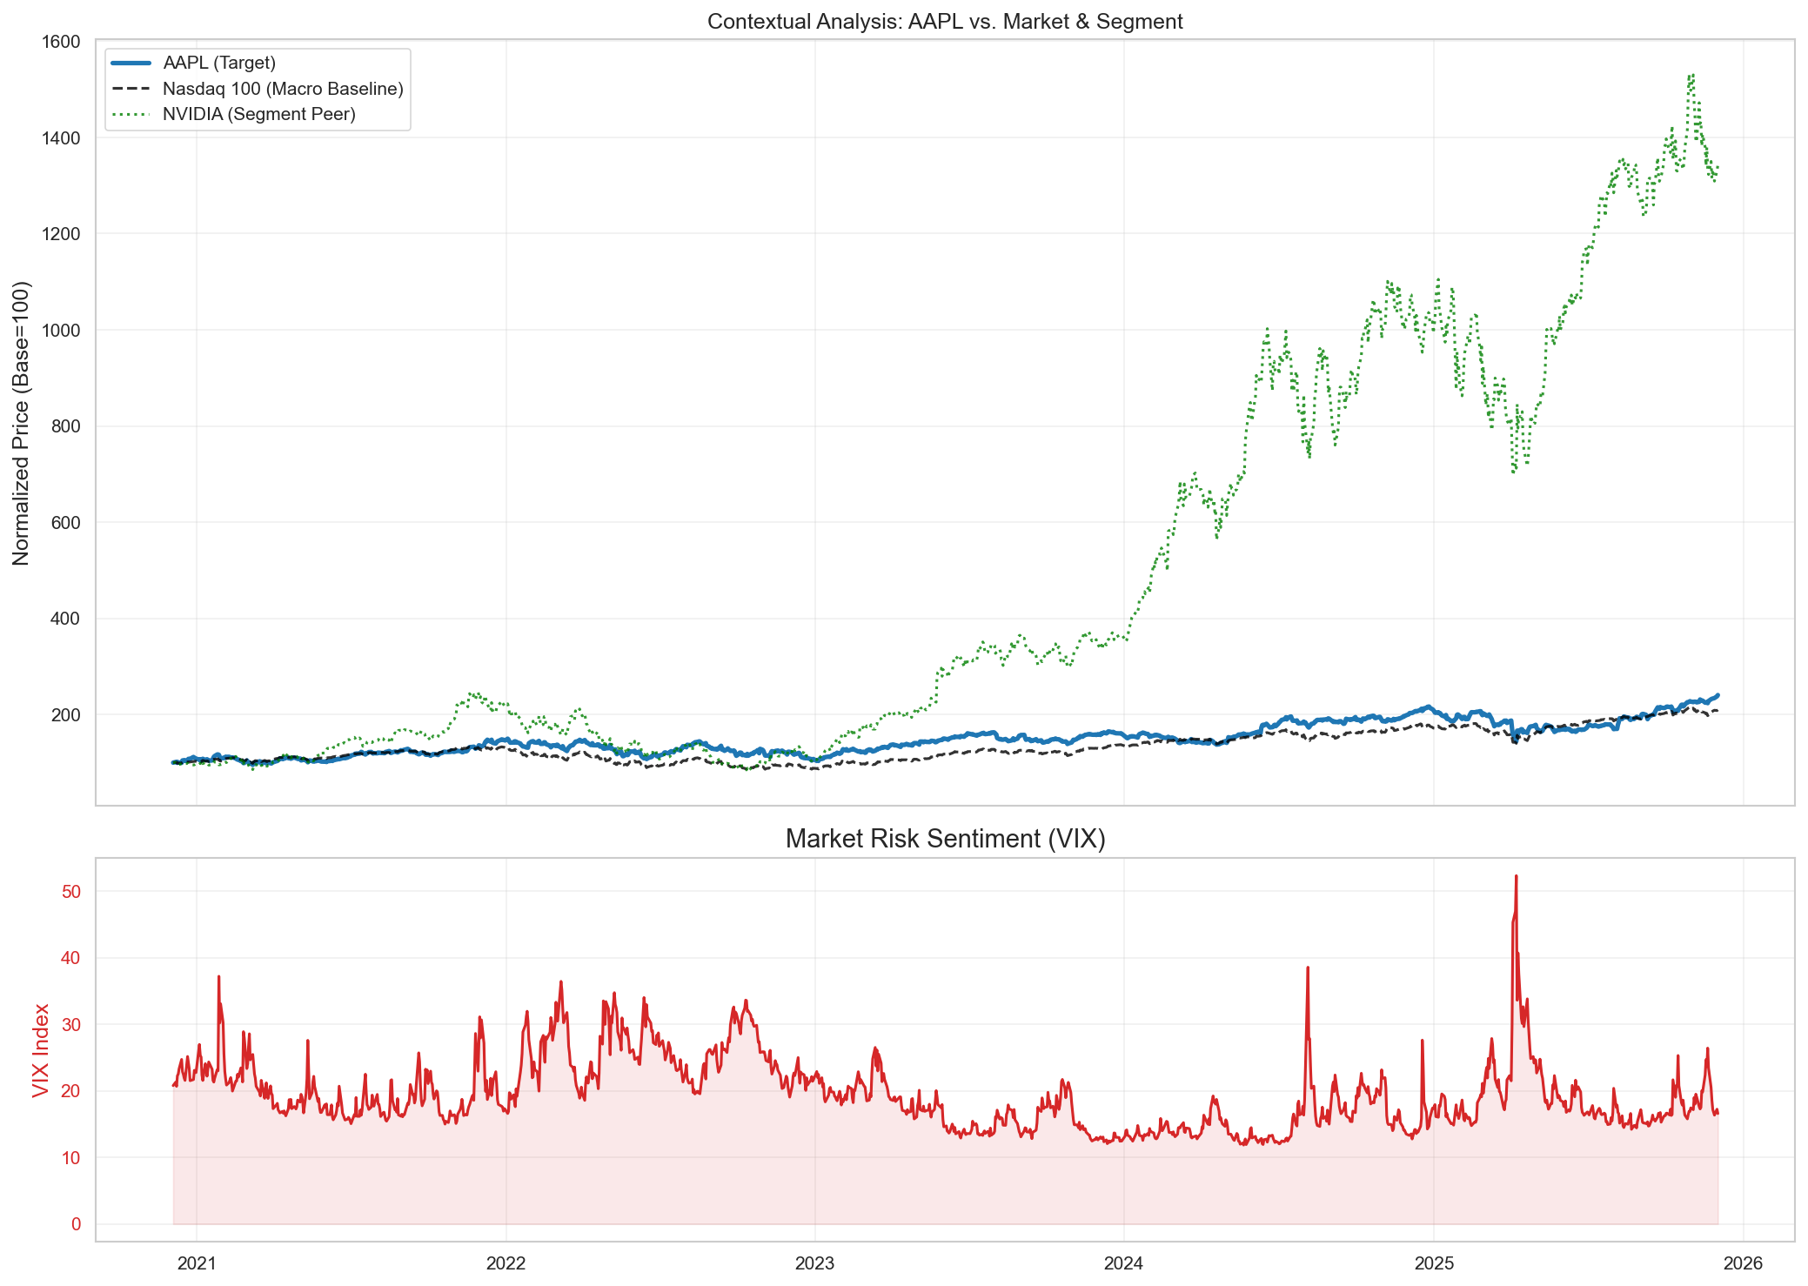
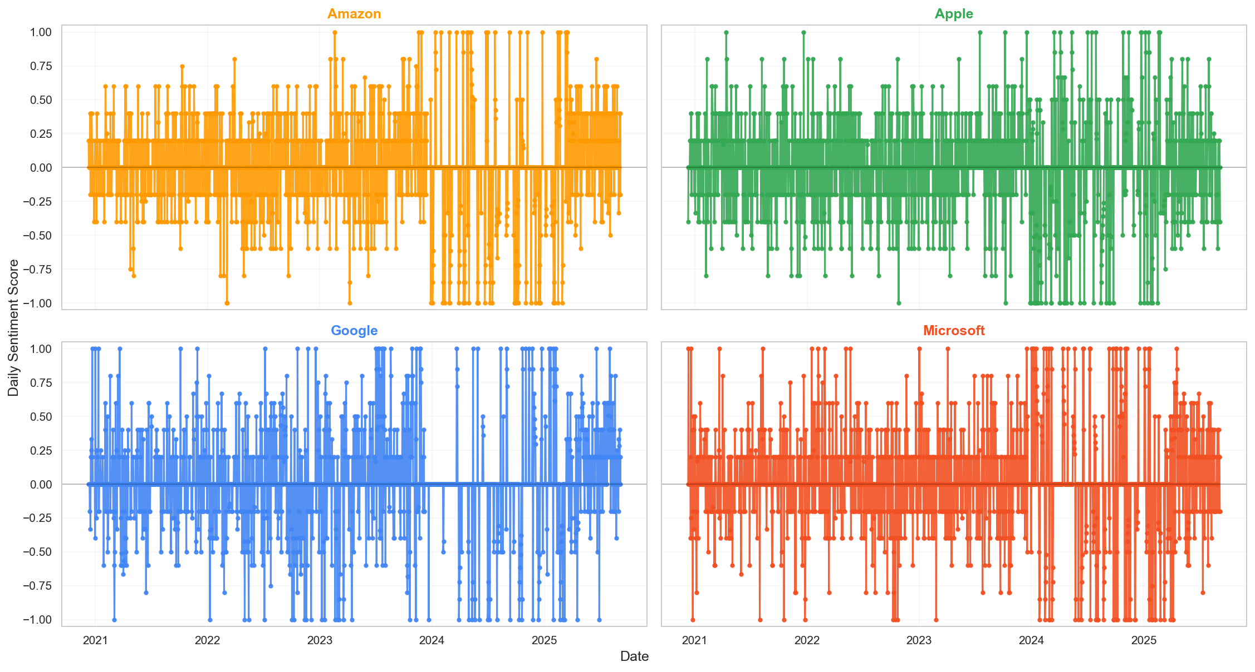
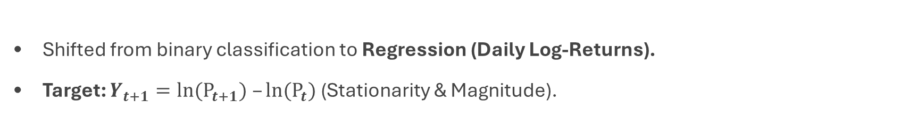
Methodology: Formulation, Features & Evaluation
Task Definition: Log-Returns Regression
Shifted from binary classification to Regression (Daily Log-Returns).
Target: $Y_{t+1}=ln(P_{t+1}) –ln(P_{t})$ (Stationarity & Magnitude).
Feature Space & Input Structure
Exogenous: FinBERT Sentiment (Stratified) + VIX + Market Index.
Temporal Logic: Lagged Features (Windowing) to capture trends.
Evaluation Strategy
Validation: Strict Temporal Split (No Look-Ahead Bias).
Metrics: MSE (Stat), Sharpe Ratio (Fin), Directional Accuracy (Util).
Notes:
Script for Shaked: Methodology & Feature Engineering
(Transition: Moran finishes speaking about Data Sources)
1. Opening & Problem Formulation (approx. 1 min)
Action: גלול במחברת לסעיף 1.2 Target Variable Definition.
Visual: תראה את הנוסחה של Log Returns או את הגרף שמראה שהמחיר לא סטציונרי.
You Say:
"Thank you, Moran.
So, moving from the raw data to our Methodology. My goal was to translate these datasets into a solvable optimization problem.
First, let's look at the Task Definition on the slide.
Initially, we considered a simple binary classification—Up or Down. However, we realized that raw stock prices are non-stationary, meaning their statistical properties change over time, which confuses ML models.
To fix this, we shifted to a Regression on Log-Returns.
As you can see in section 1.2, this transformation makes the data stationary while preserving the magnitude of the movement, not just the direction. This allows us to model the intensity of the market reaction, which is critical for a trading strategy."
2. Feature Engineering & Challenges (approx. 1.5 - 2 mins)
Action: גלול לסעיף 3.3 Sentiment Analysis (ואח"כ דפדף מעט למטה לראות את הקוד של ה-Sampling).
Visual: תראה את הקוד של ה-Stratified Sampling או גרף סנטימנט.
You Say:
"Next, I want to discuss Feature Engineering, specifically the challenge we faced with the News Data.
We use FinBERT to extract sentiment. The problem was the sheer volume—processing over 1.4 million headlines is computationally incredibly expensive. It created a major bottleneck in our pipeline.
My solution was a Stratified Sampling Strategy.
Instead of processing every single headline, we sample a representative subset per day. This reduced our runtime from hours to minutes, while still approximating the daily 'Market Sentiment' signal effectively.
In addition to sentiment, we enriched the feature space with Exogenous Signals:
We added the VIX index to inject 'market fear' levels, and the S&P 500 to capture systematic market risk.
Crucially, we structure the input using Lagged Features—meaning the model sees a window of past days (t-1, t-2) to predict the future, capturing the temporal trends."
3. Evaluation & Validation Strategy (approx. 1.5 mins)
Action: גלול לסעיף 5.1 Baseline Models או 5.2 Evaluation Metrics.
Visual: תראה את הטבלה של המטריקות או הגדרת ה-Time Split.
You Say:
"Finally, how do we evaluate success?
A common pitfall in financial ML is 'Look-Ahead Bias'. To prevent this, we strictly adhere to a Temporal Split validation—we train strictly on the past and test on the future.
We designed a Three-Layer Evaluation Framework:
Statistical: We use MSE to measure the raw regression error.
Financial: We calculate the Sharpe Ratio to see if the returns justify the risk involved.
Utility: We measure Directional Accuracy. Even though we are doing regression, knowing the correct sign (+/-) is what ultimately triggers a Buy or Sell signal.
We are comparing our results against a Naive Martingale Baseline (predicting zero change) and the CAPM Benchmark."
4. Closing & Handoff (approx. 30 sec)
Action: תסתכל על המצלמה/קהל.
You Say:
"To summarize my part: We have a stationary target, a computationally efficient NLP pipeline, and a rigorous, multi-layered evaluation framework.
I will now hand it over to Itay, who will present our current timeline and the challenges ahead."

