Slide 1
Database Project
Yarin Manoah & ITAY ostraich

Slide 2
General Description
This system manages the data for creating exams based on a project made in course 10118.
For the system to work properly, we collect data about:
Questions Type
Answers
List of all the questions and answers

Slide 3
USERS
there are 2 types of users in our program:
Teachers and Lecturers and whoever deals with Exams
Students that want to practice on exams

Slide 4
Purpose
The purposes of the Database:
To sort and manage all the data in an easy and convenient way.
Get information about the types of Questions, on what are the answers for a proper check, or let the Teacher build an exam from a bank of a variety of questions.

Slide 5
Entities – Parts of the system
To achieve all purposes as mentioned previous, the main parts of the system are divided by the entities we created:
Question
Answer
Open Question
MultiChoice Question
MultiChoice answers

Slide 6
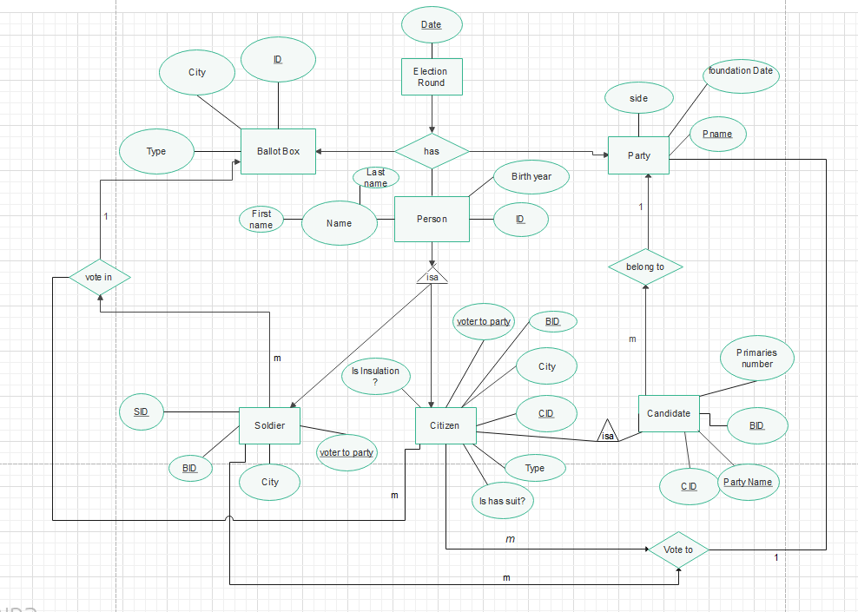

Slide 7
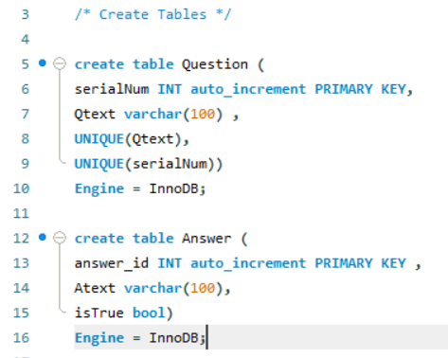
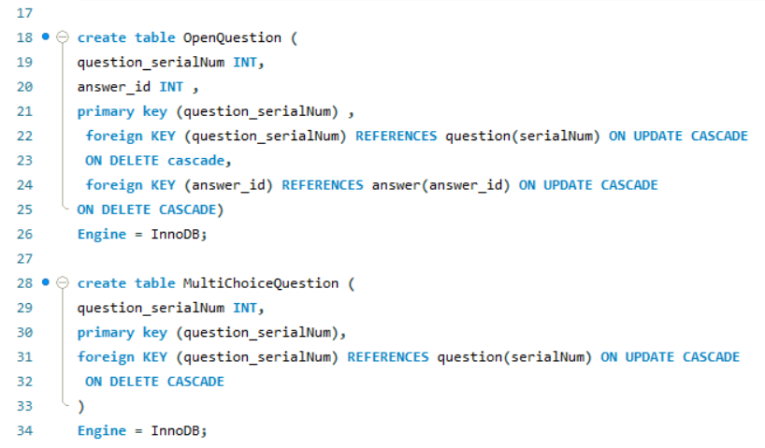
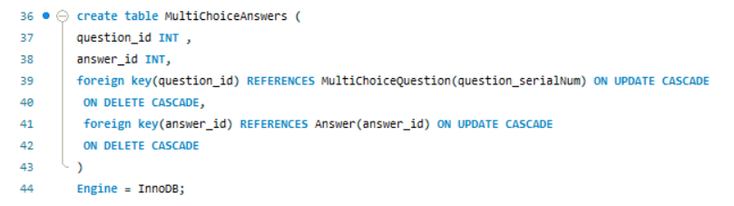
Creating the Database

Slide 8
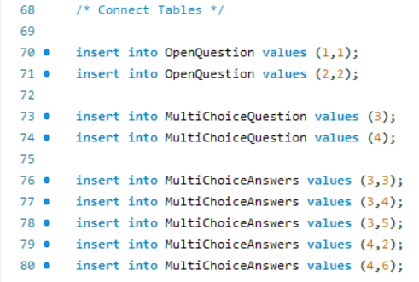
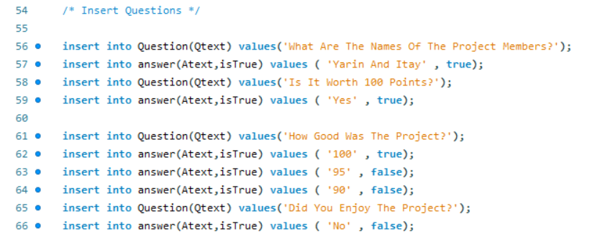
Querying the Database
Insert query:

Slide 9
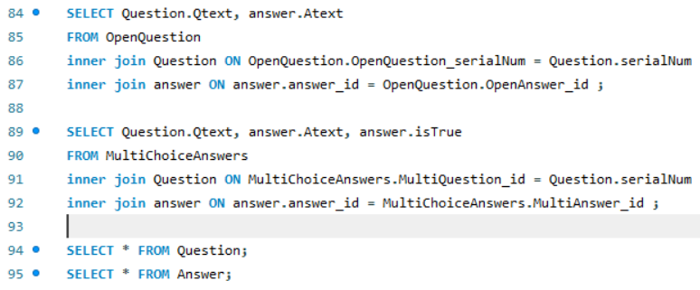
Querying the Database
Select query:

Slide 10
Querying the Database
Update query:

Slide 11
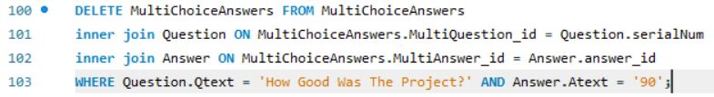
Querying the Database
Delete query:

