Slide 1
JOS LAB 6
Ophir khill – 206629966
Itay snir - 208726992

Slide 2
PROJECT OVERVIEW
NIC interrupt
Challenge 1 – EEPROM
Challenge 2 – chat server
Challenge 3 – JPF ( JOS PACKET FILTERING)

Slide 3
HANDLING nic interrupt
Setting up appropriate trap handler
01
Setting PIC enable interrupt mask
02
Setting the E1000 NIC interrupt mask register (IMS)
03

Slide 4
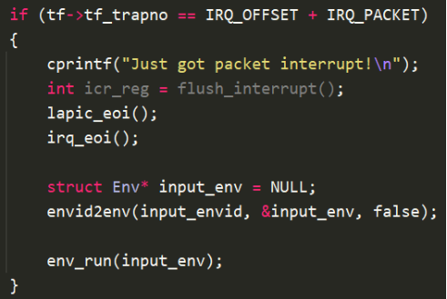
HANDLING nic interrupt
Setting up appropriate trap handler
Dummy read from ICR to acknowledge interrupt
Lapic & irq eoi
Schedule input_env to receive the incoming packet

Slide 5
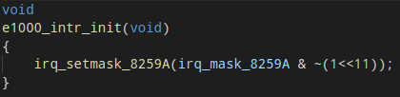
HANDLING nic interrupt
Setting PIC enable interrupt mask
Setting the appropriate IRQ line number

Slide 6
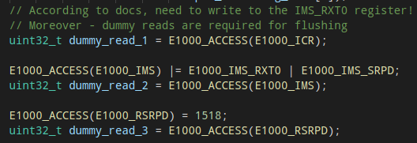
HANDLING nic interrupt
Setting the E1000 NIC interrupt mask register (IMS)
In the E1000 attach function, flush and set bits required to activate receive interrupt
RXT0 – receiver time interrupt
SRPD – small receive packet detected

Slide 7
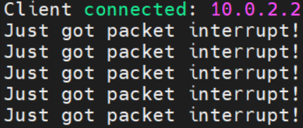
HANDLING nic interrupt
Example – each print represents a different packet receiver interrupt

Slide 8
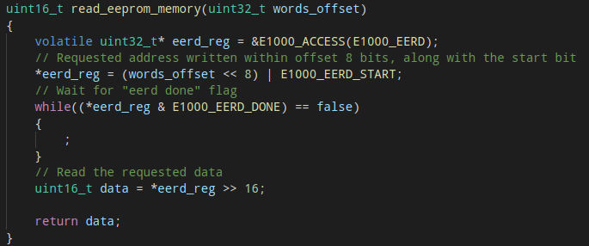
Challenge 1 – EEPROM
Using the EERD E1000 register, build the MAC address as written in the HW.
MAC bytes located at EEPROM words 0x0, 0x1, 0x2

Slide 9
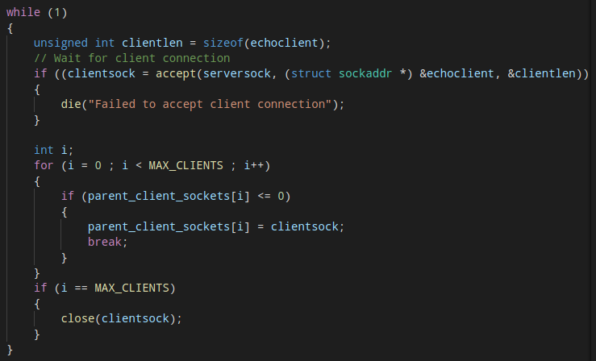
Challenge 2 – chat server
Implemented using 2 running environments
Env 1 – continuously accept new client connection and update a shared memory open socket table.

Slide 10
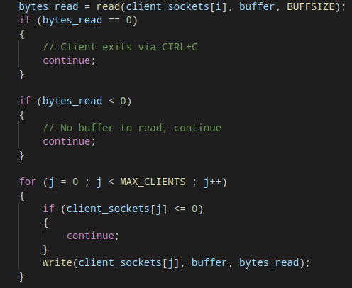
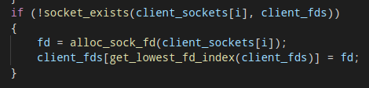
Challenge 2 – chat server
Env 2 – continuously poll data (non block) from all open sockets.
Broadcasts messages
While the process share an open sockets array, Env 2 does not have the corresponding FD’s and as such needs to construct them.

Slide 11
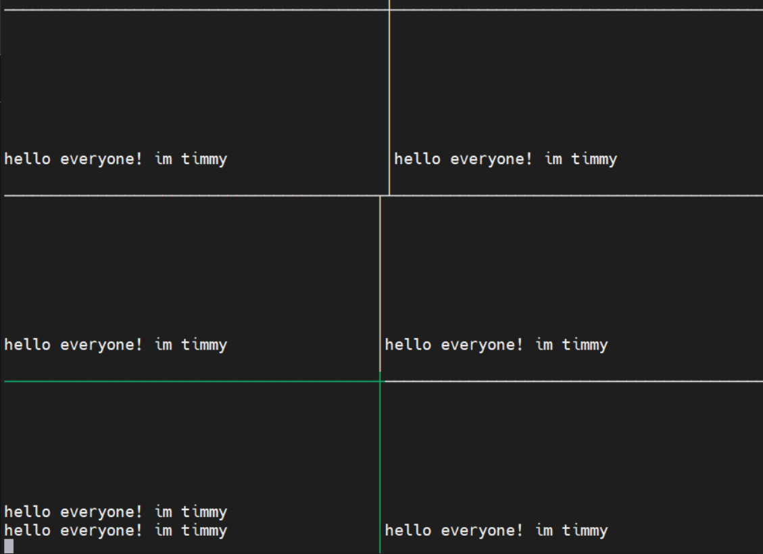
Challenge 2 – chat server
Example -
As seen, a single client is sending a message that’s broadcasted to all connected clients.

Slide 12

Challenge 3 – JPF ( JOS PACKET FILTERING)
For our own challenge, we chose to implement a simple packet filter to JOS.
The filter is used to blacklist certain IPs, ports, and IP & port pairs.
The presented filter will block out all packets the are received from port 7 (in our case – echo server)

Slide 13
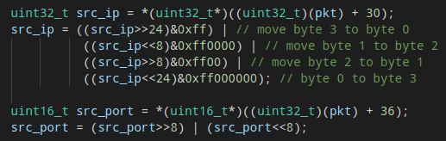
Challenge 3 – JPF ( JOS PACKET FILTERING)
While receiving a packet (Ex 11), the NIC will now check that the packet is following the filter rules.
We parse the IP & port from the received packet
Noting that the IP & port are in big endian and accommodating for that

Slide 14
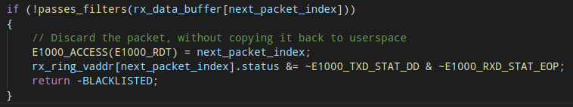
Challenge 3 – JPF ( JOS PACKET FILTERING)
Checking whether the packet should be discarded
Making sure to turn off DD so the packet will indeed be discarded

