Slide 1
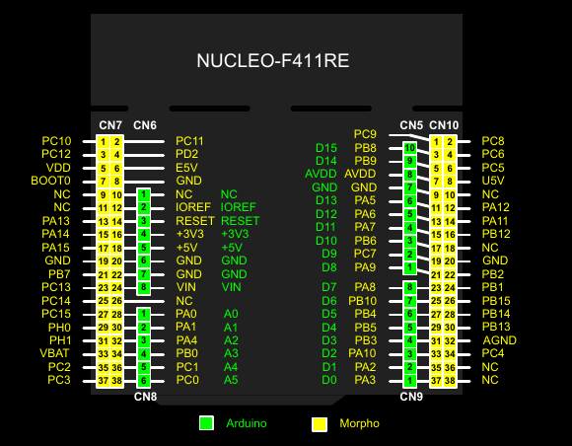

Slide 2
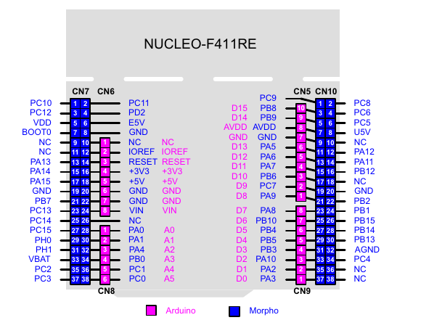

Slide 3
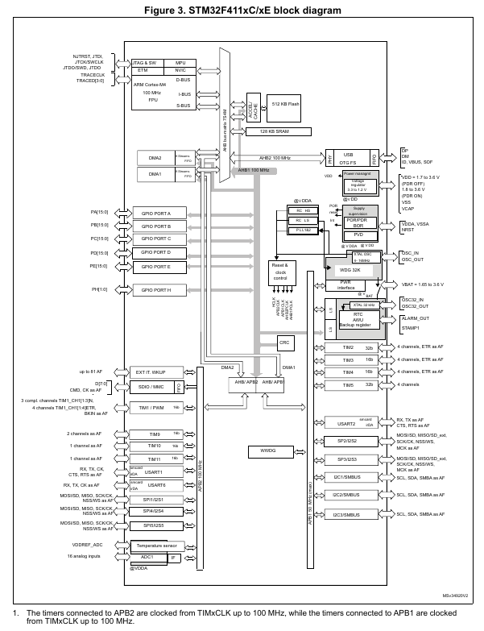

Slide 4
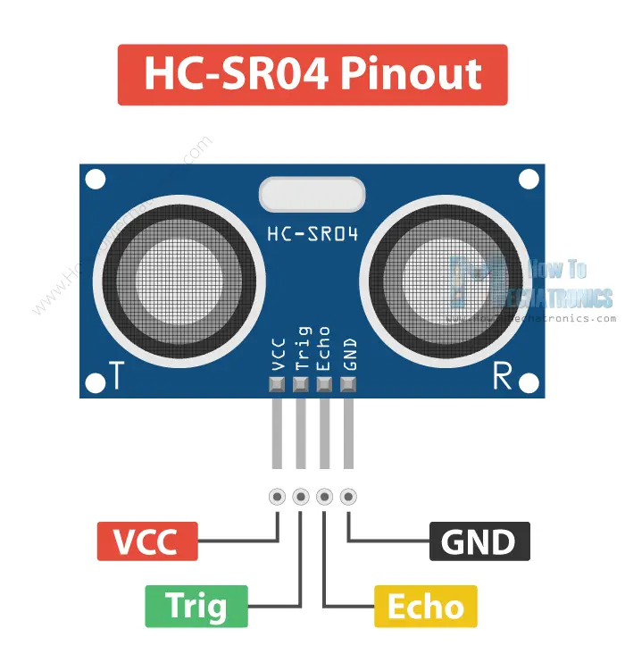
Vcc
GND
echo
trig

Slide 5
Vcc
GND
Echo
Nucleo | HC-SR04
+5V | Vcc
GND | GND
PA0 | Echo
PA1 | Trigger
Trig

