Slide 1
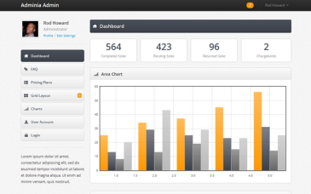







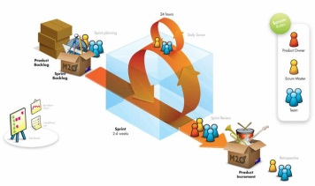

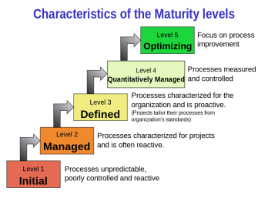
Metrics and Reporting
Knowledge
Management
Tools
Process
Use your brain!!
Roles
Continuous Delivery
Methods
Browse by Name
Process Maturity

