Slide 1

The effect of data analytics on the business of games
Research
API
User input
User analysis
Game monitoring
Account analysis

Slide 2

Introduction
The Inspiration and Ideas
The effects of Data analysis on the business of games.
Game industry rapidly changing
Data analysis is a hot topic
GDPR

Slide 3

The effect of D&A on the Business of Games
Data is an interesting topic
Wanted to relate to the course
Relatively untouched topic

Slide 4

Interest
Lecturers spoke about it last year
Business people mentioned the importance of data

Slide 5

Game industry
Industry is relatively young
Started in the 70’s
50 years

Slide 6
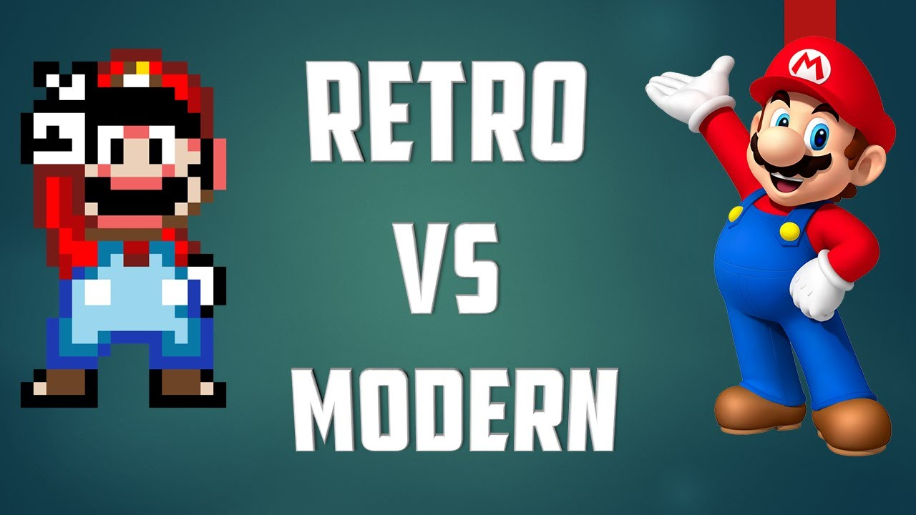
Game industry rapidly growing
Modern gaming has changed a lot
Aesthetics are obvious
A lot changes gone unnoticed

Slide 7

Very topical
GDPR
Work placement

Slide 8
Journey
R&D
Creation
Test &Review

Slide 9

Research
The parts of my research
Research report
SRS
TDD
References

Slide 10

Research Report
The purpose of a Research Report is to demonstrate or develop your ability to undertake a complete piece of research including research design, and an appreciation of its significance in the field.

Slide 11

SRS
Detailed information on the project
The software requirements
Software languages
Rough Feature breakdown

Slide 12

TDD
In Progress
Detailed on how the program is written
Code specifics
Code Snippets

Slide 13
Plan
Manipulate API info
Analyse the data for specific games
Note user data
Represent user data
Provide recommendation for user based on info
Create playable version

Slide 14

Over Christmas
Finish TDD
Finalise the MVP
Make ordered list of extras
Play with APIs

Slide 15
Return after Christmas
Start C++ programming
Pull in the details to C++ program
Make the MVP
Test thoroughly

Slide 16

Phase 2
Begin phase 2 extras
Test
Review

Slide 17
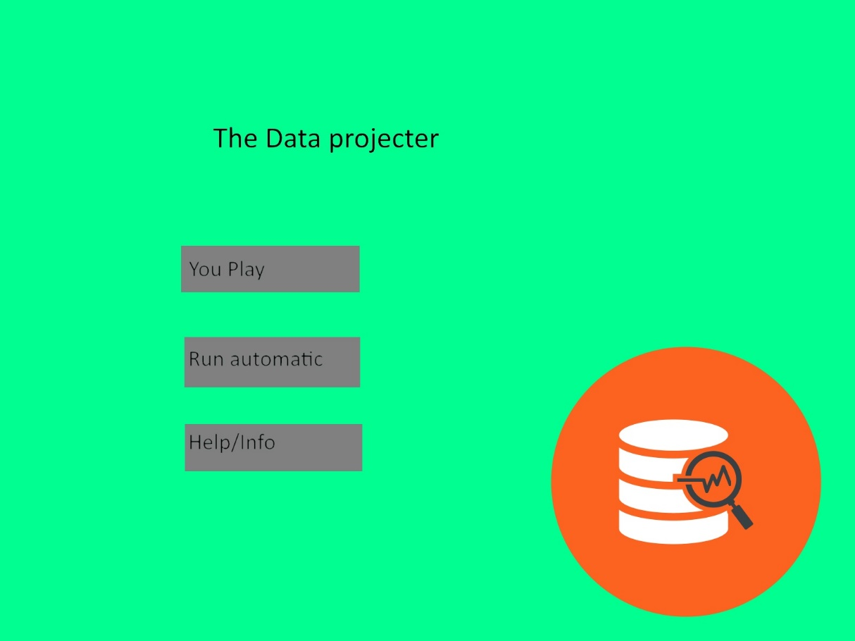
Menu Mock up

Slide 18
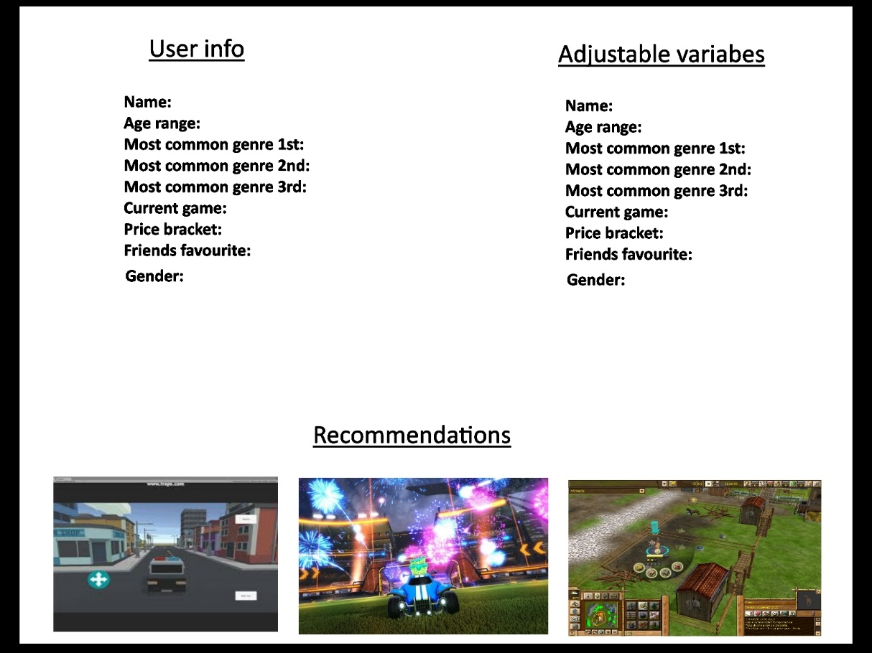
App mock up

Slide 19

Thank You
Any Questions?

