Slide 1


PLEDGE TO PROGRESS Sustainability Hackathon
Sponsored By
Your Team Name : Green Wave
Your team bio : Anindya Neogi, Manas Manoj, Shrinidhi Deshapande, Pallav Krishna Rakesh, Swapnil Roy
Date : 30-04-2023

Slide 2
Problem Statement?
The batch of products or processes that are exemplary in their environmental, social, and economic sustainability can lead to significant improvements in a company's overall environmental footprint. Achieving a Golden Batch in Aluminium manufacturing can result in reduced environmental impacts, more responsible resource use, improved working conditions for employees, stronger relationships with local communities, and a competitive advantage in an increasingly eco-conscious market, ultimately contributing to a more sustainable and resilient ecosystem. Our use-case is focusing on optimizing controllable parameters and provide guardrails to the non-controllable parameters in the manufacturing process to achieve the Golden Batch.
(Golden Batch refers to Aluminium batch that has been produced under ideal conditions, with all the parameters and variables in the production process optimized to yield the highest quality output.)
Aluminium manufacturing utilizes lot of water and constant operator intervention to ensure optimal batch consistency. However, the machines are subject to various types of ambient conditions, raw material inconsistency etc. which ultimately result in sub-par batch quality and significant water wastage and increased wastage in the form of mud, dross and Greenhouse gas emissions.

Slide 3
User Segment & Pain Points
User Segment - Manufacturing – Mining & Metals (Aluminum)/IOT/Sustainability
Pain Points –
Operator uses OEM Manuals/guidance therein and process experience to decide on the set point controls
Inconsistent Product with compromised quality
More rejection leading to losses affecting the sustainability metrics
It requires a sufficient amount of high-quality data from multiple batch management systems to train and validate the machine learning model.
It requires a careful selection and tuning of the machine learning algorithms and parameters to achieve accurate and robust results.
It requires a reliable optimizer to provide the recommendations to the operators before the start of the Batch execution. Sometime the recommendations are also needed real time subjected to availability of high frequency data.

Slide 4
Solution Approach
To prevent the inconsistency in batch outputs resulting in increased emissions, a machine learning model can be developed to monitor the controllable parameters during the aluminum manufacturing and appropriate controllable parameters can be prescribed to the machine operators so that the outcome from batch processing will adhere to Golden batch guidelines resulting in less gas emissions and consistent quality product.
The model can use supervised learning techniques to learn the Golden batch and non-Golden batch patterns of the data connecting the process variables, operating conditions influencing the Golden Batch metric using the historical data collected during the batch processing. Further, the model can use algorithms from the Optmization classes of algorithms along with the Machine Learning model developed to optimize the required process parameters so that the desired quality of the aluminum is achieved with reduced wastage and emissions. The model can then alert the operators or trigger corrective actions when the machine is approaching a critical condition or a failure threshold to adhere to Non-Golden batch.

Slide 5
Pre-Requisite
Data availability of good quality with sufficient history

Slide 6
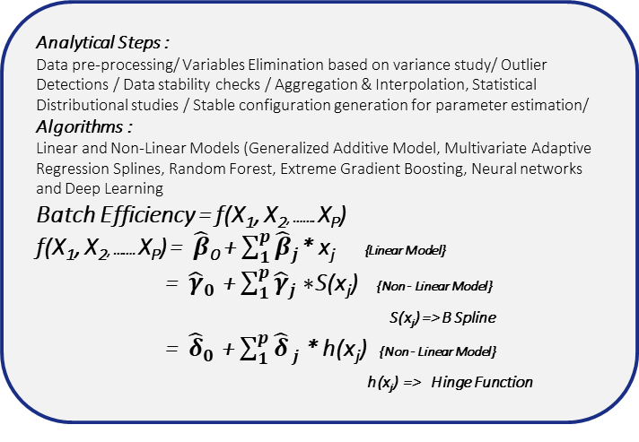
Golden Batch Model & Optimization - Analytical Framework
Optimal Operational limits for variables
Primary Manufacturing
Analytical Steps :
Data pre-processing/ Variables Elimination based on variance study/ Outlier Detections / Data stability checks / Aggregation & Interpolation, Statistical Distributional studies / Stable configuration generation for parameter estimation/
Algorithms :
Linear and Non-Linear Models (Generalized Additive Model, Multivariate Adaptive Regression Splines, Random Forest, Extreme Gradient Boosting, Neural networks and Deep Learning
Batch Efficiency = f(X₁, X₂, ……. X_{P})
f(X₁, X₂, ……. X_{P}) = $\hat{β}$₀ + $\sum_{1}^{p}{{\hat{β}}_{j}}$* x_{j} {Linear Model}
= ${\hat{γ}}_{0}$ + $\sum_{1}^{p}{{\hat{γ}}_{j}}∗$S(x_{j}) {Non - Linear Model}
S(x_{j}) => B Spline
= ${\hat{δ}}_{0}$ + $\sum_{1}^{p}{\hat{δ}}j$ * h(x_{j}) {Non - Linear Model}
h(x_{j}) => Hinge Function
Operating Variables
Operating Variable 1 : OP1
Operating Variable 2 : OP2
Operating VariaOP3
Operating Variable 4 : OP4
…
…
Operating Variable k : OPk
Controlling equation for Efficiency
Optimal operating limits
Stochastic Simulation
Find Xj* ( j = 1…..p) such that [y - f(xi)]² is minimal subject to Xj,min ≤ Xj * ≤ Xj,max

Slide 7






Tools/Resources & Solution Architecture
KPI
Golden Batch Achievement
Product Consistency
Cost savings per batch
Waste minimization
Batch processing log
Algo - Selection
Supervised
&
Unsupervised
Learning
Repository/ Registry
Ambient Data
Raw material Data
Azure Data Lake Storage
Feature Eng.
Model Training
Model Evaluation & Validation
Prediction
Service
Optimization
Service
Output:
Optimized controllable parameter values
Waste footprint
QA Input/
Feedback Service
Input:
Non-controllable parameters
User Interface
Per Batch energy footprint
Data Sources

Slide 8
Key Differentiators & Adoption Plan
High precision solution using differentiated solution framework, Machine Learning & Optimization Algorithms with proven track records in developing similar solutions
Robust Data Model built by sustainability practitioners.
Industry insights & holistic approach to solving industry problems in sustainability.
Full-stack nature of the solution.

Slide 9
Thank You
Manas Manoj
Shrinidhi Deshapande
Pallav Krishna Rakesh
Swapnil Roy
Anindya Neogi
Prasanna Shrinivas Venkataraman

