Slide 1

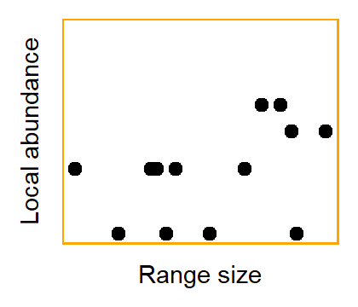
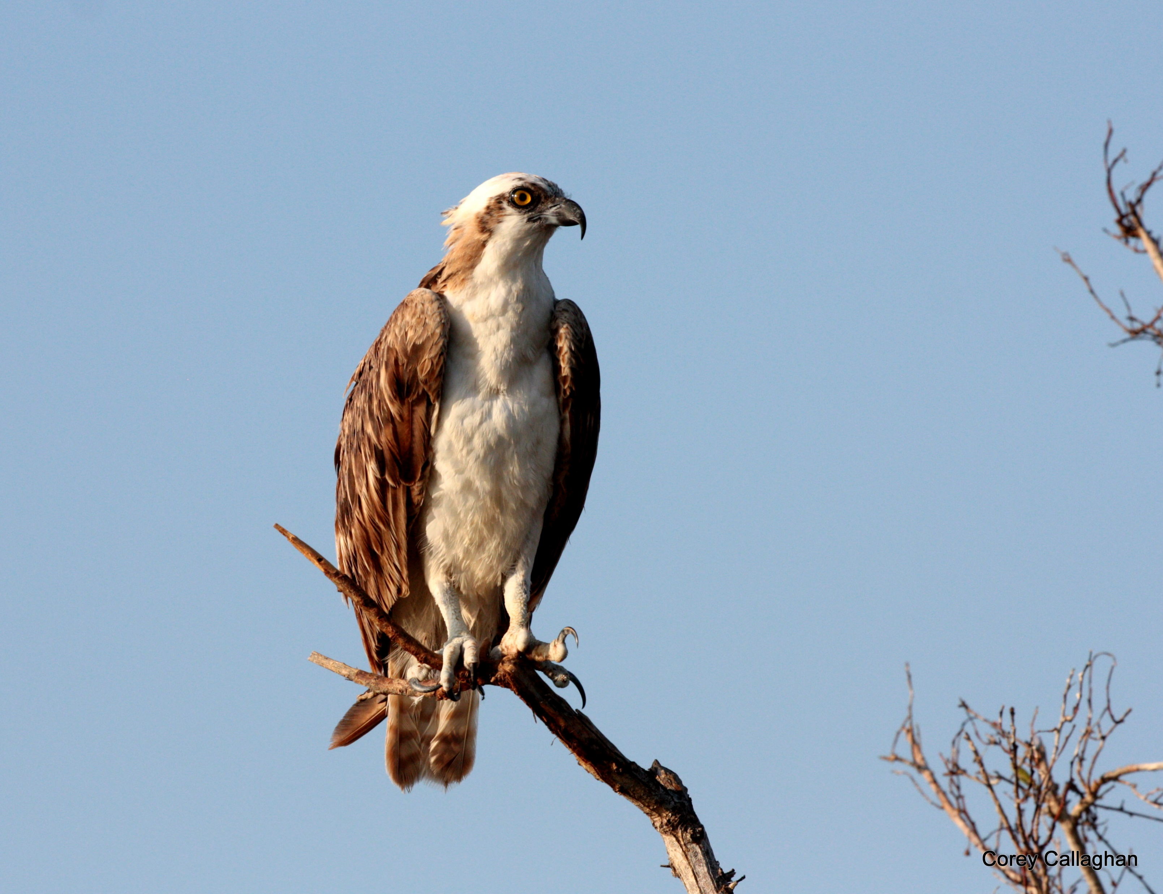
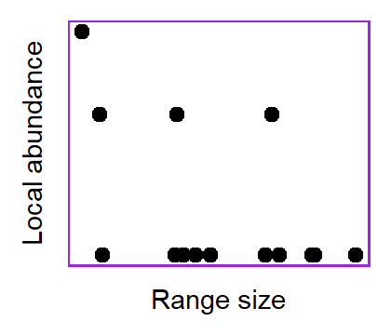
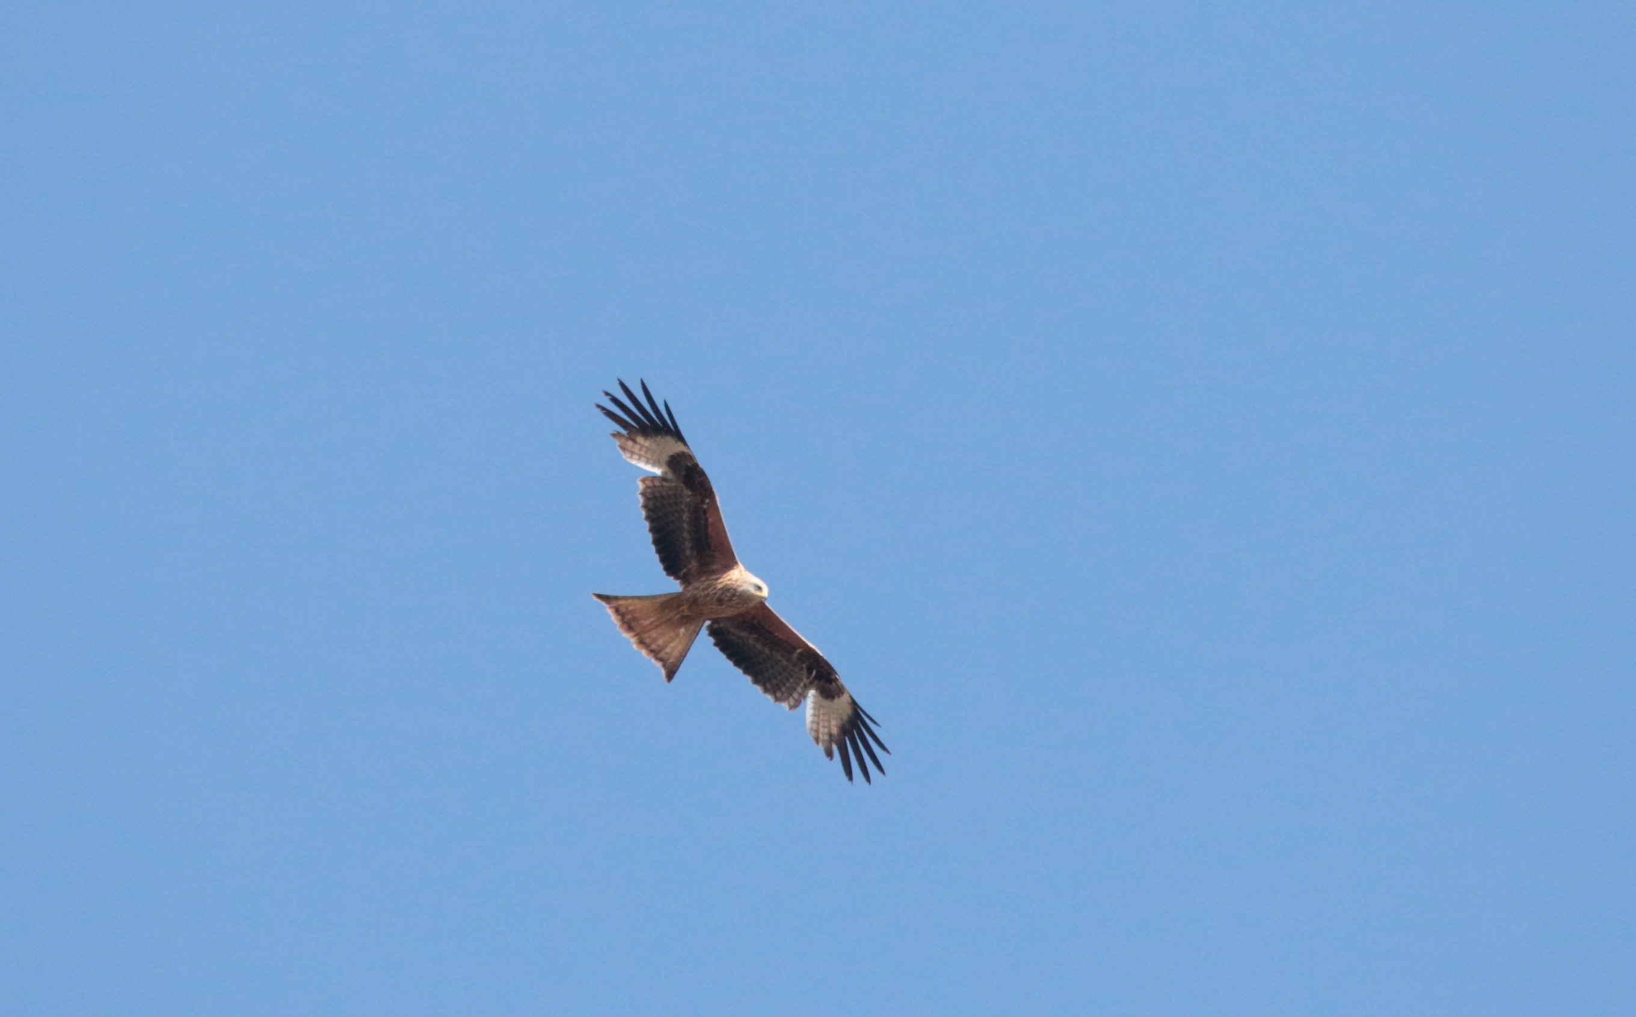
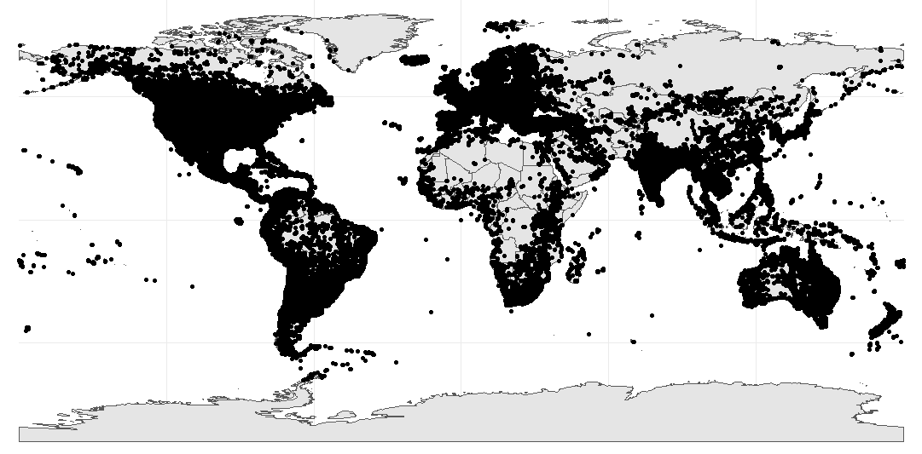
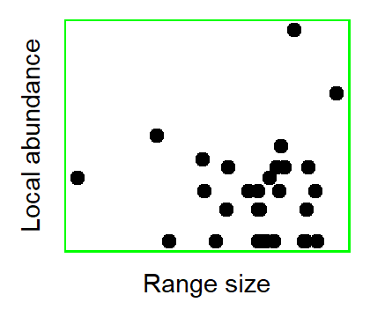
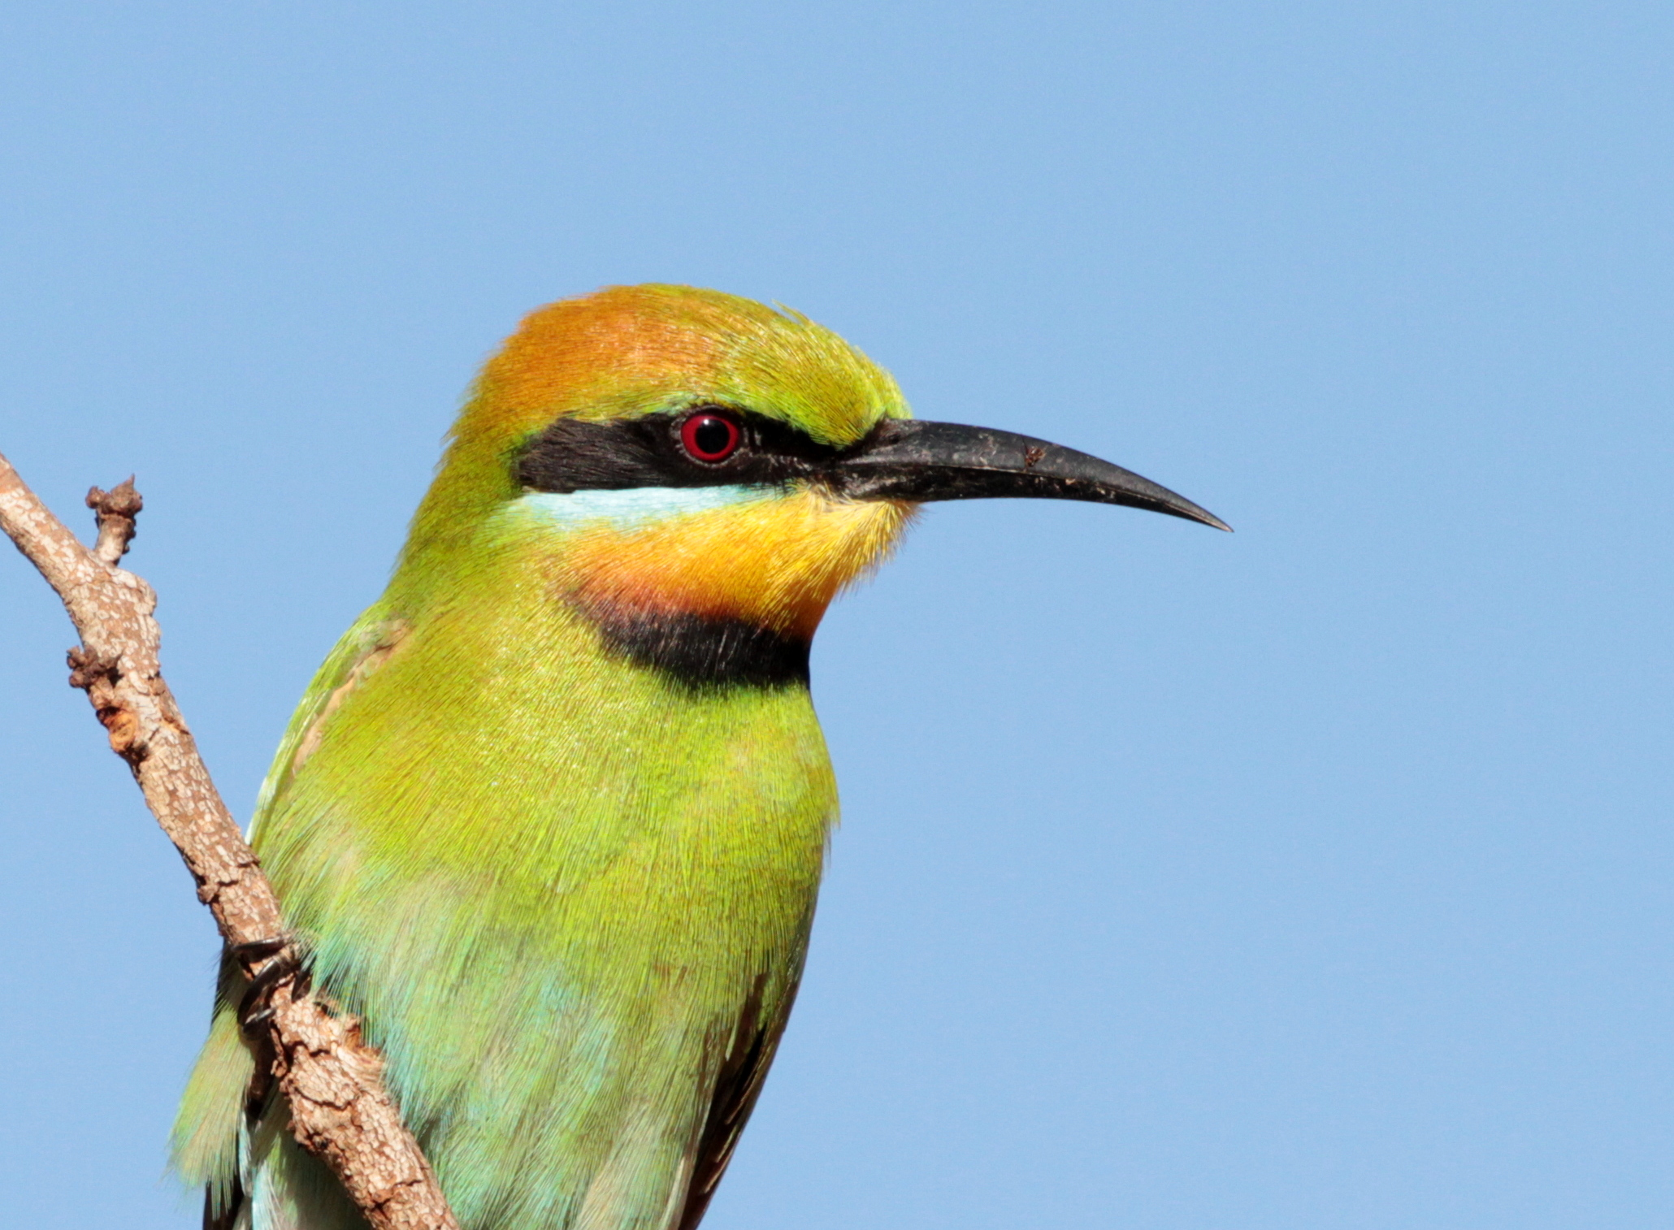
Checklist-level effect measures
r=0.41
r=-0.50
r₁
Zr₁
n₁
precision
Global estimate
r₂
Zr₂
n₂
precision
Precision
0
Zr
r_{N}
Zr_{N}
n_{N}
precision
N > 10 million correlation coefficients
N = 7,635 species
N > 3 billion total birds counted
r=0.05

