Slide 1
Machine Learning for Social Good
Breast Cancer Detection
Automated Breast Cancer Diagnosis using Ensemble Machine Learning

Slide 2
Introduction & Problem Statement
Goal: Automated Breast Cancer Detection
Early detection improves survival rates significantly.
Manual analysis of biopsy images is time-consuming and prone to error.
Solution: A reliable 'second opinion' tool for pathologists to classify breast mass cells as benign or malignant.

Slide 3
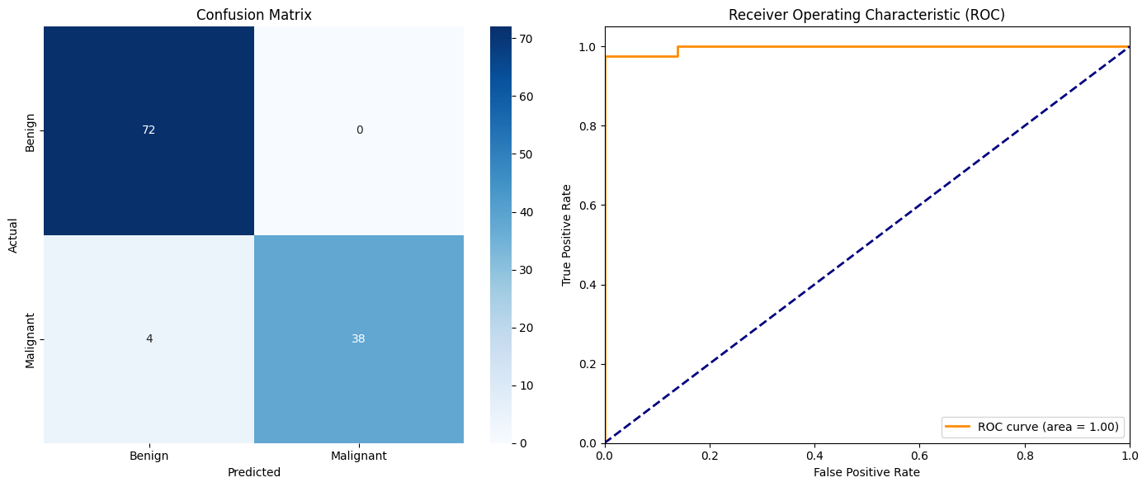
The Dataset & Mission
Breast Cancer Wisconsin Diagnostic Data Set (UCI)
Contains 30 real-valued features computed from cell nuclei (e.g., radius, texture, smoothness).
Target variable: 'M' (Malignant) or 'B' (Benign).
Reproducible setup: automated data fetching via script.

Slide 4
Ensemble Machine Learning Strategy
Maximizing recall with a multi-model approach:
1. Random Forest (Bagging): handles variance and feature interactions.
2. Gradient Boosting (Boosting): iteratively minimizes bias.
3. Logistic Regression: robust baseline model.
Voting Classifier (Soft Voting): Combines predicted probabilities for final decision.

Slide 5
Implementation Details
Data Preprocessing:
Dropped non-predictive ID column and encoded diagnosis.
Used train_test_split with stratify=y to maintain class ratios.
Applied StandardScaler (critical for Logistic Regression & distance metrics).

Slide 6
Results & Importance of Recall
Focus: Minimizing False Negatives
In a medical context, a false negative (missed cancer diagnosis) is catastrophic.
Ensemble model specifically tuned/evaluated to maximize Recall for the malignant class.

Slide 7
Future Improvements
Enhancing defensibility and interpretability:
Implement k-fold cross-validation for stability testing.
Hyperparameter tuning (e.g., Grid Search) for optimal performance.
Integrate SHAP (SHapley Additive exPlanations) for feature interpretability.

