Slide 1
Orb: A Governance-First Command
Console for Local Language Models
Specialization Project Presentation (CIA 2)
Presented By
Praneeth M (2547142)
Parthiv Sushil (2547141)
Hari Prasad (2547XX)
Project Guide
Dr. Somnath Sinha
Department of Computer Science
CHRIST (Deemed to be University), Bengaluru-29

Slide 2
Introduction
Local large language models such as Llama, Qwen, and Gemma now run entirely on personal hardware through runtimes like Ollama.
Running models locally protects privacy and removes recurring cloud cost, but it also removes the safety controls that hosted providers supply by default.
On a local machine an autonomous model can read files, execute shell commands, and reach the network with no oversight.
Orb introduces a governance and observability layer that sits between the user and every action a local model performs.

Slide 3
Problem Statement
Local model runtimes expose raw inference but provide no policy control, auditing, or accountability.
Users cannot easily observe how a model reasons, how long it takes, or how likely a response is to be fabricated.
Tool-capable models can carry out destructive actions without any explicit approval step.
No unified interface exists to manage both local and cloud models under a single consistent set of rules.

Slide 4
Objectives
Provide a single console to operate local and cloud language models with full transparency.
Enforce configurable policies that allow, block, or require approval for each model action.
Deliver real-time telemetry, including inference latency and a hallucination risk indicator.
Persist user sessions and durable memory while keeping all data on the user's own machine.
Support multiple model providers through one unified connector interface.

Slide 5
Scope of the Project
In scope: a web console, a governed backend gateway, policy enforcement, telemetry, memory, and session persistence.
Supported runtimes: local Ollama models and cloud providers through bring-your-own-key connectors.
Authentication and per-user data isolation via a managed identity provider.
Out of scope: model training, fine-tuning, and multi-user cloud hosting.

Slide 6
Existing Systems and Research Gap
Chat front-ends for Ollama focus on conversation but omit policy control and auditing.
Commercial assistants offer governance only within their own hosted cloud, not for local models.
Observability tools track tokens and latency, yet they neither gate actions nor score hallucination risk.
Research gap: no local-first tool unifies conversation, governance, observability, and memory in one system.

Slide 7
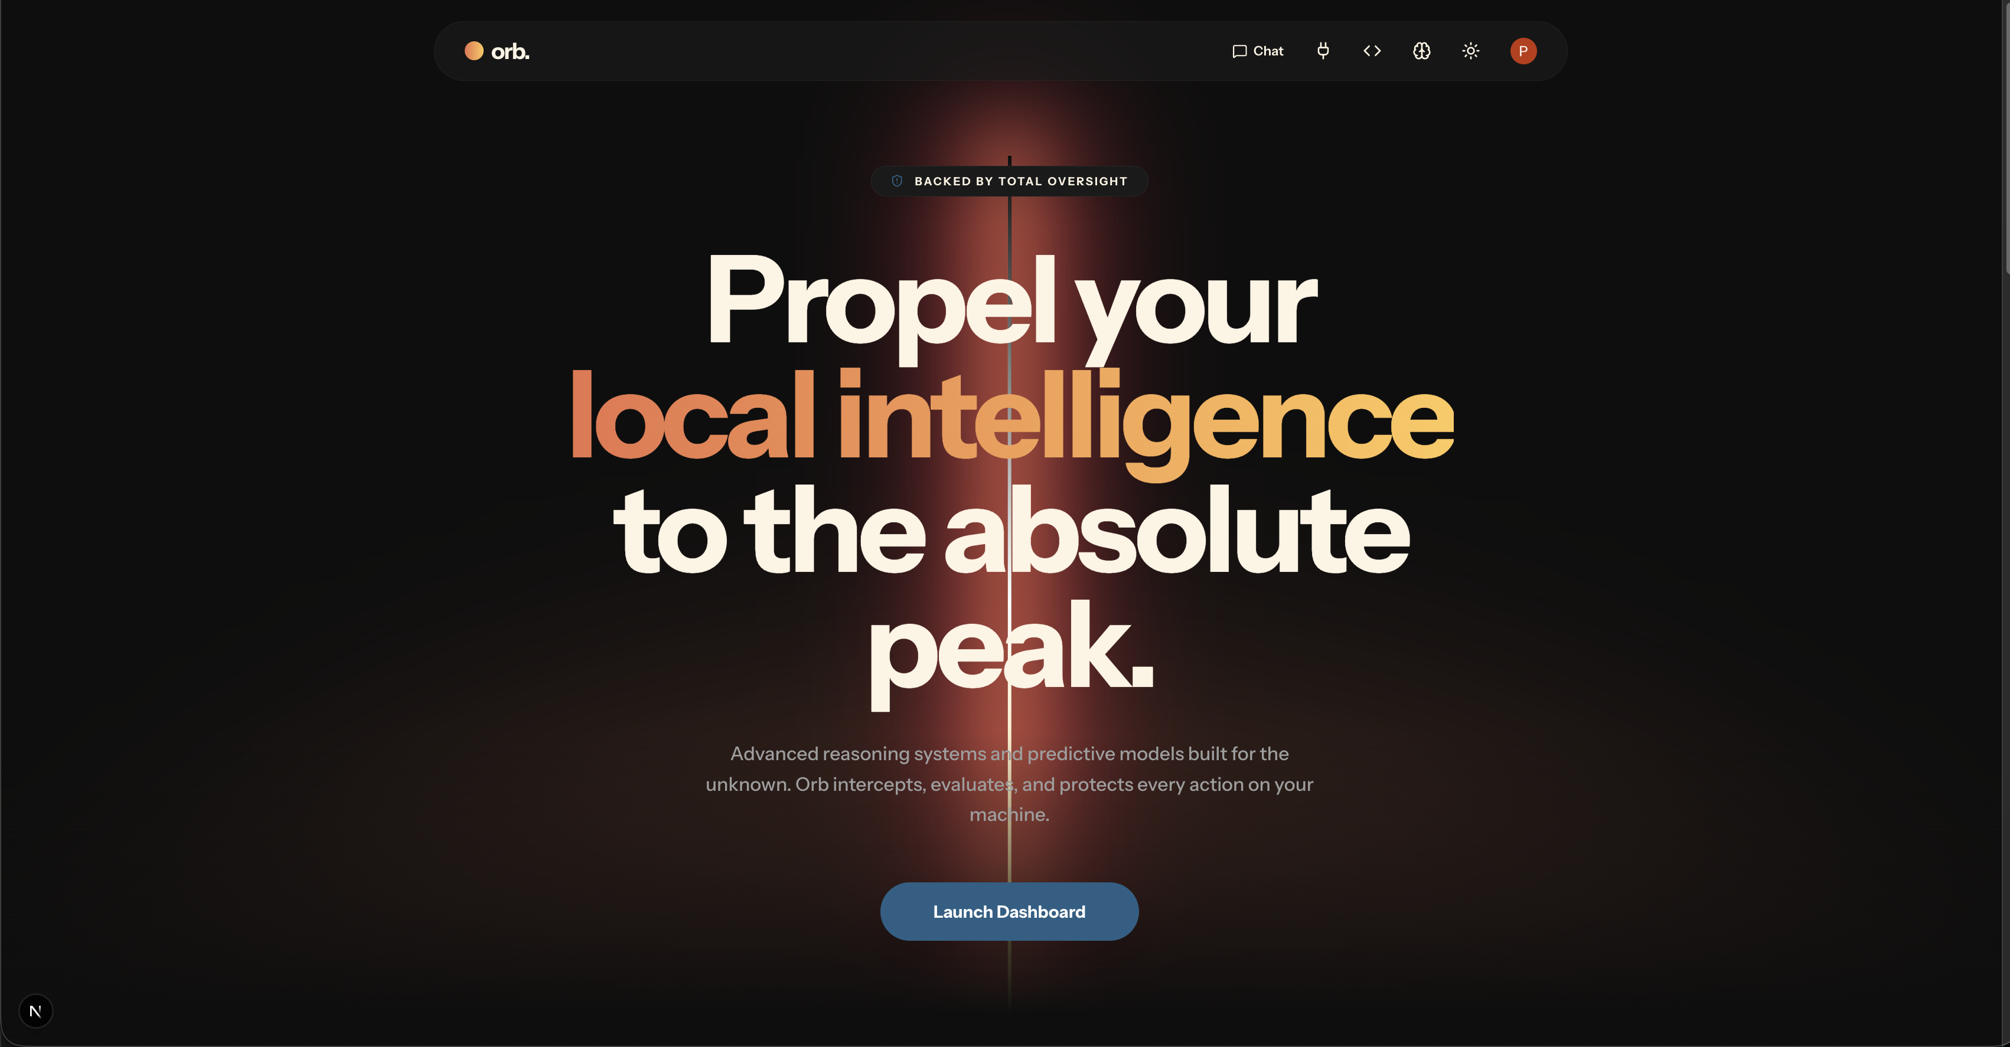
Proposed System: Orb
The Orb landing experience frames the goal: local intelligence backed by total oversight.

Slide 8
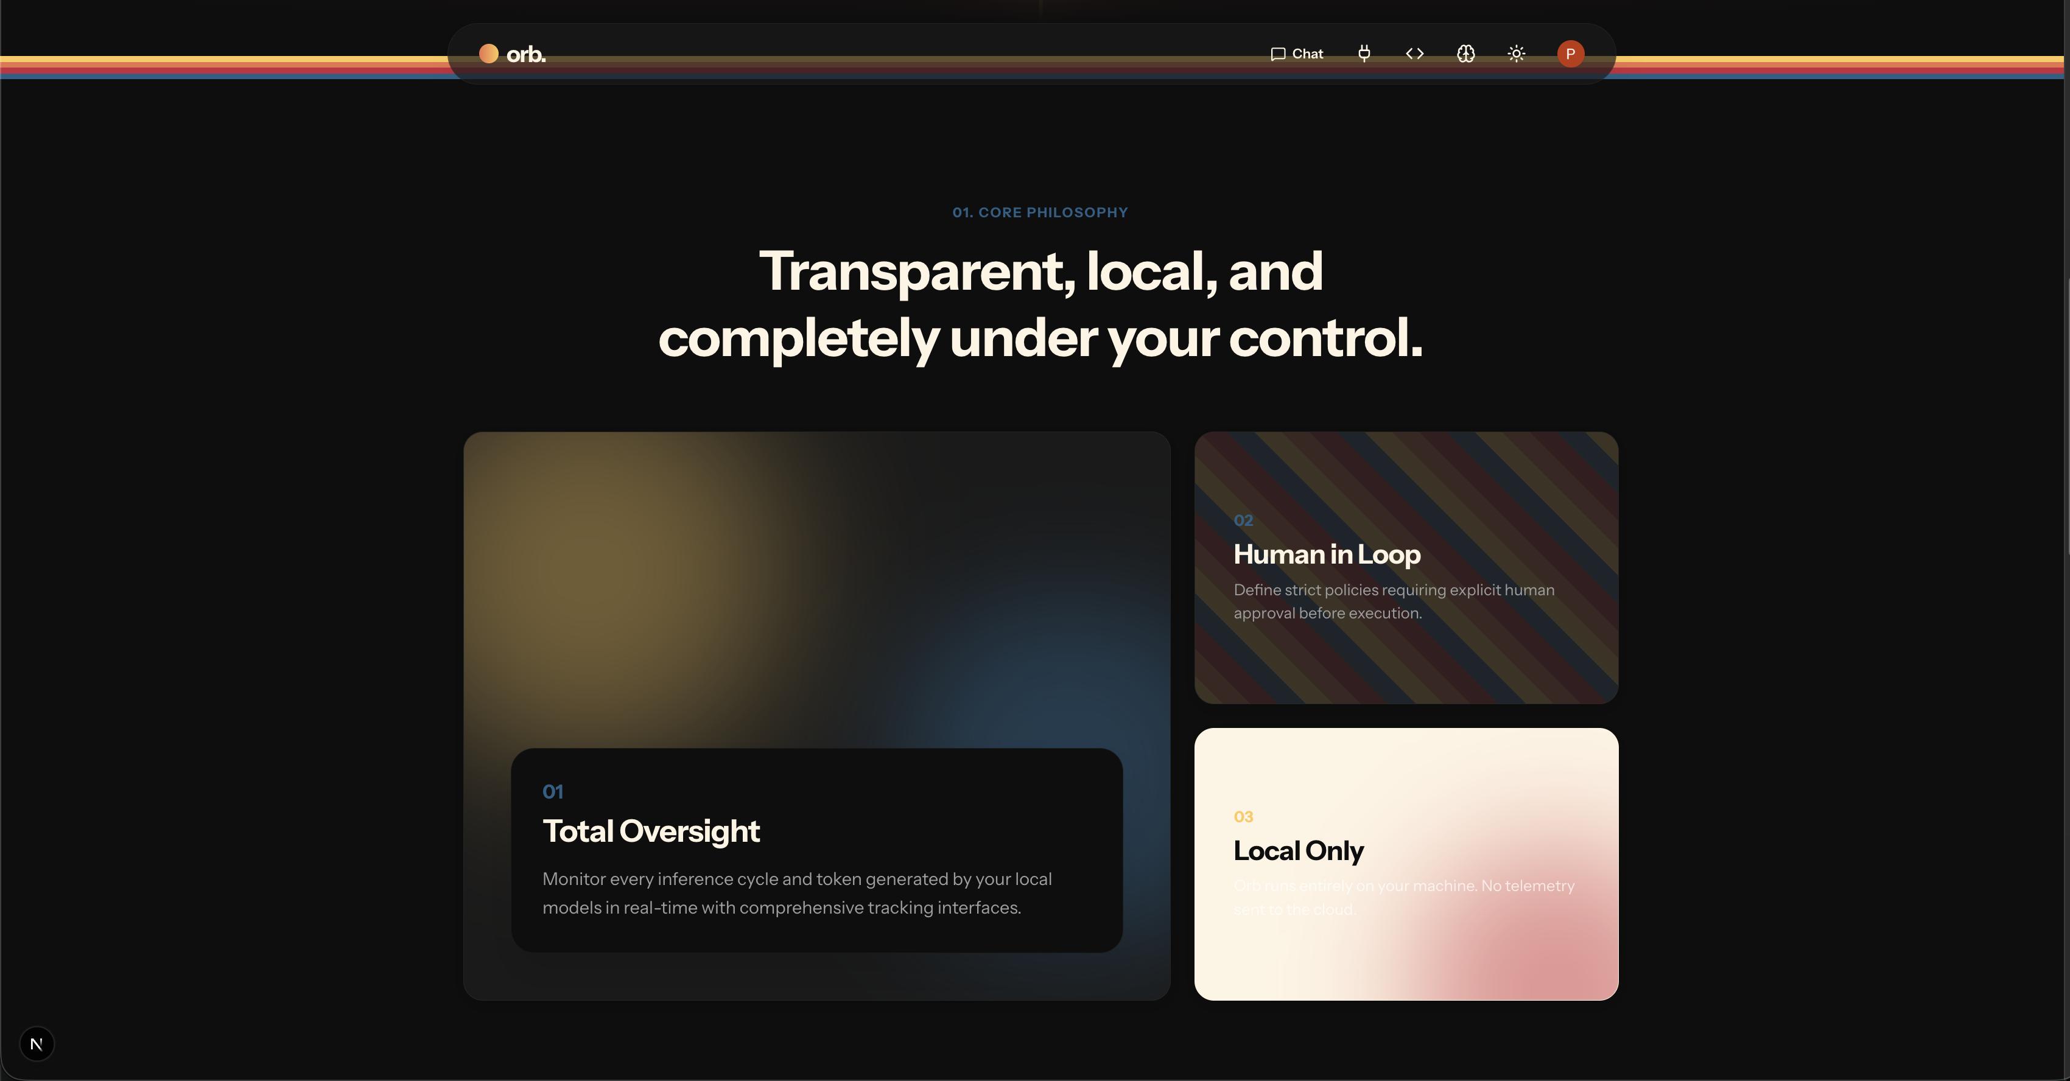
Core Design Philosophy
Three principles guide the system: Total Oversight of every inference, a Human in the Loop for sensitive actions, and Local Only execution with no cloud telemetry.

Slide 9
System Architecture
User
(Web Console)
Governed Gateway
(Express / TS)
Policy Engine
(Allow / Block / Approve)
Model Adapter
Local Ollama
& Cloud Providers
Persistence: Local SQLite (sessions · memory · API keys · audit logs) | Identity: Clerk Authentication (per-user isolation)
Every user request flows through the governed gateway, where the policy engine evaluates each tool action before it reaches a model.
Local and cloud models share one adapter, while all state and audit records remain on the user's machine.

Slide 10
Technology Stack
Frontend: Next.js, React, and TypeScript, with Framer Motion for interface animation.
Backend: Node.js and Express in TypeScript, exposing a governed model gateway.
Local inference: the Ollama runtime, serving Qwen3 and Gemma3 models.
Cloud connectors: Claude, OpenAI, Groq, Mistral, and Gemini through a shared adapter.
Data: a local SQLite database accessed with better-sqlite3.
Identity: Clerk authentication for per-user access and isolation.

Slide 11
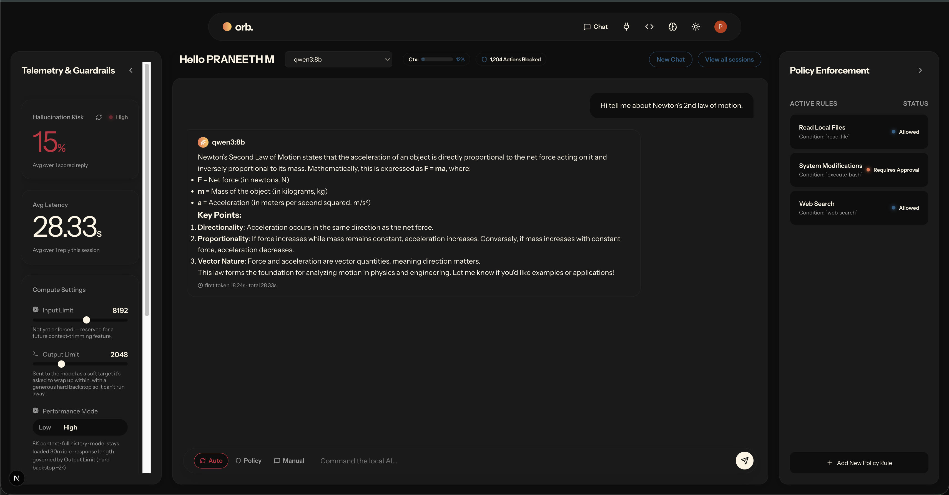
Unified Command Console
One workspace unifies conversation, live telemetry, and policy status. Here a local Qwen3 model answers under active guardrails, with latency and risk reported alongside.

Slide 12
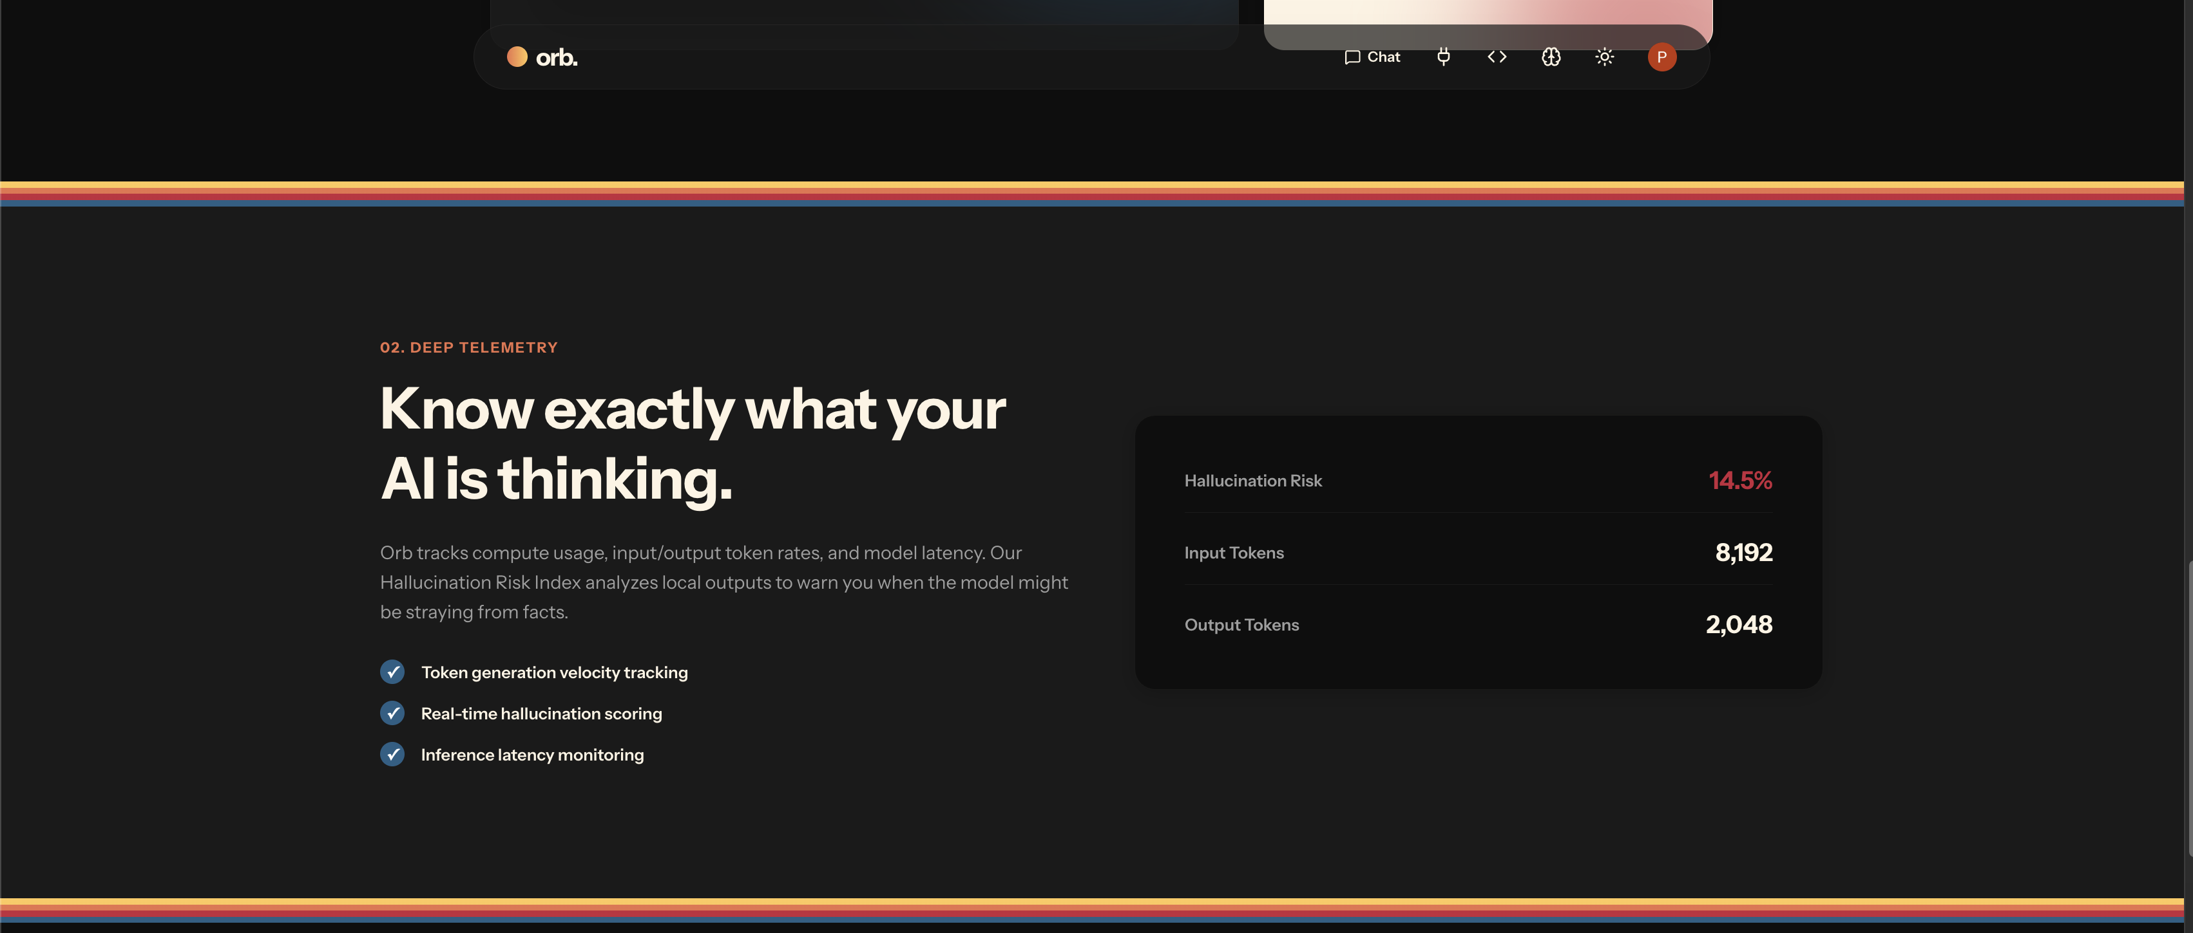
Telemetry and Hallucination Risk Index
Orb tracks token throughput and inference latency, and scores every reply for hallucination risk to warn when output may be ungrounded.

Slide 13
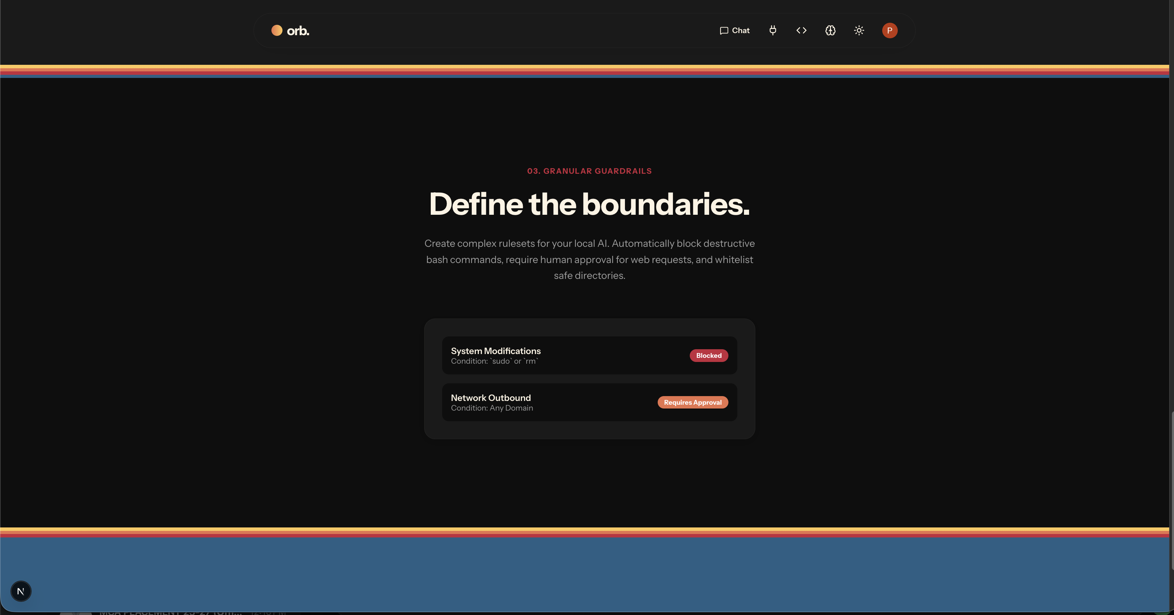
Policy Enforcement and Guardrails
Configurable rulesets allow, block, or require approval for actions such as destructive system commands and outbound network requests.

Slide 14
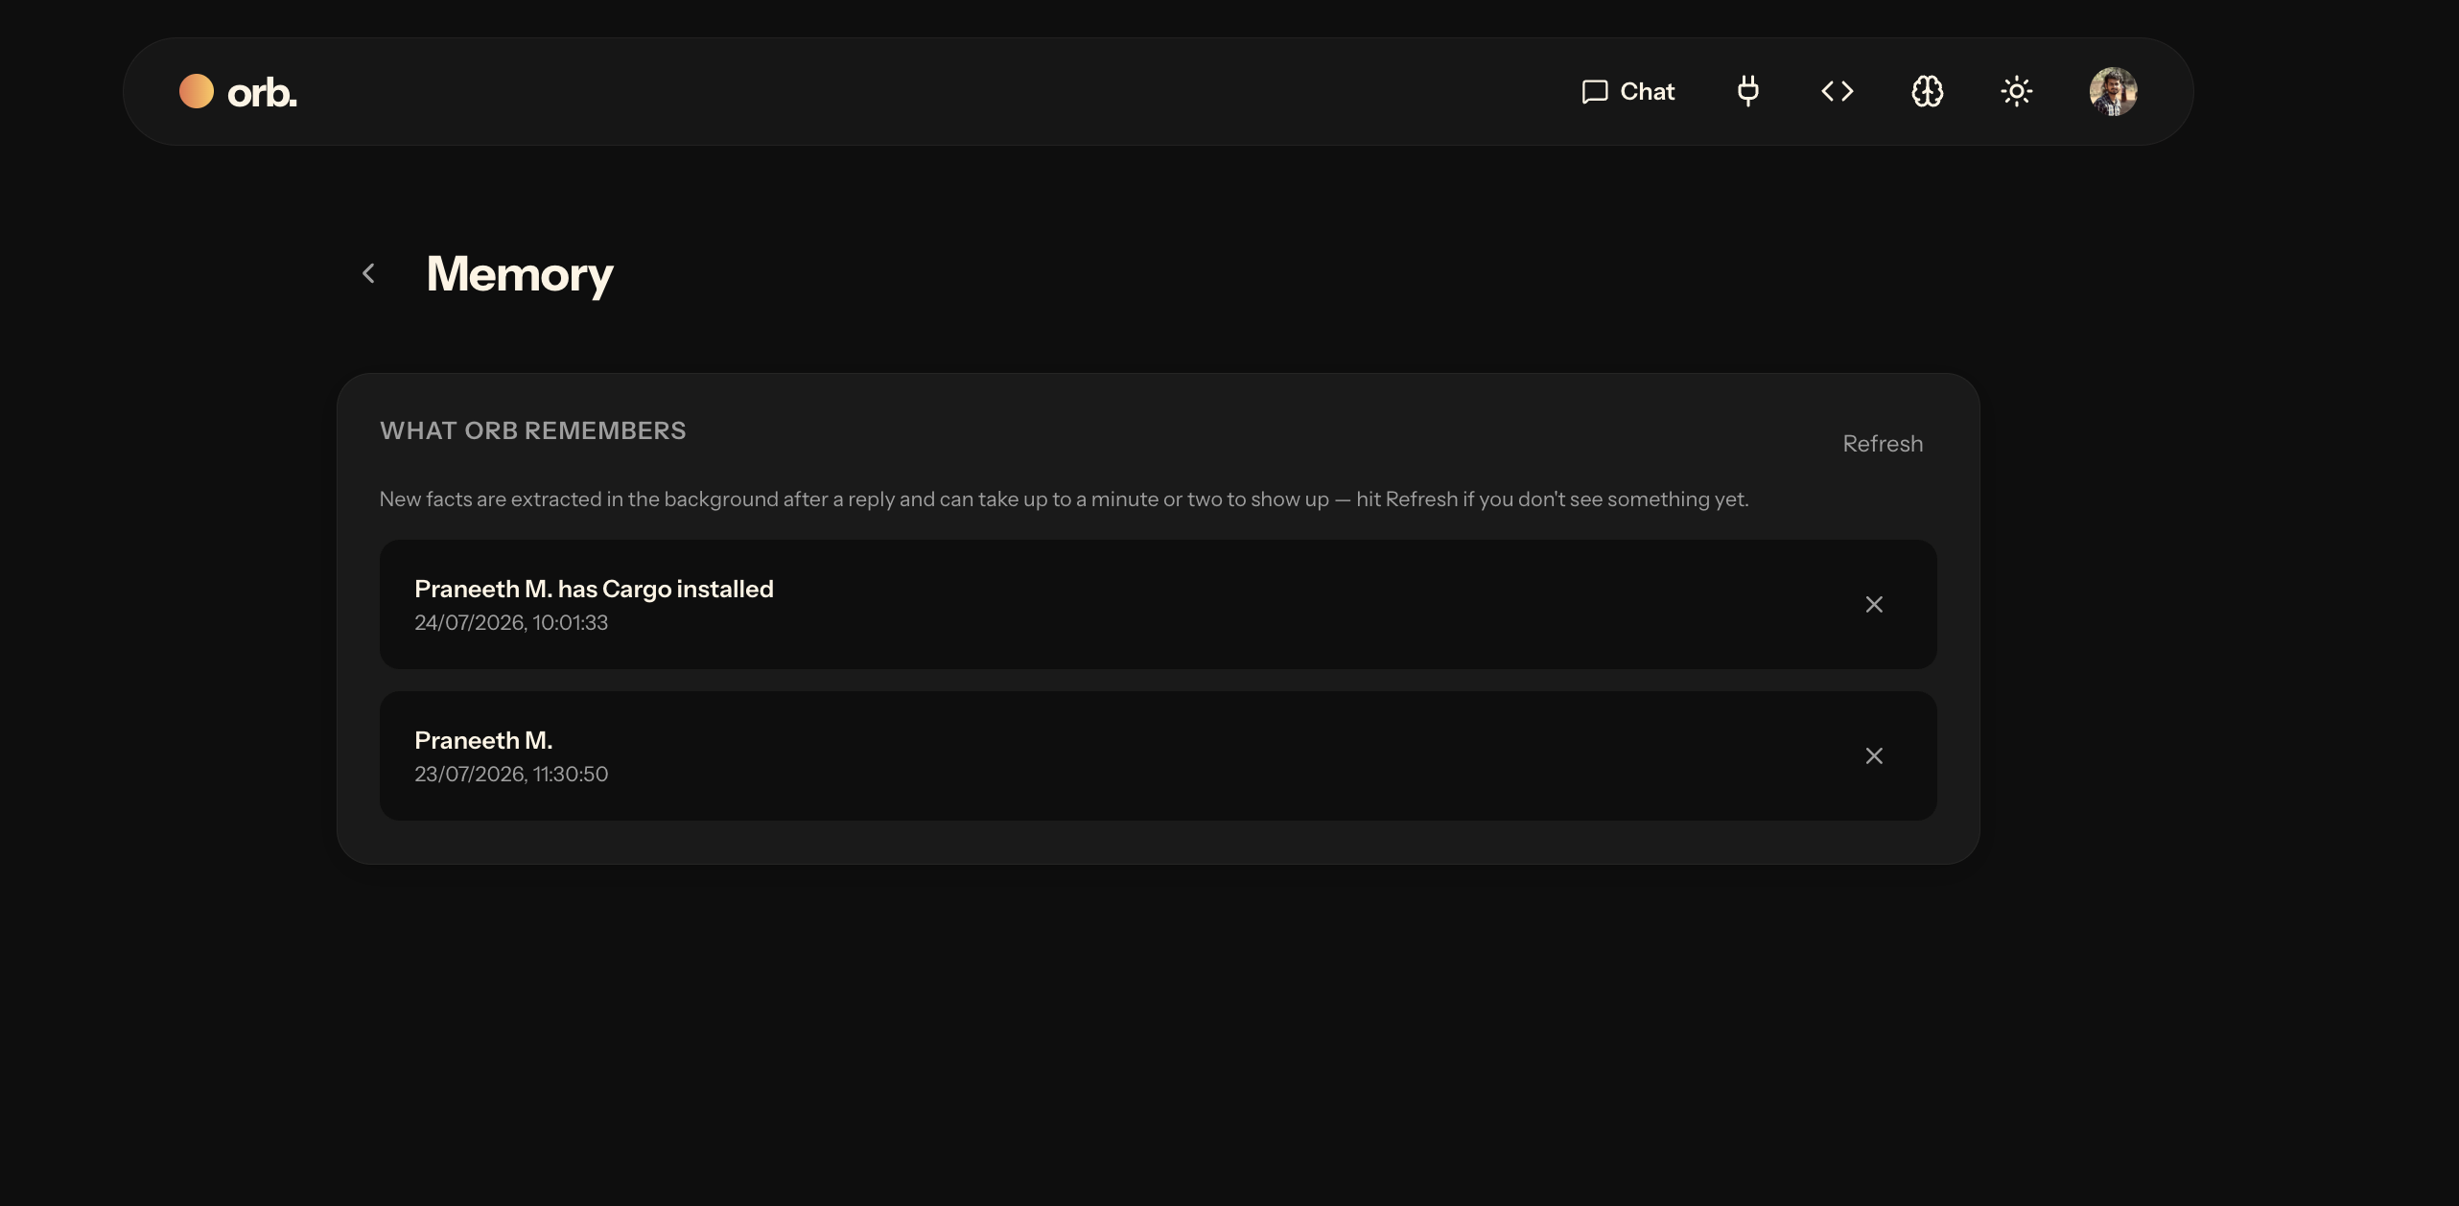
Persistent Memory
Durable facts are extracted from conversations in the background and recalled in later sessions. Memory is scoped to each authenticated user.

Slide 15
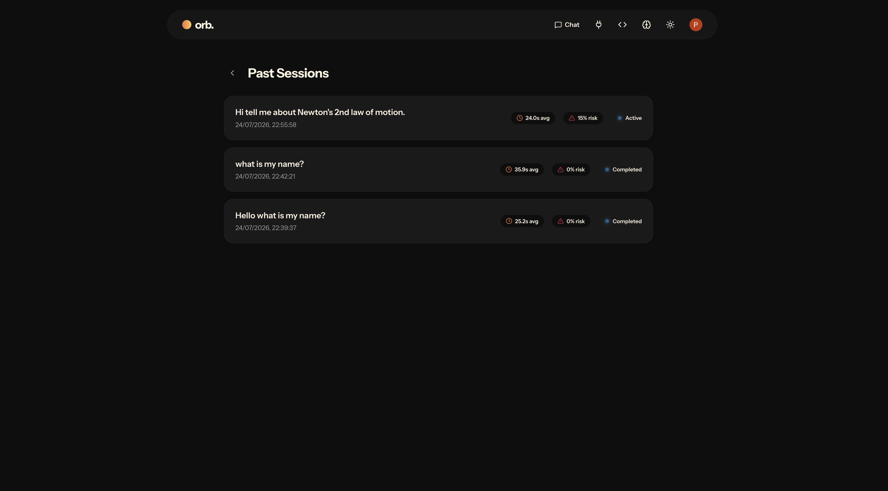
Session Persistence
Past sessions are retained with their average latency, risk score, and status, so any earlier conversation can be reviewed or resumed.

Slide 16
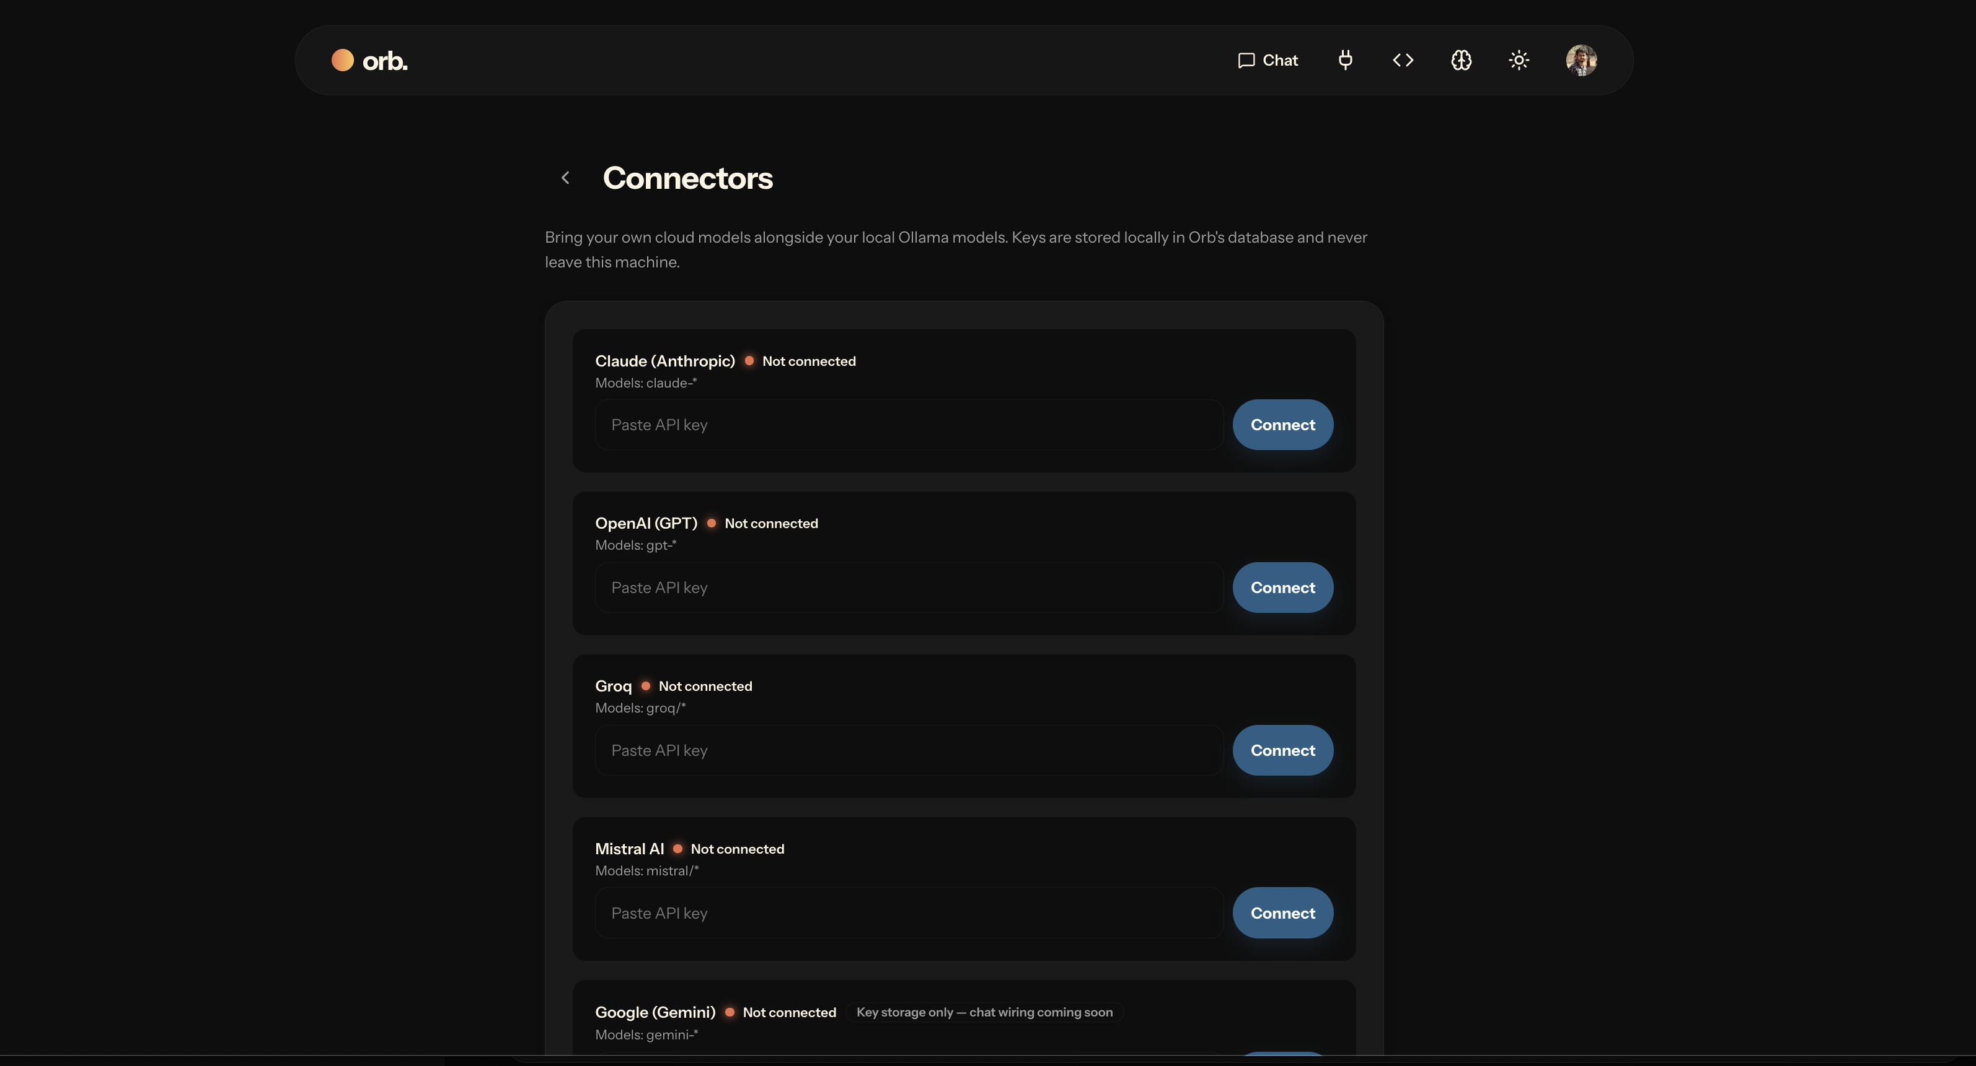
Multi-Provider Connectors
Cloud models from Claude, OpenAI, Groq, Mistral, and Gemini run beside local models. API keys are stored locally and never leave the machine.

Slide 17
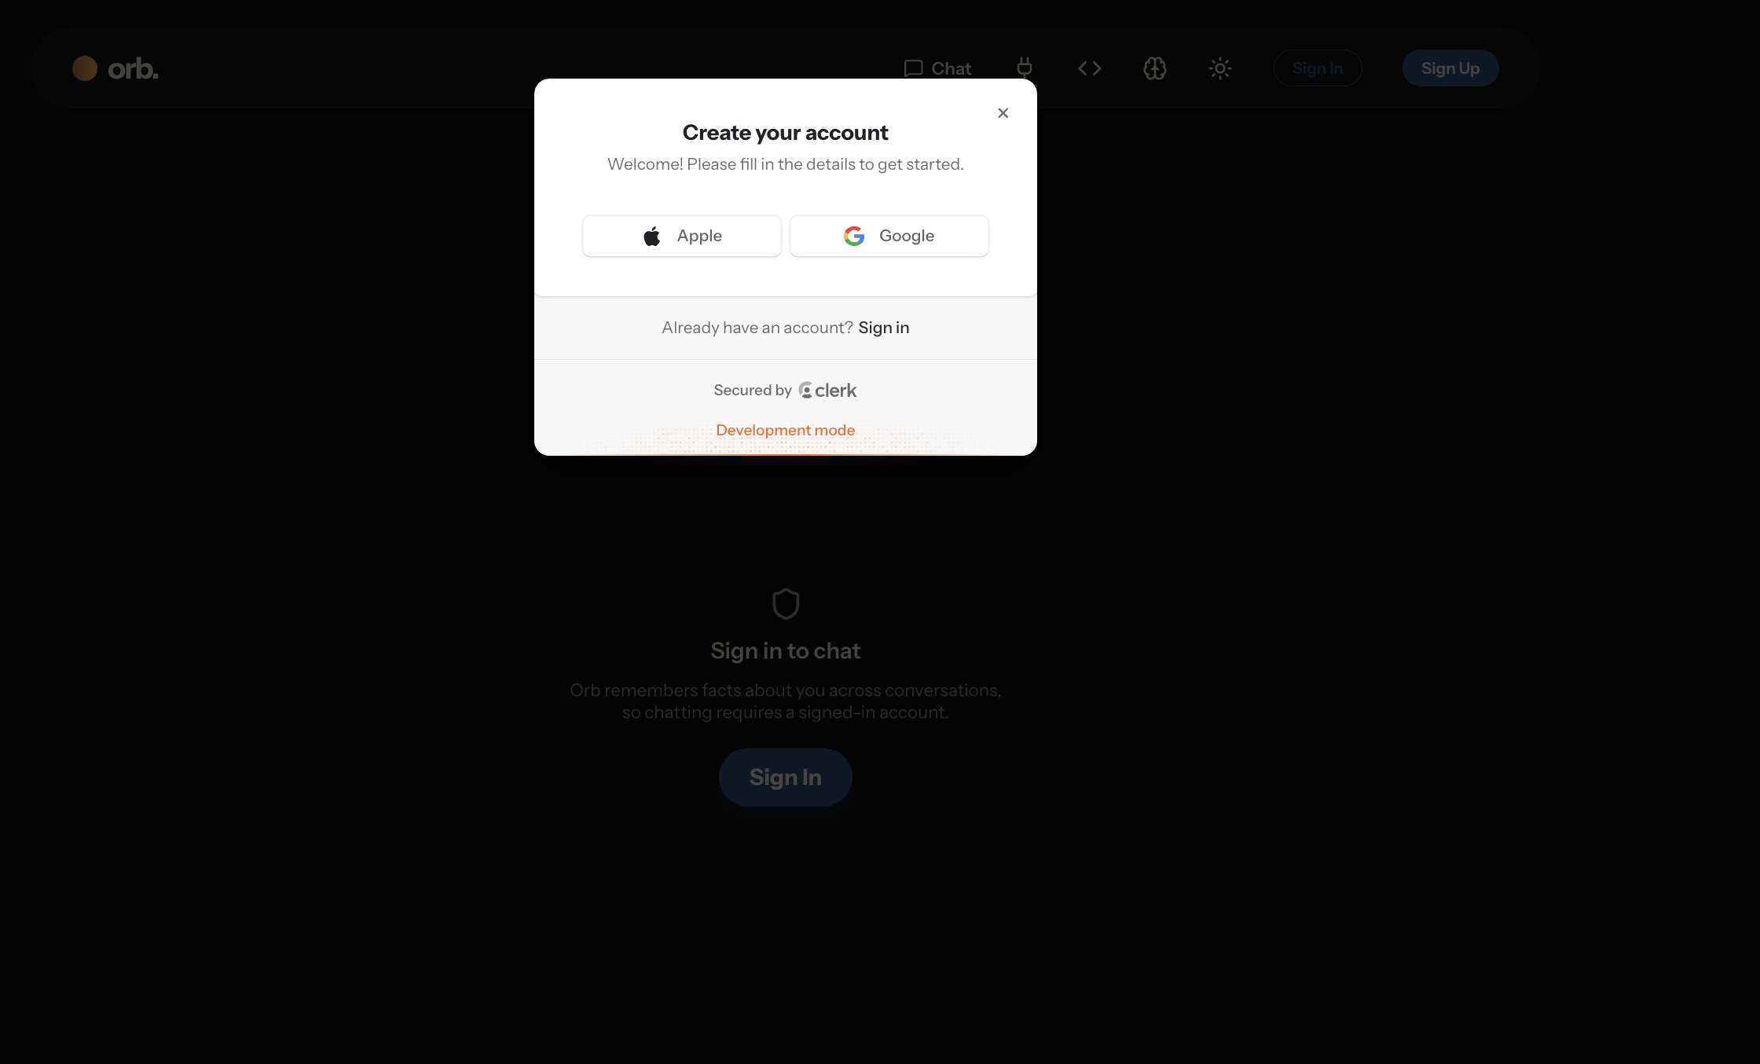
Authentication and Data Ownership
Clerk secures access and isolates each user's data, while sessions, memory, and keys remain in a local database on the user's device.

Slide 18
Results and Current Status
A working end-to-end console operates local models under enforced policies.
Real-time telemetry and background hallucination scoring are functional.
Per-user memory and session persistence are implemented on a local database.
Five cloud providers are integrated through a single connector layer.
A recent fix made background memory extraction reliable for reasoning models that emit large hidden output.

Slide 19
Challenges and Future Enhancements
Reasoning models emit extensive hidden thinking, which required careful handling of token limits during background analysis.
Planned: an inline approval dialog so gated actions can be authorised without leaving the conversation.
Planned: richer analytics with historical trends for latency and hallucination risk.
Planned: full chat wiring for the Gemini connector and exportable audit logs.

Slide 20
Conclusion
Orb shows that local language models can be operated with the governance expected of hosted systems.
The project unifies conversation, policy enforcement, observability, and memory in a single local-first console.
The outcome is a private, accountable, and extensible platform for everyday use of both local and cloud models.

Slide 21
References
Ollama: local large language model runtime. https://ollama.com
Next.js documentation, Vercel. https://nextjs.org/docs
Clerk: authentication and user management. https://clerk.com
Anthropic, OpenAI, Groq, and Mistral developer documentation.

Slide 22
Thank You
Questions and discussion are welcome.

