Slide 1

UNIVERSITY COLLEGE OF ENGINEERING, ANNA UNIVERSITY , BIT CAMPUS, TIRUCHIRAPALLI – 620 024.
Design of Deblocking Filter in Video Coding
Guide: Presented By:
Dr. R. Krishnamoorthy D. Sadwin Brunas
M. Suthan

Slide 2
INTRODUCTION – Video Coding
Reduces the storage space
Removes the redundant data
Steps involved
Frequency Transformation
Compression ( Quantization and Encoding)
Low-level feature Extraction
Box filter

Slide 3
Spatial Domain vs. Frequency Domain
Spatial
Operates directly on pixel intensity values.
Drawbacks
(i) High correlation of pixel values and
(ii) High complexity of computation.
Frequency
an alternative representation of pixel values.
gives unique information about variations of the pixel intensity values.
reduces computational complexity.

Slide 4
OBJECTIVE
Encoding the input frame (Block-based Transformation)
Forward Transformation (Orthogonal Polynomial Transformation)
Low-Level feature extraction
Deblocking through box filter

Slide 5
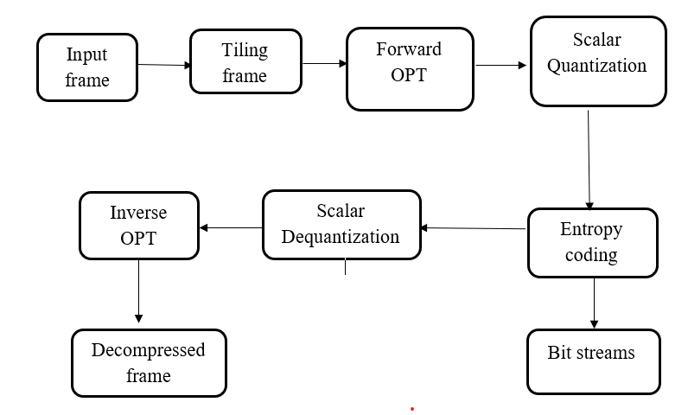
PROPOSED SYSTEM
Phase I: Video Coding Technique

Slide 6
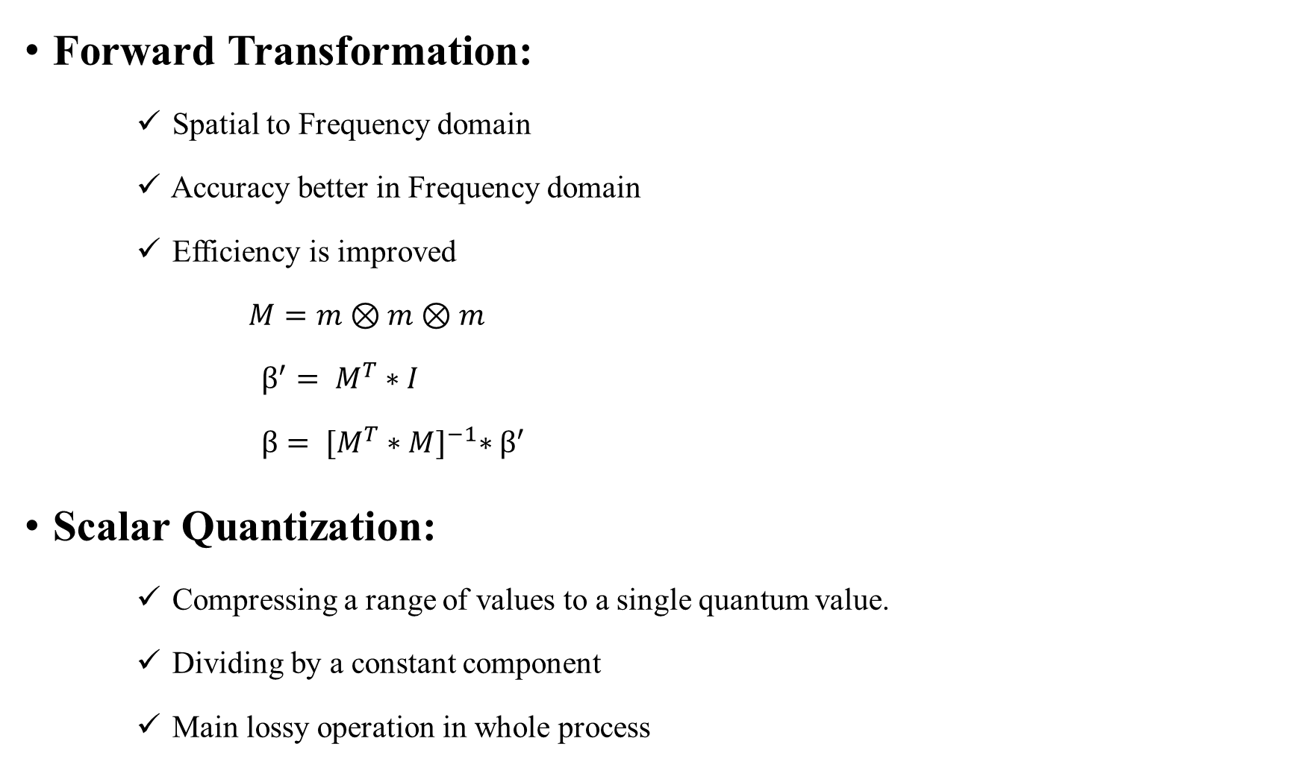
Forward Transformation:
Spatial to Frequency domain
Accuracy better in Frequency domain
Efficiency is improved
$M=m⊗m⊗m$
$β^{′}= M^{T}∗I$
$β= {[M^{T}∗M]}^{−1}∗β^{′}$
Scalar Quantization:
Compressing a range of values to a single quantum value.
Dividing by a constant component
Main lossy operation in whole process

Slide 7

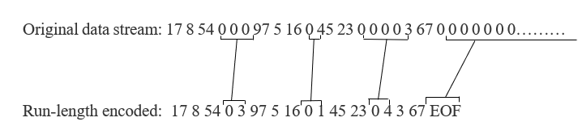
Where U (x, y) - input sub-band coefficient,
V (x, y) - output quantized coefficient,
∆ - quantizer step size
Entropy Coding:
Run-Length Coding (RLE):
Lossless data coding
Counts the run of zeros
Zeros exceeds a limit EOF is allocated

Slide 8
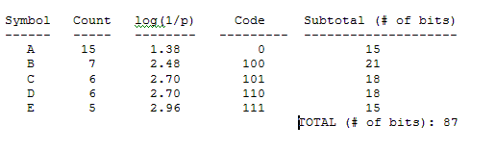
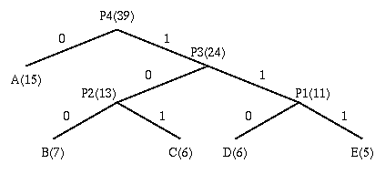
Huffman Coding
Lossless Data Compression using greedy algorithm
Viewed as a Variable-Length code table
Generate Bit stream based on Binary tree construction
Scalar Dequantization:
Inverse of the quantization process
Loss of data takes place here
Multiplied by a constant component

Slide 9


where V (x, y) - quantized coefficient,
U (x, y) - output of dequantized coefficient,
∆ - quantizer step size
Inverse Transformation:
Inverse process of the forward transformation
Converts back the Frequency coefficients to spatial domain
Pixel values are retained
$β^{′}= M^{T} ∗I$
Provides the encoded frame.

Slide 10
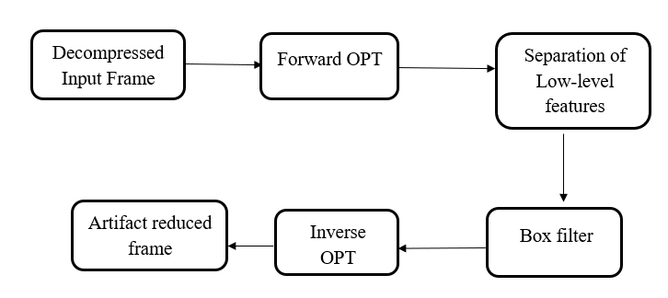
Phase II: Design of Deblocking filter

Slide 11
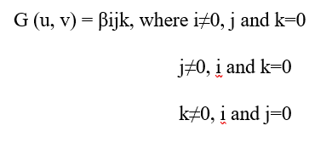

Low-Level feature extraction:
Extracted in Frequency domain
Texture primitives extracted
Edges retained in the frame itself
Compliment of this provides Texture components
where βijk represents the transformed coefficient values

Slide 12
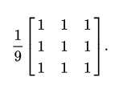
Box filter:
Determine average of the surrounding pixels
Convolution filter method of image filtering
Resultant image provides a blur image
Neighboring pixel values filled with average value
Result combined with remaining features to obtain deblocked frame

Slide 13

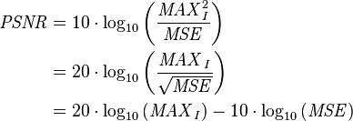
Performance Measurement
Mean Square Error (MSE)
Peak Signal to Noise Ratio

Slide 14
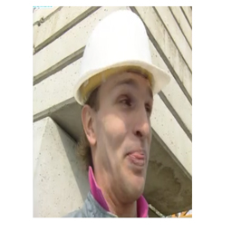

Result Obtained :
Compressed frame with qf = 10
Foreman input frame

Slide 15
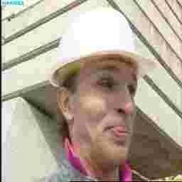
Block Artifact
Block artifact identified
Compressed frame with qf = 10

Slide 16
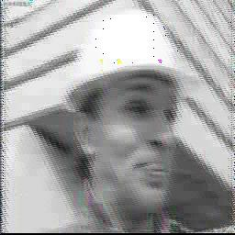
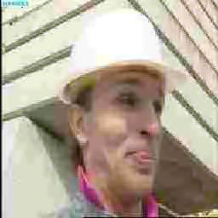
Deblocked frame
Reduced blocky noise
Extracted texture component
By transform coding
Deblocked frame after
applying box filter

Slide 17
PERFORMANCE MEASURE FOR OUTPUT
Image | Quality Factor | MSE | PSNR
Foreman | 5 | 3.3964 | 20.9178
 | 10 | 3.0868 | 25.2862
 | 20 | 2.0637 | 28.7542

Slide 18
CONCLUSION
Encoded frame from Video coding (Compression by Transform coding)
Less complexity of feature extraction (OPT)
Improved quality of the reconstructed frame (Deblocking filter)

Slide 19
Future work
Image Enhancement
Pixel Restoration
Edge Reconstruction

Slide 20
LITERATURE SURVEY
Reference No. | Title | Technique
[1] | A Deblocking Method using Wavelet Transform for H.264 Mobile TV | Total Variation Regularization
[2] | Reduction of Ringing Noise in Transform Image Coding Using a Simple Adaptive Filter | Adaptive filter
[3] | Implementation of Deblocking filter with Reconfigurable Architecture | Post-Loop deblocking filter
[4] | Compression Artifacts Removal by Signal Adaptive Weighted Sum Technique | Block-Based DCT
[5] | Video coding for low bit rate communication | Deblocking Edge Filter

Slide 21
REFERENCES
[1] T. Kariyazaki, T. Goto, S. Hirano and M. Sakurai, “A Deblocking Method using Wavelet Transform for H.264 Mobile TV”, International Symposium on Consumer Electronics (ICSE2009), pp.16-17, May 2009.
[2] A. Kaup, “Reduction of Ringing Noise in Transform Image Coding Using a Simple Adaptive Filter”, IEEE Electronics Letters, Vol.34, No.22, pp.2110-2112, October 1998.
[3] C.Karthikeyan and Dr. Rangachar (2013) “Implementation of Deblocking filter with Reconfigurable Architecture ”, International Journal of Application or Innovation in Engineering & Management, Volume 2, Issue 12.
[4] Jongho Kim and Chun-Bo Sim,” Compression Artifacts Removal by Signal Adaptive Weighted Sum Technique”, IEEE Transactions on Consumer Electronics, Vol. 57, No. 4, November 2011.
[5] ITU-T Recommendation H.263, “Video coding for low bit rate communication”, January 2005.

Slide 22


