Slide 1
b10011 Numerical Accuracy
ENGR xD52
Eric VanWyk
Fall 2012

Slide 2
Acknowledgements
The Great Wikipedia, Finder of Figures

Slide 3
Today
Manipulating Formulae for Fun and Profit
Polynomial Fits
Newton Raphson

Slide 4
Manipulating Formulae
Welcome to Algebra 404
Where Math don’t think it be like it is, but it do.
Use algebra to reformat for “good” execution
Execution Speed
Code Size
Accuracy

Slide 5
Easy Speed Tweaking
Look for degenerate expensive cases
Look for duplicated effort and eliminate it
Plan your loads / stores carefully!

Slide 6
Multiplication Tricks
Sometimes, shift-add is cheap
9x = 8x + x = X<<3 + X
In Arm and Thumb(2), this is one instruction
add $r1, $r0, $r0 lsl 3
Two ops, One Instruction?
Why?
Multiplicands with a small number of active bits

Slide 7
Booth Encoding
Represent the multiplicand as runs of ones
X*60d = X * b00111100
Runs of Ones are the difference of powers of 2
60 = 2^6 – 2^4
X*60 = X<<6 – X<<4
There are many other fixed multiplicand tricks

Slide 8
Polynomials
“Human” Form:
Ax^3+Bx^2+Cx^1+Dx^0
How many Multiplies does this use? Adds?
Notes:
Multiply : 3+2+1 = 6
Add: 3

Slide 9
Polynomials
“Human” Form:
Ax^3+Bx^2+Cx^1+Dx^0
How many Multiplies does this use? Adds?
(Paraphrased) Horner’s Scheme
((((Ax)+B)x+C)x+D)
Now how many?
Registers?
Notes:
Multiply : 3+2+1 = 6
Add: 3
Multiply: 3
Add : 3

Slide 10
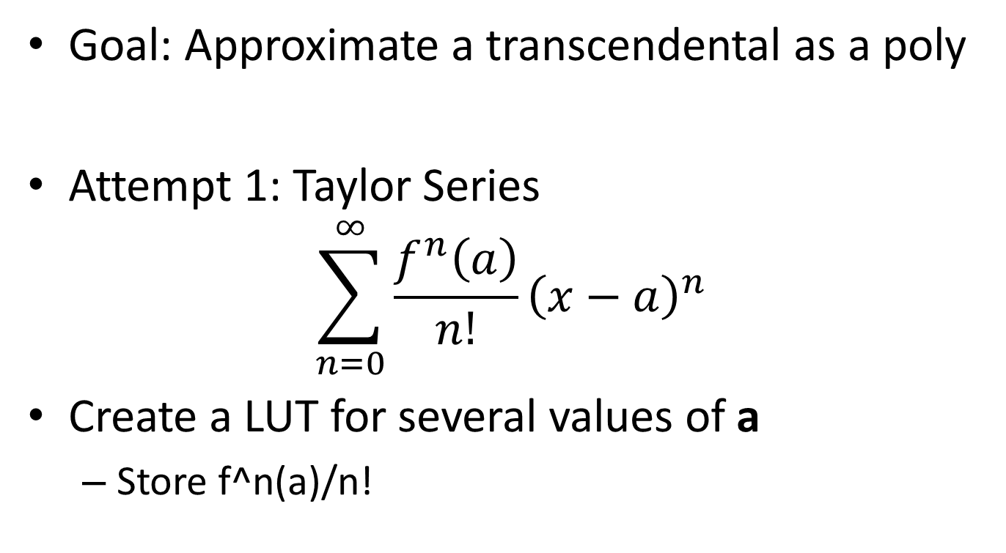
Polynomial Approximations
Goal: Approximate a transcendental as a poly
Attempt 1: Taylor Series
$$\sum_{n=0}^{∞}{\frac{f^{n}\left(a\right)}{n!}{\left(x−a\right)}^{n}}$$
Create a LUT for several values of a
Store f^n(a)/n!
Notes:
Powerpoint sucks for formulas

Slide 11
Polynomial Approximation
How deep should the LUT be?
Deeper means we are on average closer
Better approximation for a given number of terms
But Deeper also means more expensive
No easy answer ☹
How do you pick a?
Right in the middle of your range

Slide 12
Implementation: Poly/LUT
Find the nearest a in our LUT
Truncate x, use as index in to table
Load Coefficients
Sine and Cosine are special: Why?
Calculate with Horner’s Scheme

Slide 13
Picking Coefficients
Taylor Series optimizes accuracy for x ≈ a
Largest errors right between LUT points
Statistics has nice ways to optimize RMS error
Does a better job of spreading the error
But still not perfect
We care about the worst case error
I haven’t found a great way to do this yet
So I just brute force it with an annealing algorithm

Slide 14
My Method
Prototype with double precision floats
MATLAB, Python or Wolfram Alpha
Count adds, mults, loads, etc
Move to integer math
Python (X,Y)
Any catastrophic loss of precision? Rearrange
Anneal coefficients over a weekend
Automagically try several Depth/Power combos

Slide 15
Approximation “Folding”
Make use of symmetry in your functions
“Fold” the function in half cuts LUT depth in half!
Easy for trig functions
One of my favorite assembly language games
Great practice in number systems and asm tricks

Slide 16
Approximation Folding
How do you fold 1/x?
1/x^2? e^x?
These have symmetry…
But not in the linear way trig does
Higher order symmetry
1/(x) = 2^-n/(x*2^n)

Slide 17
Approximation Folding
These symmetries are harder to exploit
Count Leading Zeros
Quick stand-in for log(2)
Break spaces into powers of 2
Shift by the number of leading zeros
Compensate Later
This helps with limiting calculation Range!
Optimize for accuracy instead of range

Slide 18
Group Work
Poly/LUT fit a transcendental function
(Co)sine, e^x, or something else
Pick a range
Pick an accuracy – 24 bits?
Start with a Taylor approximation
LUT Depth? Number of terms?
What is your worst case error?
Try annealing a bit
How much did it improve?
Create and Save Figures!
We will discuss as a class

Slide 19
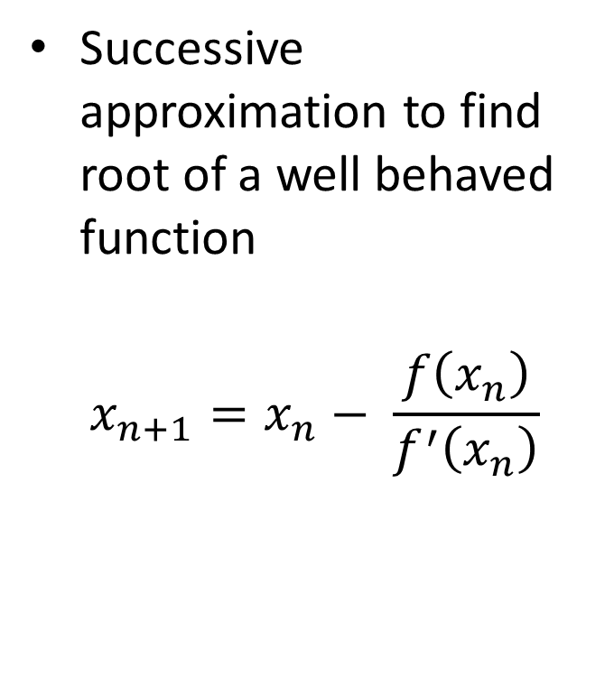
Newton Raphson
Successive approximation to find root of a well behaved function
$$x_{n+1}=x_{n}− \frac{f\left(x_{n}\right)}{f^{′}\left(x_{n}\right)}$$

Slide 20

Newton Raphson Division
$x_{n+1}=x_{n}− \frac{f\left(x_{n}\right)}{f^{′}\left(x_{n}\right)}$
$x_{n+1}=x_{n}−\frac{\frac{1}{x_{n}}−D}{−\frac{1}{x_{n}^{2}}}$
$x_{n+1}= x_{n} + x_{n}(1 – D∗x_{n})$
$x_{n+1} =x_{n}∗(2−D∗x_{n})$

Slide 21
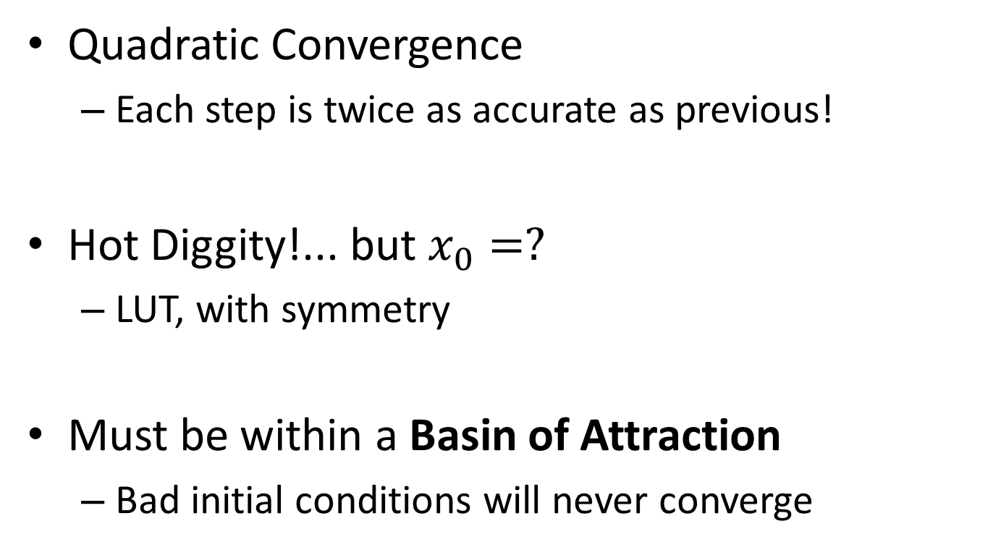
Newton Raphson Division
Quadratic Convergence
Each step is twice as accurate as previous!
Hot Diggity!... but $x_{0}=?$
LUT, with symmetry
Must be within a Basin of Attraction
Bad initial conditions will never converge

Slide 22
Newton Raphson 1/sqrt
float Q_rsqrt( float number ) {
long i;
float x2, y;
const float threehalfs = 1.5F;
x2 = number * 0.5F;
y = number;
i = * ( long * ) &y; // evil floating point bit level hacking
i = 0x5f3759df - ( i >> 1 ); // what the fuck?
y = * ( float * ) &i;
y = y * ( threehalfs - ( x2 * y * y ) ); // 1st iteration
// y = y * ( threehalfs - ( x2 * y * y ) ); // 2nd iteration, this can be removed
return y;
}

Slide 23
Translating to Fixed Point
Floating Point Newton Raphson is easy
It handles range changes for you
Fixed Point is degenerately bad
Intermediate steps are all over the place
Use symmetry to tighten up ranges
Be Careful!

Slide 24
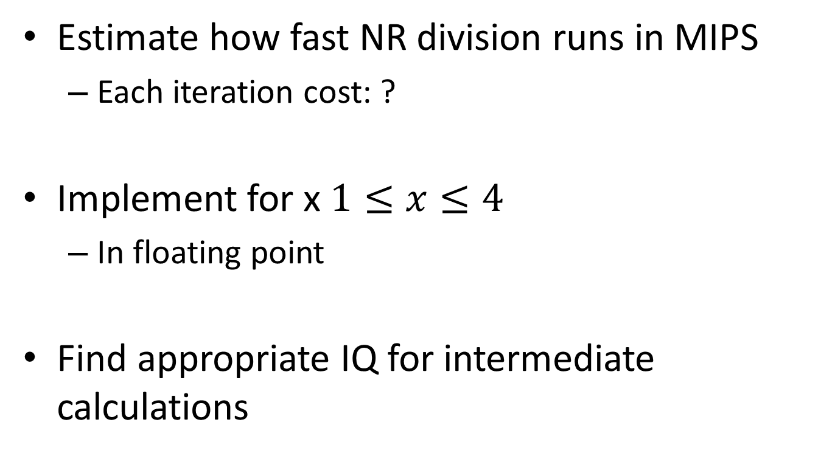
With Remaining Time
Estimate how fast NR division runs in MIPS
Each iteration cost: ?
Implement for x $1≤x≤4$
In floating point
Find appropriate IQ for intermediate calculations

