Slide 1
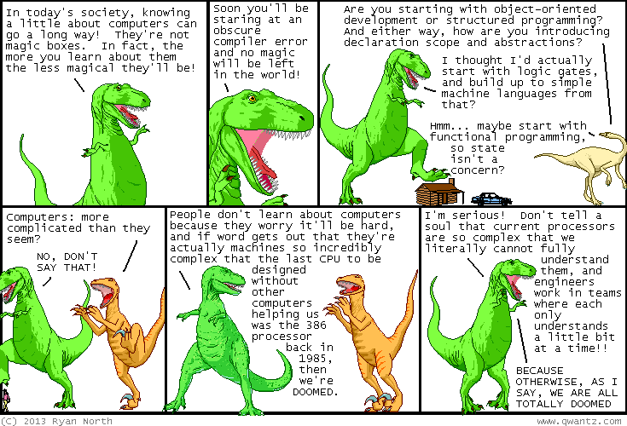

Slide 2
b0000 Zero Day
ENGR xD52
Eric VanWyk
Fall 2013

Slide 3
Agenda
General Awkwardness
Basic Orientation Information
Course Objectives & Details
VDub‘s guide to getting an A in CompArch
Boolean Logic (?)

Slide 4
Hi, I’m Eric
VanWyk, Class of ’07

Slide 5
Awkwardness

Slide 6
vanweric@gmail.com
Email and IM

Slide 7
MH 253
Rarely… IM/Email me first.

Slide 8
Monday & Thursday 0900-1040 1050-1230

Slide 9
http://wikis.olin.edu/ca/ ca@lists.olin.edu
Feel free to use for discussion!

Slide 10
Course Objectives

Slide 11
What is Computer Architecture?

Slide 12
What is Computer Architecture?
3rd grade math
Modern History
A Need for Speed
Dirty, Git’r’dun Engineering
Communication

Slide 13
Learn Digital Logic

Slide 14
Learn Digital Math

Slide 15
Build a Processor

Slide 16
Write Programs for it
In assembly

Slide 17
Build complex digital systems
In Verilog

Slide 18
Course Details

Slide 19
One Midterm
(I am so excited)

Slide 20
One Final
(You get to write this one)

Slide 21
Several Homeworks
Done individually.
Annotate collaboration per problem.

Slide 22
Several Labs
Done in groups of 2 or 3

Slide 23
One Awesome Project
Done in groups of ???

Slide 24
Late Policy:
-10% for first 24 hours
-20% for second (30% total)
-30% for third (60% total)
After 72 hours, no credit.

Slide 25
Unlate Policy
Talk to me first
Commit to a new due date
Email this new due date to comparch13@gmail.com
Reminder note in your submission email.

Slide 26
Attendance Policy:
At your own risk.

Slide 27
How To Get an A in Comp Arch
Do it in human first
Break big problems in to better chunks
Black Boxes!
Learn enough C to know what a pointer is
Pick a fun but appropriately sized final project
Give me constant feedback

Slide 28
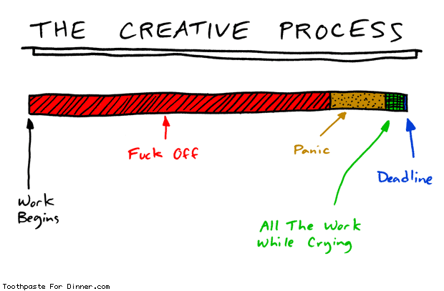
How to Seppuku CompArch
Slack

Slide 29
Acknowledgements
Mark L. Chang lecture notes for Computer Architecture (Olin ENGR3410)
Patterson & Hennessy: Book & Lecture Notes
Patterson’s 1997 course notes (U.C. Berkeley CS 152, 1997)
Tom Fountain 2000 course notes (Stanford EE182)
Michael Wahl 2000 lecture notes (U. of Siegen CS 3339)
Ben Dugan 2001 lecture notes (UW-CSE 378)
Professor Scott Hauck lecture notes (UW EE 471)
Mark L. Chang lecture notes for Digital Logic (NWU B01)

Slide 30
Digital Logic

Slide 31


Digital vs. Analog
Digital:
only assumes discrete values
Analog:
values vary over a range
continuously

Slide 32
Binary Logic
Simplest form of Digital Logic
Only two states
True and False
One and Zero
Also called Boolean Logic

Slide 33
Example: Car Electronics
Door ajar light (driver door, passenger door):
High-beam indicator (lights, high beam selected):
Notes:
Door Ajar – OR gate – if either are open, indicate the light
High-beam indicator – AND gate – only light if both are active

Slide 34
Example: Car Electronics (cont.)
Seat Belt Light (driver belt in):
Seat Belt Light (driver belt in, passenger belt in, passenger present):
Notes:
Seat Belt Light – Inverter – bother the user if the belt isn’t engaged

Slide 35
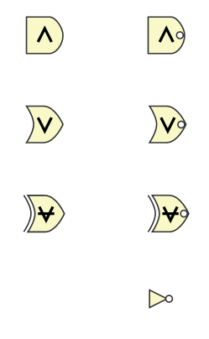
Basic Logic Gates

Slide 36
Basic Logic Gates
AND
NAND
OR
NOR
XOR
(exclusive or)
XNOR
NOT
Notes:
Briefly describe construction from transistors, etc

Slide 37
Boolean Equations
AND: AB A&B
OR: A+B
NOT: A̅ ~A

Slide 38
Basic Boolean Identities:
X + 0 = X * 1 =
X + 1 = X * 0 =
X + X = X * X =
X + X̅ = X * X̅ =
X̅ =
Notes:
X X
1 0
X X
1 0
X

Slide 39
Basic Laws
Commutative Law:
X + Y = Y + X XY = YX
Associative Law:
X+(Y+Z) = (X+Y)+Z X(YZ)=(XY)Z
Distributive Law:
X(Y+Z) = XY + XZ X+YZ = (X+Y)(X+Z)

Slide 40
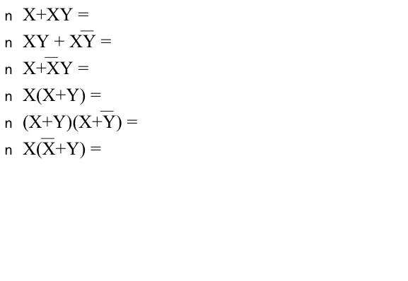
Advanced Laws
X + 0 = X X * 1 = X
X + 1 = 1 X * 0 = 0
X + X = X X * X = X
X + X̅ = 1 X * X̅ = 0
~~X = X
Notes:
X
X
X+Y
X
X
XY XY

Slide 41
Homework for Monday
Answer these question:
Why are you taking this class?
What is your favorite processor? Why?
Name at least 3 things you want to learn in this class: Be specific!
What do you want to do with what you learn here after graduation? Prognosticate!
During in class work: Music?
Email them to CompArch13@gmail.com
Subject [HW0] Your Name

Slide 42
Homework for Monday
Find examples of simple boolean logic
2-4 inputs
Well defined behavior
Interesting to you
This portion is NOT collected
It will be used in class

