Slide 1
b1110 Behavioral Verilog
ENGR xD52
Eric VanWyk
Fall 2013

Slide 2
Acknowledgements
BYU ECEn 224: http://ece224web.groups.et.byu.net/lectures/A3%20VERILOG.pdf
Y. N. Patt, UT Austin EE382N Verilog Manual: http://users.ece.utexas.edu/~patt/04s.382N/tutorial/verilog_manual.html
Asic World: Verilog Behavioral Modeling: http://www.asic-world.com/verilog/vbehave1.html
Nestoras Tzartzanis, USC EE577b – Verilog for Behavioral Modeling: http://www-scf.usc.edu/~ee577/tutorial/verilog/verilog_lec.pdf

Slide 3
Today
Lab 2 is assigned
Intro to Behavioral Verilog
Time in-class for Lab 2

Slide 4
Review: Structural Verilog
Explicitly define the structure of logic circuits
Engineer responsible for soup-to-nuts
Relatively slow to create
Can produce very small / fast implementations

Slide 5
What is “Behavioral” Verilog
Higher Level than structural verilog
Define the behavior!
synthesizer determines structure
Relatively fast to create
Size/speed is up to the synthesizer

Slide 6
Simple Gates
Structural:
and myAnd(output, input, input2)
Behavioral
output <= input & input2

Slide 7
The Register File
This is (almost) Lab 1
One read port instead of two
Common Address
Register 0 is a register
16 words
It is so tiny and cute!
Where is the mux?
How to make mux 2?
Where is the decoder?
How do the enables work?
module regFile (clk, regWE, Addr,
DataIn, DataOut);
input clk, regWE;
input[4:0] Addr;
input[31:0] DataIn;
output[31:0] DataOut;
reg [31:0] registers [15:0];
// Synchronous write logic
always @(posedge clk)
if (regWE)
registers[Addr] <= DataIn;
// Asynchronous read logic
assign DataOut = registers[Addr];
endmodule

Slide 8
Asynchronous Logic
Stuff that happens all the time
assign DataOut = registers[Addr];
“Continuous Assignment”
Left hand MUST be a wire
What are the dependencies?
When is DataOut re-calculated?
In Simulation? In “Real Life”?

Slide 9
Synchronous Logic
always @(posedge clk)
if (regWE)
registers[Addr] <= DataIn;
Stuff that happens when triggered
Trigger list in the @(______) section
When is this re-calculated?
Notes:
Every positive edge of the clock

Slide 10
Example: A counter
Is this synchronous or asynch?
What does WID do?
How would this look in structure?
module upCnt(cnt, clk, clr);
parameter WID=4;
input clk, clr;
output reg[WID-1:0] cnt;
always @(posedge clk)
if (clr)
cnt <= 0;
else
cnt <= cnt + 1;
endmodule

Slide 11
Example: A counter rewritten
<= Allows Multiple Assignments
The last one “wins”
module upCnt(cnt, clk, clr);
parameter WID=4;
input clk, clr;
output reg[WID-1:0] cnt;
always @(posedge clk)
begin
cnt <= 0;
if(!clr)
cnt <= cnt + 1;
end
endmodule

Slide 12
Example: A Weird Counter
How would this look in structure?
One Adder or Two?
How to guarantee one adder?
module Cnt2(cnt,clk,add,op);
parameter WID=4;
input clk, add;
input [WID-1:0] op;
output reg[WID-1:0] cnt;
always @(posedge clk)
if (add)
cnt <= cnt + op;
else
cnt <= cnt + 1;
endmodule

Slide 13
Example: A Full Adder
{} is Concatenation
Note that a,b,cin are not the same length
“|sum” is a Reduction
More info at http://www-scf.usc.edu/~ee577/tutorial/verilog/verilog_lec.pdf
wire[15:0] sum,a,b;
wire cin, cout, zero;
assign {cout, sum} = a + b + cin;
assign zero = !(|sum);

Slide 14
= vs <=
= is a blocking assignment
Evaluate right hand side, assign to left immediately
<= is a non-blocking assignment
Evaluate right hand side
Schedule assignment for the end of the time step

Slide 15
= vs <=: Swap Fest
What are the values of the registers after each clock period?
Which block swaps?
Which block stomps?
always @(posedge clk)
begin
a = b;
b = a;
end
always @(posedge clk)
begin
c <= d;
d <= c;
end
Notes:
<= swaps

Slide 16
= vs <= : Timing
reg a, b, c, d, e, f, g, h, i;
initial begin
#10 a = 1; // a assigned at time 10
#2 b = 0; // b assigned at time 12
#4 c = 1; // c assigned at time 16
end
initial begin
#10 d <= 1; // d assigned at time 10
#2 e <= 0; // e assigned at time 12
#4 f <= 1; // f assigned at time 16
end
initial begin
g <= #10 1; // g assigned at time 10
h <= #2 0; // h assigned at time 2
i<= #4 1; // i assigned at time 4
end
Blocking Assignments
Each line blocks the next line
Non Blocking Assigments
Wait statement in scheduling
The waits cause the blocking
Non Blocking Assignments
Wait statement in assignment

Slide 17
= vs <= : TL;DR;
I prefer using <=
Converts from circuits more naturally
How regs actually work
You can use =
Converts from C code more naturally
Synthesizer has more work to do

Slide 18
Synthesizing Behavioral
assign Q =
(S == 0) ? in0 :
(S == 1) ? in1 :
(S == 2) ? in2 :
in3;
The ?: notation is the “ternary operator”
X ? Y : Z; // If X is true, Y. Else, Z
Lets synthesize this code
What does it do?
How should it be implemented?
How will it actually be implemented?

Slide 19
Synthesizing Behavioral
assign Q =
(S == 0) ? in0 :
(S == 1) ? in1 :
(S == 2) ? in2 :
in3;
Lets synthesize this code
What does it do?
4 input Mux!
How should it be implemented?
… an 4 input mux…
How will it actually be implemented?
I don’t actually know ☹

Slide 20
How does it Synthesize
Assuming a naïve tool chain:
Find logic to handle each portion
Apply Boolean law to reduce size

Slide 21
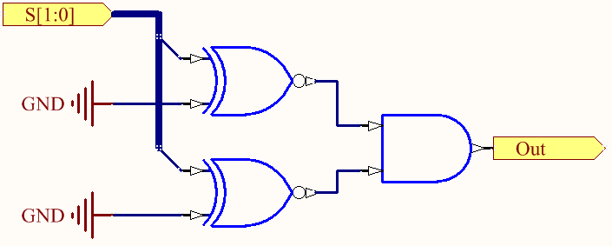
How does it Synthesize: (S==0)
(S==0) is a bunch of XNOR and a big AND gate

Slide 22
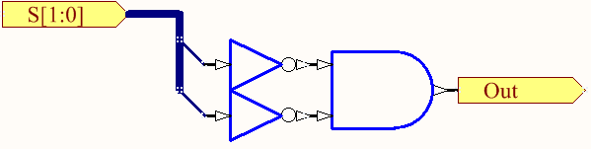
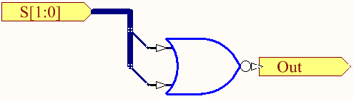
How does it Synthesize: (S==0)
Simplify based on fixed constants
Reduce Further with Boolean Laws

Slide 23
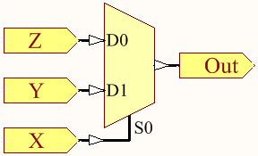
Synthesize (S == 0) ? in0 :
The ?: notation is the “ternary operator”
X ? Y : Z; // If X is true, Y. Else, Z
This is synthesized as a 2 input mux
The first operand goes in to the “select” input
The next two are the selected inputs

Slide 24
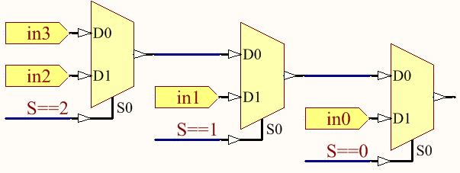
Put It All Together
This creates a chain of 2 input Muxes
S==? XNOR comparisons omitted for clarity

Slide 25
Another Option
Use Concatenation and Indexing
Assign Q = {in0,in1, in2, in3}[S]
Why does this work better?
Give the Synthesizer “room to breathe”
Looks like something it is “used to”

Slide 26
3 to 8 Decoder
module decoder3to8(in,out);
input [2:0] in;
output [7:0] out;
reg [7:0] out;
always @ (in) begin
case (in)
3'b000 : out = 8'b0000_0001;
3'b001 : out = 8'b0000_0010;
3'b010 : out = 8'b0000_0100;
3'b011 : out = 8'b0000_1000;
3'b100 : out = 8'b0001_0000;
3'b101 : out = 8'b0010_0000;
3'b110 : out = 8'b0100_0000;
3'b111 : out = 8'b1000_0000;
endcase
end
endmodule
Structural on the outside
Behavioral on the inside

Slide 27
3 to 8 Decoder Propagation
Describe synthesis
Time it by hand
Explain
Insert
/*
This could be implemented as 8 parallel AND3 gates with an inverter for each input bit. The total propagation delay would therefore be 40+10
*/

Slide 28
3 to 8 Decoder
// 8 output decoder with 3 select (in) bits.
module decoder3to8(in,out);
// This could be implemented as 8 parallel AND3 gates with an inverter for // each input bit. The total propagation delay would therefore be 40+10
input [2:0] in;
output [7:0] out;
reg [7:0] out;
always @ (in) begin
case (in)
3'b000 : out = #50 8'b0000_0001;
3'b001 : out = #50 8'b0000_0010;
3'b010 : out = #50 8'b0000_0100;
3'b011 : out = #50 8'b0000_1000;
3'b100 : out = #50 8'b0001_0000;
3'b101 : out = #50 8'b0010_0000;
3'b110 : out = #50 8'b0100_0000;
3'b111 : out = #40 8'b1000_0000; // No inverters in the way
endcase
end
endmodule
Notes:
Yell about buffers for a bit here

Slide 29
Lets Break the 3 to 8 Decoder
module decoder3to8(in,out);
input [2:0] in;
output [7:0] out;
reg [7:0] out;
always @ (in) begin
case (in)
3'b000 : out = 8'b0000_0001;
3'b001 : out = 8'b0000_0010;
3'b010 : out = 8'b0000_0100;
3'b011 : out = 8'b0000_1000;
3'b100 : out = 8'b0001_0000;
3'b101 : out = 8'b0010_0000;
3'b110 : out = 8'b0100_0000;
3'b111 : out = 8'b1000_0000; endcase
end
endmodule
Forget one case
Now case b111 remembers the previous state of the decoder!
Extra IMPLIED DFFs!!

Slide 30
Lets Break the 3 to 8 Decoder
module decoder3to8we(in,out, en);
input [2:0] in;
input en;
output [7:0] out;
reg [7:0] out;
always @ (in) begin
out = 0;
if(en) begin
case (in)
3'b000 : out = 8'b0000_0001;
3'b001 : out = 8'b0000_0010;
3'b010 : out = 8'b0000_0100;
3'b011 : out = 8'b0000_1000;
3'b100 : out = 8'b0001_0000;
3'b101 : out = 8'b0010_0000;
3'b110 : out = 8'b0100_0000;
3'b111 : out = 8'b1000_0000;
endcase
end
end
endmodule
Add an Enable Signal
The out = 0 is never overwritten
What did I forget to do?

Slide 31
Lets Break the 3 to 8 Decoder
module decoder3to8we(in,out, en);
input [2:0] in;
input en;
output [7:0] out;
reg [7:0] out;
always @ (in, en) begin
out = 0;
if(en) begin
case (in)
3'b000 : out = 8'b0000_0001;
3'b001 : out = 8'b0000_0010;
3'b010 : out = 8'b0000_0100;
3'b011 : out = 8'b0000_1000;
3'b100 : out = 8'b0001_0000;
3'b101 : out = 8'b0010_0000;
3'b110 : out = 8'b0100_0000;
3'b111 : out = 8'b1000_0000;
endcase
end
end
endmodule
What did I forget to do?
Update Sensitivities!
Synthesises a DFF for en
Updates only on (in)
TL;DR
Sensitive to sensitivities

Slide 32
With Remaining Time
Practice / Read about Behavioral Verilog
Work on Lab 2 Planning with your group

Slide 33
Loading Memories from Files
module memory(clk, regWE, Addr,
DataIn, DataOut);
input clk, regWE;
input[9:0] Addr;
input[31:0] DataIn;
output[31:0] DataOut;
reg [31:0] mem[1023:0];
always @(posedge clk)
if (regWE)
mem[Addr] <= DataIn;
initial $readmemb(“file.dat”, mem);
assign DataOut = registers[Addr];
endmodule
$readmemb and $readmemh allow you to load a memory from a file
b for Binary
h for Hexadecimal
Done in an initial block
Examples are in the lab3 starter package on the wiki

