Slide 1
b1111 Multi-Cycle CPUs
ENGR xD52
Eric VanWyk
Fall 2013

Slide 2
Acknowledgements
Mark L. Chang lecture notes for Computer Architecture (Olin ENGR3410)
Microchip Technology Inc (Datasheet)
A. Sahu, Indian Institute of Technology

Slide 3
Today
Clocks
Recall Single-Cycle CPUs
Single-Cycle Shortcomings
Multi-Cycle CPUs

Slide 4
Execution Overview
Instruction
Fetch
Fetch instruction from memory
Decode instruction into actions/controls
Fetch/Decode operands
Compute result value or status
Push result(s) to storage
Determine next instruction
Instruction
Decode
Operand
Fetch
Execute
Result
Store
Next
Instruction

Slide 5
Execution Overview
Instruction
Fetch
Fetch instruction from memory
Decode instruction into actions/controls
Fetch/Decode operands
Compute result value or status
Push result(s) to storage
Determine next instruction
Reference Lecture b1001
Instruction
Decode
Operand
Fetch
Execute
Result
Store
Next
Instruction

Slide 6
Clocks and Stability
The clock is a massive, chip wide signal
All timing slaves to it
Huge buffers to keep everyone in line
Usually a Crystal (XTAL / XO) as a time base
Very precise – Easily tens of parts per million
Sometimes an RC oscilator
ModCon all over again

Slide 7
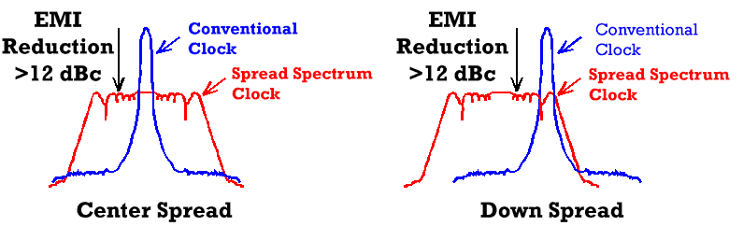
Clocks and Instability
Specialized systems can change clock freq
Phase Locked Loop to multiply / divide freq
Some can change this multiplier during operation
Spread Spectrum Oscillator:
http://www.mecxtal.com/clk_hm.php

Slide 8
Information Rippling
Each Clock Cycle “ripples” left to right
Elements emit garbage values until they stabilize
Elements on the Left (leading edge of cycle)
Spend most of the time “bored” (stable)
Under-utilized
Elements on the Right (lagging edge of cycle)
Spend most of the time twitching as things settle
Spend unnecessary dynamic power

Slide 9
Performance of Single-Cycle Machine
Clock speed is set by the slowest instruction
Arithmetic & Logic
Load
Store
Branch
Jump
PC
Instr. Memory
Reg Read
mux
ALU
mux
Reg Setup
PC
Instr. Memory
Reg Read
mux
ALU
Data Memory
mux
Reg Setup
PC
Instr. Memory
Reg Read
mux
ALU
Data Memory
PC
Instr. Memory
Reg Read
mux
ALU
Adder
mux
PC setup
PC
Instr. Memory
mux
PC setup

Slide 10
Clock TL;DR;
Unable to change for each instruction
Slow instruction slows EVERY instruction
Harrison Bergeron applied to Transistors

Slide 11
Reducing Cycle Time
Cut combinational dependency graph and insert register / latch
Do same work in N fast cycles, rather than one slow one
storage element
storage element
Acyclic
Combinational
Logic (A)
Acyclic
Combinational
Logic
storage element
Acyclic
Combinational
Logic (B)
storage element
storage element

Slide 12
Goals
Free up fast instructions from slow clock curse
Load Word is Super Slow
Make better use of available resources
Reuse components (2 Memories, 2 or 3 Adders)
Free up space to speed up components
One big fast ALU, not multiple slow ALU/adders

Slide 13
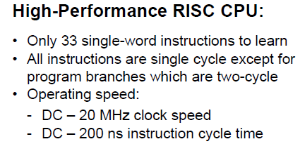
Multi-Cycle CPUs in the Wild
Common in small embedded spaces
PIC16, PIC18
4 bit micros (watches)
Marketing will try to confuse you
Advertise MHz
Hide CPI, Instructions per second, etc
http://ww1.microchip.com/downloads/en/DeviceDoc/41213D.pdf

Slide 14
Preview of White Boards to Come
We will go to the white boards “soon”.
You will create the schematic necessary to run the RTL design I’m about to give you.
I’m “cheating” and giving you parts of MY answer, to make your reinvention smoother
There is nothing sacred about MY answer,
You’re usually on the hook for the whole shebang
If it fulfils the contract and is small/fast, awesome.

Slide 15
Strategy
Enumerate all the stuff we have to do
Per Instruction
Highlight Common Features
Break tasks in to N phases
N is different for different instructions
Balance work done in each phase

Slide 16
“Typical” Phases
IF: Instruction Fetch
ID: Instruction Decode (& register fetch)
EX: Execute
MEM: Read from Memory
WB: Write Back to Memory
Other Architectures make different divisions!

Slide 17
New Registers
Instruction Register (IR)
Instruction fetched from Data Memory
Data Register (DR)
Data fetched from Data Memory
Operands (A, B)
Fetched from Register File
Result (Res)
Result of the ALU calculation
Some of these may need write enable controls!

Slide 18
Phases: Load Word
IF: Instruction Register = Memory[PC]
PC=PC+4
ID: A = RegFile[rs]
B = RegFile[IR[16:20]]
EX: Result = A + sign extended immediate
MEM: DataReg = Mem[Result]
WB: RegFile[rt] = DataReg
Notes:
We don’t use B later, so this doesn’t matter. We don’t care if it gets executed or not

Slide 19
Phases: ADD
IF: Instruction Register = Memory[PC]
PC=PC+4
ID: A = RegFile[rs]
B = RegFile[rt]
EX: Result = A + B
MEM:
WB: RegFile[rd] = Result

Slide 20
Phases: Store Word
IF: Instruction Register = Memory[PC]
PC=PC+4
ID: A = RegFile[rs]
B = RegFile[rt]
EX: Result = A + sign extended immediate
MEM: Mem[Result] = B
WB:

Slide 21
Phases: Branch if Equal
IF: Instruction Register = Memory[PC]
PC=PC+4
ID: A = RegFile[rs]
B = RegFile[rt]
Res = PC + sign extended immediate
EX: if(A==B) PC = Res
MEM:
WB:

Slide 22
Phases: Jump
IF: Instruction Register = Memory[PC]
PC=PC+4
ID: PC = PC[31:28],IR[25:0],b00
EX:
MEM:
WB:

Slide 23
Example Control Diagram
OP | Cycle | Phase Type | PC Enable | A Enable | ALU Control | IR Enable
AND | 0 | IF | 1 | X | Add4 | 1
 | 1 | ID | 0 | 1 | X | 0
 | 2 | EX | 0 | X | AND | 0
 | 3 | WB | 0 | X | X | 0
LW | 0 | IF | 1 | X | Add4 | 1
 | 1 | ID | 0 | 1 | X | 0
 | 2 | EX | 0 | X | Add Immed | 0
 | 3 | MEM | 0 | X | X | 0
 | 4 | WB | 0 | X | X | 0

Slide 24
Lets Make It
Create a Multi-Cycle CPU that can do the instructions on prior pages
Jump, Branch, R-type, I-type, LW, SW
Show everything except the actual decode logic
Reference Lecture b1001, but put everything on one “page”
Sketch a Schematic for your Multi Cycle CPU
ALU, Register File, Unified Instruction/Data Memory
Sign Extender, (Optional) Shift by Two
IR, DR, A, B, Res Registers
OMG MUXES EVERYWHERE
Create a control chart (to show the actual decode logic)
Show each cycle of each instruction
Mux selects, ALU Control Lines, Register Enables
Use “X” for “Don’t Care”
Turn this in to CompArch13@gmail.com (Group HW/ClassWork)
We will informally present for the last 15 minutes

Slide 25
This Page Intentionally Left Blank
Except for that text up there
And some more over here
But really, it is so you don’t accidentally see one possible answer.
But… if you are stuck, go for it.

Slide 26
Multi Cycle w/ Controls
MemIn
PCSrc
PC_WE
Mem_WE
IR_WE
ALUSrcA
ALUOp
Concat
IR
PC
WrEn
Addr Dout
Memory
Din
Rs
Rt
Rd
Imm16
SignExtnd
<<2
Aw Ab Aa
Da
Registers
Dw WrEn Db
ALU RES
MDR
A
B
4
A_WE
B_WE
Dst
RegIn
Reg_WE
ALUSrcB

Slide 27
Preview of things to Come
How to control a Multi-Cycle CPU
Timing Concerns and Explicit Balancing
Modern CPUs: Pipelining

Slide 28
Desk Work
Time your Multicycle design from Monday
Do symbolically first, then substitute real numbers
Remember parallel paths!
Component | Symbol | Delay
ALU | tALU | 5ns
Register File | tRF | 3ns
Instruction/Data Memory | tMEM | 6ns
Muxes | 0 | 0
Registers | 0 | 0

Slide 29
Summary
Split Single Cycle in to multiple cycles
Use variable number of cycles per instruction
No More Harrison Bergeron-ing
Most Instructions become Faster
Longest Instruction gets Longer
From unbalanced phases
Costs: Registers, control logic

