Slide 1
b0000 Timing and Control
ENGR xD52
Eric VanWyk
Fall 2012

Slide 2
b10000 Timing and Control
ENGR xD52
Eric VanWyk
Fall 2012

Slide 3
Today
Review: Controlling a Single Cycle CPU
Controlling a Multi Cycle CPU
Balancing Cycles
More Multi Cycle Board Work
With Hints of MicroOps!

Slide 4
Decoding Instructions
Decoder for Single Cycle CPU: Look Up Table
Depth = Number of OpCodes
Width = Number of Control Signal Bits
Process:
Translate all the RTL into single schematic
Add enables and muxes to support conflicts
List states of these for each op
Record in human readable table
Translate Human Table to Lookup Table

Slide 5
Single Cycle Encode: Store Word
Rd
Rt
RegDst
Rs
Rt
ALUcntrl
MemWr
MemToReg
Aw Aa Ab Da
Dw Db
Register
WrEn File
RegWr
WrEn Addr
Din Dout
Data
Memory
SignExtnd
imm16
ALUSrc
RegDst | X
RegWr | 0
ALUcntrl | ADD
ALUsrc | IMM
MemWr | 1
MemToReg | X
Addr = Reg[rs] + SignExtend(imm);
Mem[Addr] = Reg[rt];
Note: State of RegWr, MemToReg?

Slide 6
Single Cycle Decode LUT
Human Readable Table
HRT
Assign Numerics
ALUsrc
IMM -> 0
REG -> 1
Whatever works, works
op | sw | lw | add | sub
RegDst | X | rt | rd | rd
RegWr | 0 | 1 | 1 | 1
ALUctrl | ADD | ADD | ADD | SUB
ALUsrc | IMM | IMM | REG | REG
MemWr | 1 | 0 | 0 | 0
MemToReg | X | MEM | ALU | ALU

Slide 7
Single Cycle Decode LUT
Human Readable Table
HRT
Assign Numerics
ALUsrc
IMM -> 0
REG -> 1
Whatever works, works
op | sw | lw | add | sub
RegDst | X | 0 | 1 | 1
RegWr | 0 | 1 | 1 | 1
ALUctrl | 0 | 0 | 0 | 1
ALUsrc | 1 | 1 | 0 | 0
MemWr | 1 | 0 | 0 | 0
MemToReg | X | 1 | 0 | 0

Slide 8
Single Cycle Decode LUT
Human Readable Table
HRT
Op line becomes select
op | 0 | 1 | 2 | 3
RegDst | X | 0 | 1 | 1
RegWr | 0 | 1 | 1 | 1
ALUctrl | 0 | 0 | 0 | 1
ALUsrc | 1 | 1 | 0 | 0
MemWr | 1 | 0 | 0 | 0
MemToReg | X | 1 | 0 | 0

Slide 9
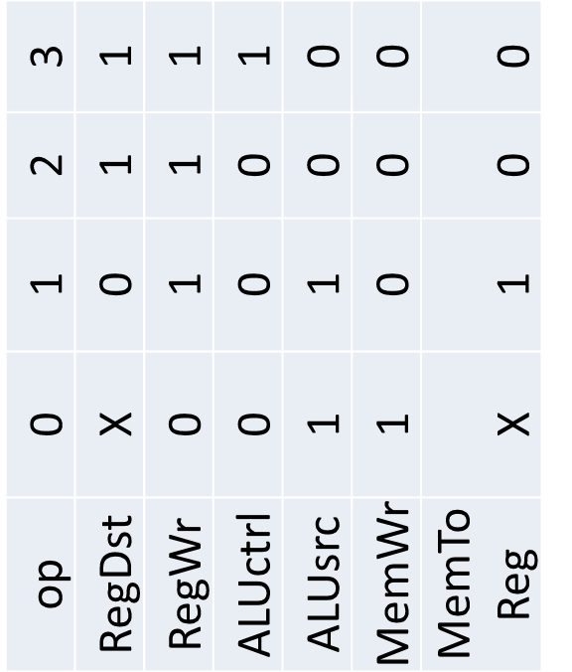
Single Cycle Decode LUT
Human Readable Table
HRT
Op line becomes select
Tada! LUT!
SELECT

Slide 10
Multi Cycle
Multi-Cycle Decoder has to track micro-ops
This becomes a Finite State Machine
…which is also a LUT

Slide 11
Finite State Machines
A group of States and Transitions
Move from one state to another along a transition line when the transition’s conditions are met
Temp <68F
Heater Off
Heater On
Temp >72F

Slide 12
Flying Spaghetti Monsters
In Computer Architecture, FSMs:
Usually transition on a clock edge
Are Complete
All states define transitions for all inputs
Are deterministic (Unless Quantum)
Temp <68F
Heater Off
Heater On
Temp >72F

Slide 13
FSM Implementation
Register to hold current state
Wires to provide inputs (arguments)
Look Up Table(s) to map transitions
Inputs
Control Logic
(LUTs)
Controls
Register
Current State | Inputs | Resulting State
Heater Off | Too Cold | Heater On
Heater Off | --- | Heater Off
Heater On | Too Hot | Heater Off
Heater On | --- | Heater On

Slide 14
All Hail Our Partial FSM
Each Phase becomes an FSM State
Most states have only one transition that is always taken
no conditions
Note the Re-Use!
IFetch
Decode
Op = = 35
Op = = 43
Store 1
Load 1
Store 2
Load 2
Load 3

Slide 15
Process
Enumerate states
Assign Values
Calculate Width
Make a LUT
State | Inputs | Next State
IFetch | X | Decode
Decode | Op==43 | Store 1
Decode | Op==35 | Load 1
Store 1 | X | Store 2
Store 2 | X | IFetch
Load 1 | X | Load 2
Load 2 | X | Load 3
Load 3 | X | IFetch

Slide 16
Process
Enumerate states
Assign Values
Calculate Widths
Make a LUT
State | Inputs | Next State
0 | X | 1
1 | Op==43 | 2
1 | Op==35 | 4
2 | X | 3
3 | X | 0
4 | X | 5
5 | X | 6
6 | X | 0

Slide 17
Process
Enumerate states
Assign Values
Calculate Widths
Make a LUT
State[0:3] | Inputs[0:5] | Next State
0 | X | 1
1 | Op==43 | 2
1 | Op==35 | 4
2 | X | 3
3 | X | 0
4 | X | 5
5 | X | 6
6 | X | 0

Slide 18
2 LUTs 1 State Machine
Control signals only depend on the state
Not the other inputs
“Moore Machine” vs “Mealy Machine”
Split Control Logic in to two separate LUTs
Control Signals: Shallow & Wide
State Updates: Deep and Narrow
Better use of space
What parts can be shared?
Notes:
Mealy Machine: Outputs depend on state AND inputs
Moore Machine: Outputs only depend on state
Destination

Slide 19
Balance
An unbalanced design has some operations doing more “work” (time) than the others
Wastes time in fast cycles
Moving work between operations is Balancing
Reduce the global clock period by leveling
Balance adjacent ops by register positioning
Some ops are hard to “slice”

Slide 20
Example
Instruction has 5 components:
1, 2, 3, 4, and 5 nanoseconds long
In that order
Divide optimally in to 3 operations:
Minimum Clock Period?
How much time is wasted per instruction?

Slide 21
Example
Instruction has 5 components:
1, 2, 3, 4, and 5 nanoseconds long
In that order
Divide optimally in to 3 cycles:
Minimum Clock Period? 6ns
How much time is wasted per instruction? 3ns
{1,2,3}{4}{5}

Slide 22
Balancing
Not all resources are fungible
Some micro-operations are hard to subdivide
Order of operations matters sometimes
The slowest unit sets the pace for everything
Compare “Optimal” time to Reality
Measure of Balance

Slide 23
Example Timings
Instr/Cycle | RTL | Symbolic | Numeric
LW:0 | IR = Mem[PC] | tX1 + tMEM | 10
LW:0 | PC=PC+4 | tX1+tALU+tX2 In Parallel with tX2+tALU+tX2 | 5 5
LW:1 | AB = RegFile[_] | tRF | 3
LW:2 | Res = A + SEI | tALU | 5
LW:3 | DR = Mem[Res] | tX1 + tMEM | 10
LW:4 | RegFile[rt] = DR | tRF+tX1 | 3
Component | Symbol | Delay
ALU | tALU | 5ns
Register File | tRF | 3ns
Instruction/Data Memory | tMEM | 10ns
Muxes (Optional) | tXn | 0ish
Registers | 0 | 0

Slide 24
Bored Work
Finish the HRT for your MultiCycleCPU
Or do it for the example on the next slide
Show the FSM with state transitions
White Board
Create the two LUTs from the HRT+FSM
Use a spreadsheet program for this part

Slide 25
Multi Cycle w/ Controls
MemIn
PCSrc
PC_WE
Mem_WE
IR_WE
ALUSrcA
ALUOp
Concat
IR
PC
WrEn
Addr Dout
Memory
Din
Rs
Rt
Rd
Imm16
SignExtnd
<<2
Aw Ab Aa
Da
Registers
Dw WrEn Db
ALU RES
MDR
A
B
4
Dst
RegIn
Reg_WE
ALUSrcB

Slide 26
Bonus Work
Time your Multicycle design from Monday
Do symbolically first, then substitute real numbers
Remember parallel paths!
Calculate Execution time of a program with
10,000 Instructions
50% Add-like instructions
20% Load, 10% Store, 10% Branch, 10% Jump
Find & Measure one way to improve this
Balancing? Combining Cycles?
Compare to Single Cycle
Notes:
10ns per cycle
4*.5 + 5*.2 + 3*.1 + 2*.1 = 3.5CPI = 350 microseconds

Slide 27
Ultra Bonus Work
Implement Shift-Left-as-a-loop in the decoder
Start Adding!
Draw the FSM, don’t bother with the LUT
How many cycles does it take? Cycle Time?
Shift-With-A-Barrel-Shifter in the ALU
Assume ALU is now 3x slower than before
Just For Giggles
How many cycles does the total instruction take?
New Cycle Time?
What percent of our ALU ops need to be SLL to justify using a hardware barrel shifter?

Slide 28
Addr[31:2]
Addr[1:0]
Instruction
Memory
PC[31:28]
Concatenate
“00”
Target Instr[25:0]
“1”
0 1
PC
Cin
Adder
Instr[31:0]
“0”
SignExtnd
0 1
imm16
Branch
[25:21]
[20:16]
[15:11]
[15:0]
Rs
Rt
Rd
Imm16
Rd
Rt
RegDst
Rs
Rt
ALUcntrl
Zero
MemWr
MemToReg
Aw Aa Ab Da
Dw Db
Register
WrEn File
RegWr
WrEn Addr
Din Dout
Data
Memory
SignExtnd
imm16
ALUSrc
Notes:
Single Cycle CPU

Slide 29
Conclusions?
What was the original balancing penalty?
After Improvement?
How did it compare to Single Cycle?
Where were the gains? Losses?
Decoders decode Operations into MicroOps

