Slide 1
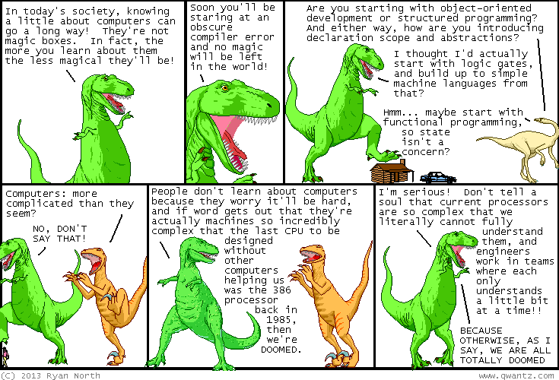

Slide 2
b0000 Zero Day
ENGR xD52
Eric VanWyk
Fall 2014

Slide 3
Agenda
General Awkwardness
Basic Orientation Information
Course Objectives & Details
Eric’s guide to getting an A in CompArch
Boolean Logic

Slide 4
Hi, I’m Eric
VanWyk, Class of ’07

Slide 5
vanweric@gmail.com
Email and IM

Slide 6
MH 353(?)
Rarely… IM/Email me first.

Slide 7
Monday & Thursday 1050-1230 1520-1800

Slide 8
http://wikis.olin.edu/ca/ ca@lists.olin.edu
Feel free to use for discussion!

Slide 9
Times to See Eric
Good Idea
Terrible Idea
By Appointment!
M&R 1330-1500
R 1800->
Just Before Class
I’m busy panicking
1245-1330
Unless you eat with me

Slide 10
Continuous Improvement
Feedback is extremely important
Methods:
Directly approach me in person (my favorite)
Email me
Talk to / Email a NINJA (they can anonymize)
Talk to OSL, your advisor, Jessica, etc

Slide 11
Continuous Improvement
This is my last CA semester (for awhile)
Ben Hill is taking over
He is awesome
We are going to write letters to him
2 Assigned Students per day
Volunteer more as you see fit

Slide 12
What is Computer Architecture?

Slide 13
What is Computer Architecture?
3rd grade math
Modern History
A Need for Speed
Git’r’dun Engineering
Communication

Slide 14
Course Objectives

Slide 15
Learn Digital Logic

Slide 16
Learn Digital Math

Slide 17
Build a Processor

Slide 18
Write Programs for it
In assembly

Slide 19
Build complex digital systems
In Verilog

Slide 20
Course Details

Slide 21
One Midterm
(I am so excited)

Slide 22
No Final

Slide 23
Several Homeworks
Done individually.
Annotate collaboration per problem.

Slide 24
Four Labs
Done in groups of 2 or 3

Slide 25
One Awesome Project
Done in groups of ???

Slide 26
Late Policy:
-10% for first 24 hours
-20% for second (30% total)
-30% for third (60% total)
After 72 hours, no credit.

Slide 27
Unlate Policy
Talk to me or Lyra in person first
Commit to a new due date
Email this new due date to comparch14@gmail.com
Reminder note in your submission email.

Slide 28
Attendance Policy
At your own risk.

Slide 29
How To Get an A in Comp Arch
Do it in human first
Break big problems in to better chunks
Black Boxes!
Learn enough C to know what a pointer is
Pick a fun but appropriately sized final project
Give me constant feedback

Slide 30
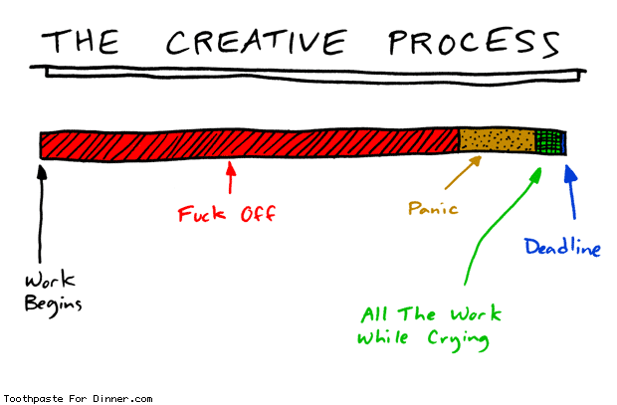
How to Seppuku CompArch
Slack

Slide 31
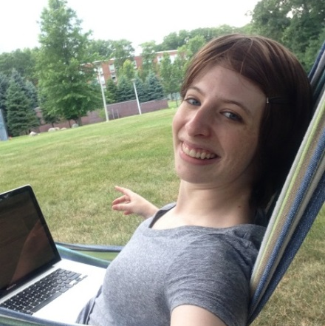

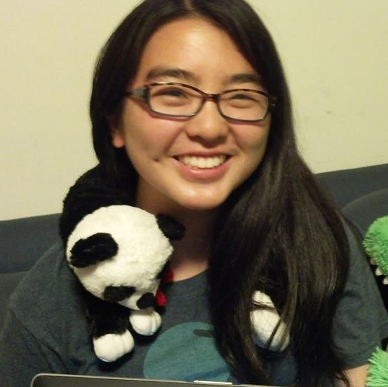
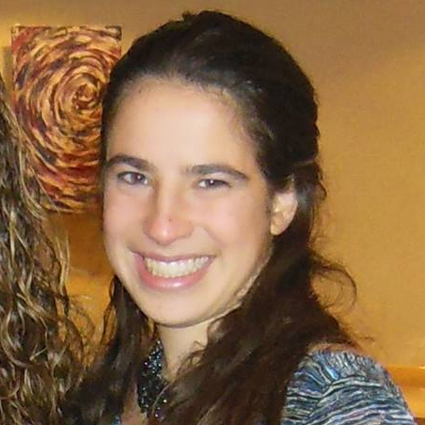
Ninja Team
Lyra Silverwolf
Derek Redfern
Emily Wang
Jamie Gorson

Slide 32
Acknowledgements
Mark L. Chang lecture notes for Computer Architecture (Olin ENGR3410)
Patterson & Hennessy: Book & Lecture Notes
Patterson’s 1997 course notes (U.C. Berkeley CS 152, 1997)
Tom Fountain 2000 course notes (Stanford EE182)
Michael Wahl 2000 lecture notes (U. of Siegen CS 3339)
Ben Dugan 2001 lecture notes (UW-CSE 378)
Professor Scott Hauck lecture notes (UW EE 471)
Mark L. Chang lecture notes for Digital Logic (NWU B01)

Slide 33
Digital Logic

Slide 34


Digital vs. Analog
Digital:
only assumes discrete values
Analog:
values vary over a range
continuously

Slide 35
Binary Logic
Simplest form of Digital Logic
Only two states
True and False
One and Zero
Also called Boolean Logic

Slide 36
Example: Car Electronics
Door ajar light (driver door, passenger door):
High-beam indicator (lights, high beam selected):
Notes:
Door Ajar – OR gate – if either are open, indicate the light
High-beam indicator – AND gate – only light if both are active

Slide 37
Example: Car Electronics (cont.)
Seat Belt Light (driver belt in):
Seat Belt Light (driver belt in, passenger belt in, passenger present):
Notes:
Seat Belt Light – Inverter – bother the user if the belt isn’t engaged

Slide 38
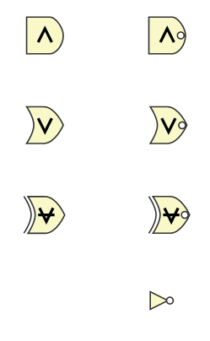
Basic Logic Gates

Slide 39
Basic Logic Gates
AND
NAND
OR
NOR
XOR
(exclusive or)
XNOR
NOT
Notes:
Briefly describe construction from transistors, etc

Slide 40
Boolean Equations
AND: AB A&B
OR: A+B
NOT: A̅ ~A

Slide 41

Basic Boolean Identities:
X + 0 = X * 1 =
X + 1 = X * 0 =
X + X = X * X =
X + X̅ = X * X̅ =
$\overset{̿}{X}$ =
Notes:
X X
1 0
X X
1 0
X

Slide 42

Basic Boolean Identities:
X + 0 = 0 X * 1 = X
X + 1 = 1 X * 0 = 0
X + X = X X * X = X
X + X̅ = 1 X * X̅ = 0
$\overset{̿}{X}$ = X
Notes:
X X
1 0
X X
1 0
X

Slide 43
Basic Laws
Commutative Law:
X + Y = Y + X XY = YX
Associative Law:
X+(Y+Z) = (X+Y)+Z X(YZ)=(XY)Z
Distributive Law:
X(Y+Z) = XY + XZ X+YZ = (X+Y)(X+Z)

Slide 44
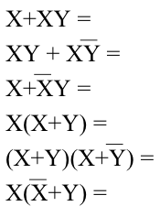

Advanced Laws
X + 0 = X X * 1 = X
X + 1 = 1 X * 0 = 0
X + X = X X * X = X
X + X̅ = 1 X * X̅ = 0
$\overset{̿}{X}$ = X
X(Y+Z) = XY+XZ X+YZ=(X+Y)(X+Z)
Notes:
X
X
X+Y
X
X
XY XY

Slide 45
Homework for Monday
Answer these question:
Why are you taking this class?
What is your favorite processor? Why?
Name at least 3 things you want to learn in this class: Be specific!
What do you want to do with what you learn here after graduation? Prognosticate!
Email them to CompArch14@gmail.com
Subject [HW0] Your Name

Slide 46
Homework Coming Soon
Install ModelSim
Install Xilinx tool chain
Ninjas will help you with this

