Slide 1
b1010 Assembly
ENGR xD52
Eric VanWyk
Fall 2013

Slide 2
Acknowledgements
Derek Redfern
Alethea Butler

Slide 3
Today
Review Encodings
Context of Assembly
Your First Assembly Programs

Slide 4
Limited Encoding Example
Create a 16 / 24 bit encoding
Needs to be able to:
Math
Branch if Zero
Jump
Load
Store
Load Immediate
What to trim?

Slide 5
My Choices
Drop all immediate compound instructions
ADD w/ Immediate becomes 2 ops:
Load Immediate
Add w/ 2 Registers
Reduce to 16 registers
Combine Target and Source Register Address
A=A+B instead of A=B+C

Slide 6
Load Immediate
15
14
13
12
11
10
09
08
07
06
05
04
03
02
01
00
OP is 00
POS indicates where IMM is placed
00 → Bottom 12 bits
01 → Next 12 Bits
10 → Top 8 bits
11 → Bottom 12 bits, preserve other 20
Always placed in register 0
0 0
POS
IMM12

Slide 7
Math
15
14
13
12
11
10
09
08
07
06
05
04
03
02
01
00
OP is 01
RSD is target and first operand
RT is second operand
FUNCT enumerates specific op
Add, Sub, And, Or, etc
Up to 64 ops
0 1
RSD
RT
FUNCT

Slide 8
Branch and Jump
15
14
13
12
11
10
09
08
07
06
05
04
03
02
01
00
Same encoding as Math
RSD is test register
If equal to zero, branch
RT stores the destination
FUNCT:
Branch, Absolute
Branch, Relative
Jump, Absolute
1 0
RSD
RT
FUNCT

Slide 9
Load and Store
15
14
13
12
11
10
09
08
07
06
05
04
03
02
01
00
OP is 11
RSD stores address of register with data memory address
RT stores address to be read from / written to
FUNCT
Load, Store
1 1
RSD
RT
FUNCT

Slide 10
How did I do?
ADD w/ Immediate is now 4 operations
Load first 12 bits of immediate to Reg 0
Load next 12
Load final 8
Add
Might need additional moves
Where was data before?
Where should it end up?

Slide 11
How did I do?
Encoding is really “loose”
Maybe I cut too many things?
OP could be 1 bit:
Is this load immediate?
FUNCT has 64 options, plenty of space

Slide 12
TL;DR;
Simpler Instructions, but more of them
What is important?
Execution Speed
Transistor count
Memory size
Package pin count

Slide 13
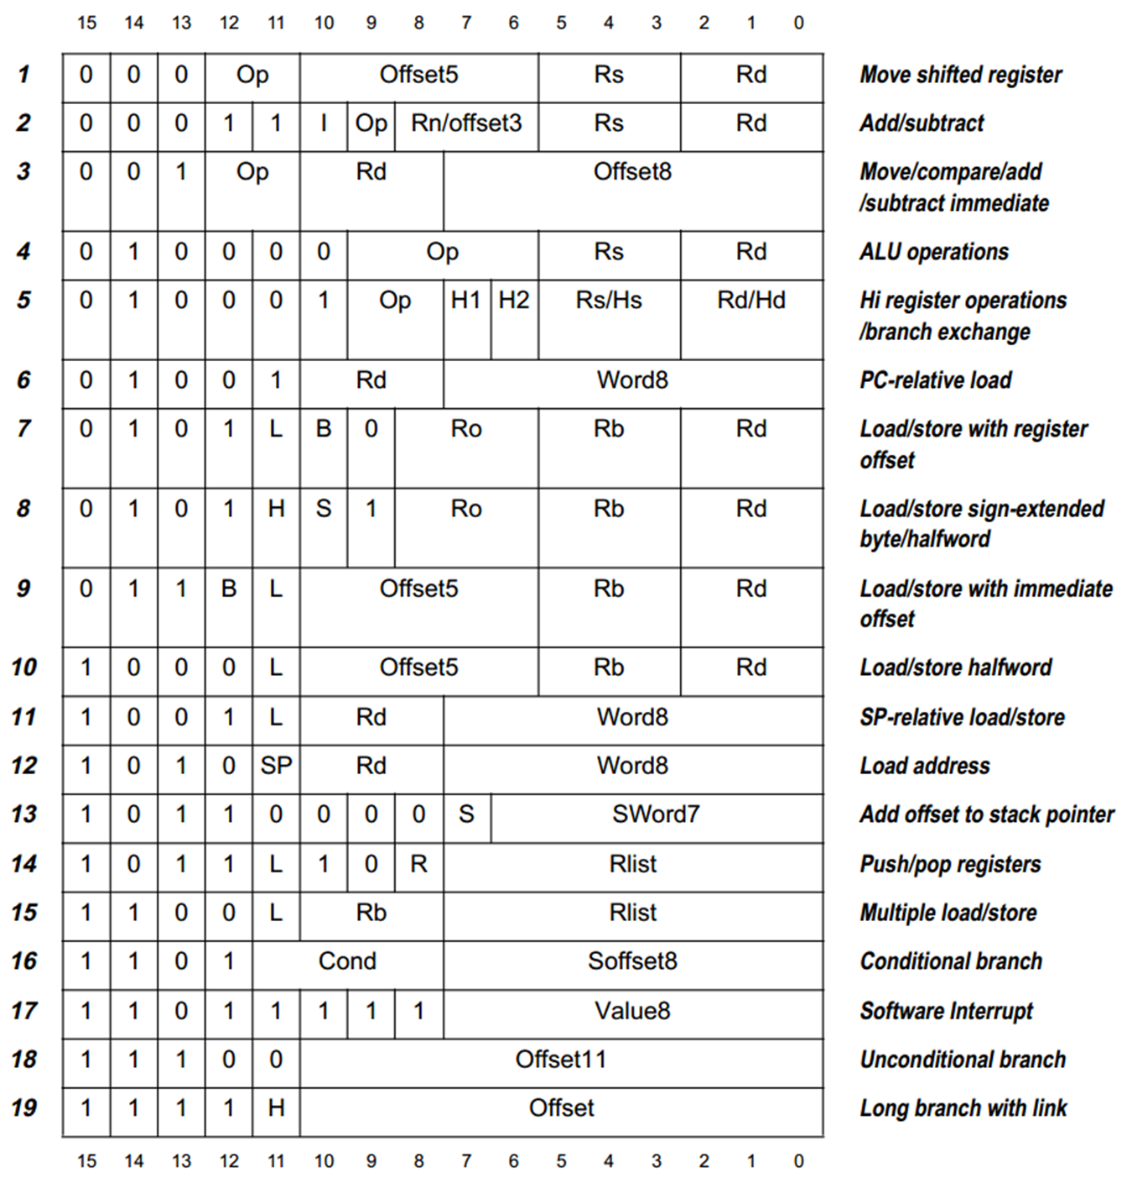
Thumb (1) 16 bit Encoding

Slide 14
What is Assembly?
Assembly is the lowest level language that humans routinely deal with
Simple, regular instructions
building blocks of C & other languages
One-to-one mapping to machine language
… Usually

Slide 15
What is Assembly?
Instruction
Fetch
It is how we feed steps 1 & 2
Instruction
Decode
Operand
Fetch
Execute
Result
Store
Next
Instruction

Slide 16
Why Shouldn’t I learn Assembly?
Writing in Assembly is usually slower than writing in other languages
Time to Market!
Assembly is not portable
Specific to a processor (family)
Modern Compilers are pretty darn good

Slide 17
Why Should I Learn Assembly?
Someone has to write those compilers…
Hand Optimized Assembly can be wicked fast
Reading Assembly >>> Writing Assembly
Good practice for designing VMs/protocols
Initializing an embedded system
Setting up Memory, Transitioning execution…

Slide 18
Why Should I Learn Assembly?
It will make you a better software architect
Optimize from the top down

Slide 19
How should I learn Assembly?
Generically!
With a cheat sheet in hand
Do Not Memorize Specifics

Slide 20
“C is Built On Assembly”
WRONG
C is built on Machine Code
Machine Code can be decompiled to Assembly
Assembly -> Machine Code -> Assembly loses relatively little information
Notes:
The only information lost in Assembly -> Machine Code -> Assembly are the human-readable location labels and comments.

Slide 21
MIPS Assembly Language
The basic instructions have four components:
Operator name
Destination
1st operand
2nd operand
add <dst>, <src1>, <src2> # <dst> = <src1> + <src2>
sub <dst>, <src1>, <src2> # <dst> = <src1> - <src2>
Simple format: easy to implement in hardware
More complex: A = B + C + D – E

Slide 22
Register File Allocation
Register | Name | Function | Comment
$0 | $zero | Always 0 | No-op on write
$1 | $at | Reserved for assembler | Don’t use it!
$2-3 | $v0-v1 | Function return
$4-7 | $a0-a3 | Function call parameters
$8-15 | $t0-t7 | Volatile temporaries | Not saved on call
$16-23 | $s0-s7 | Temporaries (saved across calls) | Saved on call
$24-25 | $t8-t9 | Volatile temporaries | Not saved on call
$26-27 | $k0-k1 | Reserved kernel/OS | Don’t use them
$28 | $gp | Pointer to global data area
$29 | $sp | Stack pointer
$30 | $fp | Frame pointer
$31 | $ra | Function return address

Slide 23
Register File Allocation
Register | Name | Function | Comment
$0 | $zero | Always 0 | No-op on write
$1 | $at | Reserved for assembler | Don’t use it!
$2-3 | $v0-v1 | Function return
$4-7 | $a0-a3 | Function call parameters
$8-15 | $t0-t7 | Volatile temporaries | Not saved on call
$16-23 | $s0-s7 | Temporaries (saved across calls) | Saved on call
$24-25 | $t8-t9 | Volatile temporaries | Not saved on call
$26-27 | $k0-k1 | Reserved kernel/OS | Don’t use them
$28 | $gp | Pointer to global data area
$29 | $sp | Stack pointer
$30 | $fp | Frame pointer
$31 | $ra | Function return address
STOP MEMORIZING THIS

Slide 24
Register File Allocation Redux
0 is $zero is 0x00000000
The only physically special address
Specific to MIPS!
The other 31 are all interchangeable
But we treat them differently for convenience
For today, we’ll use $t0 through $t9

Slide 25
Basic Operations
Mathematic: add, sub, mul, div add $t0, $t1, $t2 # t0 = t1+t2
Unsigned (changes overflow condition) addu $t0, $t1, $t2 # t0 = t1+t2
Immediate (one input a constant) addi $t0, $t1, 100 # t0 = t1+100
Logical: and, or, nor, xor and $t0, $t1, $t2 # t0 = t1&t2
Immediate andi $t0, $t1, 7 # t0 = t1&b0111
Shift: left & right logical, arithmetic sllv $t0, $t1, $t2 # t0 = t1<<t2
Immediate sll $t0, $t1, 6 # t0 = t1<<6
Notes:
Wikipedia has a pretty clear reference for MIPS: http://en.wikipedia.org/w/index.php?title=MIPS_architecture&oldid=521742082#MIPS_assembly_language
Also http://www.mrc.uidaho.edu/mrc/people/jff/digital/MIPSir.html is very good.

Slide 26
Basic Operations
Mathematic: add, sub, mul, div add $t0, $t1, $t2 # t0 = t1+t2
Unsigned (changes overflow condition) addu $t0, $t1, $t2 # t0 = t1+t2
Immediate (one input a constant) addi $t0, $t1, 100 # t0 = t1+100
Logical: and, or, nor, xor and $t0, $t1, $t2 # t0 = t1&t2
Immediate andi $t0, $t1, 7 # t0 = t1&b0111
Shift: left & right logical, arithmetic sllv $t0, $t1, $t2 # t0 = t1<<t2
Immediate sll $t0, $t1, 6 # t0 = t1<<6
Use A Cheat Sheet For These

Slide 27
Our First Assembly Program
Average Four Numbers
$t5 = ($t0 + $t1 + $t2 + $t3)/4
How do we write this in MIPS Assembly?

Slide 28
Our First Assembly Program
$t5 = ($t0 + $t1 + $t2 + $t3)/4
add $t5, $t0, $t1 # $t5 = $t0 + $t1
add $t5, $t5, $t2 # $t5 += $t2
add $t5, $t5, $t3 # $t5 += $t3
??? $t5, $t5, 2 # $t5 /= 4
Which Shift do we use?
What assumptions are we making for the inputs?
Notes:
Shift Right Logical – srl
Shift Right Arithmatic – sra
Answer: We’re assuming that the inputs are integers, and that they’re all small enough that summing them won’t cause an overflow. Also, the choice of shift indicates signed vs unsigned

Slide 29
Jumping and Branching
Review:
Jumps change the Program Counter, period.
Branches check a condition and optionally jump.
Needs a target location or offset to go to/by
Calculating jump locations by hand is boring
Let the Assembler do it for us!
Use Labels

Slide 30
Jumping / Branching Example
if (a ==b)
a+=3
else
b+=7
c=a+b
A simple example to show case jumping and branching

Slide 31
Jumping / Branching Example
if (a==b)
a+=3;
ELSEIF:
b+=7;
ENDIF:
c=a+b
Add labels to indicate our branch / jump targets

Slide 32
Jumping / Branching Example
if (a !=b) goto ELSEIF
a+=3;
goto ENDIF
ELSEIF:
b+=7;
ENDIF:
c=a+b
Rewrite our if statements
If (x) do y becomes
If (~x) skip y

Slide 33
Jumping / Branching Example
bne a, b, ELSEIF
a+=3;
j ENDIF
ELSEIF:
b+=7;
ENDIF:
c=a+b
Use specific jump and branch operations

Slide 34
Jumping / Branching Example
bne a, b, ELSEIF
add a, a, 3
j ENDIF
ELSEIF:
add b, b, 7
ENDIF:
add c, a, b
Translate remaining code
Todo:
Assign registers to a,b,c
Human Job
Calculate offsets
Assembler Job

Slide 35
Desk/Board Work
Download MARS
http://courses.missouristate.edu/kenvollmar/mars/
http://goo.gl/mOsZ8
Open the environment, start writing assembly
Hint: Work through the process methodically

Slide 36
Desk/Board Work
Calculate the Sum of integers [0,N]
Calculate Nth Fibonacci Number
Hints:
N starts in $a0, put answer in $v0
Use $t0-$t9 as temporary storage
Set initial conditions with add <dest>, $zero, value
Comment with #
Bonus:
Multiply without using mul, mult, etc
Find Square Root (with a Nope Loop? binary search?)
Find Nth Prime

Slide 37
Fibonacci Solution with Loops
#assume N>=2
addi $t0, $zero, 1 #F_(n-1)
addi $t1, $zero, 1 #F_(n-2)
addi $t2, $zero, 2 #n
#t3 is F_n
loop:
add $t3,$t0,$t1 #F_n=F_(n-1)+F_(n-2)
beq $t2,$a0,breakloop #if (n==N) goto breakloop;
addi $t2,$t2,1 #n++
add $t1,$zero,$t0 #F_(n-2)=F_(n-1)
add $t0,$zero,$t3 #F_(n-1)=F_n
j loop #restart loop
breakloop:
add $v0,$zero,$t3 #return the answer

Slide 38
Memory Organization
Lets talk to Data Memory!
Viewed as an 1-dimension array
Memory address indexes into array
Byte Addressable:
8 bits of data per address
0
8 bits of data
1
8 bits of data
2
8 bits of data
3
8 bits of data
4
8 bits of data
5
8 bits of data
6
8 bits of data
...

Slide 39
Memory Organization
Bytes are nice, but our registers are "words"
For MIPS, a word is 32 bits or 4 bytes.
2³² bytes with byte addresses from 0 to 2³²-1
2³⁰ words with byte addresses 0, 4, 8, ... 2³²-4
0
32 bits of data
4
32 bits of data
Our registers hold 32 bits of data
8
32 bits of data
12
32 bits of data
...

Slide 40
Loads & Stores
Loads & Stores move words between memory and registers
All operations on registers, but too small to hold all data
lw $t0, $t1 # $t0 = Memory[$t1]
sw $t2, $t3 # Memory[$t3] = $t2
Note: lbu & sb load & store bytes
General
Purpose
Registers
Load
Memory
12:
140:
t0:
t1:
t2:
t3:
124
Store
723
66
4

Slide 41
Word Alignment
Require that objects fall on an address that is a multiple of their size
What are the last two bits of a 32-bit word aligned address?
0 1 2 3
Aligned
Not
Aligned
Notes:
The last two bits of a 32-bit word aligned address will always be zero.

Slide 42
Array Example
/* Swap the kth and (k+1)th element of an array */
swap(int v[], int k)
{
int temp = v[k];
v[k] = v[k+1];
v[k+1] = temp;
}
# Assume v in $a0,
k in $a1
General
Purpose
Registers
Memory
Load
1000
0A12170D
1004
11111111
a0:
a1:
t0:
t1:
t2:
964
1008
00000000
10
Store
1012
0F0F0F0F
1016
FFFFFFFF
1020
FFFFFFFF

Slide 43
Array Example
/* Swap the kth and (k+1)th element of an array */
swap(int v[], int k)
{
load v[k] into temp0
load v[k+1] into temp1
store temp0 into v[k+1]
store temp1 into v[k]
}
# Assume v in $a0,
k in $a1
Convert array operations in to load / store operations
Why do we need temp1?
Why wasn’t it in the C code?

Slide 44
Array Example
/* Swap the kth and (k+1)th element of an array */
swap(int v[], int k)
{
address0 = v+k*4
address1 = address0 + 4
load address0 into temp0
load address1 into temp1
store temp0 into address1
store temp1 into address0
}
# Assume v in $a0,
k in $a1
Calculate memory address of v[k] as
v + k * sizeof(int)
v + k * 4

Slide 45
Array Example
/* Swap the kth and (k+1)th element of an array */
swap(int v[], int k)
{
address0 = k*4
address0+= v
address1 = address0 + 4
load address0 into temp0
load address1 into temp1
store temp0 into address1
store temp1 into address0
}
# Assume v in $a0,
k in $a1
Expand math for calculating address0

Slide 46
Array Example
/* Swap the kth and (k+1)th element of an array */
swap(int v[], int k)
{
sll address0, k, 2
add address0, address0, v
add address1, address0, 4
lw temp0, (address0)
lw temp1, (address1)
sw temp0, (address1)
sw temp1, (address0)
}
# Assume v in $a0,
k in $a1
Replace with actual instructions
sll – shift left
lw – load word
sw – store word
Todo:
Assign Registers

Slide 47
Array Example
/* Swap the kth and (k+1)th element of an array */
swap(int v[], int k)
{
sll address0, k, 2
add address0, address0, v
add address1, address0, 4
lw temp0, (address0)
lw temp1, (address1)
sw temp0, (address1)
sw temp1, (address0)
}
# Assume v in $a0,
k in $a1
/* Swap the kth and (k+1)th element of an array */
swap(int v[], int k)
{
int temp = v[k];
v[k] = v[k+1];
v[k+1] = temp;
}
# Assume v in $a0,
k in $a1

Slide 48
Remainder of Class
Write one final exam question
Practice Assembly
Can you reverse an array?
Can you sort an array?
How do you multiply in IQ?
Signed? Unsigned?
Calculate a Polynomial?
Work on Lab
Hint: Prepopulating Arrays
… code code code…
lw $t0, array1($t1)
…snip moar code…
.data
array1
0x12345678 #element0
0x23456789 #element1
…

Slide 49
IQ in Assembly
Total number of bits is usually:
Full Word (I+Q=32)
Half Word (I+Q=16)
Add/Sub are very easy
Use Integer operations unchanged
Multiplication is mildly tricky
May require additional operations
Division is a pain

Slide 50
IQ in Assembly
How do you Multiply?
Integer Multiplication
Shift it back in place
Overflow?
For now, use I8Q8 sign extended
Top 16 bits are all zero or all one

Slide 51
IQ in Assembly
Multiply U8Q8 x U8Q8
Becomes U16Q16
Shift by 8
Becomes U16Q8 with 16 leading zero bits
And 0x0000FFFF
Becomes U8Q8 with 16 leading zero bits

