Slide 1
b1011 Processor to Processor
ENGR xD52
Eric VanWyk
Fall 2014

Slide 2
Today
Allow our Processors out into the wild!
This is an experimental lecture
Time for HW4 at End

Slide 3
… but first
EMAIL ALL OF US
NOT JUST LYRA
IT MAKES LYRA SAD
IT MAKES YOU SLOW

Slide 4
Check In
We’ve glanced at the full stack
Gates -> Sub-systems -> Processor -> Code
How do we talk to the rest of the world?
Example: Analog to Digital Converter

Slide 5
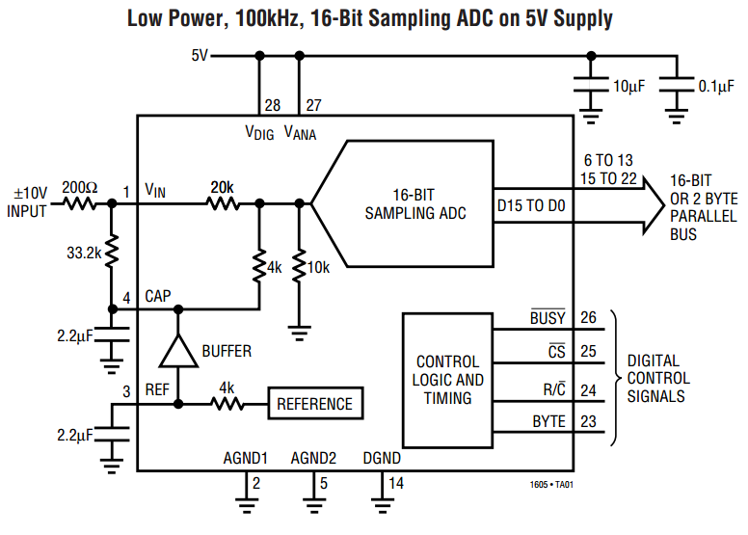
LTC1605

Slide 6
LTC1605

Slide 7
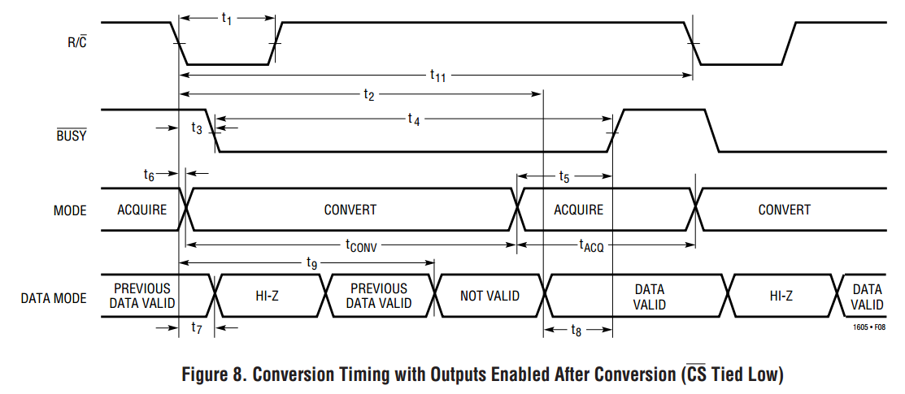
Timing Diagram

Slide 8
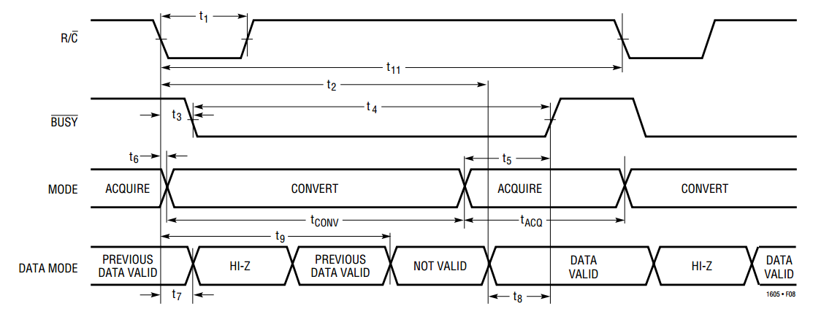
Timing Diagram
Conversion begins when R/C goes low
Busy is asserted
Data becomes INVALID

Slide 9
Timing Diagram
Conversion Finishes
Data becomes valid
Wait a moment
Busy is de-asserted

Slide 10
Timing Diagram
Invalid Data
Recall lecture 2: Timing and Latches
Hi-Z
Nothing asserted, line floats.

Slide 11
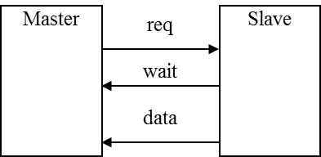
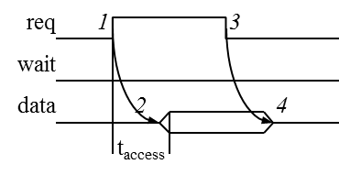
Generic Parallel Access (Fast)
Master Requests Data
Slave responds with data within Access Time
Master reads Data, finishes Request
Slave ready for next request

Slide 12
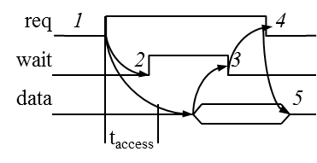
Generic Parallel Access (Slow)
Master Requests Data
Slave is too slow to respond within Access Time, Asserts WAIT
Slave deasserts wait after providing data
Master receives, stops request
Slave ready for next request

Slide 13
Parallel Port
N Data Pins
Control Pins:
Request Behaviors
Indicate Readiness
What if we need more Data?
Add More Pins ☹

Slide 14
Pseudo Parallel Port
D Flip Flops to re-use existing Data Pins
Total Controlled Bits:
D Data Pins
L Latch Pins
DL Total

Slide 15
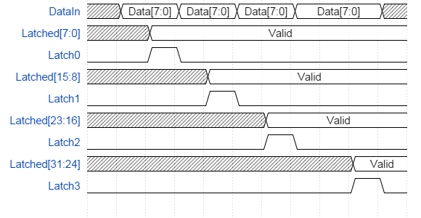
Pseudo Parallel Port
Notes:
{signal: [
{name: 'DataIn', wave: 'x2.2.2.2..x', data: 'Data[7:0] Data[7:0] Data[7:0] Data[7:0] '},
{name: 'Latched[7:0]', wave: 'x.2........', data: 'Valid'},
{name: 'Latch0', wave:'0.10.......'},
{name: 'Latched[15:8]', wave: 'x...2......', data: 'Valid'},
{name: 'Latch1', wave:'0...10.....'},
{name: 'Latched[23:16]', wave: 'x.....2....', data: 'Valid'},
{name: 'Latch2', wave:'0.....10...'},
{name: 'Latched[31:24]', wave: 'xxxcxxxxx2.', data: 'Valid'},
{name: 'Latch3', wave:'0........10'},
{},
]}

Slide 16
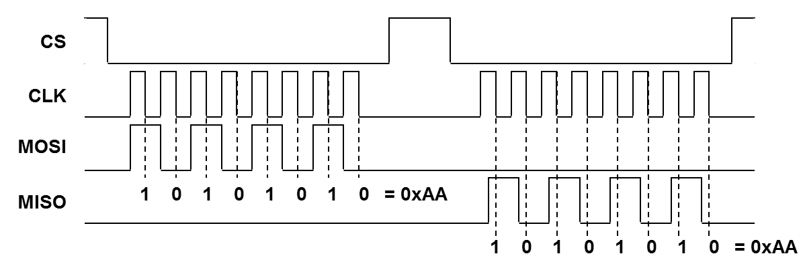
Serial Peripheral Interface
One data pin per direction
MOSI – Master Out Slave In
MISO – Master In Slave Out
One Clock Pin
Replaces all of the Latch Pins
Chip Select
Tells a peripheral we’re talking to it
One bit of data per clock strobe

Slide 17
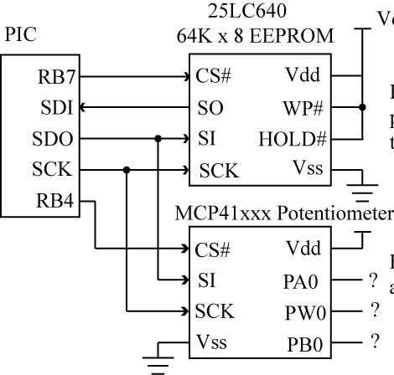
Multiple Peripherals require individual Chip Select

Slide 18
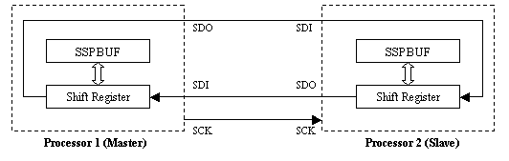
Implementation
Basically, Shift Registers

Slide 19
UART
Universal Asynchronous Receiver Transmitter
One Data Pin per Direction
Inconsistently Named
Rx? Tx?
No Clock Pin!

Slide 20
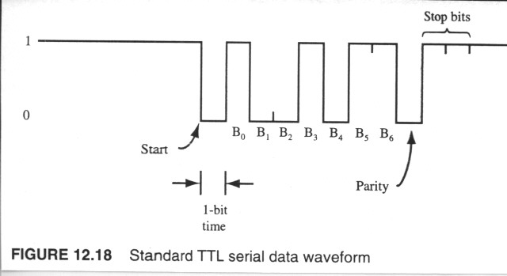
UART Clocking
No Explicit Clock
Instead, agree on speed and hope for the best
Notes:
http://www.ee.nthu.edu.tw/jcliao/mic97/chap12R/showCh12R.htm

Slide 21
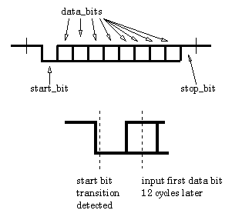
UART Clocking
Starts High
Drops low to start
Start Bit
Data Bits are sent
Remains High to recover
Stop Bit(s)
Receiver measures data halfway through each bit
In case of clock error
1.5 Bit Times

Slide 22
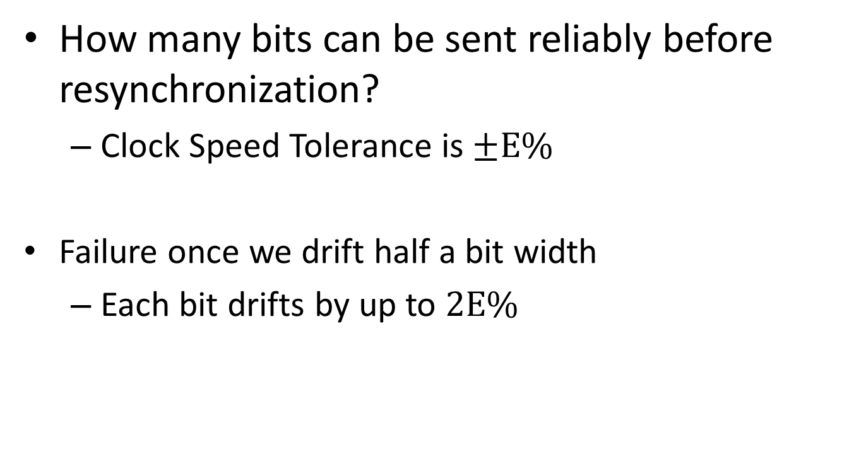

UART Clock Error
How many bits can be sent reliably before resynchronization?
Clock Speed Tolerance is $±E\%$
Failure once we drift half a bit width
Each bit drifts by up to $2Ε\%$
“Correct” Sampling Time
Drifted Sampling Time
Failure after $\frac{1}{4Ε\%}$ Bit Widths

Slide 23
Serial Vs Parallel
Parallel
Serial
One Word at a time
Cheaper Logic
Fast for short distances
Many bits per clock
One Bit at a time
Cheaper Wiring
Fast for long distances
Faster Clock possible
Distance affects maximum clock rate:
Capacitance affects slew time
Slowly charge wire, delays stability
Wire length mismatch creates skew time
Some signals arrive sooner than others
Parallel wires create extra capacitance
Parallel is more affected than Serial

Slide 24
Bi-Directionality
So far, every pin has a defined direction
This can be done with normal gates!
To do bidirectional, we need new equipment

Slide 25
Lets get PHYsical
PHY interfaces logic with the physical world
Needed whenever we go “off chip”
Simplest PHY is an inverter.
Orientation determines input vs output

Slide 26
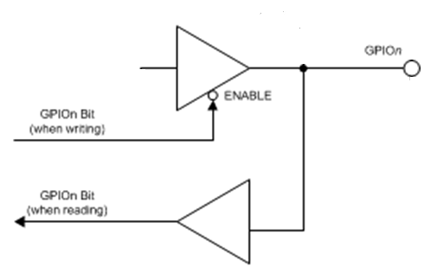
GPIO
Input is a Buffer
Cleans signal for internal logic
Output Tri-State Buffer
Can “release” the line
Only asserts when enabled

Slide 27
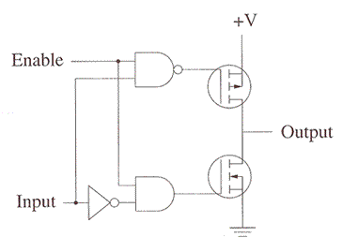
TriState Buffer
When Enable is true, acts like a normal buffer
PFET on for Input = 1
NFET on for Input = 0
When Enable is false, doesn’t assert a state
Neither FET is on
Output “Floats”
Output = Z or Hi-Z
http://www-mdp.eng.cam.ac.uk/web/library/enginfo/mdp_micro/lecture1/lecture1-5-4.html

Slide 28
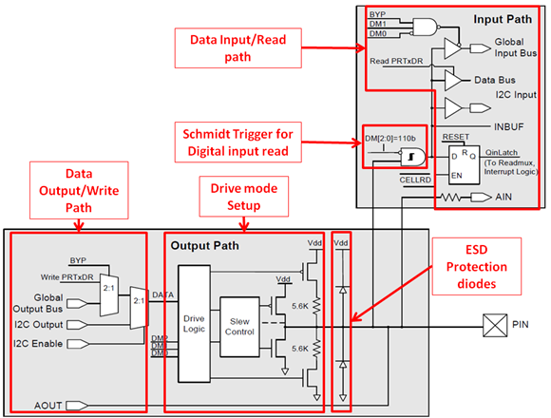
PSOC GPIO Structure
http://www.cypress.com/

Slide 29
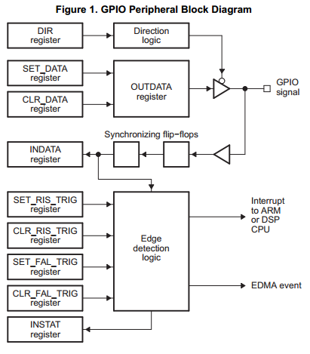
http://www.ti.com/lit/ug/sprueq8a/sprueq8a.pdf
Notes:
TMS320DM646x GPIO structure

Slide 30
I2C = Inter-Integrated Circuit
Two Wire Serial Protocol
SDA = Serial DAta
SCL = Serial Clock
7 bit addressing: Up to 127 devices per bus
… unless capacitance kills you (400pF nom max)

Slide 31
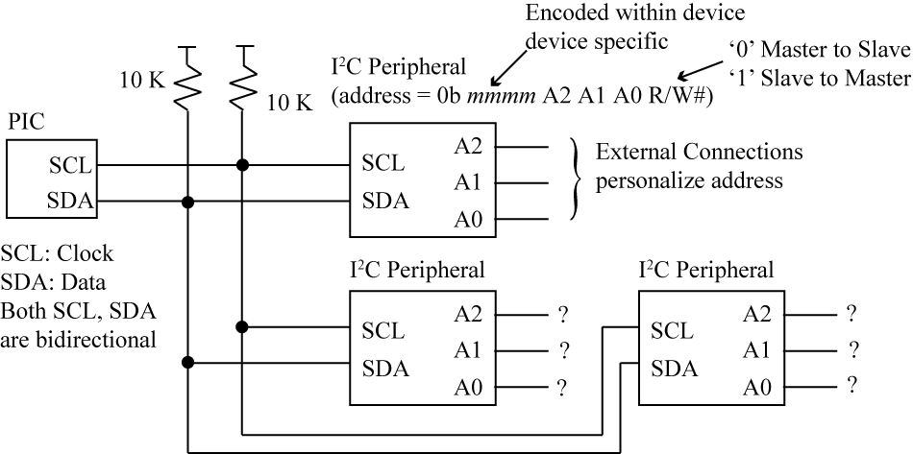
Whose Line is it, Anyway?
No Chip Select Lines
Each message has an address preamble
If it isn’t for you, ignore it.

Slide 32
Bidirectionality
Lines have Pullup Resistors
Gently pulls it to VDD
Default state is 1
Devices yank to ground to assert a zero
If no one asserts 0, it is a 1
This is called “Open Drain”

Slide 33
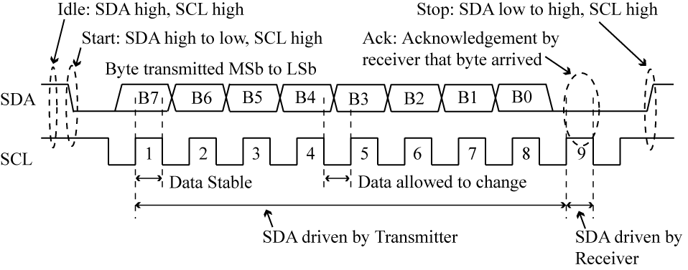
I2C Bus Transfer
Multiple bytes sent in a transaction; every 8 bits has a 9th bit that is an acknowledge.

Slide 34
I2C
Pull-Ups limit max clock frequency
VERY sensitive to total capacitance
400pF max
Slower than other serial protocols
100kHz Normal, 400kHz Enhanced
Higher R, Slower max frequency
Lower R, Higher power dissipation
Addresses can be a pain!
Not all bits are definable
Overlap happens more often than you’d expect!

Slide 35
CAN – Controller Area Network
Typically found in Vehicles, Robots
1 Megabit per Second, 11 bit addressing
Dominant / Recessive Signalling
No Separate Clock Signal

Slide 36
CAN - Dominance
Like I2C, Dominant vs Recessive
Requires a separate PHY chip
To Assert:
Pull CAN HI up
Pull CAN LO down
Otherwise, resistor pulls two wires back

Slide 37
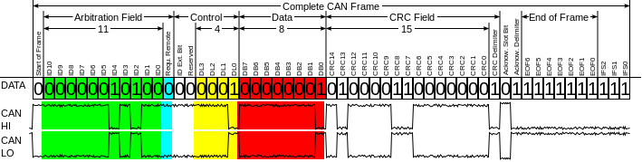
CAN - Frame
Green – Address
Yellow – Data Length in Bytes
Red – Actual Data

Slide 38
TL;DR;
Data Width
Parallel
Serial
Timing:
Explicit / Shared Clock
Assumed Clock
Clock Recovery
Asynchronous (Ick)
Targets
One to One
Broadcast with Address
Broadcast with Select
PHY
GPIO?
Explicit PHY

Slide 39
Memory Mapped Peripherals
Pretend that Peripherals are weird Memory
Registers that control peripherals are write-only memory addresses
Registers that receive data are read-only
Following Slides are derived from http://www.ti.com/lit/ug/sprugp2a/sprugp2a.pdf

Slide 40
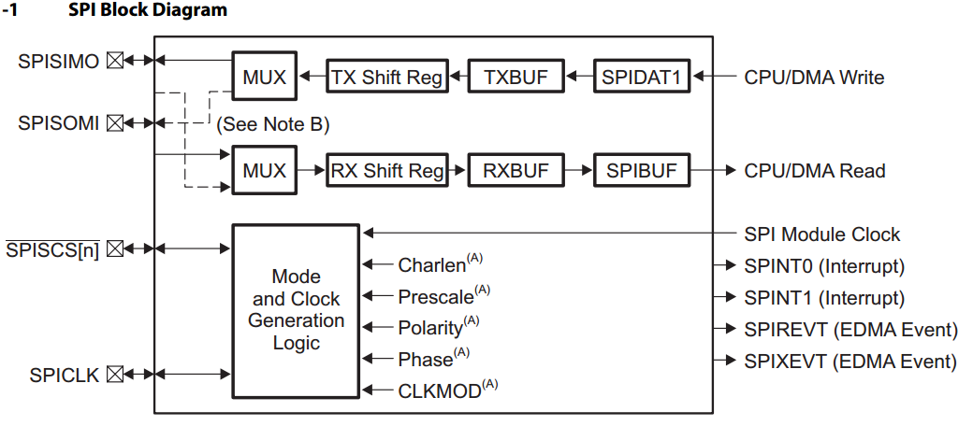

Slide 41
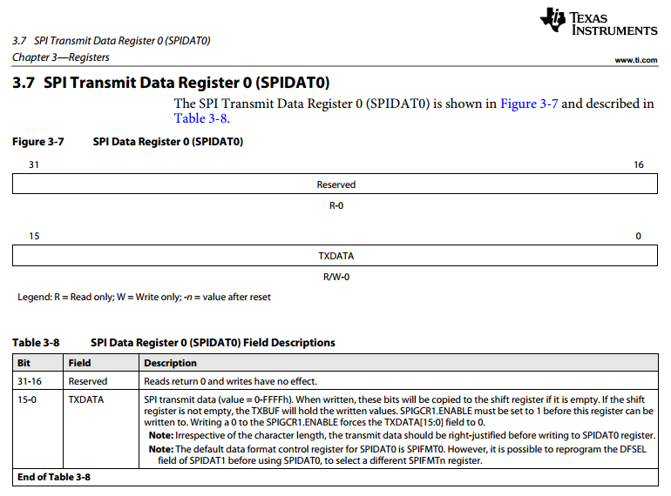

Slide 42
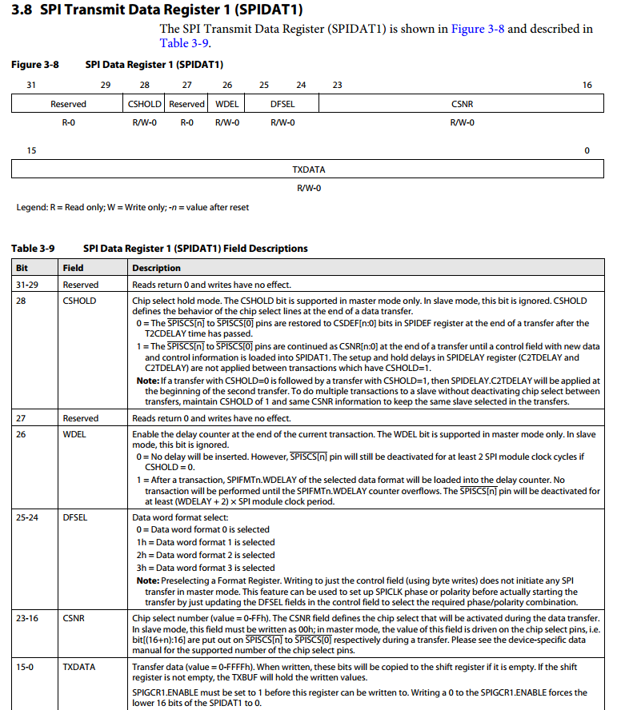

Slide 43
HW4
Behavioral Behavioral Behavioral
First 6 Deliverables should take <2 Hour Total
Unless you are doing them wrong ☹

Slide 44
Registers
Deliverable 1
Use DFF as a component
Don’t draw its implementation
Deliverable 2
Copy paste, add 14 characters
Deliverable 3
Copy paste, “Assign _____ = 0”

Slide 45
Test Bench
Xxxx = 42?
YUP

Slide 46
With Remaining Time
Work On HW4

Slide 47
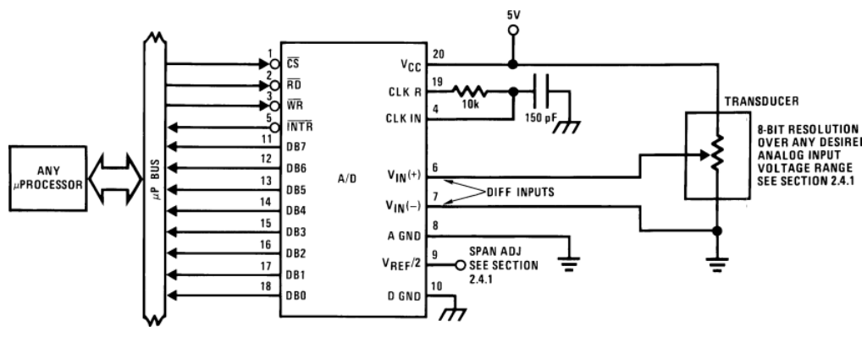
ADC0803
8 Bit Differential ADC
135ns Sample Time

Slide 48
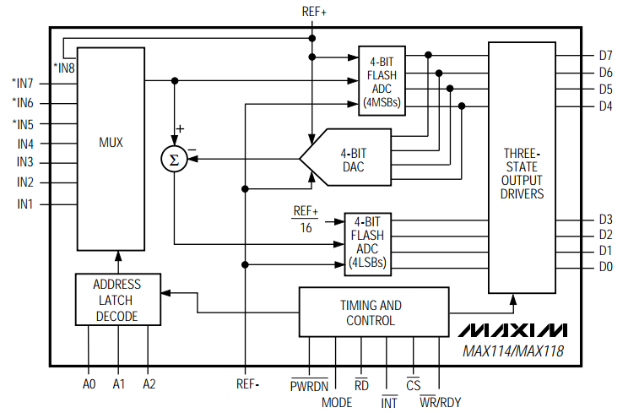
MAX114/MAX118

Slide 49
DB[7:0] – Data Bits
RD – Pull low to begin reading
INT – Pulled low to indicate conversion finish

Slide 50
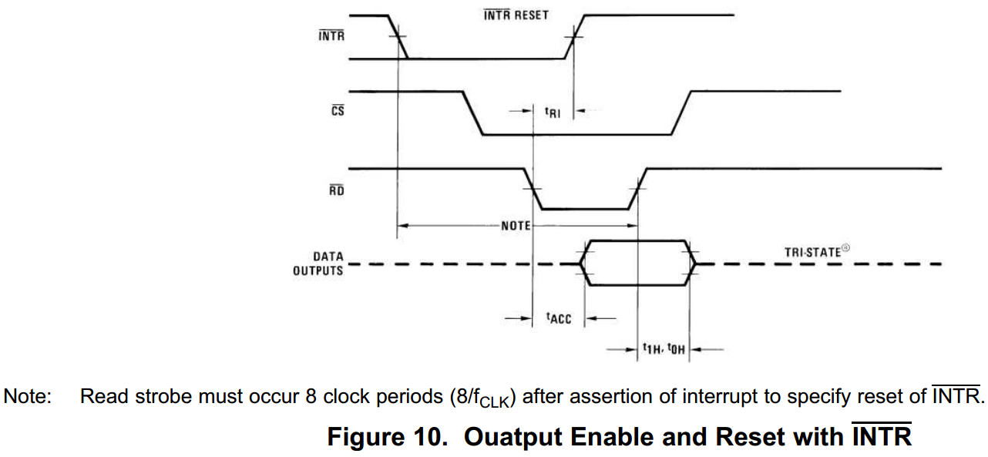
Timing Diagram

Slide 51
Instruction Mapped Peripheral

