Slide 1
b1100 Finite State Machines
ENGR xD52
Eric VanWyk
Fall 2014

Slide 2
Acknowledgements
BYU ECEn 224: http://ece224web.groups.et.byu.net/lectures/A3%20VERILOG.pdf
Y. N. Patt, UT Austin EE382N Verilog Manual: http://users.ece.utexas.edu/~patt/04s.382N/tutorial/verilog_manual.html
Asic World: Verilog Behavioral Modeling: http://www.asic-world.com/verilog/vbehave1.html
Nestoras Tzartzanis, USC EE577b – Verilog for Behavioral Modeling: http://www-scf.usc.edu/~ee577/tutorial/verilog/verilog_lec.pdf
Vishwani Agrawal, ELEC 2200-001 – Digital Logic Circuits
Mike Chen, Finite State Machines

Slide 3
Today
Finite State Machines
Encodings
Behavioral
MP2

Slide 4
Finite State Machines
A group of States and Transitions
Move from one state to another along a transition line when the transition’s conditions are met
Temp <68F
Heater Off
Heater On
Temp >72F

Slide 5
Flying Spaghetti Monsters
In Computer Architecture, FSMs:
Usually transition on a clock edge
Are Complete
All states define transitions for all inputs
Are deterministic (Unless Quantum)
Temp <68F
Heater Off
Heater On
Temp >72F

Slide 6
FSM Implementation
Register to hold current state
Wires to provide inputs (arguments)
Look Up Table(s) to map transitions
Inputs
Control Logic
(LUTs)
Controls
Register
(State)
Current State | Inputs | Resulting State
Heater Off | Too Cold | Heater On
Heater Off | --- | Heater Off
Heater On | Too Hot | Heater Off
Heater On | --- | Heater On

Slide 7
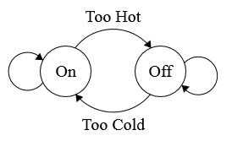
Transitions -> LUT
Current State | Inputs | Resulting State
Heater Off | Too Cold | Heater On
Heater Off | --- | Heater Off
Heater On | Too Hot | Heater Off
Heater On | --- | Heater On
State | Cold? | Hot? | Next State
Off | Yes | Yes | X
Off | Yes | No | On
Off | No | Yes | Off
Off | No | No | Off
On | Yes | Yes | X
On | Yes | No | On
On | No | Yes | Off
On | No | No | On

Slide 8
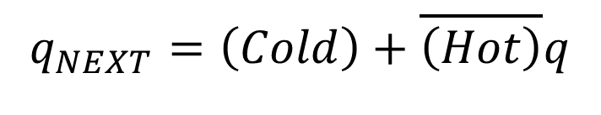
LUT -> Kmap -> Circuit
State | Cold? | Hot? | Next State
Off | Yes | Yes | X
Off | Yes | No | On
Off | No | Yes | Off
Off | No | No | Off
On | Yes | Yes | X
On | Yes | No | On
On | No | Yes | Off
On | No | No | On
$$q_{NEXT}=\left(Cold\right)+\overline{\left(Hot\right)}q$$

Slide 9
FSM Process Summary
Design Requirements
Define States
Define Transitions
Assign Values / Binary Codes
Calculate Widths
Make a LUT
Connect Registers
(Optional) Simplify
Inputs
Logic (LUT)
Outputs
Present
state
REG
Next
state
Clock

Slide 10
Types of FSM
Moore
Mealy
Output only depends on state
More States
“Pure” LUT Solution
Output depends on state AND inputs
Fewer States
Additional Logic?

Slide 11
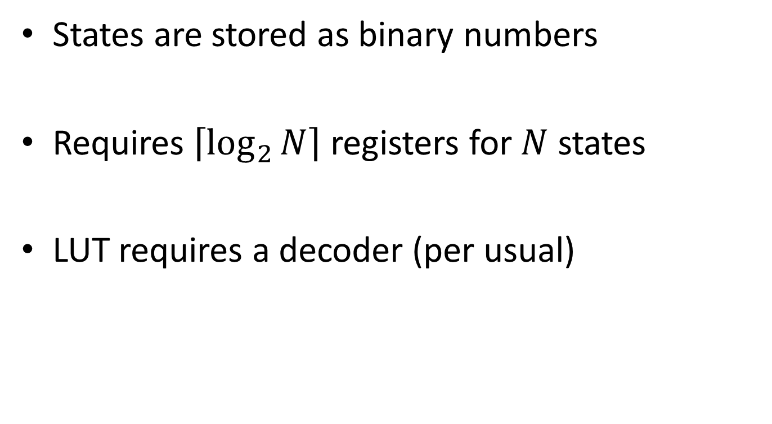
Binary Encoding
States are stored as binary numbers
Requires $\left\lceil \log_{2}{N}\right\rceil$ registers for $N$ states
LUT requires a decoder (per usual)

Slide 12
One Hot Encoding
States are stored as one bit being “hot”
Requires N registers for N states
LUT doesn’t require a decoder
The encoding is like a decoder!
Binary | One Hot
00 | 0001
01 | 0010
10 | 0100
11 | 1000

Slide 13
Encoding Comparison
Binary
One Hot
Fewer Flip Flops
Slower
Wider LUTs
More Flip Flops
Faster Clock Speeds
Simpler Logic
Many Illegal States
What if 2 bits are hot?
LOTS of “Don’t Cares” in logic

Slide 14
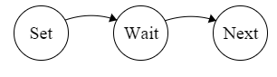
Wait States
Typical Data Flow:
FSM creates control signals for a clocked element
Other element takes N cycles to finish
FSM proceeds to next task
Wait States delay the FSM
Very Simple → Single Transition
One Hot → Just a D Flip Flop, no logic!

Slide 15
Create FSMs for:
Output True if the number of 1s is a multiple of 4
Every clock cycle, increment if input = 1
Output True if the number of pulses is a multiple of 3
Only increment if there was a 0 between 1s.
A Soda Machine
Inputs: Nickle Detected, Dime Detected
Outputs: Every 25 cents, it gives you sugar water
Sequential Adder
Inputs: 2 streams of bits, LSB first
Output: 1 stream of bits, LSB first equal to the sum of the inputs
For Each:
Flow Diagram
One Hot Schematic
Binary Schematic

Slide 16
Hints for Board Work Slide
Output True if the number of 1s is a multiple of 4
Use 4 states connected in a ring. Advance on 1.
State0 outputs 1, all others output 0
Output True if the number of pulses is a multiple of 3
Use 6 states (3 pairs). Each transition represents a positive or negative edge on the input signal.
A Soda Machine
Use 5 states (5 cents each). Advance by 0, 1 or 2 states based on inputs (3 states depending on how you interpret reqs)
Sequential Adder
Use your states to hold carry information.

Slide 17
Behavioral Verilog Hints for MP2

Slide 18
Asynchronous Logic
Stuff that happens all the time
assign DataOut = registers[Addr];
“Continuous Assignment”
Left hand MUST be a wire
What are the dependencies?
When is DataOut re-calculated?
In Simulation? In “Real Life”?

Slide 19
Example: A Full Adder
{} is Concatenation
Note that a,b,cin are not the same length
“|sum” is a Reduction
More info at http://www-scf.usc.edu/~ee577/tutorial/verilog/verilog_lec.pdf
wire[15:0] sum,a,b;
wire cin, cout, zero;
assign {cout, sum} = a + b + cin;
assign zero = !(|sum);

Slide 20
Synchronous Logic
always @(posedge clk)
if (regWE)
registers[Addr] <= DataIn;
Stuff that happens when triggered
Trigger list in the @(______) section
When is this re-calculated?
Notes:
Every positive edge of the clock

Slide 21
Example: A counter
Is this synchronous or asynch?
What does WID do?
How would this look in structure?
module upCnt(cnt, clk, clr);
parameter WID=4;
input clk, clr;
output reg[WID-1:0] cnt;
always @(posedge clk)
if (clr)
cnt <= 0;
else
cnt <= cnt + 1;
endmodule

Slide 22
= vs <=
= is a blocking assignment
Evaluate right hand side, assign to left immediately
<= is a non-blocking assignment
Evaluate right hand side
Schedule assignment for the end of the time step

Slide 23
= vs <=: Swap Fest
What are the values of the registers after each clock period?
Which block swaps?
Which block stomps?
always @(posedge clk)
begin
a = b;
b = a;
end
always @(posedge clk)
begin
c <= d;
d <= c;
end
Notes:
<= swaps

Slide 24
= vs <= : Timing
reg a, b, c, d, e, f, g, h, i;
initial begin
#10 a = 1; // a assigned at time 10
#2 b = 0; // b assigned at time 12
#4 c = 1; // c assigned at time 16
end
initial begin
#10 d <= 1; // d assigned at time 10
#2 e <= 0; // e assigned at time 12
#4 f <= 1; // f assigned at time 16
end
initial begin
g <= #10 1; // g assigned at time 10
h <= #2 0; // h assigned at time 2
i<= #4 1; // i assigned at time 4
end
Blocking Assignments
Each line blocks the next line
Non Blocking Assigments
Wait statement in scheduling
The waits cause the blocking
Non Blocking Assignments
Wait statement in assignment

Slide 25
= vs <= : TL;DR;
I prefer using <=
Converts from circuits more naturally
How regs actually work
You can use =
Converts from C code more naturally
Synthesizer has more work to do

Slide 26
Setting Defaults
Good for “rare” signals
always @(posedge clk) begin
outputsignal <= 0;
Case(state)
State0:
State1:
outputsignal <= 1;
…
StateN:
endcase

Slide 27
Behavioral Verilog Hints and Tricks
Binary Encoding
One Hot Encoding
case(state)
State0: begin
// do stuff
end
State1: begin
// do stuff
end
endcase
“Normal Case Statement”
case(1’b1)
State[0]: begin
// do stuff
end
State[1]: begin
// do stuff
end
endcase
“Reversed Case Statement”

Slide 28
3 to 8 Decoder
// 8 output decoder with 3 select (in) bits.
module decoder3to8(in,out);
input [2:0] in;
output [7:0] out;
reg [7:0] out;
always @ (in) begin
case (in)
3'b000 : out = 8'b0000_0001;
3'b001 : out = 8'b0000_0010;
3'b010 : out = 8'b0000_0100;
3'b011 : out = 8'b0000_1000;
3'b100 : out = 8'b0001_0000;
3'b101 : out = 8'b0010_0000;
3'b110 : out = 8'b0100_0000;
3'b111 : out = 8'b1000_0000;
endcase
end
endmodule
Notes:
Yell about buffers for a bit here

Slide 29
Lets Break the 3 to 8 Decoder
module decoder3to8(in,out);
input [2:0] in;
output [7:0] out;
reg [7:0] out;
always @ (in) begin
case (in)
3'b000 : out = 8'b0000_0001;
3'b001 : out = 8'b0000_0010;
3'b010 : out = 8'b0000_0100;
3'b011 : out = 8'b0000_1000;
3'b100 : out = 8'b0001_0000;
3'b101 : out = 8'b0010_0000;
3'b110 : out = 8'b0100_0000;
3'b111 : out = 8'b1000_0000; endcase
end
endmodule
Forget one case
Now case b111 remembers the previous state of the decoder!
Extra IMPLIED DFFs!!

Slide 30
Lets Break the 3 to 8 Decoder
module decoder3to8we(in,out, en);
input [2:0] in;
input en;
output [7:0] out;
reg [7:0] out;
always @ (in) begin
out = 0;
if(en) begin
case (in)
3'b000 : out = 8'b0000_0001;
3'b001 : out = 8'b0000_0010;
3'b010 : out = 8'b0000_0100;
3'b011 : out = 8'b0000_1000;
3'b100 : out = 8'b0001_0000;
3'b101 : out = 8'b0010_0000;
3'b110 : out = 8'b0100_0000;
3'b111 : out = 8'b1000_0000;
endcase
end
end
endmodule
Add an Enable Signal
The out = 0 is never overwritten
What did I forget to do?

Slide 31
Lets Break the 3 to 8 Decoder
module decoder3to8we(in,out, en);
input [2:0] in;
input en;
output [7:0] out;
reg [7:0] out;
always @ (in, en) begin
out = 0;
if(en) begin
case (in)
3'b000 : out = 8'b0000_0001;
3'b001 : out = 8'b0000_0010;
3'b010 : out = 8'b0000_0100;
3'b011 : out = 8'b0000_1000;
3'b100 : out = 8'b0001_0000;
3'b101 : out = 8'b0010_0000;
3'b110 : out = 8'b0100_0000;
3'b111 : out = 8'b1000_0000;
endcase
end
end
endmodule
What did I forget to do?
Update Sensitivities!
Synthesises a DFF for en
Updates only on (in)
TL;DR
Sensitive to sensitivities

Slide 32
Behavioral FSM
Use parameter for state names
parameter state_GETTING_ADDRESS = 0;
parameter state_GOT_ADDRESS = 1;
parameter state_READ = 2;
parameter state_READ_WAIT = 3;
Better than define
Locally Scoped

Slide 33
Virtual
Only affects GUI in ModelSim
No impact on actual simulation
Virtual Type
Allows you to define an enumeration
Again, only in the GUI
Virtual Function
Allows you to define a new signal calculated from simulation information into the GUI kernel
Again, doesn’t propagate back to the simulation

Slide 34
Virtual Example
virtual type {list of names} type_name
virtual function {(type) source_signal} new_signal_name
virtual type {{0 GET} {1 GOT} {2 READ} {3 READ2} {4 DONE}} state_type
virtual function {(state_type) /spiMemoryTest/spim/state} state_virtual
add wave -position insertpoint \
sim:/spiMemoryTest/spim/state_virtual

Slide 35
Loading Memories from Files
module memory(clk, regWE, Addr,
DataIn, DataOut);
input clk, regWE;
input[9:0] Addr;
input[31:0] DataIn;
output[31:0] DataOut;
reg [31:0] mem[1023:0];
always @(posedge clk)
if (regWE)
mem[Addr] <= DataIn;
initial $readmemb(“file.dat”, mem);
assign DataOut = registers[Addr];
endmodule
$readmemb and $readmemh allow you to load a memory from a file
b for Binary
h for Hexadecimal
Done in an initial block
Examples are in the lab3 starter package on the wiki

Slide 36
With Remaining Time
Work on Lab 2 Planning with your group

Slide 37
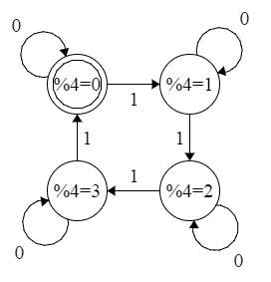
 |  |  | Out
State | Input | Next | Moore | Mealy
00 | 0 | 00 | 1 | 1
00 | 1 | 01 | 1 | 0
01 | 0 | 01 | 0 | 0
01 | 1 | 10 | 0 | 0
10 | 0 | 10 | 0 | 0
10 | 1 | 11 | 0 | 0
11 | 0 | 11 | 0 | 0
11 | 1 | 00 | 0 | 1

Slide 38
Pulse Counting

