Slide 1
b1101
Multi-Cycle CPUs
ENGR xD52
Eric VanWyk
Fall 2014

Slide 2
Acknowledgements
Mark L. Chang lecture notes for Computer Architecture (Olin ENGR3410)
Microchip Technology Inc (Datasheet)
A. Sahu, Indian Institute of Technology

Slide 3
Today
Clocks
Recall Single-Cycle CPUs
Single-Cycle Shortcomings
Multi-Cycle CPUs
Instruction Decoding with an FSM

Slide 4
Execution Overview
Instruction
Fetch
Fetch instruction from memory
Decode instruction into actions/controls
Fetch/Decode operands
Compute result value or status
Push result(s) to storage
Determine next instruction
Instruction
Decode
Operand
Fetch
Execute
Result
Store
Next
Instruction

Slide 5
Execution Overview
Instruction
Fetch
Fetch instruction from memory
Decode instruction into actions/controls
Fetch/Decode operands
Compute result value or status
Push result(s) to storage
Determine next instruction
Reference Lecture b100x
Instruction
Decode
Operand
Fetch
Execute
Result
Store
Next
Instruction

Slide 6
Clocks and Stability
The clock is a massive, chip wide signal
  All timing slaves to it
  Huge buffers to keep everyone in line
Usually a Crystal (XTAL / XO) as a time base
  Very precise – Easily tens of parts per million
Sometimes an RC oscilator
  ModCon all over again

Slide 7
Types of Oscillators w/ DigiKey Pricing
Crystals:
  50ppm → 16 cents @ 1kU
  10ppm → 24 cents (for common frequencies)
XO (Crystal + Support Circuitry)
  50ppm → 53 cents
  10ppm → 84 cents
  0.5ppm → $1.12
TCXO (Temperature Compensated X0)
  0.5ppm → $1.20
  280ppb → $10.41
OCXO (Oven Compensated XO)
  50ppb → $39
  5ppb → $112
  0.1ppb → $1,798
Notes:
These are drift specs, not initial accuracy.

Slide 8
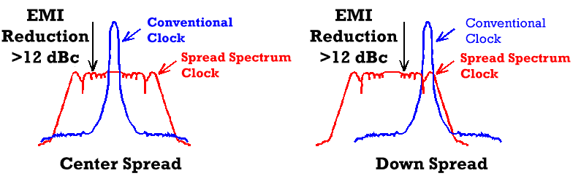
Clocks and Instability
Specialized systems can change clock freq
Phase Locked Loop to multiply / divide freq
  Some can change this multiplier during operation
Spread Spectrum Oscillator:
http://www.mecxtal.com/clk_hm.php

Slide 9
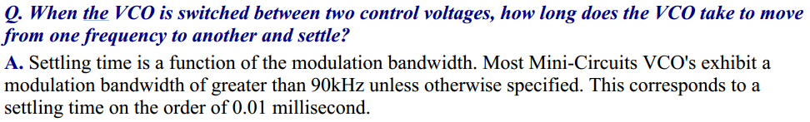
Clocks Change Slowly
Spread Spectrum effects are slow!
How many clock cycles is 0.01ms?
http://www.minicircuits.com/app/VCO15-20.pdf
Notes:
10 Cycles per MHz

Slide 10
Clock Changes Slower than Instructions
For our processors, clock isn’t adjustable
  Decided at Manufacture Time
For modern processors, clock adjusts:
  Very explicitly. Processor pauses during change.
  Dynamic Frequency Scaling → Power Save
Ben has been working on changing this

Slide 11
Information Rippling
Each Clock Cycle “ripples” left to right
  Elements emit garbage values until they stabilize
Elements on the leading edge of cycle (LEFT)
  Spend most of the time “bored” (stable)
  Under-utilized
Elements on the lagging edge of cycle (RIGHT)
  Spend most of the time twitching as things settle
  Spend unnecessary dynamic power

Slide 12
Performance of Single-Cycle Machine
Clock speed is set by the slowest instruction
Arithmetic & Logic
Load
Store
Branch
Jump
PC
Instr. Memory
Reg Read
mux
ALU
mux
Reg Setup
PC
Instr. Memory
Reg Read
mux
ALU
Data Memory
mux
Reg Setup
PC
Instr. Memory
Reg Read
mux
ALU
Data Memory
PC
Instr. Memory
Reg Read
mux
ALU
Adder
mux
PC
setup
PC
Instr. Memory
mux
PC
setup

Slide 13
Clock TL;DR;
Unable to change for each instruction
Slow instruction slows EVERY instruction
Harrison Bergeron applied to Transistors

Slide 14
Reducing Cycle Time
Cut combinational dependency graph and insert register / latch
Do same work in N fast cycles, rather than one slow one
storage element
storage element
Acyclic
Combinational
Logic (A)
Acyclic
Combinational
Logic
storage element
Acyclic
Combinational
Logic (B)
storage element
storage element

Slide 15
Goals
Free up fast instructions from slow clock curse
  Load Word is Super Slow
Make better use of available resources
  Reuse components (2 Memories, 2 or 3 Adders)
Free up space to speed up components
  One big fast ALU, not multiple slow ALU/adders

Slide 16
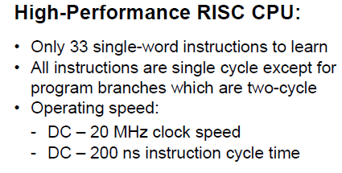
Multi-Cycle CPUs in the Wild
Common in small embedded spaces
  PIC16, PIC18
  4 bit micros (watches)
Marketing will try to confuse you
  Advertise MHz
  Hide CPI, Instructions per second, etc
http://ww1.microchip.com/downloads/en/DeviceDoc/41213D.pdf

Slide 17
Preview of White Boards to Come
We will go to the white boards “soon”.
You will create the schematic necessary to run the RTL design I’m about to give you.
I’m “cheating” and giving you parts of MY answer, to make your reinvention smoother
There is nothing sacred about MY answer,
  You’re usually on the hook for the whole shebang
  If it fulfils the contract and is small/fast, awesome.

Slide 18
Strategy
Enumerate all the stuff we have to do
  Per Instruction
  Highlight Common Features
Break tasks in to N phases
  N is different for different instructions
Balance work done in each phase

Slide 19
“Typical” Phases
IF: Instruction Fetch
ID: Instruction Decode (& register fetch)
EX: Execute
MEM: Read from Memory
WB: Write Back to Memory
Other Architectures make different divisions!

Slide 20
New Registers
IR
Instruction Register (IR)
  Instruction fetched from Data Memory
Data Register (MDR)
  Data fetched from Data Memory
Operands (A, B)
  Fetched from Register File
Result (Res)
  Result of the ALU calculation
Some of these may need write enable controls!
Rs
Rt
Rd
Imm16
MDR
A
B
ALU RES

Slide 21
Old Friends
Aw Aa Ab Da
Dw Db
Register
WrEn File
SignExtnd
WrEn Addr
Din Dout
Data
Memory
Concatenate
PC

Slide 22
Phases: Load Word
IF: Instruction Register = Memory[PC]
PC=PC+4
ID: A = RegFile[rs]
B = RegFile[IR[16:20]]
EX: Result = A + sign extended immediate
MEM: DataReg = Mem[Result]
WB: RegFile[rt] = DataReg
Notes:
We don’t use B later, so this doesn’t matter. We don’t care if it gets executed or not

Slide 23
Phases: ADD
IF: Instruction Register = Memory[PC]
PC=PC+4
ID: A = RegFile[rs]
B = RegFile[rt]
EX: Result = A + B
MEM:
WB: RegFile[rd] = Result

Slide 24
Phases: Store Word
IF: Instruction Register = Memory[PC]
PC=PC+4
ID: A = RegFile[rs]
B = RegFile[rt]
EX: Result = A + sign extended immediate
MEM: Mem[Result] = B
WB:

Slide 25
Phases: Branch if Equal
IF: Instruction Register = Memory[PC]
PC=PC+4
ID: A = RegFile[rs]
B = RegFile[rt]
Res = PC + sign extended immediate
EX: if(A==B) PC = Res
MEM:
WB:

Slide 26
Phases: Jump
IF: Instruction Register = Memory[PC]
PC=PC+4
ID: PC = PC[31:28],IR[25:0],b00
EX:
MEM:
WB:

Slide 27
Example Control Diagram
OP | Cycle | Phase Type | PC Enable | A Enable | ALU Control | IR Enable
AND | 0 | IF | 1 | X | Add4 | 1
 | 1 | ID | 0 | 1 | X | 0
 | 2 | EX | 0 | X | AND | 0
 | 3 | WB | 0 | X | X | 0
LW | 0 | IF | 1 | X | Add4 | 1
 | 1 | ID | 0 | 1 | X | 0
 | 2 | EX | 0 | X | Add Immed | 0
 | 3 | MEM | 0 | X | X | 0
 | 4 | WB | 0 | X | X | 0

Slide 28
Lets Make It
Create a Multi-Cycle CPU that can do the instructions on prior pages
  Jump, Branch, R-type, I-type, LW, SW
  Show everything except the actual decode logic
  Reference Lecture b1001, but put everything on one “page”
Sketch a Schematic for your Multi Cycle CPU
  ALU, Register File, Unified Instruction/Data Memory
  Sign Extender, (Optional) Shift by Two
  IR, DR, A, B, Res Registers
  OMG MUXES EVERYWHERE
Create a control chart (to show the actual decode logic)
  Show each cycle of each instruction
  Mux selects, ALU Control Lines, Register Enables
  Use “X” for “Don’t Care”
Create a One Hot FSM to generate control signals
  Flow Diagram First, then push to DFF and Logic
  Then do the ALUsrcB control signal in its entirety
  Then the other control signals as time allows
Send to CompArch14@gmail.com “[MultiCycle] Names”
Notes:
Used to include following text:
Turn this in to CompArch13@gmail.com (Group HW/ClassWork)

Slide 29
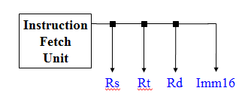
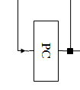
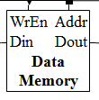
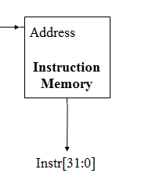

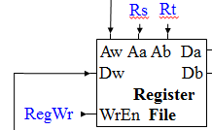




Slide 30
This Page Intentionally Left Blank
Except for that text up there
And some more over here
But really, it is so you don’t accidentally see one possible answer.
But… if you are stuck, go for it.

Slide 31
Multi Cycle w/ Controls
MemIn
PCSrc
PC_WE
Mem_WE
IR_WE
ALUSrcA
ALUOp
Concat
IR
PC
WrEn
Addr Dout
Memory
Din
Rs
Rt
Rd
Imm16
SignExtnd
<<2
Aw Ab Aa
Da
Registers
Dw WrEn Db
ALU RES
MDR
A
B
4
A_WE
B_WE
Dst
RegIn
Reg_WE
ALUSrcB

Slide 32
Preview of things to Come
How to control a Multi-Cycle CPU
Timing Concerns and Explicit Balancing
Modern CPUs: Pipelining

Slide 33
Desk Work
Time your Multicycle design from Monday
  Do symbolically first, then substitute real numbers
  Remember parallel paths!
Component | Symbol | Delay
ALU | tALU | 5ns
Register File | tRF | 3ns
Instruction/Data Memory | tMEM | 6ns
Muxes | 0 | 0
Registers | 0 | 0

Slide 34
Summary
Split Single Cycle in to multiple cycles
Use variable number of cycles per instruction
  No More Harrison Bergeron-ing
Most Instructions become Faster
Longest Instruction gets Longer
  From unbalanced phases
Costs: Registers, control logic

Slide 35
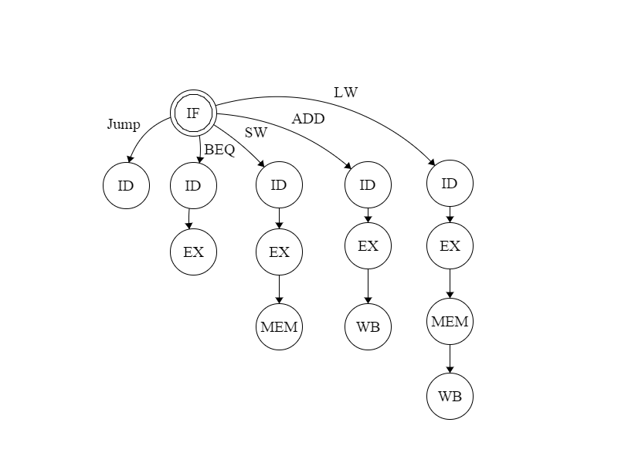

Slide 36
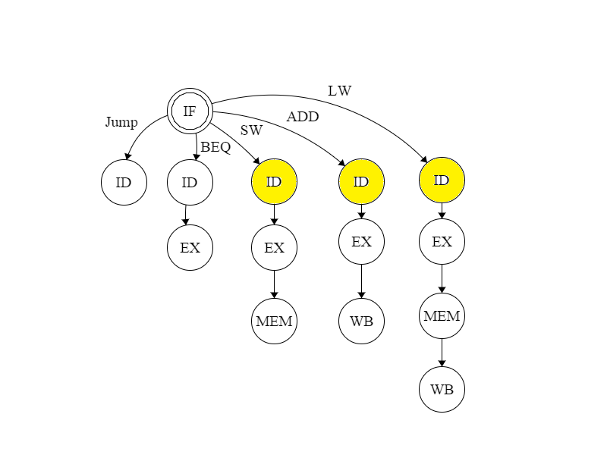
Notes:
These states have identical outputs. We can merge them.

Slide 37
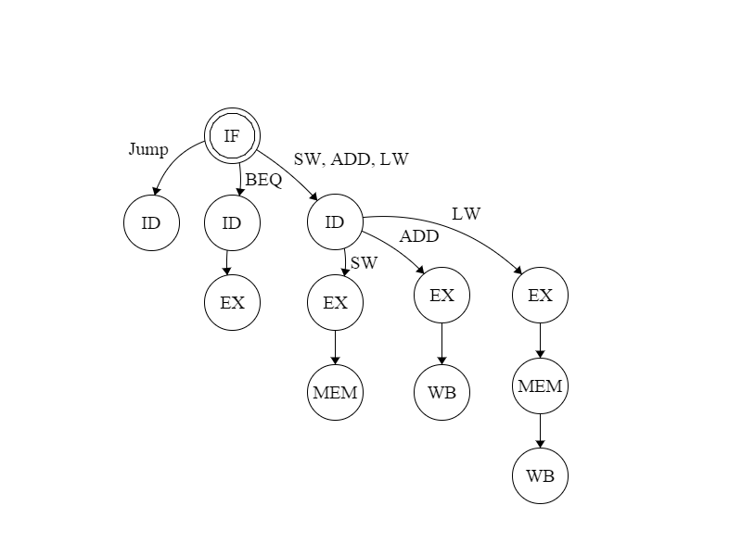

Slide 38
