Slide 1
b1110 Multicycle (Continued)
ENGR xD52
Eric VanWyk
Fall 2014

Slide 2
Today
Balancing MicroOps
Review Multicycle Board work so far
Generate FSM controllers
Complete Multicycle Rev 1

Slide 3
Balance
An unbalanced design has some operations doing more “work” (time) than the others
Wastes time in fast cycles
Moving work between operations is Balancing
Reduce the global clock period by leveling
Balance adjacent ops by register positioning
Some ops are hard to “slice”

Slide 4
Example
Instruction has 5 components:
1, 2, 3, 4, and 5 nanoseconds long
In that order
Divide optimally in to 3 cycles:
Minimum Clock Period?
How much time is wasted per instruction?

Slide 5
Example
Instruction has 5 components:
1, 2, 3, 4, and 5 nanoseconds long
In that order
Divide optimally in to 3 cycles:
Minimum Clock Period? 6ns
How much time is wasted per instruction? 3ns
{1,2,3}{4}{5}

Slide 6
Balancing
Not all resources are fungible
Some micro-operations are hard to subdivide
Order of operations matters sometimes
The slowest unit sets the pace for everything
Compare “Optimal” time to Reality
Measure of Balance

Slide 7
Example Timings
Instr/Cycle | RTL | Symbolic | Numeric
LW:0 | IR = Mem[PC] | tX1 + tMEM | 10
LW:0 | PC=PC+4 | tX1+tALU+tX2 In Parallel with tX2+tALU+tX2 | 5 5
LW:1 | AB = RegFile[_] | tRF | 3
LW:2 | Res = A + SEI | tALU | 5
LW:3 | DR = Mem[Res] | tX1 + tMEM | 10
LW:4 | RegFile[rt] = DR | tRF+tX1 | 3
Component | Symbol | Delay
ALU | tALU | 5ns
Register File | tRF | 3ns
Instruction/Data Memory | tMEM | 10ns
Muxes (Optional) | tXn | 0ish
Registers | 0 | 0
Notes:
Why are muxes ZERO???
Mostly to make the slide go better, but it isn’t as terrible as it sounds.
Muxes towards at the end of the cycle have time for their decoders to settle, and then its just a simple 2AND to go through – super fast.

Slide 8
Rebalance: Combine Stages 1 and 2
Instr/Cycle | RTL | Symbolic | Numeric
LW:0 | IR = Mem[PC] | tX1 + tMEM | 10
LW:0 | PC=PC+4 | tX1+tALU+tX2 In Parallel with tX2+tALU+tX2 | 5 5
LW:1/2 | Res = RegFile[]+SEI | tRF+tALU | 8
LW:3 | DR = Mem[Res] | tX1 + tMEM | 10
LW:4 | RegFile[rt] = DR | tRF+tX1 | 3
Component | Symbol | Delay
ALU | tALU | 5ns
Register File | tRF | 3ns
Instruction/Data Memory | tMEM | 10ns
Muxes (Optional) | tXn | 0ish
Registers | 0 | 0
Notes:
Why are muxes ZERO???
Mostly to make the slide go better, but it isn’t as terrible as it sounds.
Muxes towards at the end of the cycle have time for their decoders to settle, and then its just a simple 2AND to go through – super fast.

Slide 9
Balancing Penalty
Total time wasted per cycle from poor balance
Instr/Cycle | Time | Penalty
LW:IF | 10 | 0
LW:ID | 3 | 7
LW:EX | 5 | 5
LW:MEM | 10 | 0
LW:WB | 3 | 7
 | 31 | 19
Instr/Cycle | Time | Penalty
LW:IF | 10 | 0
LW:ID/EX | 8 | 2
LW:MEM | 10 | 0
LW:WB | 3 | 7
 | 21 | 9

Slide 10
Back to Review!

Slide 11
Multi Cycle w/ Controls
MemIn
PCSrc
PC_WE
Mem_WE
IR_WE
ALUSrcA
ALUOp
Concat
IR
PC
WrEn
Addr Dout
Memory
Din
Rs
Rt
Rd
Imm16
SignExtnd
<<2
Aw Ab Aa
Da
Registers
Dw WrEn Db
ALU RES
MDR
A
B
4
Dst
RegIn
Reg_WE
ALUSrcB

Slide 12
Phases: Jump
IF: Instruction Register = Memory[PC]
PC=PC+4
ID: PC = PC[31:28],IR[25:0],b00
EX:
MEM:
WB:

Slide 13
Phases: Jump
IF: Instruction Register = Memory[PC]
PC=PC+4
ID: PC = PC[31:28],IR[25:0],b00
PC
WrEn Addr
Din Dout
Data
Memory
IR
Rs
Rt
Rd
Imm16

Slide 14
Phases: Jump
IF: Instruction Register = Memory[PC]
PC=PC+4
ID: PC = PC[31:28],IR[25:0],b00
PC
WrEn Addr
Din Dout
Memory
IR
Rs
Rt
Rd
Imm16
4

Slide 15
Phases: Jump
IF: Instruction Register = Memory[PC]
PC=PC+4
ID: PC = PC[31:28],IR[25:0],b00
Concat
b00
PC
WrEn Addr
Din Dout
Memory
IR
Rs
Rt
Rd
Imm16
4

Slide 16
Resolve Conflicts
Muxes for conflicting inputs
Enables for conflicting outputs
Or put them on every register and remove later
Concat
b00
PCEn
PC
WrEn Addr
Din Dout
Memory
IREn
IR
Rs
Rt
Rd
Imm16
PCSrc
4

Slide 17
Control Diagram
 |  | Signals
Instruction | Phase | PCSrc | PCEn | IREn
Jump | IF
 | ID
IF: Instruction Register = Memory[PC]
PC=PC+4
ID: PC = PC[31:28],IR[25:0],b00
Concat
b00
PCEn
PC
WrEn Addr
Din Dout
Memory
IREn
IR
Rs
Rt
Rd
Imm16
PCSrc
4

Slide 18
Control Diagram
 |  | Signals
Instruction | Phase | PCSrc | PCEn | IREn
Jump | IF |  |  | 1
 | ID
IF: Instruction Register = Memory[PC]
PC=PC+4
ID: PC = PC[31:28],IR[25:0],b00
Concat
b00
PCEn
PC
WrEn Addr
Din Dout
Memory
IREn
IR
Rs
Rt
Rd
Imm16
PCSrc
4

Slide 19
Control Diagram
 |  | Signals
Instruction | Phase | PCSrc | PCEn | IREn
Jump | IF | ALU | 1 | 1
 | ID
IF: Instruction Register = Memory[PC]
PC=PC+4
ID: PC = PC[31:28],IR[25:0],b00
Concat
b00
PCEn
PC
WrEn Addr
Din Dout
Memory
IREn
IR
Rs
Rt
Rd
Imm16
PCSrc
4

Slide 20
Control Diagram
 |  | Signals
Instruction | Phase | PCSrc | PCEn | IREn
Jump | IF | ALU | 1 | 1
 | ID | Concat | 1
IF: Instruction Register = Memory[PC]
PC=PC+4
ID: PC = PC[31:28],IR[25:0],b00
Concat
b00
PCEn
PC
WrEn Addr
Din Dout
Memory
IREn
IR
Rs
Rt
Rd
Imm16
PCSrc
4

Slide 21
Control Diagram
 |  | Signals
Instruction | Phase | PCSrc | PCEn | IREn
Jump | IF | ALU | 1 | 1
 | ID | Concat | 1 | 0? X?
IF: Instruction Register = Memory[PC]
PC=PC+4
ID: PC = PC[31:28],IR[25:0],b00
Concat
b00
PCEn
PC
WrEn Addr
Din Dout
Memory
IREn
IR
Rs
Rt
Rd
Imm16
PCSrc
4

Slide 22
Control Diagram
 |  | Signals
Instruction | Phase | PCSrc | PCEn | IREn
Jump | IF | ALU | 1 | 1
 | ID | Concat | 1 | 0? X?
PC Enable is Always High
Remove it!
Only valid for an “Only Jumps” Processor
Concat
b00
PCEn
PC
WrEn Addr
Din Dout
Memory
IREn
IR
Rs
Rt
Rd
Imm16
PCSrc
4

Slide 23
Control Diagram
 |  | Signals
Instruction | Phase | PCSrc | IREn
Jump | IF | ALU | 1
 | ID | Concat | 0
PC Enable is Always High
Remove it!
Only valid for an “Only Jumps” Processor
Concat
b00
PC
WrEn Addr
Din Dout
Memory
IREn
IR
Rs
Rt
Rd
Imm16
PCSrc
4

Slide 24
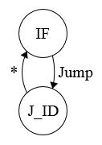
Finite State Machine
Create Transition Diagram
This one is “silly” because it is only one instruction
Yours will be “real”
 |  | Signals
Instruction | Phase | PCSrc | IREn
Jump | IF | ALU | 1
 | ID | Concat | 0

Slide 25
One Hot Encoding
Replace States with DFF
Input is an OR gate of all incoming transitions
Each transition is an AND gate:
“Sending State” AND “Transition Criteria”
Again, silly in our example ☹

Slide 26
One Hot Encoding
Replace States with DFF
Input is an OR gate of all incoming transitions
Each transition is an AND gate:
“Sending State” AND “Transition Criteria”
Again, silly in our example ☹

Slide 27
Add Control Outputs
Add Control Outputs
Outputs are an OR gate
From each State the signal is high
 |  | Signals
Instruction | Phase | PCSrc | IREn
Jump | IF | ALU=0 | 1
 | ID | Concat=1 | 0

Slide 28
Add Control Outputs
Add Control Outputs
Outputs are an OR gate
From each State the signal is high
Simplify?
 |  | Signals
Instruction | Phase | PCSrc | IREn
Jump | IF | ALU=0 | 1
 | ID | Concat=1 | 0

Slide 30
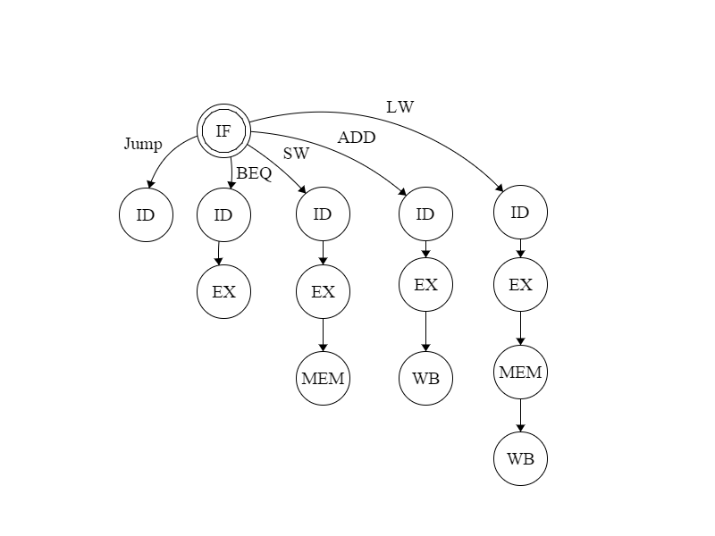
FSM Reduction
Return to IF suppressed for diagram clarity
Every terminal state returns to IF.

Slide 31
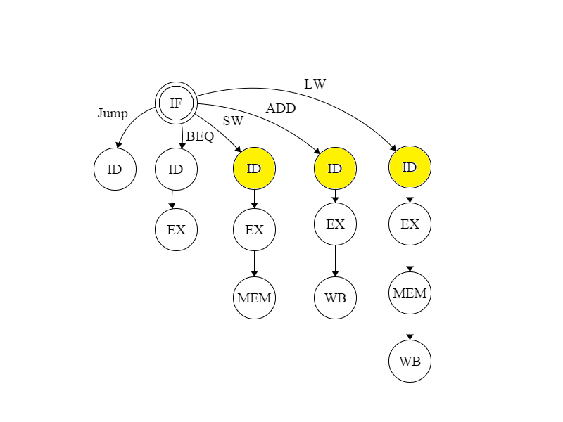
These states have identical outputs
They do not have identical transitions
We can still merge them
Notes:
These states have identical outputs. We can merge them.

Slide 32
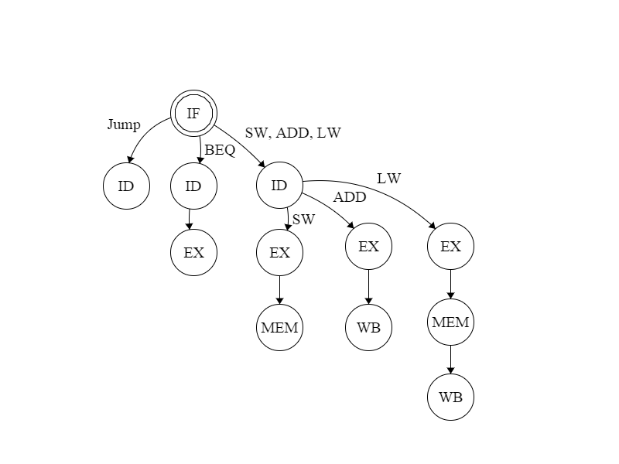
Tada!

Slide 33
Multi Cycle w/ Controls
MemIn
PCSrc
PC_WE
Mem_WE
IR_WE
ALUSrcA
ALUOp
Concat
IR
PC
WrEn
Addr Dout
Memory
Din
Rs
Rt
Rd
Imm16
SignExtnd
<<2
Aw Ab Aa
Da
Registers
Dw WrEn Db
ALU RES
MDR
A
B
4
Dst
RegIn
Reg_WE
ALUSrcB

Slide 34
Resume Board Work!
Finish Structure Schematic (or use mine)
Create Control Diagram
Google Doc Spreadsheet?
Create Finite State Machine
Create One Hot Encoding

Slide 35
Example Control Diagram
OP | Cycle | Phase Type | PC Enable | A Enable | ALU Control | IR Enable
AND | 0 | IF | 1 | X | Add4 | 1
 | 1 | ID | 0 | 1 | X | 0
 | 2 | EX | 0 | X | AND | 0
 | 3 | WB | 0 | X | X | 0
LW | 0 | IF | 1 | X | Add4 | 1
 | 1 | ID | 0 | 1 | X | 0
 | 2 | EX | 0 | X | Add Immed | 0
 | 3 | MEM | 0 | X | X | 0
 | 4 | WB | 0 | X | X | 0

Slide 36
Phases: Load Word
IF: Instruction Register = Memory[PC]
PC=PC+4
ID: A = RegFile[rs]
B = RegFile[IR[16:20]]
EX: Result = A + sign extended immediate
MEM: DataReg = Mem[Result]
WB: RegFile[rt] = DataReg
Notes:
We don’t use B later, so this doesn’t matter. We don’t care if it gets executed or not

Slide 37
Phases: ADD
IF: Instruction Register = Memory[PC]
PC=PC+4
ID: A = RegFile[rs]
B = RegFile[rt]
EX: Result = A + B
MEM:
WB: RegFile[rd] = Result

Slide 38
Phases: Store Word
IF: Instruction Register = Memory[PC]
PC=PC+4
ID: A = RegFile[rs]
B = RegFile[rt]
EX: Result = A + sign extended immediate
MEM: Mem[Result] = B
WB:

Slide 39
Phases: Branch if Equal
IF: Instruction Register = Memory[PC]
PC=PC+4
ID: A = RegFile[rs]
B = RegFile[rt]
Res = PC + sign extended immediate
EX: if(A==B) PC = Res
MEM:
WB:

Slide 40
Phases: Jump
IF: Instruction Register = Memory[PC]
PC=PC+4
ID: PC = PC[31:28],IR[25:0],b00
EX:
MEM:
WB:

Slide 41
