Slide 1
b10011 Numerically Awesome
ENGR xD52
Eric VanWyk
Fall 2014

Slide 2
Acknowledgements
The Great Wikipedia, Finder of Figures
John Carmack, Quake III Arena Source Code
Ray Andraka: A survey of CORDIC algorithms for FPGA based computers
Lumilogic
Jack E. Volder, The CORDIC Trigonometric Computing Technique

Slide 3
Today
Manipulating Formulae for Fun and Profit
Polynomial Fits
Newton Raphson
CORDIC

Slide 4
Manipulating Formulae
Welcome to Algebra 404
Where Math don’t think it be like it is, but it do.
Use algebra to reformat for “good” execution
Execution Speed
Code Size
Accuracy

Slide 5
Easy Speed Tweaking
Look for degenerate expensive cases
Look for duplicated effort and eliminate it
Plan your loads / stores carefully!

Slide 6
Multiplication Tricks
Sometimes, shift-add is cheap
9x = 8x + x = X<<3 + X
In Arm and Thumb(2), this is one instruction
add $r1, $r0, $r0 lsl 3
Two ops, One Instruction?
Why?
Multiplicands with a small number of active bits

Slide 7
Two Ops, One Instruction
This is a clue about:
What types of programs this processor runs
What instructions those programs have
DSPs often have Multiply Accumulate
X += Y*Z
X might be fixed: The Accumulator (register)
This might even be a wide register!

Slide 8
Booth Encoding
Represent the multiplicand as runs of ones
X*60d = X * b00111100
Runs of Ones are the difference of powers of 2
60 = 64 – 4 = 2^6 – 2^2
X*60 = X<<6 – X<<2
There are many other fixed multiplicand tricks

Slide 9
Polynomials
“Human” Form:
Ax^3+Bx^2+Cx^1+Dx^0
How many Multiplies does this use? Adds?
Notes:
Multiply : 3+2+1 = 6
Add: 3

Slide 10
Polynomials
“Human” Form:
Ax^3+Bx^2+Cx^1+Dx^0
How many Multiplies does this use? Adds?
Ax^3 = 3 Multiplies
Bx^2 = 2 Multiplies
… 6 Mults, 3 Adds
Notes:
Multiply : 3+2+1 = 6
Add: 3

Slide 11
Polynomials
“Human” Form:
Ax^3+Bx^2+Cx^1+Dx^0
(Paraphrased) Horner’s Scheme
((((Ax)+B)x+C)x+D)
Now how many?
Notes:
Multiply : 3+2+1 = 6
Add: 3
Multiply: 3
Add : 3

Slide 12
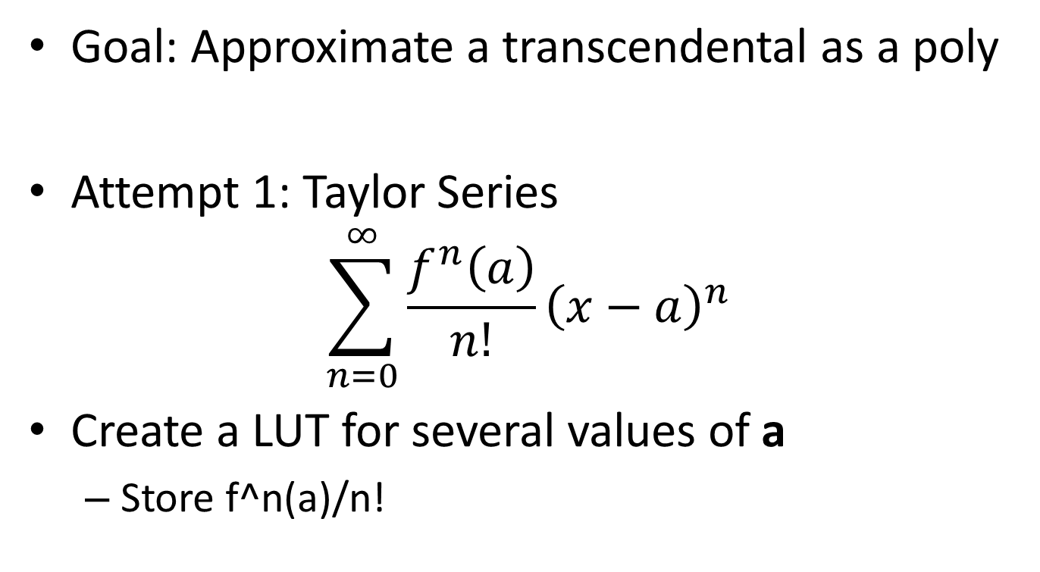
Polynomial Approximations
Goal: Approximate a transcendental as a poly
Attempt 1: Taylor Series
$$\sum_{n=0}^{∞}{\frac{f^{n}\left(a\right)}{n!}{\left(x−a\right)}^{n}}$$
Create a LUT for several values of a
Store f^n(a)/n!
Notes:
Powerpoint sucks for formulas

Slide 13
Polynomial Approximation
How deep should the LUT be?
Deeper means we are on average closer
Better approximation for a given number of terms
But Deeper also means more expensive
No easy answer ☹
How do you pick a?
Right in the middle of your range

Slide 14
Implementation: Poly/LUT
Find the nearest a in our LUT
Truncate x, use as index in to table
Load Coefficients
Sine and Cosine are special: Why?
Calculate with Horner’s Scheme

Slide 15
Picking Coefficients
Taylor Series optimizes accuracy for x ≈ a
Largest errors right between LUT points
Statistics has nice ways to optimize RMS error
Does a better job of spreading the error
But still not perfect
We care about the worst case error
I haven’t found a great way to do this yet
So I just brute force it with an annealing algorithm

Slide 16
My Method
Prototype with double precision floats
MATLAB, Python or Wolfram Alpha
Count adds, mults, loads, etc
Move to integer math
Python (X,Y)
Any catastrophic loss of precision? Rearrange
Anneal coefficients over a weekend
Automagically try several Depth/Power combos

Slide 17
Approximation “Folding”
Make use of symmetry in your functions
“Fold” the function in half cuts LUT depth in half!
One of my favorite assembly language games
Great practice in number systems and asm tricks
How do you fold cos(x)?

Slide 18
Fold cos(x)=cos(|x|)
x=abs(x) on MIPS
slt $t1, $t0, $zero // $t0<0?
beq $t1, $zero, negative // branch
sub $t0, $zero, $t0 // negate
negative:
x=abs(x) on MIPS
sra $t1, $t0, 31 // -1 or 0
xor $t0, $t0, $t1 // |x|-1 or x
sub $t0, $t0, $t1 // |x|-1-(-1) or x-0
x=abs(x) on ARM
cmp r0, #0 // Compare r0 to zero
rsblt r0, r0, #0 // If <0, r0 = 0 – r0

Slide 19
Further Trig Folding
Trig functions are periodic
sin(x) = sin(x%2pi)
In radians
modulo power of 2 is super easy
Linearly scale so that 1 cycle is a power of 2
Get rid of extra high bits

Slide 20
Approximation Folding
How do you fold 1/x?
1/x^2? e^x?
These have symmetry…
But not in the linear way trig does
Higher order symmetry
1/(x) = 2^-n/(x*2^n)

Slide 21
Approximation Folding
These symmetries are harder to exploit
Count Leading Zeros
Quick stand-in for log(2)
Break spaces into powers of 2
Shift by the number of leading zeros
Compensate Later
This helps with limiting calculation Range!
Optimize for accuracy instead of range

Slide 22
Calculating Interesting Functions
GIANT LUTs
Because we have silicon area to burn
Area doubles per bit of accuracy
Power Series and LUTs:
Approximation by polynomial
More efficient in space, but still improves slowly
Lets find better ways
That gain accuracy faster

Slide 23
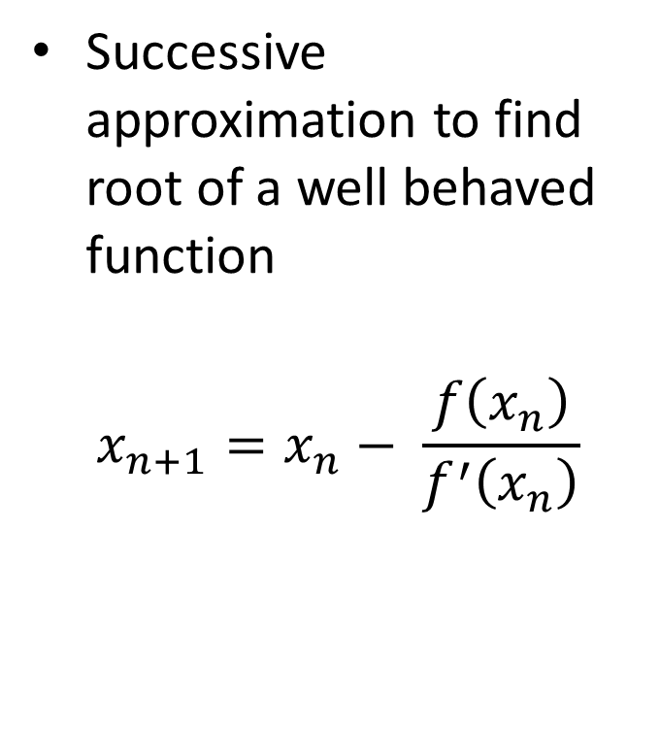
Newton Raphson
Successive approximation to find root of a well behaved function
$$x_{n+1}=x_{n}− \frac{f\left(x_{n}\right)}{f^{′}\left(x_{n}\right)}$$

Slide 24
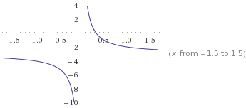
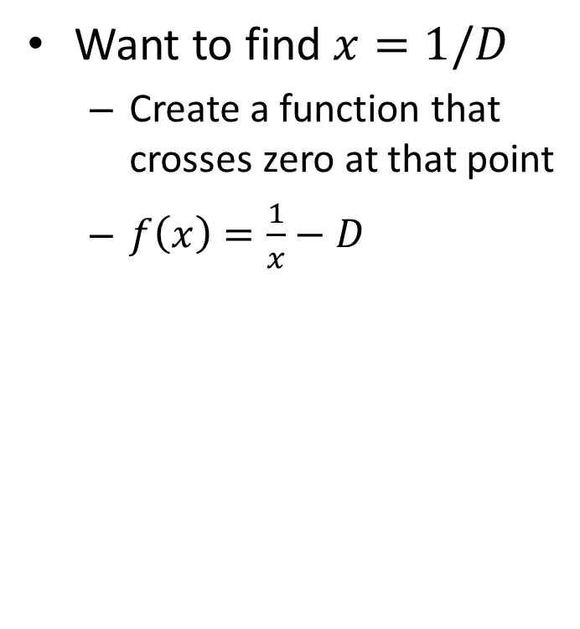
Newton Raphson Division
Want to find $x=1/D$
Create a function that crosses zero at that point
$f\left(x\right)=\frac{1}{x}−D$
D=3

Slide 25

Newton Raphson Division
$x_{n+1}=x_{n}− \frac{f\left(x_{n}\right)}{f^{′}\left(x_{n}\right)}$
$x_{n+1}=x_{n}−\frac{\frac{1}{x_{n}}−D}{−\frac{1}{x_{n}^{2}}}$
$x_{n+1}= x_{n} + x_{n}(1 – D∗x_{n})$
$x_{n+1} =x_{n}∗(2−D∗x_{n})$

Slide 26
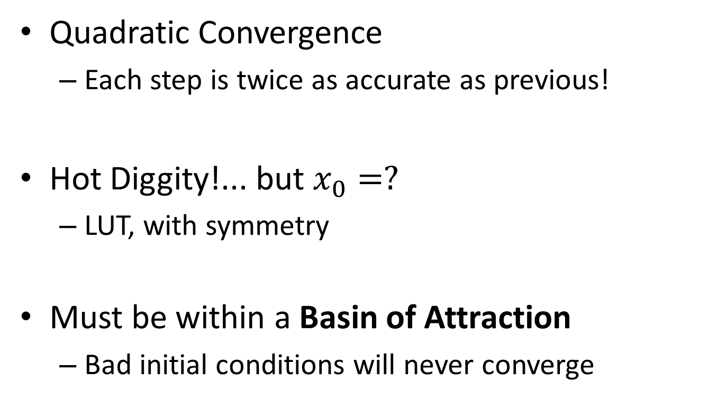
Newton Raphson Division
Quadratic Convergence
Each step is twice as accurate as previous!
Hot Diggity!... but $x_{0}=?$
LUT, with symmetry
Must be within a Basin of Attraction
Bad initial conditions will never converge

Slide 27
Basin of Attraction
What does the black line represent?

Slide 28
Basin of Attraction
Now it will never converge ☹

Slide 29
Newton Raphson 1/sqrt
float Q_rsqrt( float number ) {
long i;
float x2, y;
const float threehalfs = 1.5F;
x2 = number * 0.5F;
y = number;
i = * ( long * ) &y; // evil floating point bit level hacking
i = 0x5f3759df - ( i >> 1 ); // what the fuck?
y = * ( float * ) &i;
y = y * ( threehalfs - ( x2 * y * y ) ); // 1st iteration
// y = y * ( threehalfs - ( x2 * y * y ) ); // 2nd iteration, this can be removed
return y;
}
Quake III Arena Source Code

Slide 30
Initial Approximation
float Q_rsqrt( float number ) {
long i;
float x2, y;
const float threehalfs = 1.5F;
x2 = number * 0.5F;
y = number;
i = * ( long * ) &y; // evil floating point bit level hacking
i = 0x5f3759df - ( i >> 1 ); // what the fuck?
y = * ( float * ) &i;
y = y * ( threehalfs - ( x2 * y * y ) ); // 1st iteration
// y = y * ( threehalfs - ( x2 * y * y ) ); // 2nd iteration, this can be removed
return y;
}
Quake III Arena Source Code

Slide 31
Newton Raphson Iteration
float Q_rsqrt( float number ) {
long i;
float x2, y;
const float threehalfs = 1.5F;
x2 = number * 0.5F;
y = number;
i = * ( long * ) &y; // evil floating point bit level hacking
i = 0x5f3759df - ( i >> 1 ); // what the fuck?
y = * ( float * ) &i;
y = y * ( threehalfs - ( x2 * y * y ) ); // 1st iteration
// y = y * ( threehalfs - ( x2 * y * y ) ); // 2nd iteration, this can be removed
return y;
}
Quake III Arena Source Code

Slide 32
Translating to Fixed Point
Floating Point Newton Raphson is easy
It handles range changes for you
Fixed Point is degenerately bad
Intermediate steps are all over the place
Use symmetry to tighten up ranges
Be Careful!

Slide 33
CORDIC
Multiplies are expensive in hardware
So many adders!
Jack Volder invented CORDIC in 1959
Trig functions using only shifts, adds, LUTs
We’ll be looking at this half
John Stephen Welther generalized it at HP
Hyperbolics, exponentials, logs, etc
This half is awesome too

Slide 34
CORDIC?
COordinate Rotation DIgital Computer
A simple way to rotate a vector quickly
Creates rotation matrices based on 2^i
Makes the math redonkulously quick

Slide 35
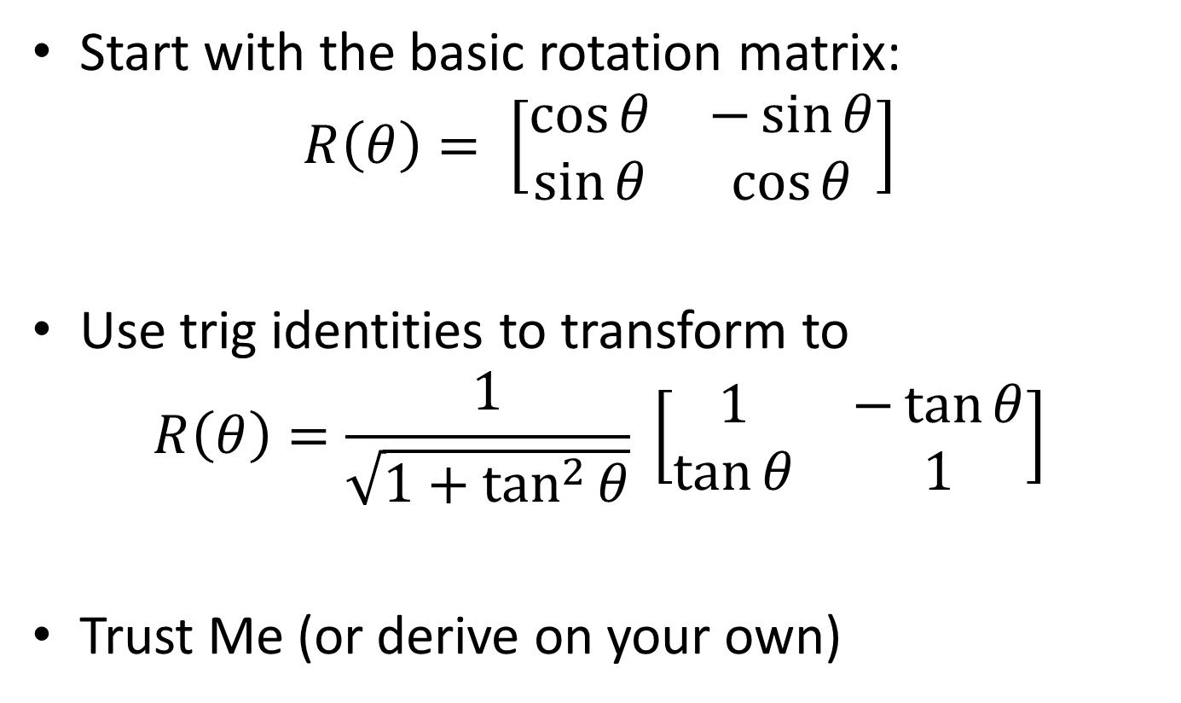
Super Glossy Transformation Step
Start with the basic rotation matrix:
$$R\left(θ\right)= \left[\begin{matrix}\cos{θ} & −\sin{θ} \\ \sin{θ} & \cos{θ}\end{matrix}\right]$$
Use trig identities to transform to
$$R\left(θ\right)=\frac{1}{\sqrt{1+\tan^{2}{θ}}} \left[\begin{matrix}1 & −\tan{θ} \\ \tan{θ} & 1\end{matrix}\right]$$
Trust Me (or derive on your own)

Slide 36
The Clever Bit
Pick values of $θ$ to make the math easy
$$\tan{θ={±2}^{−i}}$$
Now the rotation simplifies to
$$R\left(θ\right)=\frac{1}{\sqrt{1+2^{−2i}}} \left[\begin{matrix}1 & −(±2^{−i}) \\ {±2}^{−i} & 1\end{matrix}\right]$$
Store two separate look up tables
$\operatorname{atan}{2^{−i} }$
$1/\sqrt{1+2^{−2i}}$ … maybe

Slide 37
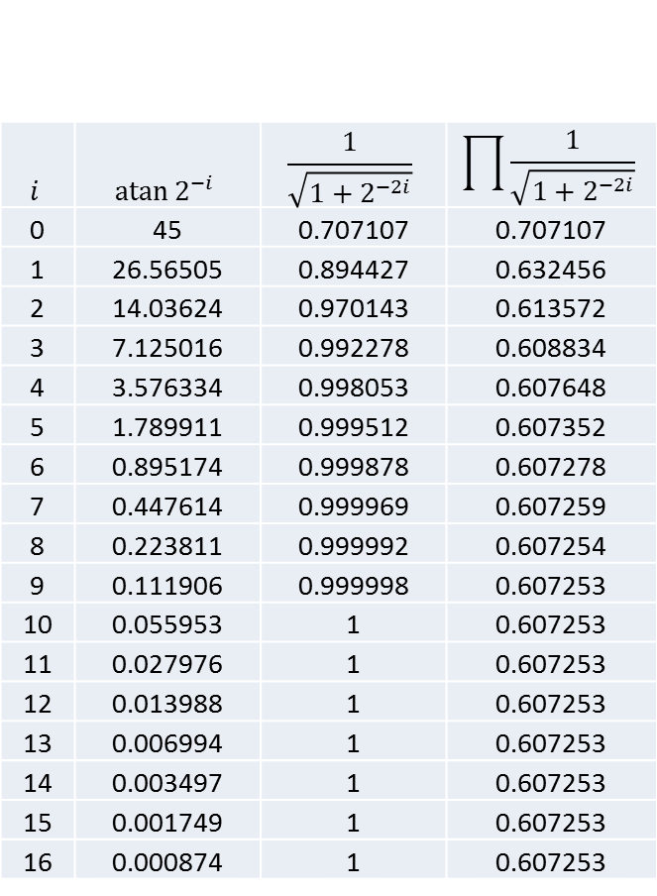
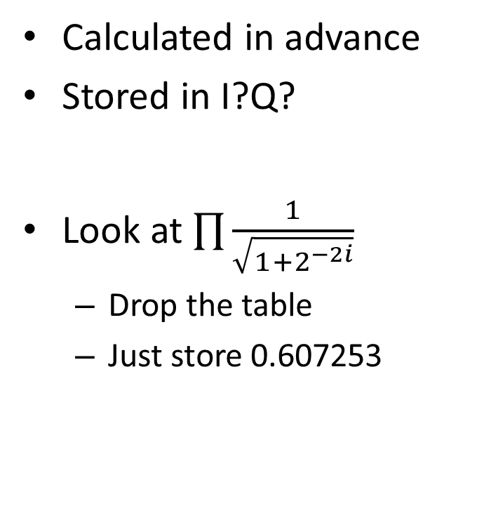
CORDIC LUT
Calculated in advance
Stored in I?Q?
Look at $\prod{\frac{1}{\sqrt{1+2^{−2i}}}}$
Drop the table
Just store 0.607253
$$i$$ | $$atan⁡2^{−i}$$ | $$\frac{1}{\sqrt{1+2^{−2i}}}$$ | $$\prod{\frac{1}{\sqrt{1+2^{−2i}}}}$$
0 | 45 | 0.707107 | 0.707107
1 | 26.56505 | 0.894427 | 0.632456
2 | 14.03624 | 0.970143 | 0.613572
3 | 7.125016 | 0.992278 | 0.608834
4 | 3.576334 | 0.998053 | 0.607648
5 | 1.789911 | 0.999512 | 0.607352
6 | 0.895174 | 0.999878 | 0.607278
7 | 0.447614 | 0.999969 | 0.607259
8 | 0.223811 | 0.999992 | 0.607254
9 | 0.111906 | 0.999998 | 0.607253
10 | 0.055953 | 1 | 0.607253
11 | 0.027976 | 1 | 0.607253
12 | 0.013988 | 1 | 0.607253
13 | 0.006994 | 1 | 0.607253
14 | 0.003497 | 1 | 0.607253
15 | 0.001749 | 1 | 0.607253
16 | 0.000874 | 1 | 0.607253

Slide 38
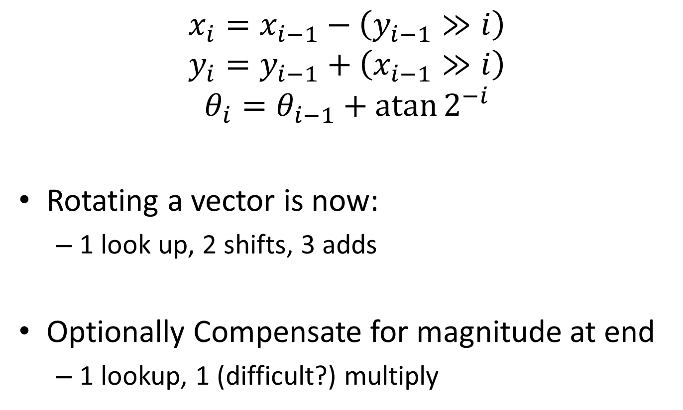
The Result
$$x_{i}=x_{i−1}−\left(y_{i−1}≫i\right)$$
$$y_{i}=y_{i−1}+\left(x_{i−1}≫i\right)$$
$$θ_{i}=θ_{i−1}+\operatorname{atan}{2^{−i}}$$
Rotating a vector is now:
1 look up, 2 shifts, 3 adds
Optionally Compensate for magnitude at end
1 lookup, 1 (difficult?) multiply

Slide 39
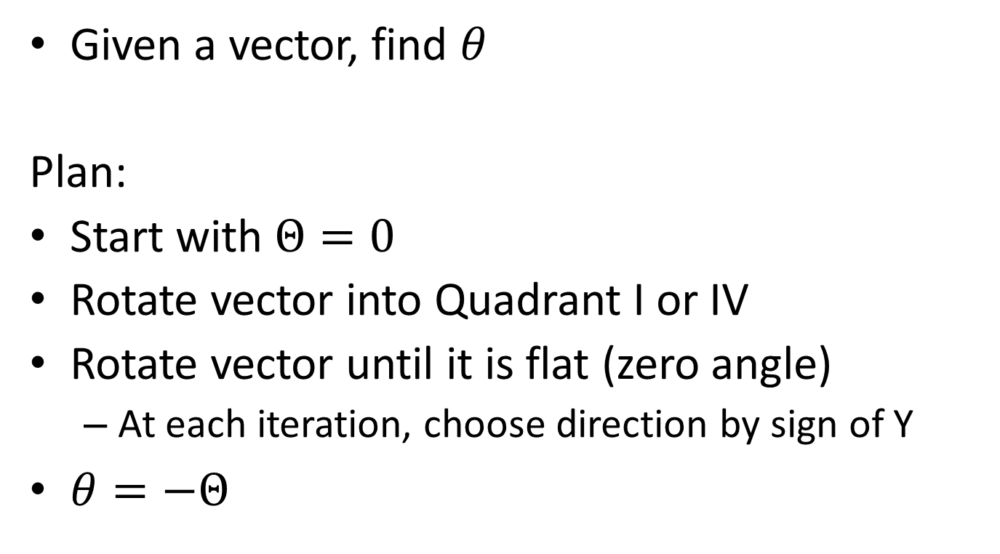
Example: Finding the Phase
Given a vector, find $θ$
Plan:
Start with $Θ=0$
Rotate vector into Quadrant I or IV
Rotate vector until it is flat (zero angle)
At each iteration, choose direction by sign of Y
$θ=−Θ$

Slide 40
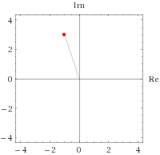
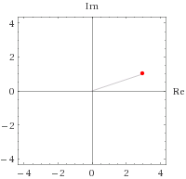

Example: Finding the Phase
Find Phase of -1+3j
Rotate into a start Quadrant
This is not yet CORDIC
$$x=−1, y=3, Θ=0$$
$$x=3, y=1, Θ=−90$$

Slide 41
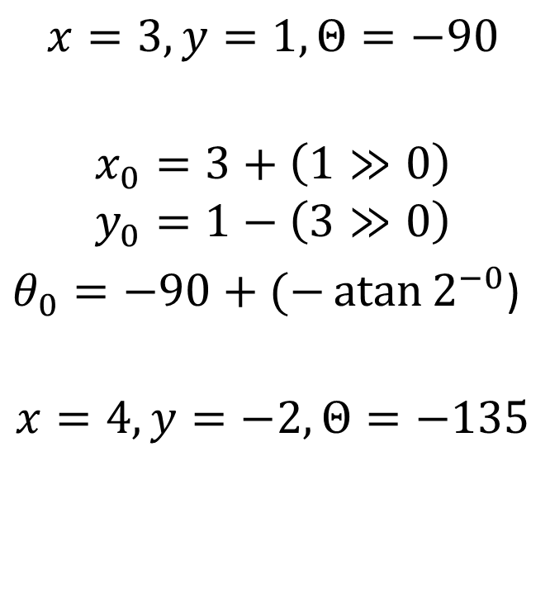
Example: Finding the Phase I=0
Iteration 0
Y is positive
Rotate “Down”
$$x=3, y=1, Θ=−90$$
$$x_{0}=3+\left(1≫0\right)$$
$$y_{0}=1−\left(3≫0\right)$$
$θ_{0}=−90+(−\operatorname{atan}{2^{−0}}$)
$$x=4, y=−2, Θ=−135$$

Slide 42
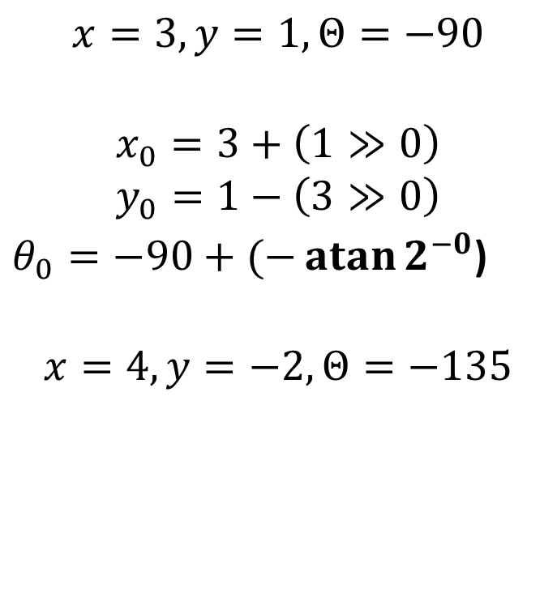
Example: Finding the Phase I=0
Iteration 0
Y is positive
Rotate “Down”
-atan2^-0 from LUT
=45 degrees
NOTE: Magnitude changed
|-1+3j| != |4+2j|
$$x=3, y=1, Θ=−90$$
$$x_{0}=3+\left(1≫0\right)$$
$$y_{0}=1−\left(3≫0\right)$$
$θ_{0}=−90+(−\operatorname{atan}{2^{−0}}$)
$$x=4, y=−2, Θ=−135$$

Slide 43
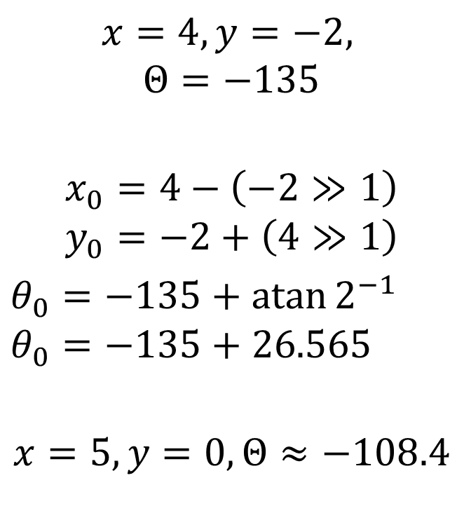

Example: Finding the Phase I=1
Iteration 1
Y is negative
Rotate “Up”
$\operatorname{atan}{2^{−1}}≈26.565$
$$x=4, y=−2,$$
$$Θ=−135$$
$$x_{0}=4−\left(−2≫1\right)$$
$$y_{0}=−2+\left(4≫1\right)$$
$θ_{0}=−135+\operatorname{atan}{2^{−1}}$ $θ_{0}=−135+26.565$
$$x=5, y=0, Θ≈−108.4$$

Slide 44

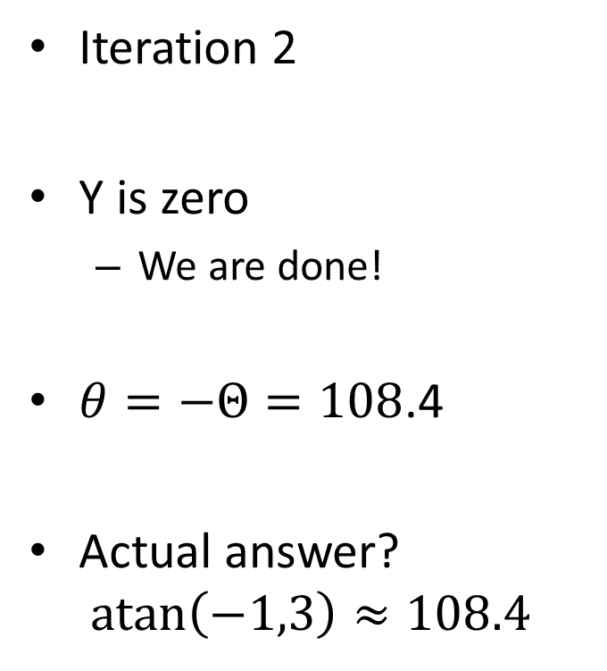
Example: Finding the Phase I=2
Iteration 2
Y is zero
We are done!
$θ=−Θ=108$.4
Actual answer?
$$atan\left(−1,3\right)≈108.4$$
$$x=5, y=0,$$
$$Θ=−108.4$$

Slide 45

Example: Finding the Magnitude
Apply the $\frac{1}{\sqrt{1+2^{−2i}}}$ compensations now
5$\frac{1}{\sqrt{1+2^{−0}}}\frac{1}{\sqrt{1+2^{−2}}}=\sqrt{1^{2}+3^{2}}≈3.1622…$

Slide 46
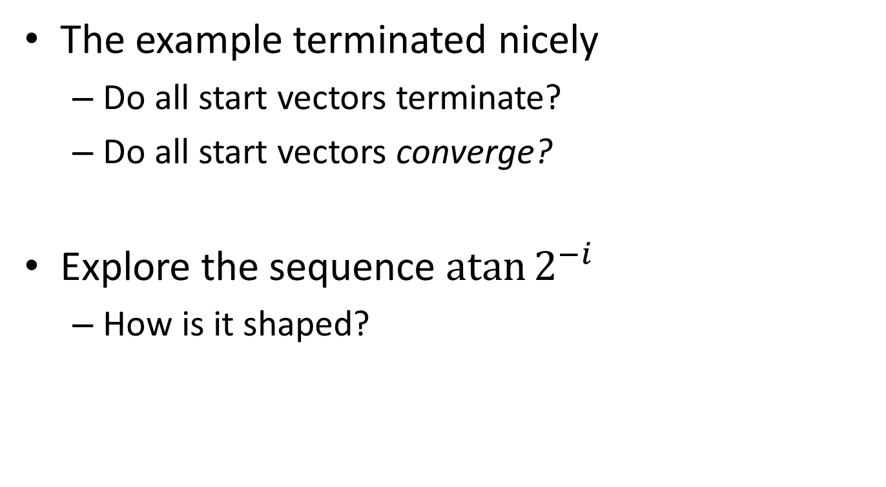
Am I lucky or what?!
The example terminated nicely
Do all start vectors terminate?
Do all start vectors converge?
Explore the sequence $\operatorname{atan}{2^{−i}}$
How is it shaped?
Notes:
Since it reduces slower than 2^-i, we will always converge!

Slide 47
The Point?
Area increases linearly per bit of accuracy
Cheap Hardware
Very reusable

Slide 48
With Remaining Time
Relax
OR
Do any of these in Python / MATLAB / MIPS:
CORDIC – Sine? Arcsine?
Newton Raphson – invsqrt?
Better than Taylor Approximation – annealing!

Slide 50
With Remaining Time
Play with CORDIC
What other functions can it calculate?
Continue with practice from before
Start HW3

Slide 51
Group Work
Poly/LUT fit a transcendental function
(Co)sine, e^x, or something else
Pick a range
Pick an accuracy – 24 bits?
Start with a Taylor approximation
LUT Depth? Number of terms?
What is your worst case error?
Try annealing a bit
How much did it improve?
Create and Save Figures!
We will discuss as a class

Slide 52
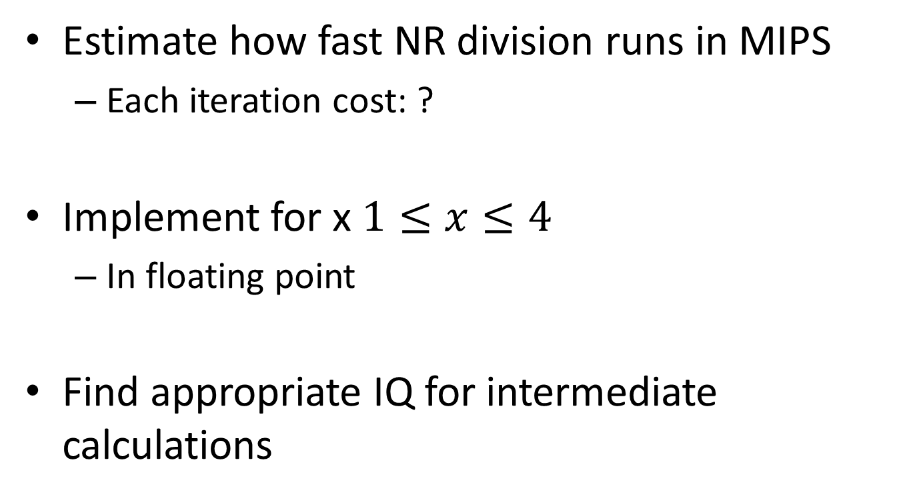
With Remaining Time
Estimate how fast NR division runs in MIPS
Each iteration cost: ?
Implement for x $1≤x≤4$
In floating point
Find appropriate IQ for intermediate calculations

