Slide 1
b0001 Boolean Logic
ENGR xD52
Eric VanWyk
Fall 2013

Slide 2
Acknowledgements
Mark L. Chang lecture notes for Computer Architecture (Olin ENGR3410)
Patterson & Hennessy: Book & Lecture Notes
Patterson’s 1997 course notes (U.C. Berkeley CS 152, 1997)
Tom Fountain 2000 course notes (Stanford EE182)
Michael Wahl 2000 lecture notes (U. of Siegen CS 3339)
Ben Dugan 2001 lecture notes (UW-CSE 378)
Professor Scott Hauck lecture notes (UW EE 471)
Mark L. Chang lecture notes for Digital Logic (NWU B01)

Slide 3
Today:
Review Survey from last class
Review of Basic Boolean Laws
Clarification of a Basic Law
Truth Tables and Karnaugh Maps

Slide 4
Most Favoritest Processors
“whatever I have in my laptop”
Second was “what?”
Specific Intel part numbers
ARM
M-Cortex!
DSP
ATMega (328)
TM4C1294NCPDT (M4F)
AIC3254 (MiniDSP)
Knight’s Landing (Septuagintaduple cores)
Snapdragon
Raspberry Pi (BCM2835 -> ARM1176JZF-S + GPU)
IBM TrueNorth (Synaptic Processor)
AMD64
Pentium M
Intel 4004
Image Processor / GPU
PIC18f4520
Microsoft Word/Food Processor

Slide 5
I want to learn:
Why NAND/NOR is ‘universal’
Boolean Logic
How math happens
2’s compliment
Endian
Floats
What makes an architecture ‘good’ or ‘elegant’
How to Debug / Test / Fix / Analyze large systems
What else is in a computer
How to program in assembly
What do I need to know
what can be ignored?
Communications
SPI
Ethernet
Memory Hierarchy and Distribution
Do I actually want to be an ECE/SparkE? (YES)
Embedded Development
Clock speed * # of cores = goodness?
Future of Comp Arch?
GPUs
FPGAs

Slide 6
I want to learn:
Why NAND/NOR is ‘universal’
Boolean Logic
How math happens
2’s compliment
Endian
Floats
What makes an architecture ‘good’ or ‘elegant’
How to Debug / Test / Fix / Analyze large systems
What else is in a computer
How to program in assembly
What do I need to know
what can be ignored?
Communications
SPI
Ethernet
Memory Hierarchy and Distribution
Do I actually want to be an ECE/SparkE? (YES)
Embedded Development
Clock speed * # of cores = goodness?
Future of Comp Arch?
GPUs
FPGAs

Slide 7
I want to learn:
Why NAND/NOR is ‘universal’
Boolean Logic
How math happens
2’s compliment
Endian
Floats
What makes an architecture ‘good’ or ‘elegant’
How to Debug / Test / Fix / Analyze large systems
What else is in a computer
How to program in assembly
What do I need to know
what can be ignored?
Communications
SPI
Ethernet
Memory Hierarchy and Distribution
Do I actually want to be an ECE/SparkE? (YES)
Embedded Development
Clock speed * # of cores = goodness?
Future of Comp Arch?
GPUs
FPGAs

Slide 8
I want to learn:
Why NAND/NOR is ‘universal’
Boolean Logic
How math happens
2’s compliment
Endian
Floats
What makes an architecture ‘good’ or ‘elegant’
How to Debug / Test / Fix / Analyze large systems
What else is in a computer
How to program in assembly
What do I need to know
what can be ignored?
Communications
SPI
Ethernet
Memory Hierarchy and Distribution
Do I actually want to be an ECE/SparkE? (YES)
Embedded Development
Clock speed * # of cores = goodness?
Future of Comp Arch?
GPUs
FPGAs

Slide 9
Review of Boolean Algebra
1930s: Shannon applies Boole’s algebra to circuits and logic gates
Method to improve representation of a given circuit or logic
Execution speed
Resources consumed
Basis of modern processors

Slide 10
Boolean Laws
1+1 = 1
… Sorry.

Slide 11
Boolean Laws So Far
X + 0 = X
X * 1 = X
X + 1 = 1
X * 0 = 0
X + X = X
X * X = X X + X̅ = 1
X * X̅ = 0
~~X = X
X+XY = X
XY+XY̅ = X
X+X̅Y = X+Y
X(X+Y) = X
(X+Y)(X+Y̅) = X
X(X̅+Y) = XY
X+Y = Y+X
XY = YX
X+(Y+Z) = (X+Y)+Z
X(YZ) = (XY)Z
X(Y+Z) = XY + XZ
X+YZ = (X+Y)(X+Z)
Notes:
Derived in class last week

Slide 12
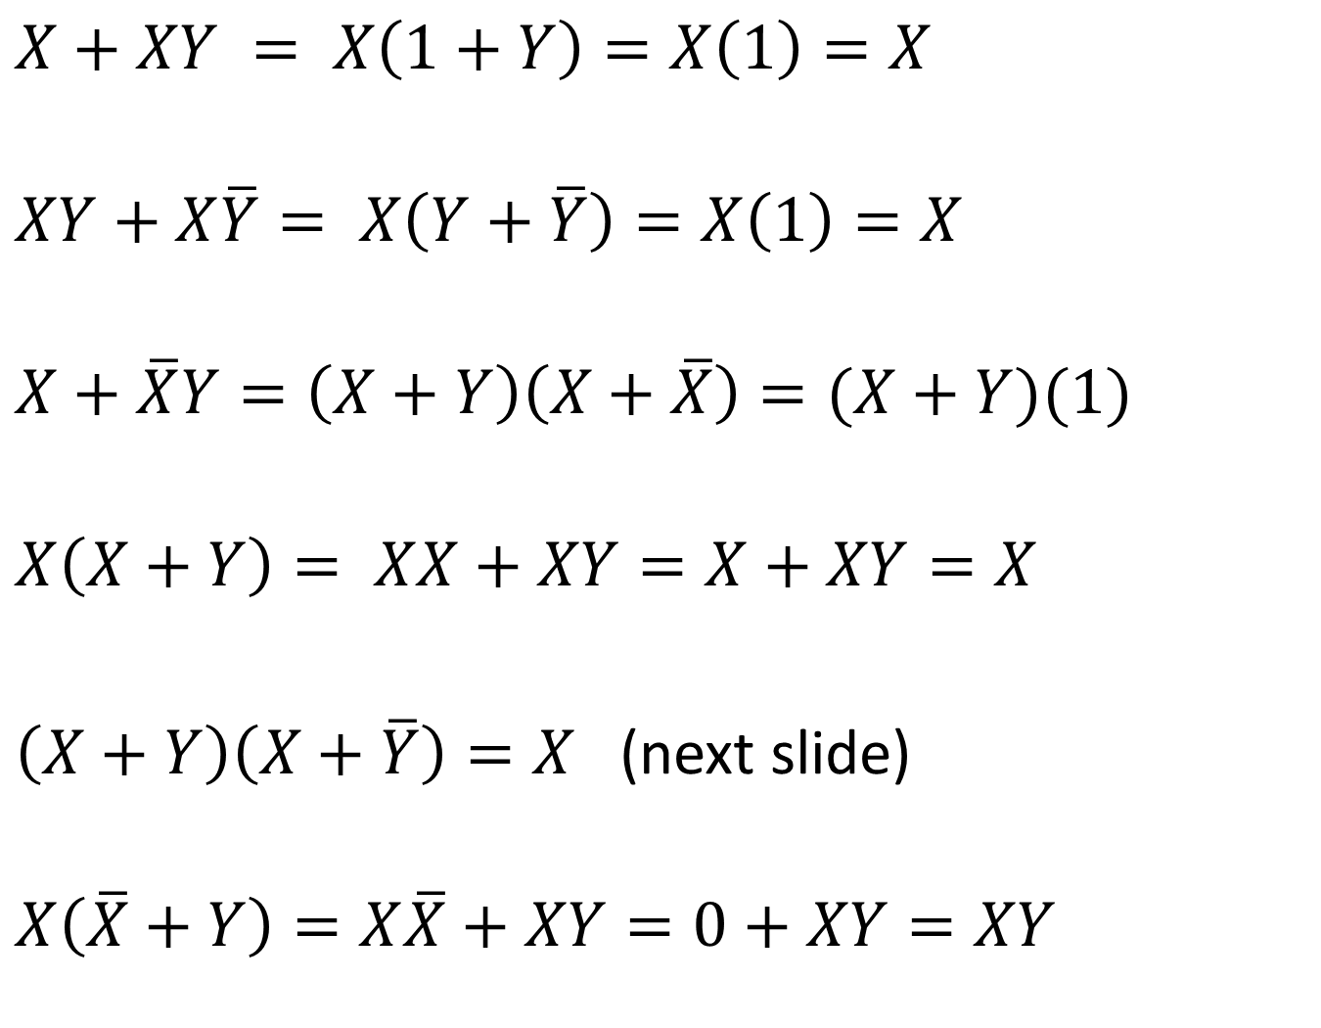
$$X+XY = X\left(1+Y\right)=X\left(1\right)=X$$
$$XY+X\overline{Y}= X\left(Y+\overline{Y}\right)=X\left(1\right)=X$$
$$X+\overline{X}Y=\left(X+Y\right)\left(X+\overline{X}\right)=(X+Y)(1)$$
$$X\left(X+Y\right)= XX+XY=X+XY=X$$
$\left(X+Y\right)\left(X+\overline{Y}\right)=X$ (next slide)
$$X\left(\overline{X}+Y\right)=X\overline{X}+XY=0+XY=XY$$

Slide 13


$$\left(X+Y\right)\left(X+\overline{Y}\right)=X$$
$$XX+XY+X\overline{Y}+Y\overline{Y}$$
$$X+X\left(Y+\overline{Y}\right)+0$$
X+X(1)
X

Slide 14
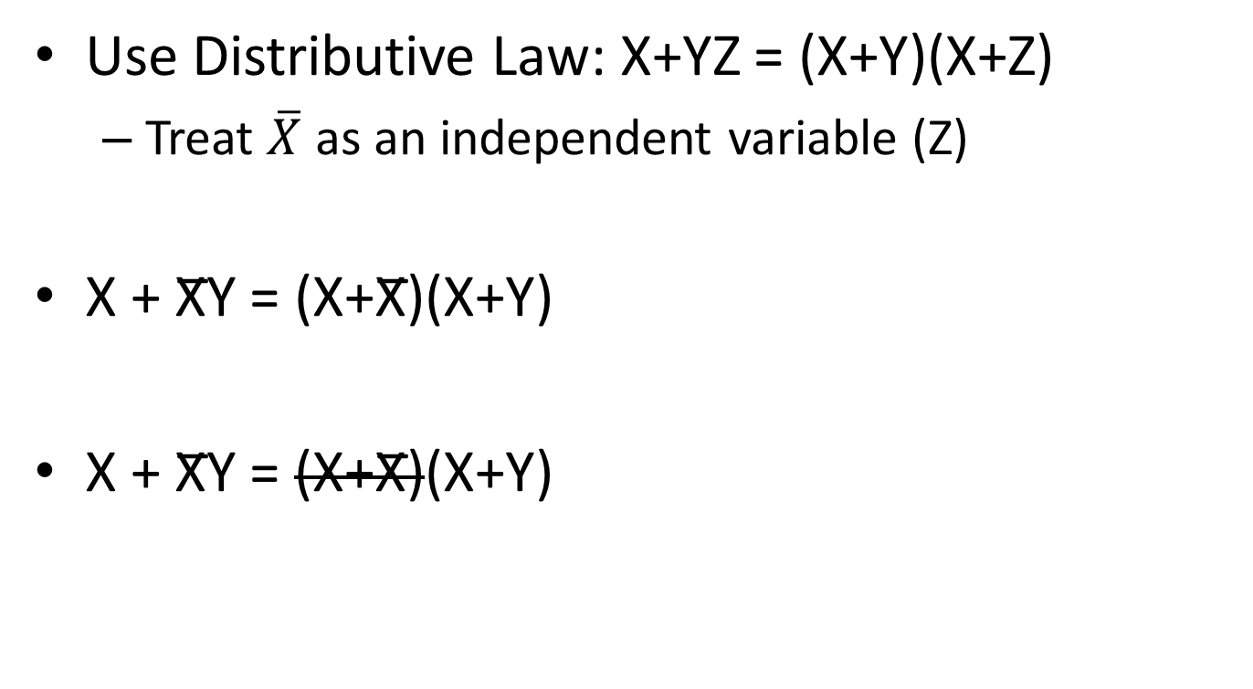
X + X̅Y = X+Y
Use Distributive Law: X+YZ = (X+Y)(X+Z)
Treat $\overline{X}$ as an independent variable (Z)
X + X̅Y = (X+X̅)(X+Y)
X + X̅Y = (X+X̅)(X+Y)
Notes:
Treat ~X as an independent variable for the use of the distributive law

Slide 15
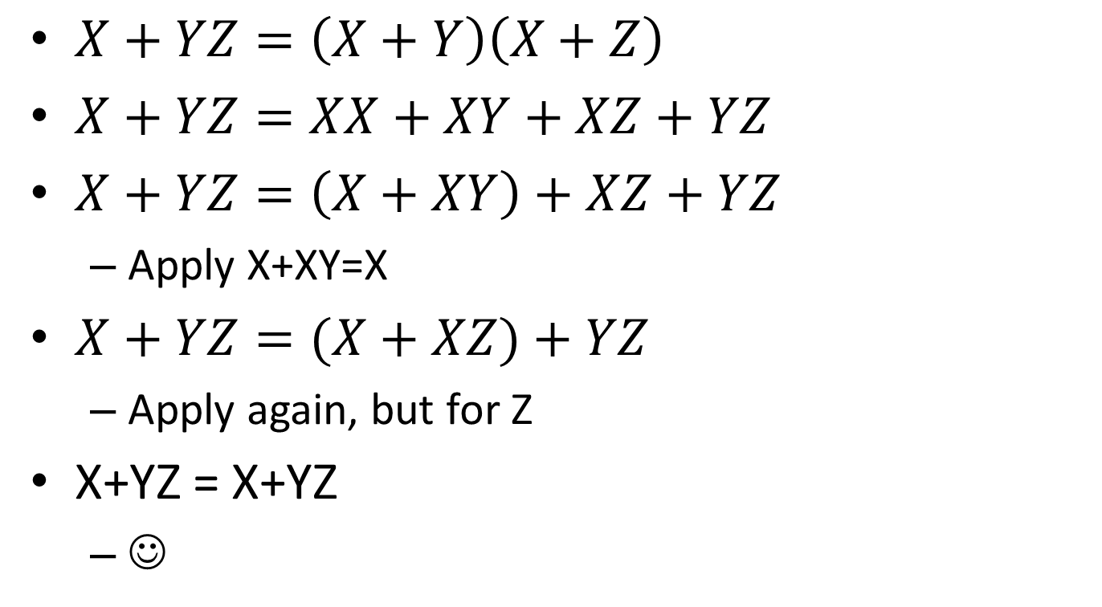
Proving Distributive Law
$X+YZ=\left(X+Y\right)\left(X+Z\right)$
$X+YZ=XX+XY+XZ+YZ$
$X+YZ=\left(X+XY\right)+XZ+YZ$
Apply X+XY=X
$X+YZ=(X+XZ)+YZ$
Apply again, but for Z
X+YZ = X+YZ
☺

Slide 16
Mechanical Forms
Truth Table
Good for finding the results of equations
Build up large equations in chunks
Karnaugh Map
Good for finding new representations of equations
Only really useable for up to 4 inputs at a time
((For Humans, synthesizers do many more))

Slide 17
Times Tables
X | 1 | 2 | 3 | 4
1 | 1 | 2 | 3 | 4
2 | 2 | 4 | 6 | 8
3 | 3 | 6 | 9 | 12
4 | 4 | 8 | 12 | 16

Slide 18
Boolean Tables
X | 0 | 1
0 | 0 | 0
1 | 0 | 1
+ | 0 | 1
0 | 0 | 1
1 | 1 | 1 2
AND Operator
OR Operator

Slide 19
Truth Tables
A | B | AB
0 | 0 | 0
0 | 1 | 0
1 | 0 | 0
1 | 1 | 1
A | B | A+B
0 | 0 | 0
0 | 1 | 1
1 | 0 | 1
1 | 1 | 1
AND Operator
OR Operator

Slide 20
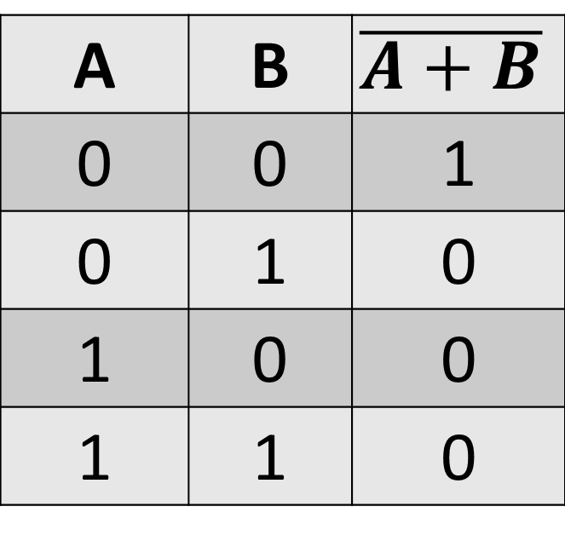
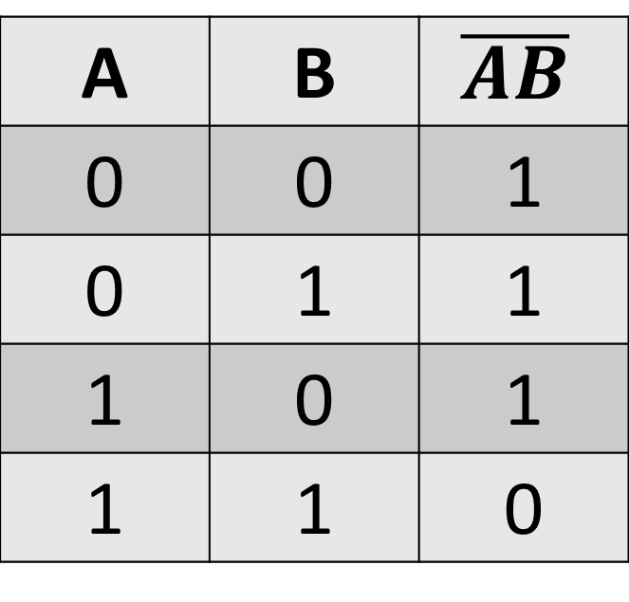
Truth Tables
A | B | $$\overline{AB}$$
0 | 0 | 1
0 | 1 | 1
1 | 0 | 1
1 | 1 | 0
A | B | $$\overline{A+B}$$
0 | 0 | 1
0 | 1 | 0
1 | 0 | 0
1 | 1 | 0
NAND Operator
NOR Operator

Slide 21



Truth Tables
Inputs in left columns
Outputs on the right
Notes in the middle
Enumerate all input combinations
Count in Binary
Calculate each Row
Equations are equivalent if they have matching truth tables
Notes:
My preference is to start with 0 0 0 and increment as though counting in binary.
Do truth table for basic law on white board X+YZ = (X+Y)(X+Z)
X y z (X+Y)

Slide 22
Example: X+YZ = (X+Y)(X+Z)
X | Y | Z | YZ | X+Y | X+Z | (X+Y)(X+Z) | X+YZ
0 | 0 | 0
0 | 0 | 1
0 | 1 | 0
0 | 1 | 1
1 | 0 | 0
1 | 0 | 1
1 | 1 | 0
1 | 1 | 1

Slide 23
Example: X+YZ = (X+Y)(X+Z)
X | Y | Z | YZ | X+Y | X+Z | (X+Y)(X+Z) | X+YZ
0 | 0 | 0 | 0 | 0 | 0
0 | 0 | 1 | 0 | 0 | 1
0 | 1 | 0 | 0 | 1 | 0
0 | 1 | 1 | 1 | 1 | 1
1 | 0 | 0 | 0 | 1 | 1
1 | 0 | 1 | 0 | 1 | 1
1 | 1 | 0 | 0 | 1 | 1
1 | 1 | 1 | 1 | 1 | 1

Slide 24
Example: X+YZ = (X+Y)(X+Z)
X | Y | Z | YZ | X+Y | X+Z | (X+Y)(X+Z) | X+YZ
0 | 0 | 0 | 0 | 0 | 0 | 0 | 0
0 | 0 | 1 | 0 | 0 | 1 | 0 | 0
0 | 1 | 0 | 0 | 1 | 0 | 0 | 0
0 | 1 | 1 | 1 | 1 | 1 | 1 | 1
1 | 0 | 0 | 0 | 1 | 1 | 1 | 1
1 | 0 | 1 | 0 | 1 | 1 | 1 | 1
1 | 1 | 0 | 0 | 1 | 1 | 1 | 1
1 | 1 | 1 | 1 | 1 | 1 | 1 | 1

Slide 25
Truth Table -> Equation
Just used a truth table to prove equivalency
Start with two equations
Used for Equation Transformations?
Start with one equation, create another

Slide 26

Truth Table -> Equation
X | Y | Z | (X+Y)(X+Z)
0 | 0 | 0 | 0
0 | 0 | 1 | 0
0 | 1 | 0 | 0
0 | 1 | 1 | 1
1 | 0 | 0 | 1
1 | 0 | 1 | 1
1 | 1 | 0 | 1
1 | 1 | 1 | 1
$$\overline{X}\overline{Y}\overline{Z}$$
$$\overline{X}\overline{Y}Z$$
$$\overline{X}Y\overline{Z}$$
$$\overline{X}YZ$$
$$X\overline{Y}\overline{Z}$$
$$X\overline{Y}Z$$
$$XY\overline{Z}$$
$$XYZ$$

Slide 27

Truth Table -> Equation
X | Y | Z | (X+Y)(X+Z)
0 | 0 | 0 | 0
0 | 0 | 1 | 0
0 | 1 | 0 | 0
0 | 1 | 1 | 1
1 | 0 | 0 | 1
1 | 0 | 1 | 1
1 | 1 | 0 | 1
1 | 1 | 1 | 1
$$\overline{X}\overline{Y}\overline{Z}$$
$$\overline{X}\overline{Y}Z$$
$$\overline{X}Y\overline{Z}$$
$$\overline{X}YZ$$
$$X\overline{Y}\overline{Z}$$
$$X\overline{Y}Z$$
$$XY\overline{Z}$$
$$XYZ$$

Slide 28

Truth Table -> Equation
X | Y | Z | (X+Y)(X+Z)
0 | 0 | 0 | 0
0 | 0 | 1 | 0
0 | 1 | 0 | 0
0 | 1 | 1 | 1
1 | 0 | 0 | 1
1 | 0 | 1 | 1
1 | 1 | 0 | 1
1 | 1 | 1 | 1
$\overline{X}YZ$+
$$X\overline{Y}\overline{Z}\text{+}$$
$$X\overline{Y}Z\text{+}$$
$$XY\overline{Z}\text{+}$$
$$XYZ$$

Slide 29
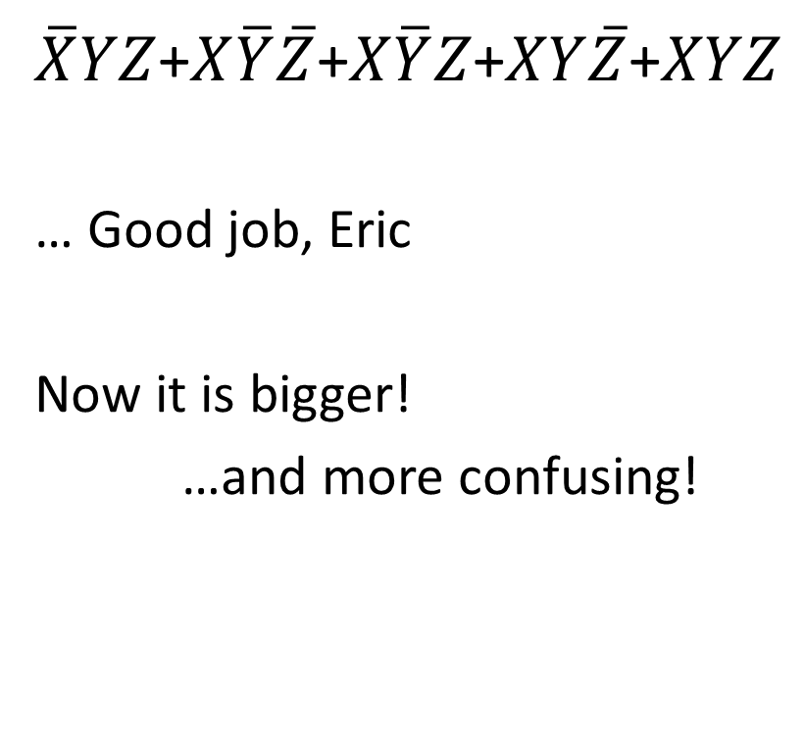
Truth Table -> Equation
X | Y | Z | (X+Y)(X+Z)
0 | 0 | 0 | 0
0 | 0 | 1 | 0
0 | 1 | 0 | 0
0 | 1 | 1 | 1
1 | 0 | 0 | 1
1 | 0 | 1 | 1
1 | 1 | 0 | 1
1 | 1 | 1 | 1
$\overline{X}YZ$+$X\overline{Y}\overline{Z}\text{+}X\overline{Y}Z\text{+}XY\overline{Z}\text{+}XYZ$
… Good job, Eric
Now it is bigger!
…and more confusing!

Slide 30
Karnaugh Map
Moving one square changes only one input.
Cover all 1s with boxes.
Boxes must be power of 2 sized.
Create Sum of Products
Boxes can “wrap around” the edges of the map.
Toroidal mapping
Invented in ‘52 by Maurice Karnaugh
Notes:
Note: Gray coded! This means only one transition for one movement.

Slide 31
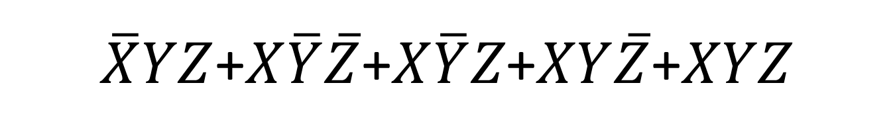
$\overline{X}YZ$+$X\overline{Y}\overline{Z}\text{+}X\overline{Y}Z\text{+}XY\overline{Z}\text{+}XYZ$
X | Y | Z | (X+Y)(X+Z)
0 | 0 | 0 | 0
0 | 0 | 1 | 0
0 | 1 | 0 | 0
0 | 1 | 1 | 1
1 | 0 | 0 | 1
1 | 0 | 1 | 1
1 | 1 | 0 | 1
1 | 1 | 1 | 1
 | X | ~X
YZ | XYZ | ~XYZ
~YZ | X~YZ | ~X~YZ
~Y~Z | X~Y~Z | ~X~Y~Z
Y~Z | XY~Z | ~XY~Z

Slide 32
X | Y | Z | (X+Y)(X+Z)
0 | 0 | 0 | 0
0 | 0 | 1 | 0
0 | 1 | 0 | 0
0 | 1 | 1 | 1
1 | 0 | 0 | 1
1 | 0 | 1 | 1
1 | 1 | 0 | 1
1 | 1 | 1 | 1
 | X | ~X
YZ | 1
~YZ
~Y~Z
Y~Z

Slide 33
X | Y | Z | (X+Y)(X+Z)
0 | 0 | 0 | 0
0 | 0 | 1 | 0
0 | 1 | 0 | 0
0 | 1 | 1 | 1
1 | 0 | 0 | 1
1 | 0 | 1 | 1
1 | 1 | 0 | 1
1 | 1 | 1 | 1
 | X | ~X
YZ | 1
~YZ |  | 0
~Y~Z |  | 0
Y~Z |  | 0

Slide 34
X | Y | Z | (X+Y)(X+Z)
0 | 0 | 0 | 0
0 | 0 | 1 | 0
0 | 1 | 0 | 0
0 | 1 | 1 | 1
1 | 0 | 0 | 1
1 | 0 | 1 | 1
1 | 1 | 0 | 1
1 | 1 | 1 | 1
 | X | ~X
YZ | 1 | 1
~YZ | 1 | 0
~Y~Z | 1 | 0
Y~Z | 1 | 0

Slide 35
X | Y | Z | (X+Y)(X+Z)
0 | 0 | 0 | 0
0 | 0 | 1 | 0
0 | 1 | 0 | 0
0 | 1 | 1 | 1
1 | 0 | 0 | 1
1 | 0 | 1 | 1
1 | 1 | 0 | 1
1 | 1 | 1 | 1
 | X | ~X
YZ | 1 | 1
~YZ | 1 | 0
~Y~Z | 1 | 0
Y~Z | 1 | 0

Slide 36
X+YZ
X | Y | Z | (X+Y)(X+Z)
0 | 0 | 0 | 0
0 | 0 | 1 | 0
0 | 1 | 0 | 0
0 | 1 | 1 | 1
1 | 0 | 0 | 1
1 | 0 | 1 | 1
1 | 1 | 0 | 1
1 | 1 | 1 | 1
 | X | ~X
YZ | 1 | 1
~YZ | 1 | 0
~Y~Z | 1 | 0
Y~Z | 1 | 0
YZ
X

Slide 37
Karnaugh Map
Moving one square changes only one input.
Cover all 1s with boxes.
Boxes must be power of 2 sized.
Create Sum of Products
Boxes can “wrap around” the edges of the map.
Toroidal mapping
Invented in ‘52 by Maurice Karnaugh
Notes:
Note: Gray coded! This means only one transition for one movement.

Slide 38
Four Input Karnaugh Map Example
 | AB | A̅B | A̅B̅ | AB̅
CD | ABCD | A̅BCD | A̅B̅CD | AB̅CD
C̅D | ABC̅D | A̅BC̅D | A̅B̅C̅D | AB̅C̅D
C̅D̅ | ABC̅D̅ | A̅BC̅D̅ | A̅B̅C̅D̅ | AB̅C̅D̅
CD̅ | ABCD̅ | A̅BCD̅ | A̅B̅CD̅ | AB̅CD̅
Which “advanced” law allows us to combine boxes?

Slide 39
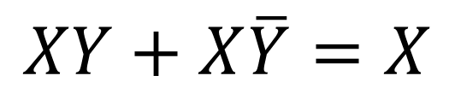
Four Input Karnaugh Map Example
 | AB | A̅B | A̅B̅ | AB̅
CD | ABCD | A̅BCD | A̅B̅CD | AB̅CD
C̅D | ABC̅D | A̅BC̅D | A̅B̅C̅D | AB̅C̅D
C̅D̅ | ABC̅D̅ | A̅BC̅D̅ | A̅B̅C̅D̅ | AB̅C̅D̅
CD̅ | ABCD̅ | A̅BCD̅ | A̅B̅CD̅ | AB̅CD̅
Which “advanced” law allows us to combine boxes?
$$XY+X\overline{Y}=X$$

Slide 40
4 Input Karnaugh Map (WhiteBoard)
 | AB | A̅B | A̅B̅ | AB̅
CD | ABCD | A̅BCD | A̅B̅CD | AB̅CD
C̅D | ABC̅D | A̅BC̅D | A̅B̅C̅D | AB̅C̅D
C̅D̅ | ABC̅D̅ | A̅BC̅D̅ | A̅B̅C̅D̅ | AB̅C̅D̅
CD̅ | ABCD̅ | A̅BCD̅ | A̅B̅CD̅ | AB̅CD̅

Slide 41
Why Karnaugh?
“Mechanical” method guaranteed to get something that works.
Result is only two layers deep – Fast!

Slide 42
Why not Karnaugh?
Confusing visually for more than 4 variables
But it still works if you squint
Optimizes for speed, not space.

Slide 43
To The Boards!
Prove equivalency:
F=(X+Y̅+XY̅)(XY+X̅Z+YZ)
Evaluate Truth Table
Pro Tip: Build in Layers
Simplify with Karnaugh
Simplify again with Boolean Law
Draw with Gates
(X + Y) = X * Y
(X * Y) = X + Y
X
Y
X
Y
X
+
Y
X•Y
0
0
1
1
0
1
1
0
1
0
0
1
1
1
0
0
X
Y
X
Y
X•Y
X
+
Y
0
0
1
1
0
1
1
0
1
0
0
1
1
1
0
0

Slide 44
DeMorgan’s Law
X
Y
X
Y
X
+
Y
X•Y
0
0
1
1
(X + Y) = X * Y
0
1
1
0
1
0
0
1
1
1
0
0
(X * Y) = X + Y
X
Y
X
Y
X•Y
X
+
Y
0
0
1
1
0
1
1
0
1
0
0
1
1
1
0
0
The negation of a conjunction is the disjunction of the negations.
The negation of a disjunction is the conjunction of the negations.*
* Thanks, Wikipedia!

Slide 45
DeMorgan’s Law
Provides a way to convert AND ←→ OR
Flip ALL the things
Invert all the inner terms
Swap AND ←→ OR
Invert the entire boolean phrase
This works for a single gate with arbitarily many inputs

Slide 46
The Universal Gates
Karnaugh maps can frame any boolean equation in sum of products (OR of ANDs)
DeMorgan can frame any AND/OR in NAND/NORs
NAND and NOR can represent any combinatorial boolean equation.
Notes:
NAND or NOR can be used as an inverter by tying the inputs together

Slide 47
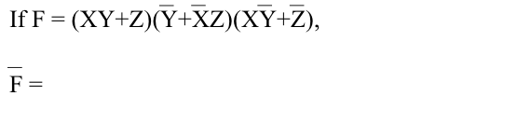
DeMorgan’s Law example
Example:
Z = A B C + A B C + A B C + A B C
Z = (A + B + C) * (A + B + C) * (A + B + C) * (A + B + C)

Slide 48
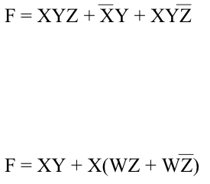
Boolean Equations to Circuit Diagrams

Slide 49
HW1 is Posted
Due September 15th Midnight
But you submit by showing a NINJA
They have sleep schedules

