Slide 1
Quizzical Projection
ENGR xD52
Eric VanWyk
Fall 2014

Slide 2
Today
Pop Quiz
Final Project Coordination
mp3 Work Time

Slide 3
Quiz
Closed Books, Closed Notes, Closed Internet
You can use MARS (but it is likely a waste of time)
40 minutes
Email to comparch2014@gmail.com
[Quiz0] YourName

Slide 4


Slide 5
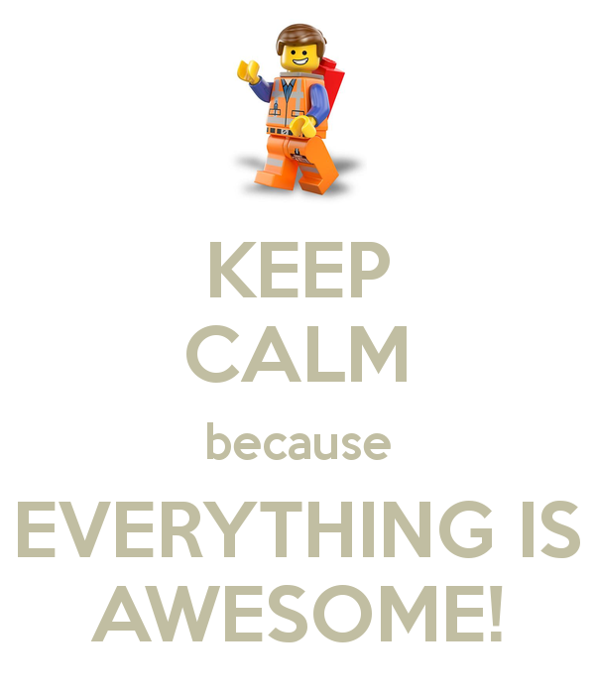

Slide 6

1 Minutes

Slide 7

5 Minute

Slide 8

Turn It In!

Slide 9
Final Project Catagories
Communication
Peripherals
Math
Electronics
Mechanics
Video
Audio
Pedagogy

Slide 10
Communication / Peripherals
CAN
PWM
SPI
UART
I2C
As a slave to another device (mp2)
As a peripheral on your processor (mp3)
As a co-processor

Slide 11
Math
Fixed Point Math Library in ASM
Numerical Methods
Implement additional math opcodes
Fast Math Structures
Neat Adders / Multipliers
Cryptanalysis

Slide 12
Electronics
Logic Gates (on a PCB)
74 series logic?
Old School Memory
Prox Card Reader / Writer

Slide 13
Mechanics
K’Nex Logic
Fix existing Library Stuff
Make something more visually intuitive

Slide 14
Video
Video Games
On an FPGA
About Comp Arch
In Minecraft
Video / Image Processing
On an FPGA

Slide 15
Audio
Chip Tunes
FPGA Piano
Filtering / Processing sound

Slide 16
Pedagogy
Intro to ModelSim for future students
Tips / Tricks / Hacks
Machine Learning / GA
Ehhhhhh….

Slide 17
Key Point: Flexible Deliverables
Enumerate, Prioritize, Nest your deliverables
Implement the DCPU-16 from 0x10^c
Runs a specific program with limited instructions
Runs all opcodes
In Modelsim
On an FPGA
On an FPGA as a co-processor

Slide 18
Planning Keys
What do you do when stuff happens?
Give possible faults with mitigations
Ex: The FPGA is too small to fit our code
Convert more behavioral code to structural
Purchase a larger FPGA (schedule?)
Run in simulation only
Reduce feature set to fit

Slide 19
Initial Project Proposal
Project Name
Team Members
1-3 paragraphs description of project
Red / Yellow / Green Feature sets
2 potential things that can go wrong, with mitigations
What are your two next steps?
1-2 Pages Total
Due Wednesday after Turkeys Get Ate

Slide 20
Midterm Discussion Time
Emily wants us to freestyle rap about midterm
How did you:
Input Condition
Handle the 4 states
Generate the pattern
Be Awesome

