Slide 1
b0010 Time for Time
ENGR xD52
Eric VanWyk
Fall 2012

Slide 2
Acknowledgements
Mark L. Chang lecture notes for Computer Architecture (Olin ENGR3410)
Patterson & Hennessy: Book & Lecture Notes
Patterson’s 1997 course notes (U.C. Berkeley CS 152, 1997)
Tom Fountain 2000 course notes (Stanford EE182)
Michael Wahl 2000 lecture notes (U. of Siegen CS 3339)
Ben Dugan 2001 lecture notes (UW-CSE 378)
Professor Scott Hauck lecture notes (UW EE 471)
Mark L. Chang lecture notes for Digital Logic (NWU B01)
Texas Instruments Data Sheets

Slide 3
Today
The ravages of time
Latches, Flip Flops

Slide 4
Combinational vs. Sequential Logic
X
Z
Network implemented from logic gates.
The presence of feedback
distinguishes between sequential
and combinational networks.
1
1
X
Logic
Z
2
2
-
-
-
Network
-
X
-
-
Z
n
m
Combinational logic
no feedback among inputs and outputs
outputs are a pure function of the inputs
e.g., seat belt light:
(Dbelt, Pbelt, Passenger) mapped into (Light)
Driver_belt
Logic Circuit
Passenger_belt
Seat Belt Light
Passenger

Slide 5
Circuit Timing Behavior
Simple model: gates react after fixed delay
A
D
E
B
C
F
A
B
C
D
E
F
0
1
1
0
Notes:
Why not immediately?
Parasitic Capacitance * Output Impedence forms an RC low pass (simple model)

Slide 6
Circuit Timing Behavior
Simple model: gates react after fixed delay
A
D
E
B
C
F
A
B
C
D
E
F
0
1
1
0

Slide 7
Hazards/Glitches
Circuit can temporarily go to incorrect states
Copilot Autopilot Request
B
A
Pilot in Charge?
Autopilot Engaged
Pilot Autopilot Request
C
CAR
PIC
PAR
A
B
C
AE
Must filter out temporary states

Slide 8
Hazards/Glitches
Circuit can temporarily go to incorrect states
Copilot Autopilot Request
B
A
Pilot in Charge?
Autopilot Engaged
Pilot Autopilot Request
C
CAR
PIC
PAR
A
B
C
AE
OH NO
Must filter out temporary states

Slide 9
Safe Sequential Circuits
Clocked elements on feedback, perhaps outputs
Clock signal synchronizes operation
Clocked elements hide glitches/hazards
X
Z
1
1
X
Logic
Z
2
2
-
-
-
Network
-
X
-
-
Z
n
m
Clock
Clock
Data
Compute
Valid
Compute
Valid
Compute

Slide 10
Safe Sequential Circuits
Clocked elements on feedback, perhaps outputs
Clock signal synchronizes operation
Clocked elements hide glitches/hazards
X
Z
1
1
X
Logic
Z
2
2
-
-
-
Network
-
X
-
-
Z
n
m
Clock
Clock
Data
GLITCHES
Stable
GLITCHES
Stable
GLITCHES

Slide 11
“Clocked” Elements
Two main categories:
Flip Flops and Latches
“Hold on” to state until triggered to update.
Many kinds

Slide 12
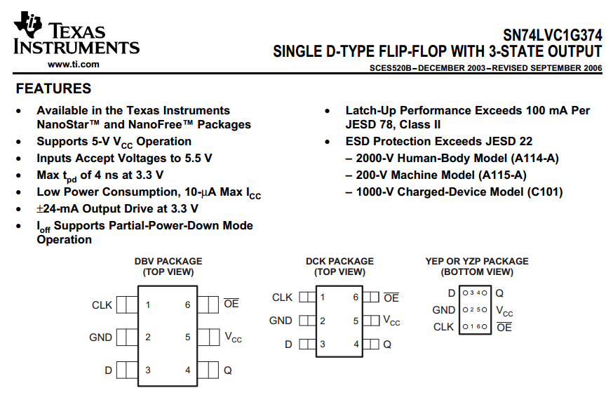
http://www.ti.com/lit/ds/symlink/sn74lvc1g374.pdf

Slide 13
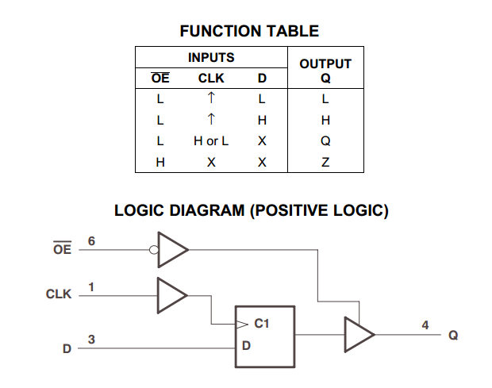
http://www.ti.com/lit/ds/symlink/sn74lvc1g374.pdf
Notes:
What does X mean? It means we don’t care what the input is

Slide 14
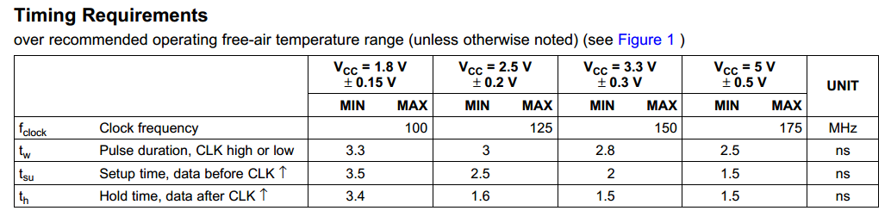
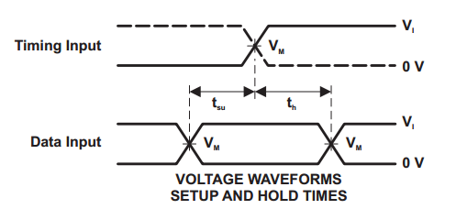
http://www.ti.com/lit/ds/symlink/sn74lvc1g374.pdf

Slide 15
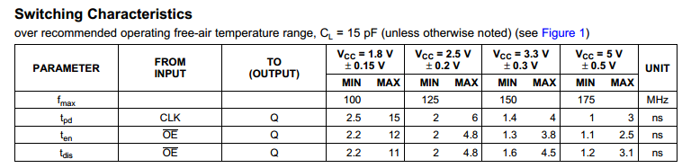
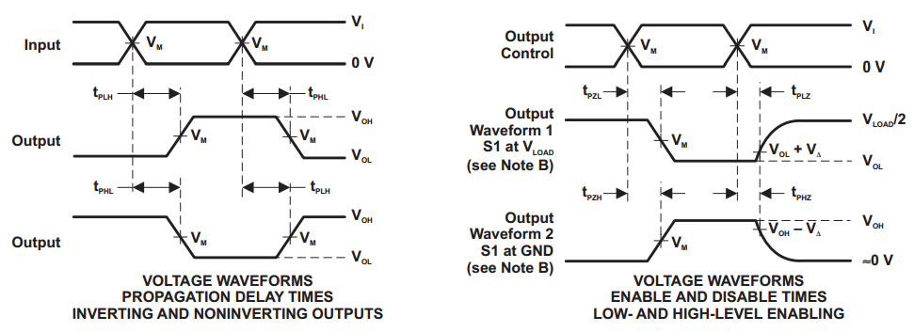
http://www.ti.com/lit/ds/symlink/sn74lvc1g374.pdf

Slide 16
Vocab!
Setup – Required stability before
Hold – Required stability after
Propagation Delay – Until outputs update

Slide 17
Reinventing the SR Latch
“SR” for “Set Reset”
Cross-coupled NOR/NAND
S | R | Q Next
0 | 0
0 | 1
1 | 0
1 | 1
http://en.wikipedia.org/wiki/File:R-S_mk2.gif

Slide 18
Reinventing the SR Latch
“SR” for “Set Reset”
Cross-coupled NOR/NAND
S | R | Q Next
0 | 0 | Q
0 | 1 | 0
1 | 0 | 1
1 | 1 | X
http://en.wikipedia.org/wiki/File:R-S_mk2.gif

Slide 19

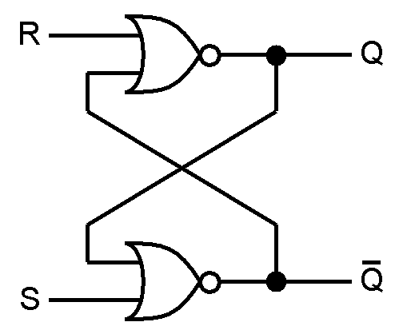
SR Latch Timing
S
R
Q
Q ̅

Slide 20
SR Latch Timing
S
R
Q
Q ̅

Slide 21
SR Latch Timing
S
R
Q
Q ̅

Slide 22
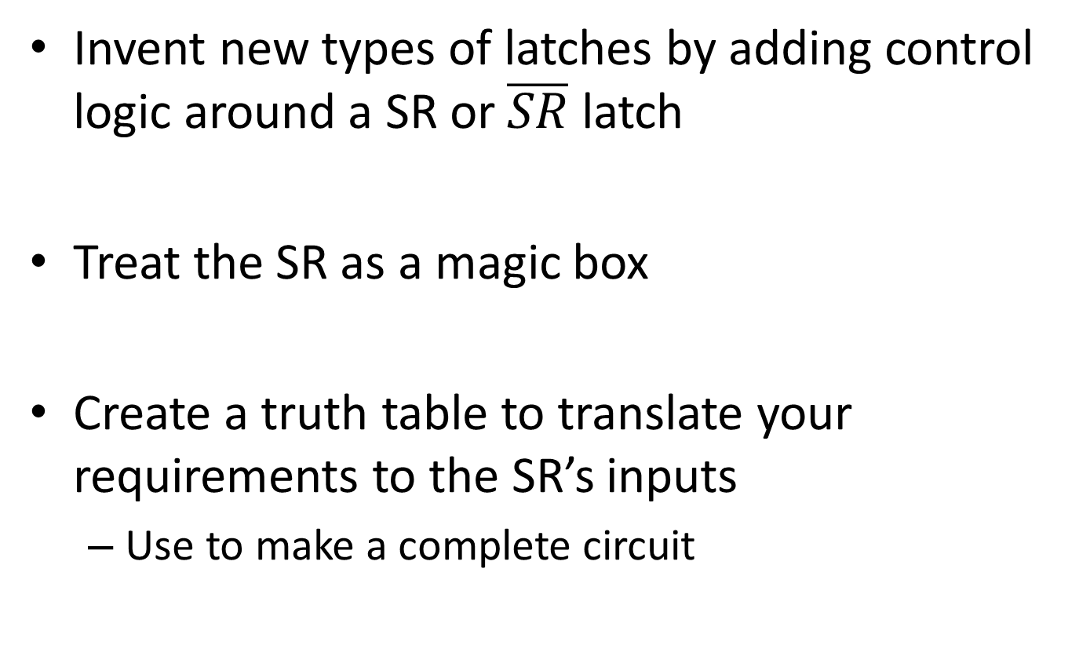
Design Time!
Invent new types of latches by adding control logic around a SR or $\overline{SR}$ latch
Treat the SR as a magic box
Create a truth table to translate your requirements to the SR’s inputs
Use to make a complete circuit

Slide 23
Boards
Gated SR latch
Enable is True, S/R behave like a standard SR latch
When Enable is false, S/R have no effect
Outputs remain the same
Design a Gated D Latch
One Data input instead of Set Reset.
Output follows D input while enabled
When Enable is false, Output holds last value
Smallest design? Fastest?

Slide 24
You promised a Flop
Confusing vocab – they are similar
A latch is typically Enabled
Updates continuously or holds value
A Flip Flop is typically Clocked
Updates only at a specific moment
All are forms of ‘Bistable Multivibrators’

Slide 25

Master Slave D-Flip Flop
Two D-Latches in series with opposite polarity Enable lines
Pulse Triggered
Capture on one edge
Display on the other
http://en.wikipedia.org/wiki/File:Negative-edge_triggered_master_slave_D_flip-flop.svg

Slide 26
Edge Triggered D-Flip Flop
Functionally similar to Master Slave
Edge Triggered, not Pulse
Don’t waste half your clock period!
Construction highly process dependent
Can be roughly three SR Latches
Can be “Dynamic Logic” – Learn in VLSI

Slide 27
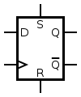
Edge Triggered D-Flip Flop
Clk | D | Q
↑ | 0 | 0
↑ | 1 | 1
Other | X | Q
Always has:
Clk, D, Q
May also have:
S, R, ~Q
Set and Reset are asynchronous (ignore clock)
Can be used to define initial conditions (e.g. at boot)
http://en.wikipedia.org/wiki/File:D-Type_Flip-flop.svg

Slide 28
Common Uses
In between processing stages
“Debounce” inputs
Hide external noise / uncertainty from the inputs
Synchronization

Slide 29
Other Flops
Ternary: Flip-Flap-Flop.
T Flip Flop
Output toggles if input “T” is high
Stays the same if low
Good for cutting frequency in half
JK Flip Flop
Clocked SR flip flop that also supports toggling

Slide 30
Final Board
Create a T Flip Flop from an D Flip Flop
Create 16x frequency divider from T Flip Flops
10x?
Design an Elevator Controller
Start with a two story building
What Inputs?
What Outputs?
What Memory?
Don’t worry if you don’t finish
TFF
DFF
????

Slide 31
TFF (no input T)

Slide 32
TFF (with T input)

Slide 33
Divide by 16

Slide 34
Divide by 10
Divide by 5 followed by divide by 2
Single pulse runs through the 4 flip flops:
0000 1
1000 0
0100 0
0010 0
0001 0
Notes:
I like this design because it uses a single primary clock. Only one of the 5 outputs (4 dffs and a NOR) is high, and it runs through in 5 cycles. The T flip flop flips once per 5 cycles when it hits T high. This gives a 50/50 duty cycle.

Slide 35
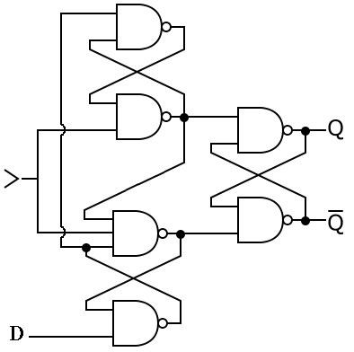
Edge Triggered D-Flip Flop

Slide 36
Elevator
Request Floor 1, Request Floor 2, At Floor 1, At Floor 2
Moving, Direction

Slide 37
Possible Circuit?

Slide 38
Possible Circuit?

