Slide 1
b0011 Fabric
ENGR xD52
Eric VanWyk
Fall 2013

Slide 2
Acknowlegements
ARM Holdings: M3 Cortex Instruction Set
Addison Wesley Longman: Figures
Wikipedia: Figures
Asic World

Slide 3
Today
Review from Thursday
Decoders , Muxes, LUTs
PALs, CPLDs and FPGAs
Preparation for your first Lab
Letter Writers: Tenzin Choetso, Deniz Celik

Slide 4
Component Re-Use
You were “given” the D Flip Flop
Assume it does what I told you it does
How do you formally re-use a component?
Step-By-Step with _separate_ truth tables

Slide 5
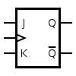
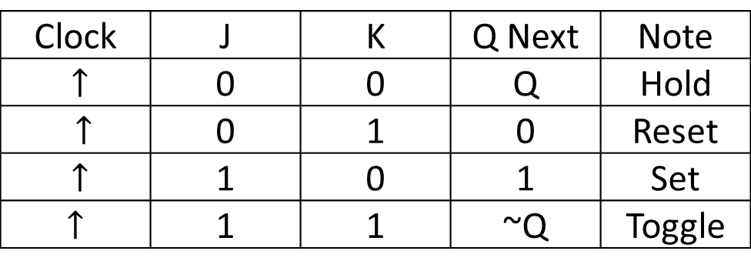
Example: JK Flip Flop
3 Inputs: Clock, J, K
2 Outputs: Q, ~Q
Clock | J | K | Q Next | Note
$↑$ | 0 | 0 | Q | Hold
$↑$ | 0 | 1 | 0 | Reset
$↑$ | 1 | 0 | 1 | Set
$↑$ | 1 | 1 | ~Q | Toggle
http://en.wikipedia.org/wiki/Flip-flop_(electronics)#JK_flip-flop

Slide 6
Construct with a D Flip Flop
What logic can we add to a DFF to make a JKFF?
Compare Truth Tables
J
D Q
??
K

Slide 7
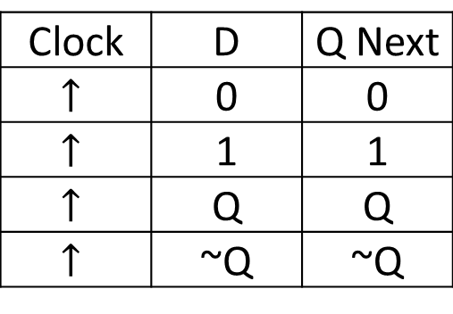
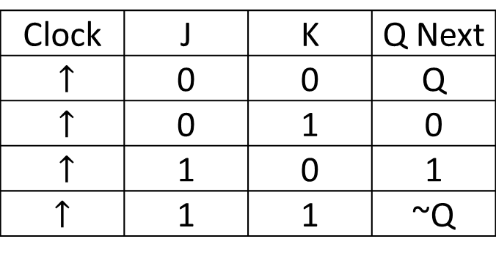
Clock | J | K | Q Next
$↑$ | 0 | 0 | Q
$↑$ | 0 | 1 | 0
$↑$ | 1 | 0 | 1
$↑$ | 1 | 1 | ~Q
Clock | D | Q Next
$$↑$$ | 0 | 0
$$↑$$ | 1 | 1
$$↑$$ | Q | Q
$$↑$$ | ~Q | ~Q

Slide 8
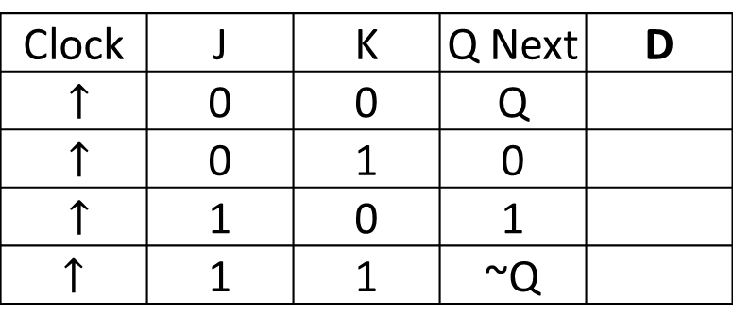
What goes into D to get desired Qn?
Clock | J | K | Q Next | D
$↑$ | 0 | 0 | Q
$↑$ | 0 | 1 | 0
$↑$ | 1 | 0 | 1
$↑$ | 1 | 1 | ~Q
Clock | D | Q Next
$$↑$$ | 0 | 0
$$↑$$ | 1 | 1
$$↑$$ | Q | Q
$$↑$$ | ~Q | ~Q

Slide 9
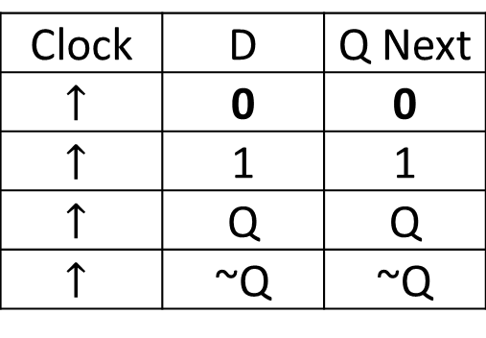
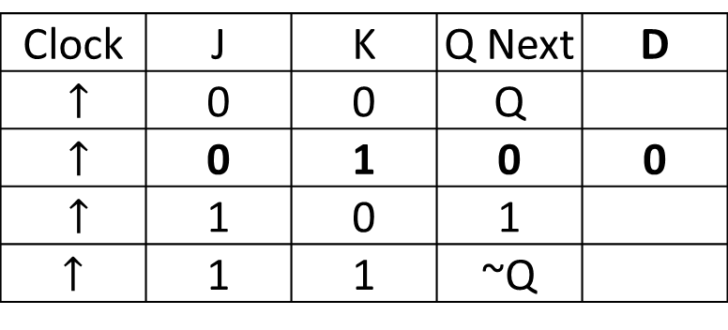
What goes into D to get desired Qn?
Clock | J | K | Q Next | D
$↑$ | 0 | 0 | Q
$↑$ | 0 | 1 | 0 | 0
$↑$ | 1 | 0 | 1
$↑$ | 1 | 1 | ~Q
Clock | D | Q Next
$$↑$$ | 0 | 0
$$↑$$ | 1 | 1
$$↑$$ | Q | Q
$$↑$$ | ~Q | ~Q

Slide 10
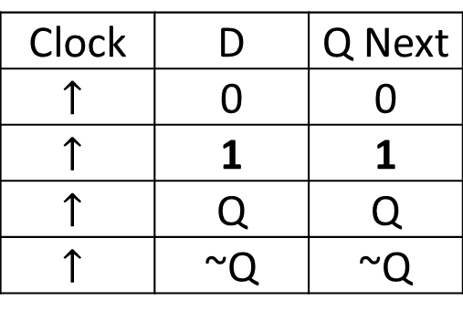
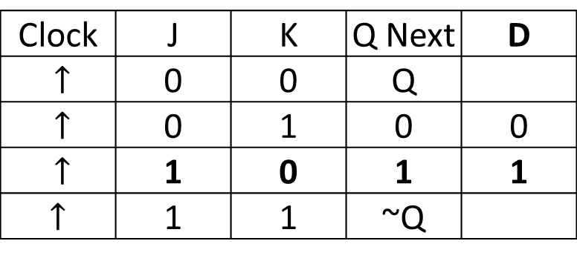
What goes into D to get desired Qn?
Clock | J | K | Q Next | D
$↑$ | 0 | 0 | Q
$↑$ | 0 | 1 | 0 | 0
$↑$ | 1 | 0 | 1 | 1
$↑$ | 1 | 1 | ~Q
Clock | D | Q Next
$$↑$$ | 0 | 0
$$↑$$ | 1 | 1
$$↑$$ | Q | Q
$$↑$$ | ~Q | ~Q

Slide 11
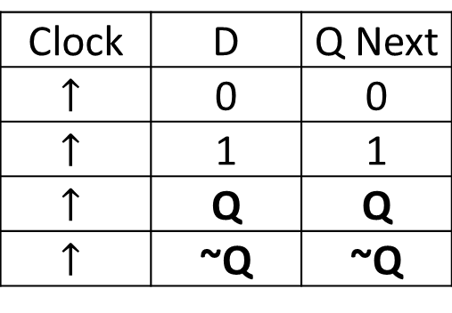
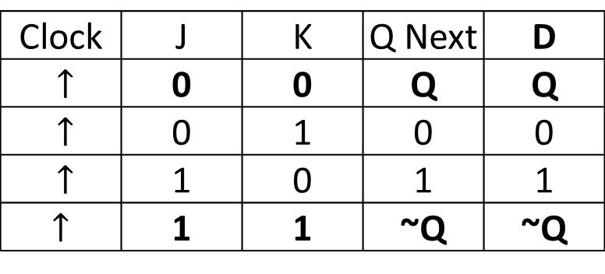
What goes into D to get desired Qn?
Clock | J | K | Q Next | D
$↑$ | 0 | 0 | Q | Q
$↑$ | 0 | 1 | 0 | 0
$↑$ | 1 | 0 | 1 | 1
$↑$ | 1 | 1 | ~Q | ~Q
Clock | D | Q Next
$$↑$$ | 0 | 0
$$↑$$ | 1 | 1
$$↑$$ | Q | Q
$$↑$$ | ~Q | ~Q

Slide 12
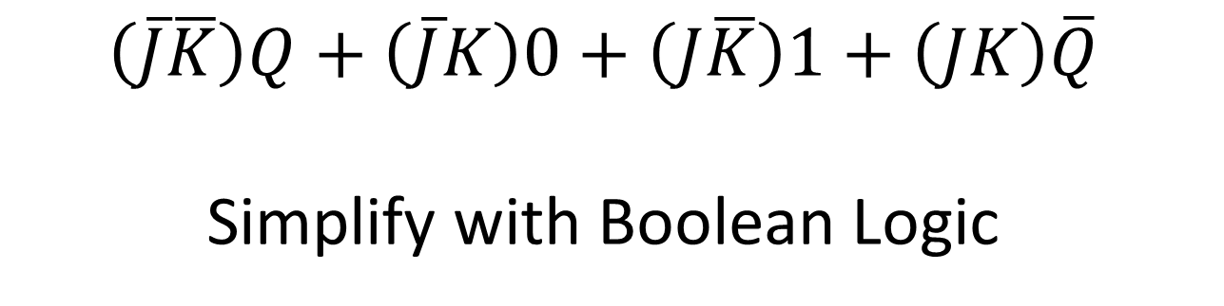
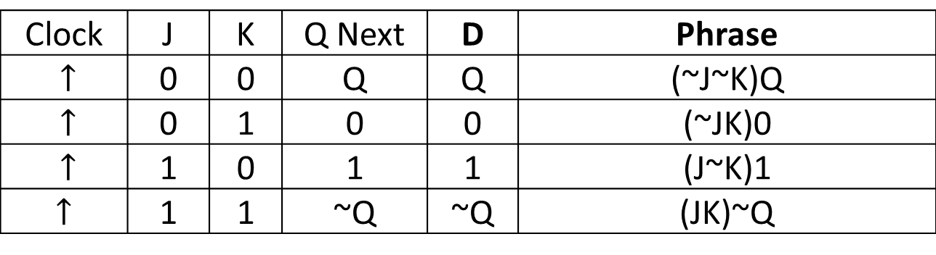
Construct Logic from Truth Table
Clock | J | K | Q Next | D | Phrase
$↑$ | 0 | 0 | Q | Q | (~J~K)Q
$↑$ | 0 | 1 | 0 | 0 | (~JK)0
$↑$ | 1 | 0 | 1 | 1 | (J~K)1
$↑$ | 1 | 1 | ~Q | ~Q | (JK)~Q
$$\left(\overline{J}\overline{K}\right)Q+\left(\overline{J}K\right)0+\left(J\overline{K}\right)1+\left(JK\right)\overline{Q}$$
Simplify with Boolean Logic

Slide 13
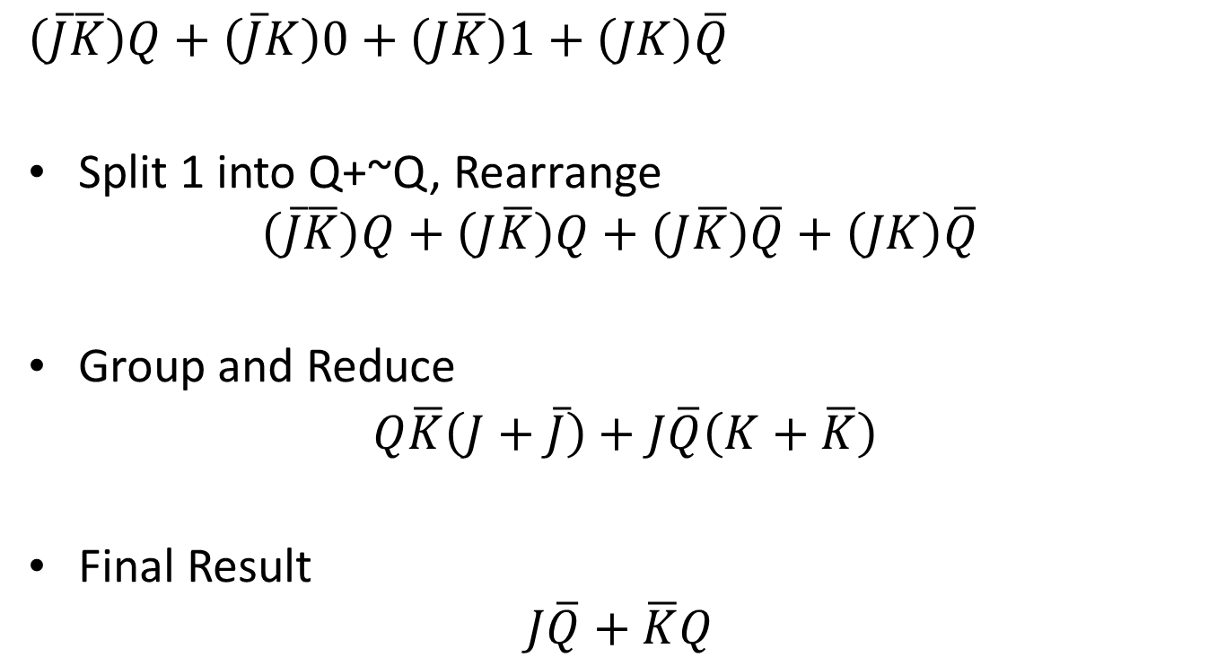
Simplify with Boolean Logic
$$\left(\overline{J}\overline{K}\right)Q+\left(\overline{J}K\right)0+\left(J\overline{K}\right)1+\left(JK\right)\overline{Q}$$
Split 1 into Q+~Q, Rearrange
$$\left(\overline{J}\overline{K}\right)Q+\left(J\overline{K}\right)Q+\left(J\overline{K}\right)\overline{Q}+\left(JK\right)\overline{Q}$$
Group and Reduce
$Q\overline{K}\left(J+\overline{J}\right)+J\overline{Q}\left(K+\overline{K}\right)$
Final Result
$$J\overline{Q}+\overline{K}Q$$

Slide 14
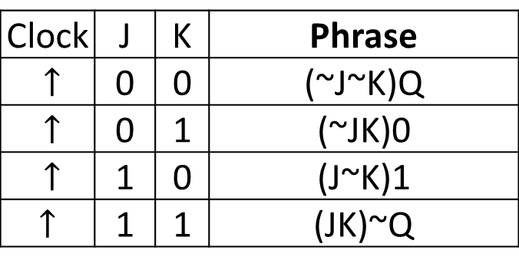
Karnaugh Map
 | Q | ~Q
JK | 0 | 1
~JK | 0 | 0
~J~K | 1 | 0
J~K | 1 | 1
Clock | J | K | Phrase
$↑$ | 0 | 0 | (~J~K)Q
$↑$ | 0 | 1 | (~JK)0
$↑$ | 1 | 0 | (J~K)1
$↑$ | 1 | 1 | (JK)~Q

Slide 15
Karnaugh Simplification
 | Q | ~Q
JK | 0 | 1
~JK | 0 | 0
~J~K | 1 | 0
J~K | 1 | 1
Is the RED box needed?
Why? Why Not?
Resulting Equation:
~KQ+J~Q+J~K
Notes:
PPT makes it hard to make truncated boxes ☹

Slide 16



Final Result
$$J\overline{Q}+\overline{K}Q$$
$$J\overline{Q}$$
$$\overline{K}Q$$

Slide 17
More Practice
If you are interested:
Start with a JK Flip Flop, create a D Flip Flop
Inception!
Formally repeat last class’s examples
SR Latch is more interesting
Post practice problems on the Wiki later this week

Slide 18
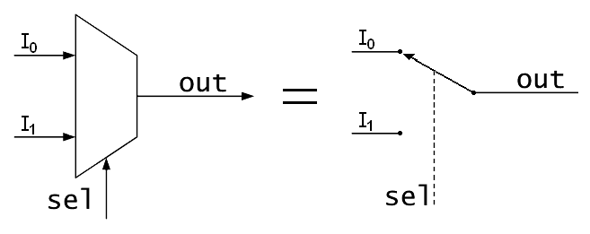
Muxes, AKA Multiplexor
Select or switch between inputs
Has one output, two types of inputs
‘Input’
‘Select’
#‘Select’ >= log2(# ‘Input’)
8 inputs needs 3 select (address) bits
Notes:
Figure Credit: Wikipedia

Slide 19
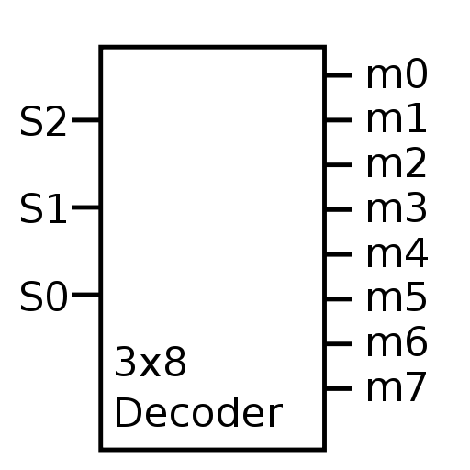
(Binary) Decoder
Also called a ‘demux’
Because it is the exact opposite.
Only one output is active at once
Usually has 2^inputs number of outputs
Sometimes has an enable input
All Low or All Hi-Z
Notes:
Figure Credit: Wikipedia

Slide 20
Designing from Documentation
Clone the following parts from basic gates:
DigiKey Part No 568-4448-2-ND
568-8857-1-ND
MC74HC164ADR2GOSTR-ND
Hint: Use D-Flip-Flops as a black box
Do your solutions match theirs?
Does it matter?
Notes:
Picked datasheets with the “answers” in them on purpose. Good for practice and verification.
1x 3:8
2x 4:1
Shift Register – Uses Master Slave DFF!

Slide 21
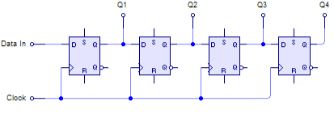
Shift Register
Chain of Flip Flops form a “Bucket Brigade”
On Clock, data proceeds one step down chain
http://en.wikipedia.org/wiki/Shift_register

Slide 22
Programmable Logic
1969: XC157
Mask Programmed, 12 gates 30 pins
1978: Programmable Logic Arrays
Field Programmed by burning fuses
Sum of Products
Equivalent to “Dozens” of gates
1985: Generic Array Logic
Field Reprogammable
Notes:
Mask Programmed – done at the factory
Field Programmed – done

Slide 23
Programmable Logic
Complex Programmable Logic Device:
1000s to 10ks of Gates equivalent
Non-volatile (typically)
Sum of Products (typically)

Slide 24
Field Programmable Gate Array
1985: Xilinx releases the XC2064
Equivalent to 1000 gates
Typical Features:
Volatile (Reprogram every time power is applied)
Sea of Gates (Look Up Tables + Routing)
Programmable Logic Blocks
“Hard” Features – RAM, Multipliers, CPUs

Slide 25
Xilinx Zynq 7000
Up to 6.6 Million Gates Equivalent
277,400 Look Up Tables
554,800 Flip Flops
>2 Trillion Multiply Accumulates per second
Dual Core 1GHz ARM Cortex A9
2.5 DMIPS/MHz
Equivalent to 5 billion instructions per second (ish)
$5,401.26 (2013) $3,776.67 (2014)

Slide 26
Look Up Tables
A form of Read Only Memory
Defined by Width and Depth
Width = How many bits per word
Depth = How many words available
Constructed as Muxes with constant inputs
Use Select to look up the table entry

Slide 27
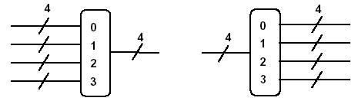
Width
The width of a bus is how many bits are in that signal.
A wire is a bus with width = 1

Slide 28
Look Up Table as a Truth Table
A0 | A1 | A2 | Out0 | Out1 | Out2 | Out3
0 | 0 | 0
0 | 0 | 1
0 | 1 | 0
0 | 1 | 1
1 | 0 | 0
1 | 0 | 1
1 | 1 | 0
1 | 1 | 1
Stored Information
Depth
Address
Inputs
Width

Slide 29
Fabric Design
FPGA ‘Fabric’ is a sea of reconfigurable logic blocks embedded in reconfigurable routing logic.
The reconfigurable logic used to be mostly look up tables with configurable constants.
Now it is LUTs + other stuff (“hard” elements)

Slide 30
Fabric Design Example
Making an Inverter with a LUT
A | Out
0 | 1
1 | 0
Depth
Address
Inputs
Width

Slide 31
Fabric Design Example
Making an Inverter with a LUT
A | Out
0 | 1
1 | 0

Slide 32
Fabric Design
Design a small piece of an FPGA using:
Decoders
Muxes
Basic Gates
Programmable Bits (Ignore Construction for now)
Use your FPGA cell to create both of these (at once):
AB+AC+BC
A^B^C
^ = XOR
Start by figuring out your requirements:
Width? Depth?

Slide 33
HW2
Assigned Today, due next Monday night
Create and Test Mux, Demux, Full Adder
We’ll cover Full Adder Thursday
Test Benches:
Simplest – Enumerate entire Truth Table
Harder – Explain how less is ok. Be very careful

Slide 34
MP0
Assigned Thursday, Due the 29th
Tutorial Thursday Night
Work in groups 2-3
Implement and Test 4 bit Adder on FPGA
Will cover Thursday
Limited number of FPGAs

