Slide 1
b0100 Floating Point
ENGR xD52
Eric VanWyk
Fall 2013

Slide 2
Acknowledgements
Mark L. Chang lecture notes for Computer Architecture (Olin ENGR3410)
Patterson & Hennessy: Book & Lecture Notes
Patterson’s 1997 course notes (U.C. Berkeley CS 152, 1997)
Tom Fountain 2000 course notes (Stanford EE182)
Michael Wahl 2000 lecture notes (U. of Siegen CS 3339)
Ben Dugan 2001 lecture notes (UW-CSE 378)
Professor Scott Hauck lecture notes (UW EE 471)
Mark L. Chang lecture notes for Digital Logic (NWU B01)
http://docs.oracle.com/cd/E19957-01/806-3568/ncg_goldberg.html

Slide 3
Today
Better IQ representation example
Review Multiplication in Fixed Point
Signed/Unsigned and Multiplication
Invent Floating Point Numbers
Letters: Nicholas Eyre, Yun-Hsin Chen

Slide 4
Final Exam
You are writing your own Final Exams
Details are posted on the Wiki
Today’s board work should help you get in the mood.
Main Point: Collaborative material review
Anti Main Point: Angst

Slide 5
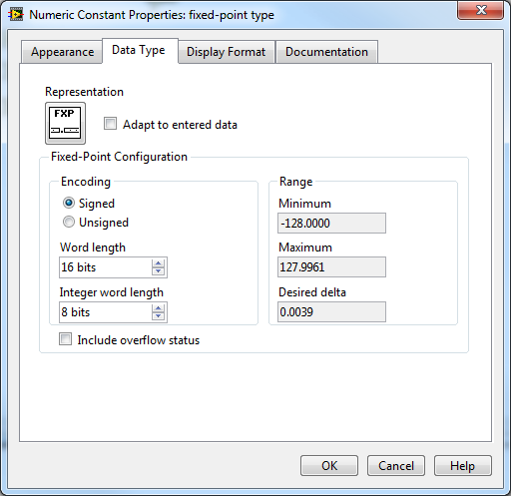
Better IQ example

Slide 6
IQ Multiplication
We ended last class with 3.0 *-0.5 in binary.
3 -> 00110000 I4Q4
-0.5 -> 11111000 I4Q4
-1.5 -> 11101000 I4Q4…?

Slide 7
Its just like Algebra, right?
11111000 -0.5 in I4Q4
* 00110000 3.0 in I4Q4
00000000
00000000
00000000
00000000
11111000
11111000
00000000
00000000
0010111010000000 ??? In I?Q?

Slide 8
Its just like Algebra, right?
1111.1000 -0.5 in I4Q4
* 0011.0000 3.0 in I4Q4
.00000000
0.0000000
00.000000
000.00000
1111.1000
11111.000
000000.00
0000000.0
00101110.10000000 46.5 In I8Q8

Slide 9
Its just like Algebra, right?
1111.1000 -0.5 in I4Q4
* 0011.0000 3.0 in I4Q4
.00000000
0.0000000
00.000000
000.00000
1111.1000
11111.000
000000.00
0000000.0
00101110.10000000 46.5 In I8Q8
Incorrect?
Correct!

Slide 10
Its just like Algebra, right?
1111.1000 -0.5 in I4Q4
* 0011.0000 3.0 in I4Q4
0000000.00000000
0000000.00000000
0000000.00000000
0000000.00000000
1111111.10000000 ← I8Q8!!
1111111.00000000
0000000.00000000
0000000.00000000
11111110.10000000 -1.5 In I8Q8

Slide 11
Negative Second Operand?
01.11 I2Q2 d1.75
* 11.10 I2Q2 –d0.50
.0000
0.111
01.11
011.1
0111.
0111 .
0111 .
0111 .
0111 .
01101111.0010 I4Q4 -d0.875

Slide 12
Negative Second Operand?
01.11 I2Q2 d1.75
* 11.10 I2Q2 –d0.50
.0000
0.111
01.11
011.1
0111. ← From sign extension!
0111 .
0111 .
0111 .
0111 . ← No effect on output
01101111.0010 I4Q4 -d0.875
Notes:
Sign extend your second operand vertically until it doesn’t affect the output.
The first four bits are unaffected by sign extension.
The next four need to be valid, which prompts the sign extension vertically.
The last four are unnecessary, and are there just to show the ‘debris’ from the calculation

Slide 13
Observations
The product is wider than the inputs
InQx*ImQy=I(n+m)Q(x+y)
Sign extend the inner terms and the multiplicand

Slide 14
Side Note…
The wikipedia article on binary multipliers is awful.
Prove and rewrite the “More advanced approach: signed integers” section instead of any two homework assignments this semester.

Slide 15
Implications
3 categories of integer (or IQ) multiply instructions:
MUL N*N->N, sign agnostic (only for Q=0)
SMUL N*N->2N, signed
UMUL N*N->2N, unsigned
Multiplication uses ever increasing amounts of memory….?
Notes:
The N*N->N sign agnosticism is a neat ‘trick’. I believe it is valid for the first bits up to the lesser of the two input lengths. E.g. I13*I33 are sign agnostic for 13 bits.

Slide 16
Operations with outputs > inputs
Addition uses 1 extra bit
I4+I4 -> I5
[-8,7]+[-8,7] → [-16,14]
Multiplication needs twice as many bits (-1)
I4*I4 -> I7
[-8,7]*[-8,7] → [-64,56]
Notes:
Minimum format to represent most positive value:
Log2((R^(N-1)-1)^2)+1
~~2(N-1)+1= 2N-1

Slide 17
Finite Memory
We can not expand every time.
Usually, output format is input format.
LSBs dropped are lost precision
Always a little bad
MSBs dropped are occasional catastrophes.
Totally fine or absolutely terrible
Overflow Errors

Slide 18
How to Handle?
Overflow
Catastrophic value change
Saturate
Wrong, but closer than Overflow
Make the programmer deal with it
They know their needs better than we do

Slide 19
Precision vs Max Magnitude
Humans handle this with scientific notation.
Lose precision to handle memory constraints
Like choosing IQ format after each calculation(ish)
1.234*10^2
Significand * R^Exponent
Significand in I?Q?, Exponent in I?

Slide 20
Lets Design Binary Scientific Notation
Need to store:
Sign
Exponent
Signficand
Nice to be able to:
Fit in memory conveniently
Sort easily
Accommodate bad things happening

Slide 21
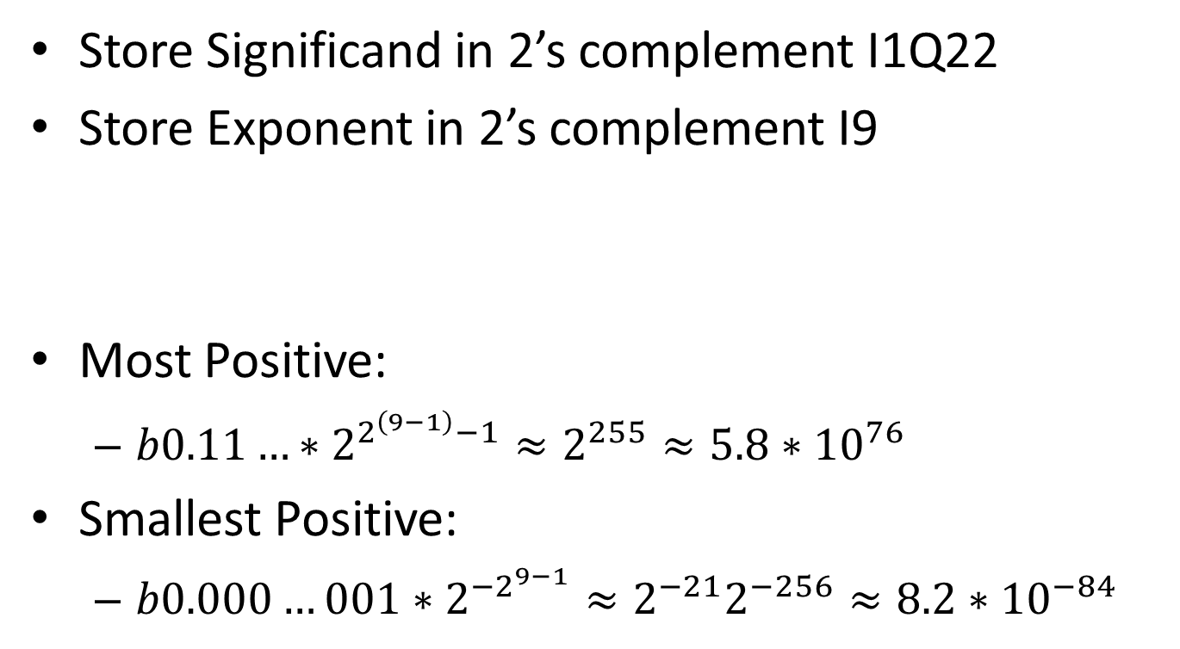
Attempt 1
Store Significand in 2’s complement I1Q22
Store Exponent in 2’s complement I9
Most Positive:
$b0.11…∗2^{2^{\left(9−1\right)}−1}≈2^{255}≈5.8∗{10}^{76}$
Smallest Positive:
$b0.000…001∗2^{{−2}^{9−1}}≈2^{−21}2^{−256}≈8.2∗{10}^{−84}$
31
30
29
28
27
26
25
24
23
22
21
20
19
18
17
16
15
14
13
12
11
10
09
08
07
06
05
04
03
02
01
00
exponent
Significand

Slide 22
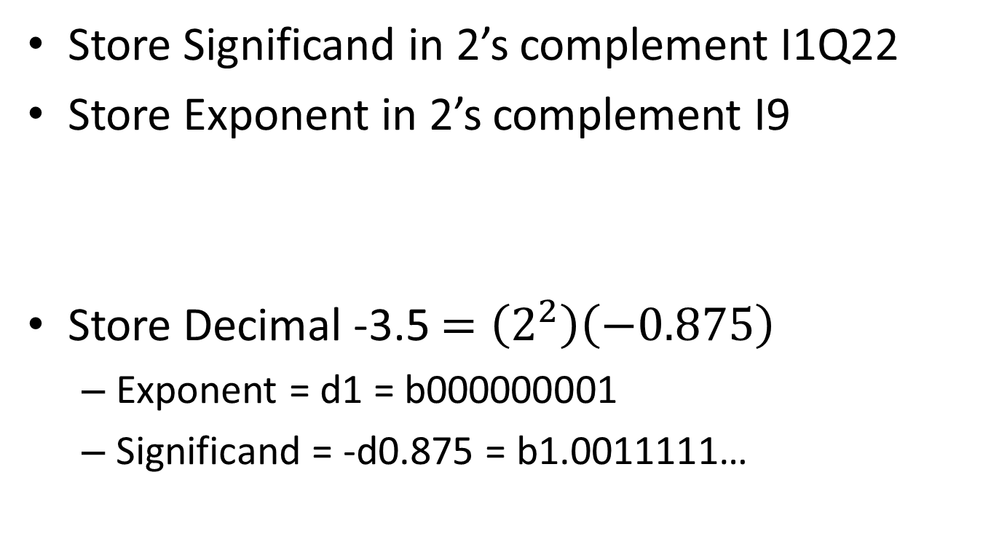
Attempt 1
Store Significand in 2’s complement I1Q22
Store Exponent in 2’s complement I9
Store Decimal -3.5 $=\left(2^{2}\right)\left(−0.875\right)$
Exponent = d1 = b000000001
Significand = -d0.875 = b1.0011111…
31
30
29
28
27
26
25
24
23
22
21
20
19
18
17
16
15
14
13
12
11
10
09
08
07
06
05
04
03
02
01
00
exponent
Significand
Notes:
0.11100000
1.00011111
1.00100000

Slide 23
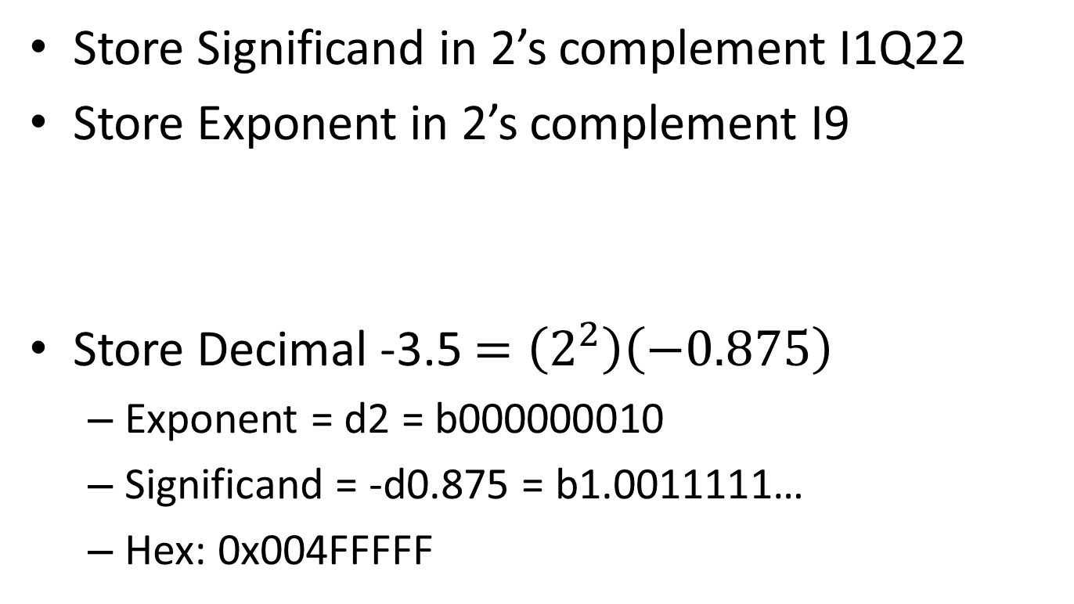
Attempt 1
Store Significand in 2’s complement I1Q22
Store Exponent in 2’s complement I9
Store Decimal -3.5 $=\left(2^{2}\right)\left(−0.875\right)$
Exponent = d2 = b000000010
Significand = -d0.875 = b1.0011111…
Hex: 0x004FFFFF
31
30
29
28
27
26
25
24
23
22
21
20
19
18
17
16
15
14
13
12
11
10
09
08
07
06
05
04
03
02
01
00
0 0 0 0 0 0 0 1 0
10011111111111111111111
Notes:
0.11100000
1.00011111
1.00100000

Slide 24
Attempt 1
Store Signficand in 2’s complement I1Q22
Store Exponent in 2’s complement I9
Does not sort well
Bit #22 is the sign bit?!
Many duplicated representations
.5*2^0 = .25*2^1
31
30
29
28
27
26
25
24
23
22
21
20
19
18
17
16
15
14
13
12
11
10
09
08
07
06
05
04
03
02
01
00
exponent
Significand

Slide 25
Renormalization
We use 0<= Significand < R
12.34*10^5 looks funny – it is in U2Q2(R10)
Scientific Notation is U1Q?R10.
What is Engineering Notation?
123.456*10^6
TLDR: Pick a significand format, stick with it
Notes:
U1Q?R1000

Slide 26
Exponent Format
Could use 2’s compliment.
But that doesn’t sort well
Use ‘biased’ notation instead.
Signed value ‘biased’ to be unsigned.
Biased means add a fixed value
Most negative number becomes 0.
Makes sorting floats easy!

Slide 27
IEEE-754 Single Precision Float
Floating Point (Float) = (-1)^{s} * (1.fraction) * 2^{(exponent-127)}
Alternative Name: binary32
Significand = 1.fraction
31
30
29
28
27
26
25
24
23
22
21
20
19
18
17
16
15
14
13
12
11
10
09
08
07
06
05
04
03
02
01
00
s
exponent
fraction
1 bit 8 bits 23 bits

Slide 28
IEEE-754 Single Precision Float
Floating Point (Float) = (-1)^{s} * (1.significand) * 2^{(exponent-127)}
Record Sign bit
Convert Significand to U1Q23
Track changes to Exponent!
Drop the MSB of Significand, record the rest
Significand = leading one + Fraction
Bias Exponent by +127, record
31
30
29
28
27
26
25
24
23
22
21
20
19
18
17
16
15
14
13
12
11
10
09
08
07
06
05
04
03
02
01
00
s
exponent
significand
Notes:
Do one on the board:
2.25 -> 10.01 *2^0 -> 1.001 * 2^1
Sign = 0. Expont = 1+127 = 128 = b10000000. Significand = .001
x40100000

Slide 29
Multiplication in Floating Point
Easy!
Multiply Significands, Add Exponents
5*10^2 * 4*10^4 = (5*4)*10^(2+4)
= 20*10^6 -> 2.0*10^7

Slide 30
Addition in Floating Point
Almost Easy!
Operands must have same exponent
Normalize to most positive exponent
9.8*10^13 + 4*10^12 -> (9.8+0.4)*10^13
= 10.2*10^13 -> 1.02*10^14

Slide 31
IEEE-754 Single Precision Board Work
Floating Point (Float) = (-1)^{s} * (1.fraction) * 2^{(exponent-127)}
Convert to fp hex:
0.75 -10 .3
Convert from fp: 0x40410100 0xC0FFEE00
Find & prove flaws in my original float design
Sorting, Packing efficiency, others?
31
30
29
28
27
26
25
24
23
22
21
20
19
18
17
16
15
14
13
12
11
10
09
08
07
06
05
04
03
02
01
00
s
exponent
fraction
Notes:
3F400000 C1200000 3E99999A 3F333333
3.015686 -7.9978027
http://www.h-schmidt.net/FloatConverter/IEEE754.html

Slide 32
Special Cases
Exponent b00000000
Fraction = 0: Zero
Fraction!=0: Subnormal
Exponent b11111111
Fraction = 0: Infinity
Fraction!= 0: Not a Number

Slide 33
When things go wrong
Overflow – it too big
Underflow – it too small
Non-Associative – Can’t reorder operations
Still commutative
Order determines end precision!
Humans like R10, but it is not representable

Slide 34
When things go wrong
Catastrophic Cancellation
Loss of precision from subtracting close numbers
A-B = C when |A| >>> |C|, C will be imprecise
Comparison Failures
float f = 3.0/7.0;
bool b = f == 3.0/7.0;
http://docs.oracle.com/cd/E19957-01/806-3568/ncg_goldberg.html

Slide 35
Break my code!
float mean(float nums[])
{
float total = 0;
for(int i=0;i<length(nums);i++)
{
total += nums[i];
}
return total/length(nums);
}
Notes:
Length(nums) is very large. How large? Hint, 2^24…

Slide 36
If you remember nothing else…
Precision: ~7 decimal digits
Relative Error is constant, absolute error varies
Exponent Range: 10^38 10^-38
Represent all integers up to 2^24
Sortable with integer operations
Notes:
Relative / absolute error – nano tech vs astronomy

Slide 37
When you are debugging:
Zero is 0x00000000
Infinity is h7F800000, -Infinity is hFF800000
NaN: h7FC00000 is most common I’ve seen.
Other NaNs exist, ish.

Slide 38
IEEE-754 Double Precision Float
AKA Binary64
11 exponent bits, 52 explicit significand bits
~16 decimal digits, 10^308 10^-308
All Integers to 2^53
31
30
29
28
27
26
25
24
23
22
21
20
19
18
17
16
15
14
13
12
11
10
09
08
07
06
05
04
03
02
01
00
s
exponent
significand
31
30
29
28
27
26
25
24
23
22
21
20
19
18
17
16
15
14
13
12
11
10
09
08
07
06
05
04
03
02
01
00
significand (continued)

Slide 39
Clever Hacks or Total BS?
Using integer operations on floats
union intfloat { int i; float f; } x;
Access like an integer with x.i;
Access like a float with x.f;
What does this do:
x.i = x.i | 0x80000000;
31
30
29
28
27
26
25
24
23
22
21
20
19
18
17
16
15
14
13
12
11
10
09
08
07
06
05
04
03
02
01
00
s
exponent
significand
Notes:
Sets bit 31 = makes it represent a negative number

Slide 40
Story Time
These ‘clever hacks’ are terrible on x86 arch
“Separate” floating point unit
Forces conversion
Doesn’t take advantage of hardware
These ‘clever hacks’ are terrible in general
Corner cases
Legibility

Slide 41
Clever Hacks or Total BS?
Float multiply by -1
Float divide by 8 using integer subtraction
Rounded log base 2 of a float
Notes:
^0x80000000
Subtract 3 from the exponent (shift 3 over the right number of bits and subtract)
Just grab the exponent part and unbias it

Slide 42
Create your own Pain
Create your own math problems that highlight the basic problems with floating point math.
You can use decimal or binary
Pick a format. 2 exponent digits, 7 significand?

