Slide 1
b0110 ALU
ENGR xD52
Eric VanWyk
Fall 2014

Slide 2
Today
Back to Gates!
Review Timing with Adders
Compare Growth Characteristics
Construct Adder/Subtractor
Construct ALU
Multiply / Divide by R^?

Slide 3
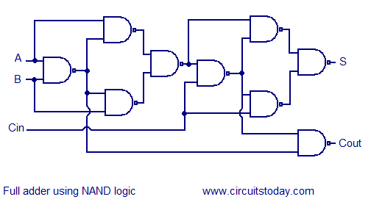
Full Adder
Calculate Propagation Delays
Multiple Paths? Choose Worst
 | A | B | Cin
Sum
Cout
^{A}
^{B}
^{CI}
^{CO}
^{S}
⁰
⁰
⁰
⁰
⁰
⁰
⁰
¹
⁰
¹
⁰
¹
⁰
⁰
¹
⁰
¹
¹
¹
⁰
¹
⁰
⁰
⁰
¹
¹
⁰
¹
¹
⁰
¹
¹
⁰
¹
⁰
¹
¹
¹
¹
¹

Slide 4
Full Adder
Calculate Propagation Delays
Multiple Paths? Choose Worst
 | A | B | Cin
Sum | 6 | 6 | 3
Cout | 5 | 5 | 2
^{A}
^{B}
^{CI}
^{CO}
^{S}
⁰
⁰
⁰
⁰
⁰
⁰
⁰
¹
⁰
¹
⁰
¹
⁰
⁰
¹
⁰
¹
¹
¹
⁰
¹
⁰
⁰
⁰
¹
¹
⁰
¹
¹
⁰
¹
¹
⁰
¹
⁰
¹
¹
¹
¹
¹

Slide 5
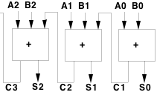
Multi-Bit Addition
 | A | B | Cin
Sum | 6 | 6 | 3
Cout | 5 | 5 | 2
 | AB0 | AB1 | AB2
S0
C1
S1
C2
S2
C3
Using previous slides’ design, find worst prop delay

Slide 6
Multi-Bit Addition
 | A | B | Cin
Sum | 6 | 6 | 3
Cout | 5 | 5 | 2
 | AB0 | AB1 | AB2
S0 | 6 | - | -
C1 | 5 | - | -
S1 | 5+3 | 6 | -
C2 | 5+2 | 5 | -
S2 | 5+2+3 | 5+3 | 6
C3 | 5+2+2 | 5+2 | 5
Using previous slides’ design, find worst prop delay

Slide 7
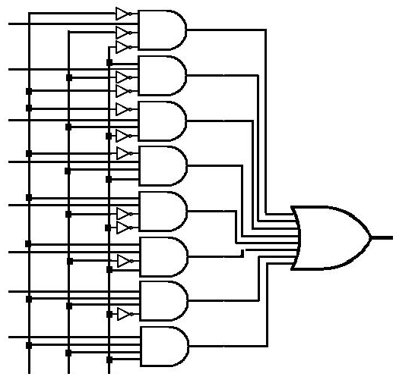
Full Adder as a LUT in Gates
Only half, slide too small to show Sum
Area Cost?
Speed?
0
0
0
1
0
1
1
1
 | A | B | Cin
Sum
Cout
A B Cin

Slide 8
Full Adder as a LUT in Gates
Only half, slide too small to show Sum
Area Cost?
Speed?
0
0
0
1
0
1
1
1
 | A | B | Cin
Sum | 3 | 3 | 3
Cout | 3 | 3 | 3
A B Cin
Notes:
Each “True” is a 3 input AND
Each output is a 4 input OR
Each input is an inverter
3*4*2 = 24
4*2 = 8
3*1 = 3
=35 GIE
Other solution was 9*2 = 18

Slide 9
Timing with Alternate Topology
 | A | B | Cin
Sum | 3 | 3 | 3
Cout | 3 | 3 | 3
 | AB0 | AB1 | AB2
S0
C1
S1
C2
S2
C3
Using new prop delays, find total delay

Slide 10
Timing with Alternate Topology
 | A | B | Cin
Sum | 3 | 3 | 3
Cout | 3 | 3 | 3
 | AB0 | AB1 | AB2
S0 | 3 | - | -
C1 | 3 | - | -
S1 | 3+3 | 3 | -
C2 | 3+3 | 3 | -
S2 | 3+3+3 | 3+3 | 3
C3 | 3+3+3 | 3+3 | 3
Using new prop delays, find total delay

Slide 11
Growth Rates
What changes as a specific design ‘grows’
Propagation delay
Silicon area
Propagation Delay for an N bit adder?
Design 1: NAND Gates
Design 2: Small LUT

Slide 12
Growth Rates
What changes as a specific design ‘grows’
Propagation delay
Silicon area
Propagation Delay for an N bit adder?
Design 1: 2N + 4
Design 2: 3N
Which design is faster for small adders?
Notes:
2N+4 = 3N when N = 4
When adding more than 4 bits, the NAND gate based circuit is faster than the LUT based approach

Slide 13

Adder/Subtractor
Add Control Line for Subtraction
$$A −B=A+\left(−B\right)=A+\overline{B}+1$$
A
B
A
B
A
B
A
B
3
3
2
2
1
1
0
0
Subtract
A
B
A
B
A
B
A
B
CO
+
CI
CO
+
CI
CO
+
CI
CO
+
CI
S
S
S
S
S
S
S
S
3
2
1
0

Slide 14
Adder/Subtractor
Add Control Line for Subtraction
$$A −B=A+\left(−B\right)=A+\overline{B}+1$$
A
B
A
B
A
B
A
B
3
3
2
2
1
1
0
0
Subtract
A
B
A
B
A
B
A
B
CO
+
CI
CO
+
CI
CO
+
CI
CO
+
CI
S
S
S
S
S
S
S
S
3
2
1
0

Slide 15
ALU: Arithmetic Logic Unit
Computes arithmetic & logic functions based on controls
Add, subtract
AND, NAND, OR, NOR, XOR, ==, <, overflow, …
A
B
Function
Select
Controls
Zero
Negative
Overflow
R

Slide 16
ALU: Easy Design
Separate units for each operation
Mux at the end

Slide 17
ALU: Easy Design
Separate units for each operation
Mux at the end
“Default” Method
Potentially fastest method
No optimization BETWEEN components

Slide 18
Bit Slice ALU Design
00: OR
10: Add
01: AND
11: Subtract
A_{i}
B_{i}
S1
00 01 10 11
S0
4:1 Mux
ALU Output Bit

Slide 19
Bit Slice ALU Design (cont.)
Route Carries
Overflow, zero, negative
1-bit
Slice
1-bit
Slice
1-bit
Slice
1-bit
Slice
ALU₃
ALU₂
ALU₁
ALU₀
ALU[3:0]

Slide 20
SLT
Set less than: if (A<B) then R = 1, else R = 0
How do we know if (A<B)
Interaction w/overflow?
Interaction w/carry out?
At your Desk:
Try 2 random examples
Try 2 corner cases
Do they all work?
-1
+0
-2
1111
0000
+1
-3
1110
0001
+2
1101
0010
-4
1100
0011
+3
-5
1011
0100
+4
-6
1010
0101
+5
1001
0110
-7
1000
0111
+6
-8
+7

Slide 21
ALU Construction Summary
Brute force approach is full parallel with muxes as wide as the number of operations
Re-use resources for space efficiency
Slower, Smaller, Narrower
Make a SMALL ALU bit slice that does:
AND, OR, NAND, NOR, XOR, Add, Subtract

Slide 22
Do a Barrel Roll
We can multiply or divide a number by 2 by moving it left or right one position
This is called a “shift”
b00000011 d3
b00000110 d6
b00001100 d12
b00011000 d24

Slide 23
Do a Barrel Roll
“Arithmetic” shifts obey 2’s complement
Sign extension
“Logical” shifts do not
Assume unsigned
Pad zeros
Barrel Rotate “wraps” around

Slide 24
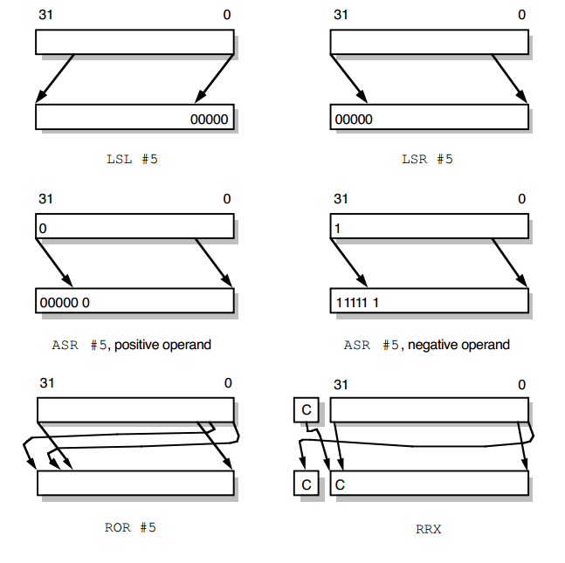
http://bwrc.eecs.berkeley.edu/research/pico_radio/Test_Bed/Hardware/Documentation/ARM/chap3.pdf

Slide 25
Create a Shifter
Start with Logical Shift Left (LSL) only
Add the others maybe
Construction Options:
Layers of Shift by R^N
Bit slices that shift a single bit an arbitrary amount
Where in the ALU would you put it?

Slide 26
Growing Shifters
Chain optional power-of-two shifts
Sometimes called a logarithmic shifter
Each Layer shifts by either zero or 2^“Layer Number”
Each Layer shifts by R^“Layer Number”*[0..R)
Requires log_{R}(N) layers
N=32, R=2 -> 5 layers
How big / fast is a R=2 Logarithmic Shifter?
What R would you choose for a N=256 Shifter?

Slide 28
As a GIANT LUT!
How expensive is a Depth by Width LUT?
2^M = Depth
Decoder (M->D)
M inverters
D M-input AND gates
2 Units of Delay
M+MD space
Decoder -> Mux
D*W 2 input AND gates
W D-input OR gates
2 Units of Delay
3DW Space
Bussed Mux -> LUT
Tie inputs to Constants
Free!
Total:
4 Units Delay
M+MD+3DW Space
2N+(5N+3)(2^2N) Space

Slide 29
Multiple Bit Addition w/ LUT
How do we construct 3-bit addition as one unified LUT?
Sum[3:0] = a[2:0]+b[2:0]
Width?
Depth?

Slide 30
Multiple Bit Addition w/ LUT
How do we construct 3-bit addition as one unified LUT?
Sum[3:0] = a[2:0]+b[2:0]
Width? 4 (3 Sum Bits, 1 final carry out bit)
Depth? 2^(3+3) = 64
Index into table = {a[2:0],b[2:0]}
Rows in table = {b2,b1,b0}+{a2,a1,a0}
Notes:
{a[2:0],b[2:0]} means concatenate the two busses into one bus who has a width equal to the sum of the their widths

Slide 31
Multiple Bit Addition w/ LUT
Example: Add d3+d4 with our LUT
a = d3 = b011
b = d4 = b100
LUT address = {a,b} = b011100
Look in table at that address
Recover answer = b0111 = d7
d3+d4=d7!
Notes:
{a[2:0],b[2:0]} means concatenate the two busses into one bus who has a width equal to the sum of the their widths

Slide 32
Multiple Bit Addition w/ LUT
Calculate the Size Growth of the LUT approach
HINT: Build up from Decoder, Mux, etc
How big is a 1 bit LUT adder?
How big is a 8 bit LUT adder?
How big is an N bit LUT adder?
Repeat for the chained Full Adder approach
Notes:
Confusion of conflating LUT with Adder. Separate for this example and then recombine.

Slide 33
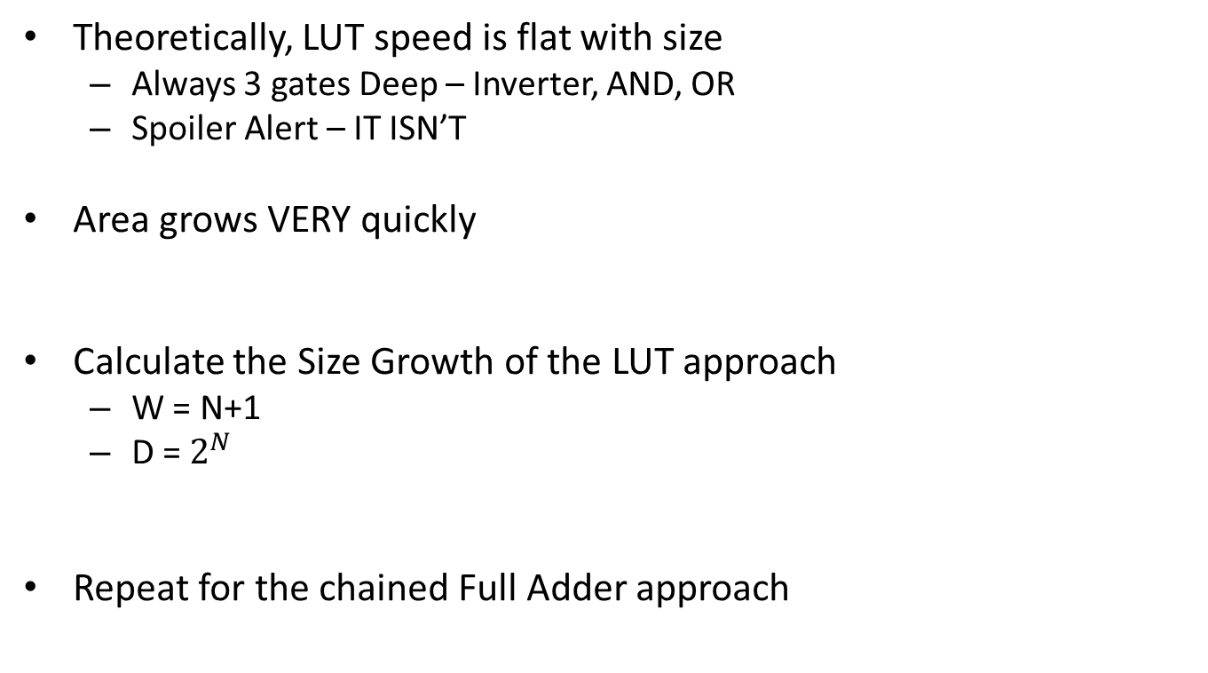
LUT Growth
Theoretically, LUT speed is flat with size
Always 3 gates Deep – Inverter, AND, OR
Spoiler Alert – IT ISN’T
Area grows VERY quickly
Calculate the Size Growth of the LUT approach
W = N+1
D = $2^{N}$
Repeat for the chained Full Adder approach
Notes:
Confusion of conflating LUT with Adder. Separate for this example and then recombine.

