Slide 1
b0111 Growth and Performance
ENGR xD52
Eric VanWyk
Fall 2014

Slide 2
Acknowledgements
Alyssa Bawgus
Orion Taylor

Slide 3
Today
Growth – Size
Homework and Lab Assigned
Verilog Tricks
Computational Performance

Slide 4
Size in Silicon
Physical Area drives manufacturing cost
# Chips per silicon wafer
Number of inputs drives gate size
Two transistors per input
Slightly worse than linear growth
Total Gate Inputs → Rough Cost Estimate

Slide 5
Decoder Growth
For a decoder with S select bits and D outputs
D = 2^S
Need
S Inverters
D AND Gates with S inputs
Total Size:

Slide 6
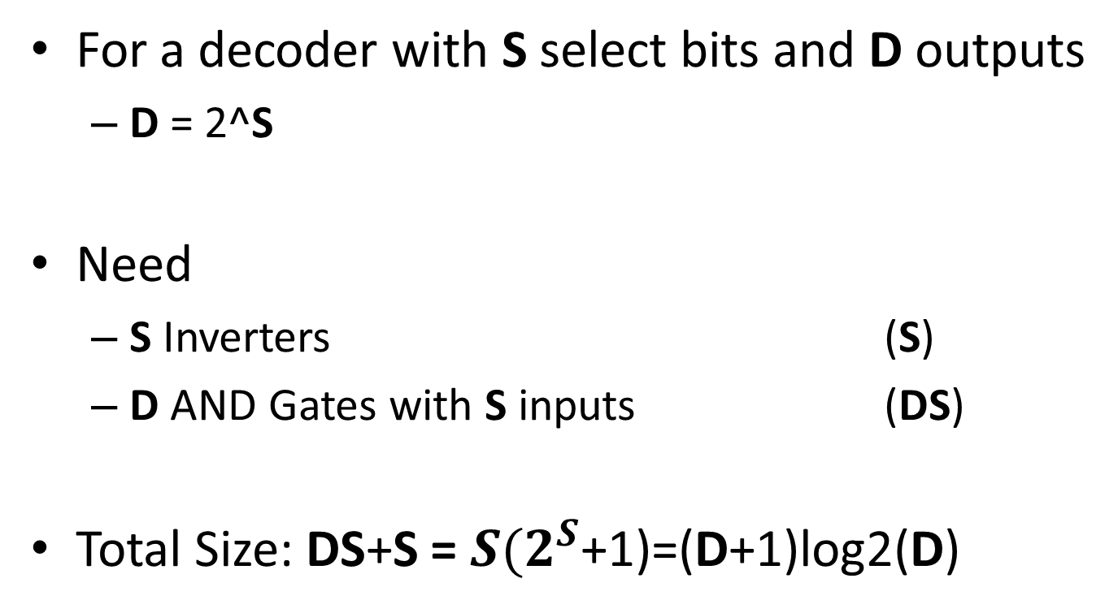
Decoder Growth Review
For a decoder with S select bits and D outputs
D = 2^S
Need
S Inverters (S)
D AND Gates with S inputs (DS)
Total Size: DS+S = $S{(2}^{S}$+1)=(D+1)log2(D)

Slide 7
Look Up Table w/Decoder

Slide 8
Look Up Table w/Decoder

Slide 9
Growth Characteristics
This has 12 Gate Inputs
4 AND2 (8)
1 OR4 (4)
Per decode line:
1 AND2
1 input of the OR
(#Decode Lines)*3

Slide 10
LUT Growth Review
For a LUT with Depth D and Output Width W
Need
1 Decoder
W Output Structures
Total Size:

Slide 11
LUT Growth Review
For a LUT with Depth D and Output Width W
Need
1 Decoder (D+1)log2(D)
W Output Structures W(3D)
Total Size: (D+1)log2(D) + W(3D)

Slide 12
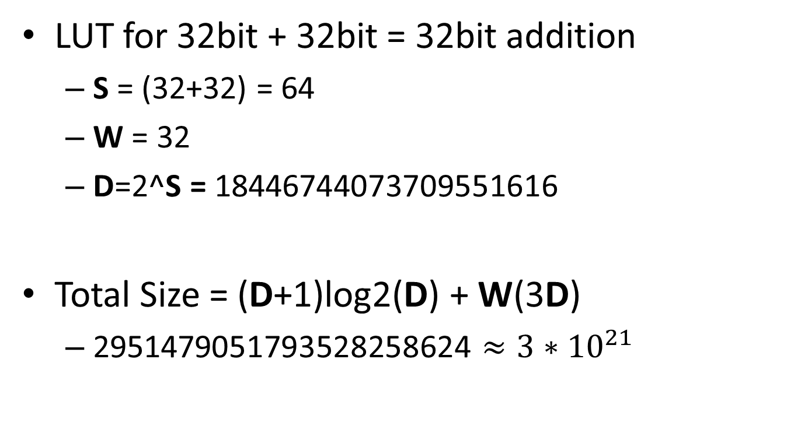
Adder Comparison
LUT for 32bit + 32bit = 32bit addition
S = (32+32) = 64
W = 32
D=2^S = 18446744073709551616
Total Size = (D+1)log2(D) + W(3D)
2951479051793528258624 $≈3∗{10}^{21}$
Notes:
This is calculated for a LUT with modifiable inputs. If the inputs are hardcoded it changes the “3” to about a half. Not a huge impact for large D.

Slide 13
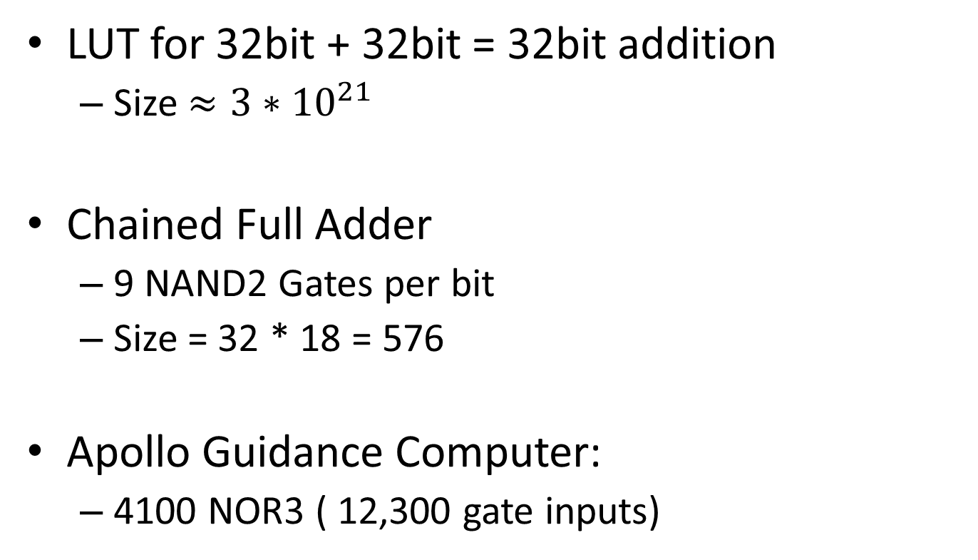
Adder Comparison
LUT for 32bit + 32bit = 32bit addition
Size $≈3∗{10}^{21}$
Chained Full Adder
9 NAND2 Gates per bit
Size = 32 * 18 = 576
Apollo Guidance Computer:
4100 NOR3 ( 12,300 gate inputs)

Slide 14
Homework and Labs
HW3 – Due this Thursday
Simple review of CompArch math
Alone
MP1 – Due next Thursday
Create and test an ALU
In groups

Slide 15
Major Goals
Understand propagation delay
Finalize mastery of Structural Verilog
Effective Testing through:
Design Reuse
Test set reduction (Orthoganality)

Slide 16
Minor Goals
Optimized Structures
Alternative Adders?
Carry Look Ahead / Carry Select / Kogge Stone
ALU shrinkage?
How small can you go?
Speed penalty?
These are not worth any grade points
Only do them if you’re interested

Slide 17
Hint: `define
Use `define syntax to avoid magic numbers
`define ADD 3'd0
`define SUB 3'd1
`define XOR 3'd2
`define SLT 3'd3
Makes for more readable code

Slide 18
Hint: LUT
Explicitly break out control logic to make a LUT
Design Flow:
Create main structure, ignore control logic
Label all control logics
Make a table and assign values per Operation
Generate LUT from this table
Delay unnecessary decisions as long as possible
Notes:
On Board, run following:
Draw Adder, mux, a couple logic gates
Don’t label anything
Add inv mux combos on B input and R output

Slide 19
Hint: LUT
Use human words:
Describe Intent
Less “Magic”
Teammates will thank you
Late Bind
Using `define?
Using enum? (Nope)
Hardcoding?
Operation | Mux | InvB | InvOutput
ADD | ADDSUB | NO | NO
SUB | ADDSUB | YES | NO
AND | AND | NO | NO
NOR | OR | NO | YES
Operation | Mux | InvB | InvOutput
ADD | MUX_ADD | 0 | 0
SUB | MUX_ADD | 1 | 0
AND | MUX_AND | 0 | 0
NOR | MUX_OR | 0 | 1

Slide 20
Hint: LUT
Behavioral only allowed for this LUT
Just to save on repetitive boolean logic practice
Don’t forget to add delays!
You know what the underlying structure is

Slide 21
Hint: Generate
This lab can get repetitive
Instantiating 32 instances of everything
Good Hierarchical design helps
e.g. Bitslice
Generate does some of this for you
generate
genvar i;
for (index = 0;
index<32;
index = index + 1)
begin
// Repeated Code
end
endgenerate

Slide 22
Hint: Param
Modules can have parameters
One design, many variants
Must be known at synthesis time
Test a smaller variant
Combine Generate and Param
Exhaustively test a 4 bit ALU?
Be careful! What did you leave untested?

Slide 24
Computer “Performance”
MIPS (Million Instructions Per Second) vs. MHz (Million Cycles Per Second)
Throughput (jobs/seconds) vs. Latency (time to complete a job)
Measuring, Metrics, Evaluation – what is “best”?
Hyper
Pipelined
Technology
3.09 GHz
Pentium 4
The PowerBook G4 outguns Pentium
III-based notebooks by up to 30 percent.*
* Based on Adobe Photoshop tests
comparing a 500MHz PowerBook G4 to
850MHz Pentium III-based portable computers

Slide 25
Performance Example: Planes
Airplane | Passenger Capacity | Cruising Range (miles) | Cruising Speed (mph) | Passenger Throughput (passengermile/hour)
Boeing 777 | 375 | 4630 | 610 | 228,750
Boeing 747 | 470 | 4150 | 610 | 286,700
Concorde | 132 | 4000 | 1350 | 178,200
Douglas DC8 | 146 | 8720 | 544 | 79,424
Which is the “best” plane?
Which gets one passenger to the destination first?
Which moves the most passengers?
Which goes the furthest?
Which is the “speediest” plane (between Seattle and NY)?
Latency: how fast is one person moved?
Throughput: number of people per time moved?

Slide 26
Computer Performance
Primary goal: execution time (time from program start to program completion)
To compare machines, we say “X is n times faster than Y”
Example: Machine Orange and Grape run a program Orange takes 5 seconds, Grape takes 10 seconds
Orange is _____ times faster than Grape

Slide 27
Execution Time
Elapsed Time
counts everything (disk and memory accesses, I/O , etc.)
a useful number, but often not good for comparison purposes
CPU time
doesn't count I/O or time spent running other programs
can be broken up into system time, and user time
Example: Unix “time” command fpga.olin.edu> time javac CircuitViewer.java 3.370u 0.570s 0:12.44 31.6%
Our focus: user CPU time
time spent executing the lines of code that are "in" our program

Slide 28
CPU Time
Application example: A program takes 10 seconds on computer Orange, with a 400MHz clock. Our design team is developing a machine Grape with a much higher clock rate, but it will require 1.2 times as many clock cycles. If we want to be able to run the program in 6 second, how fast must the clock rate be?
CPU execution time
for a program
=
CPU clock cycles
for a program
*
Clock period
CPU execution time
for a program
=
CPU clock cycles
for a program
*
1
Clock rate

Slide 29
CPI
How do the # of instructions in a program relate to the execution time?
CPU clock cycles
for a program
Instructions
for a program
Average Clock
Cycles per Instruction
(CPI)
=
*
CPU execution time
for a program
=
Instructions
for a program
*
CPI
*
1
Clock rate

Slide 30
CPI Example
Suppose we have two implementations of the same instruction set (ISA).
For some program Machine A:
clock cycle time of 10 ns
CPI of 2.0 Machine B:
clock cycle time of 20 ns
CPI of 1.2
What machine is faster for this program, and by how much?
Notes:
A = 20ns / instruction
B = 24ns / instruction

Slide 31
Computing CPI
Different types of instructions can take very different amounts of cycles
Memory accesses, integer math, floating point, control flow
Instruction Type | Type Cycles | Type Frequency | Cycles * Freq
ALU | 1 | 50%
Load | 5 | 20%
Store | 3 | 10%
Branch | 2 | 20%
 |  | CPI:
Notes:
CPI = .5 + 1 + .3 + .4 = 2.2

Slide 32
Computing CPI
Different types of instructions can take very different amounts of cycles
Memory accesses, integer math, floating point, control flow
Instruction Type | Type Cycles | Type Frequency | Cycles * Freq
ALU | 1 | 50% | .5
Load | 5 | 20% | 1
Store | 3 | 10% | .3
Branch | 2 | 20% | .4
 |  | CPI: | 2.2
Notes:
CPI = .5 + 1 + .3 + .4 = 2.2

Slide 33
CPI & Processor Tradeoffs
Instruction Type | Type Cycles | Type Frequency
ALU | 1 | 50%
Load | 5 | 20%
Store | 3 | 10%
Branch | 2 | 20%
How much faster would the machine be if:
A data cache reduced the average load time to 2 cycles?
Branch prediction shaved a cycle off the branch time?
Two ALU instructions could be executed at once?
Notes:
CPI = .5 + .4 + .3 + .4 = 1.6 -> 2.2 / 1.6 = 1.375x
CPI = .5 + 1 + .3 + .2 = 2.0 -> 2.2 / 2.0 = 1.1x
CPI = .25 + 1 + .3 + .4 = 1.95 -> 2.2 / 1.95 = 1.22x

Slide 34
Warning 1: Amdahl’s Law
The impact of a performance improvement is limited by what is NOT improved:
Example: Assume a program runs in 100 seconds on a machine, with multiply responsible for 80 seconds of this time. How much do we have to speed up multiply to make the program run 4 times faster?
5 times faster?
Execution time
after improvement
=
Execution time
of unaffected
+
Execution time affected
*
1
Amount of improvement
Notes:
100/4 = 25
25 – 20 = 5
80/5 = 16 times faster
INFINITY

Slide 35
Warning 2: MIPs, MHz ≠ Performance
Higher MHz (clock rate) doesn’t always mean better CPU
Orange computer: 1000 MHz, CPI: 2.5, 1 billion instruction program
Grape computer: 500MHz, CPI: 1.1, 1 billion instruction program
Higher MIPs (million instructions per second) doesn’t always mean better CPU
1 MHz machine, with two different compilers/instruction sets
Compiler A on program X: 10M ALU, 1M Load
Compiler B on program X: 5M ALU, 1.5M Load
Execution Time: A ____ B ____
MIPS: A ____ B ____
Instruction Type | Type Cycles
ALU | 1
Load | 5
Store | 3
Branch | 2
Notes:
15M cycles / 1MHz = 1.5 seconds
5+7.5 = 12.5M cycles = 1.25 seconds
MIPS
1.5 seconds / 1.1M instructions = 7.3MIPS
1.25 s / 6.5M instr = 5.2MIPS

Slide 36
Processor Performance Summary
Machine performance:
Better performance:
_____ number of instructions to implement computations
_____ CPI
_____ Clock rate
Improving performance must balance each constraint
Example: RISC vs. CISC
CPU execution time
for a program
=
Instructions
for a program
*
CPI
*
1
Clock rate
Notes:
Lower is better
Lower is better
Higher is better

Slide 37
Common Comparison Metrics
Whetstone MWIPS
Specific program profile stressing Floating Point
Minimal memory stress
AM386 developed 5.68MWIPS @ 40MHz (1991)
I7 930 develops 2496MWIPS @ 2800MHz

Slide 38
Common Comparison Metrics
Dhrystone
Specific program stressing integer and string ops
LINPACK
Solve linear equation Ax=b
Common calculation in engineering

Slide 39
Common Comparison Metrics: The Gibson Mix
Gibson Mix
Fixed Point Add/Subtract | 0.330
Fixed Point Multiply | 0.006
Fixed Point Divide | 0.002
Branch | 0.065
Compare | 0.040
Transfer 8 characters | 0.175
Shift | 0.046
Logical | 0.017
Modification | 0.190
Floating Point Add | 0.073
Floating Point Multiply | 0.040
Floating Point Divide | 0.016

Slide 40
Remaining Time?
Begin Homework

