Slide 1
b1000 Single Cycle CPU
ENGR xD52
Eric VanWyk
Fall 2013

Slide 2
Today
Intro to Memory
The Execution of an Instruction
Intro to Simple CPU Design
Assign Homework & Lab

Slide 3
Memory
Look Up Table is a very simple memory
Read One thing at a time
Write nothing ever
Generically, a memory is defined by:
Width & Depth
Number and Type of Ports
How many simultaneous read / write operations
Speed (access time)

Slide 4
Memory Attributes
Mutability:
Read/Write
Read Only
Write Once
Reprogrammable
Access Type
Random
Sequential
Volatility:
Non-Volatile
Volatile
Refreshed

Slide 5
Historical Side Note
History of Computer Memory is Amazing
Consider it for your final project
Crazy Memory Types:
Delay Line
Sound waves through quartz/mercury
Lasers reflected off the moom
Williams Tube
Cathode Ray Tube + Static Electricity

Slide 6
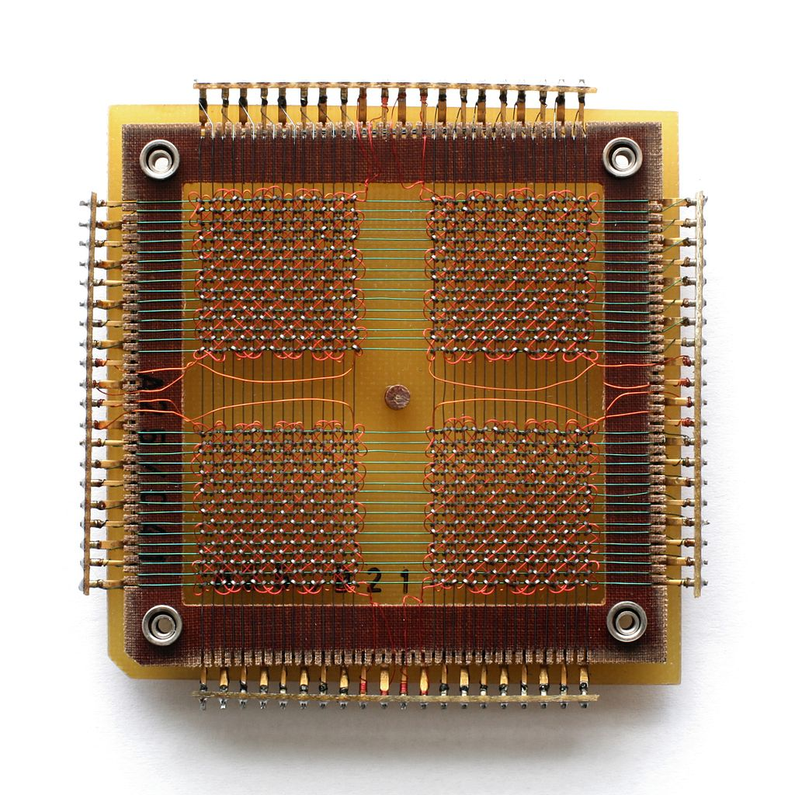
Historical Memory: Core
http://en.wikipedia.org/wiki/Magnetic-core_memory

Slide 7
Memories
We will devote several lectures entirely to memory
I will treat it as an opaque black box for this lecture, and open it in much more detail later
Your next lab is about memory interfaces

Slide 8
Context
We now have almost all of the building blocks of a computer!
Nearing completion of our first “spiral”
Today we will glance at the important ones
Moving forward we will dive deeper into each of these building blocks to expand capabilities

Slide 9
Context
You will learn the dark arts of box opacity
Practice thinking hierarchically
So… what does a CPU do?

Slide 10
CPU Execution Overview
Instruction
Fetch
Fetch instruction from memory
Decode instruction into actions/controls
Fetch/Decode operands
Compute result value or status
Push result(s) to storage
Determine next instruction
Instruction
Decode
Operand
Fetch
Execute
Result
Store
Next
Instruction

Slide 11
What boxes do we need?
Instruction
Fetch
Memory for Instructions
Something to “unpack” instructions
Memory for data
Something to compute stuff
Instruction
Decode
Operand
Fetch
Execute
Result
Store
Next
Instruction

Slide 12
What boxes do we need?
Instruction
Fetch
Memory for Instructions
Something to “unpack” instructions
Memory for data
Something to compute stuff
Instruction
Decode
Operand
Fetch
Execute
Result
Store
Next
Instruction

Slide 13
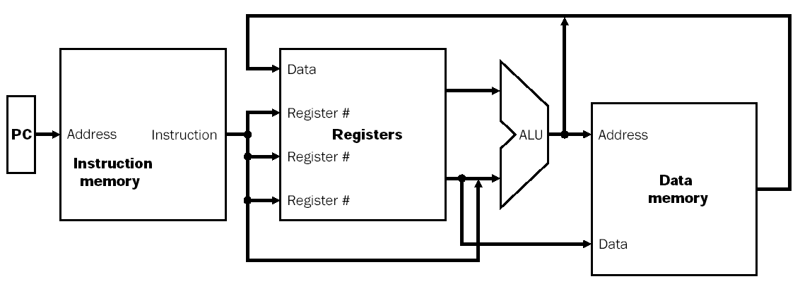
Processor Overview
Overall Dataflow
PC fetches instructions
Instructions select operand registers, ALU immediate values
ALU computes values
Load/Store addresses computed in ALU
Result goes to register file or Data memory

Slide 14
Program/Instruction Memory
Large, single ported read-only memory
For today
Stores the program the processor executes
Instructions are 4 bytes wide
For today

Slide 15
Register File
Very small, very fast multi-ported memory
Small depth, large silicon area
Each cycle reads 2 words, optionally writes 1
This is the “scratch space” for the processor
This is homework soon
Aw Aa Ab Da
Dw Db
Register
WrEn File

Slide 16
Assembly
The human readable version of the instructions the machine executes
Closely related to “Op Codes” and Instructions
We will go over this in detail soon.

Slide 17
Instruction Decode
Today we are “black boxing” instructions
Blue Wires come from the Instruction Decoder
Control signals that tell the CPU what to do
E.g. ALU Control Lines
Addresses

Slide 18
Instruction RTL
RTL is Register Transfer Level
Short Hand for what the instruction should do
Reg[Rd] = Reg[Rs] & Reg[Rt]
Set the memory at location Rd equal to the data at location Rs boolean anded with the data at location Rt.

Slide 19
Fetch Operands
Get Operand Addresses
Pull from Register File
Reg[Rd] = Reg[Rs] & Reg[Rt]
Rd Rs Rt
Aw Aa Ab Da
Dw Db
Register
WrEn File
Reg[Rs]
Reg[Rt]

Slide 20
Execute
ALU controls from Instruction Fetch/Decode
Perform actual computation in ALU
Reg[Rd] = Reg[Rs] & Reg[Rt]
Rd Rs Rt
ALUcntrl
Aw Aa Ab Da
Dw Db
Register
WrEn File
Reg[Rs] & Reg[Rt]

Slide 21
Store Results
Store the result back to the register file
Others Instructions have other effects
Reg[Rd] = Reg[Rs] & Reg[Rt]
Rd Rs Rt
ALUcntrl
Aw Aa Ab Da
Dw Db
Register
WrEn File
RegWr

Slide 22
Using Constants
Sometimes we want to use a constant as an operand instead of a Register.
How do you encode a 32 bit constant AND control signals into a 32 bit instruction?
Side Note: The Cortex has interesting options
any constant produced by shifting an 8-bit value
any constant of the form 0x00XY00XY
any constant of the form 0xXY00XY00
any constant of the form 0xXYXYXYXY
Side Note: MIPS only has boring 16 bit constants

Slide 23
Using Constants (Immediates)
Reg[rt]= Reg[rs]+SignExtend(imm);
How do we choose ALU Source?
Rt
Rs
ALUcntrl
Aw Aa Ab Da
Dw Db
Register
WrEn File
RegWr
SignExtnd
Imm16
Notes:
Note that Aw is now connected to Rt instead of Rd. This is not an error – Rd occupies the same space as part of the immediate in the instruction, and is therefore not available for this instruction. This is resolved soon!

Slide 24
Data Memory
WrEn Addr
Din Dout
Data
Memory
Big Giant Slow Memory
Gigabytes!
Read and Write, but only single port
Write Enable (WrEn) switches between the two modes
Pulling from Data Memory to Register
Load
Push from Register to Data Memory
Store

Slide 25
Hook Up On The Boards
Create simple CPU with 4 types of instructions
Listed on next Slide
Use the following Components
ALU, Register File, Data Memory, Sign Extender
Use another marker color for control signals
To make a decision, use a MUX

Slide 26
Quick Note on rd, rs, rt
Aw is inconsistent in the MIPS standard
Sometimes rt
Sometimes rd
This is ok!
Makes other things clearer later
I don’t always have to choose between two signals, but when I do, I choose Multiplexor

Slide 27
Hook Up On The Boards
Math with 2 Variables
Reg[rd] = Reg[rs] op Reg[rt];
Math with 1 variable and 1 constant
Reg[rt] = Reg[rs] op SignExtend(imm);
Load from data memory
Addr = Reg[rs] + SignExtend(imm);
Reg[rt] = Mem[Addr];
Store to data memory
Addr = Reg[rs] + SignExtend(imm);
Mem[Addr] = Reg[rt];

Slide 28
One Possible Complete Datapath
Rd
Rt
RegDst
Rs
Rt
ALUcntrl
MemWr
MemToReg
Aw Aa Ab Da
Dw Db
Register
WrEn File
RegWr
WrEn Addr
Din Dout
Data
Memory
SignExtnd
imm16
ALUSrc

Slide 29
With the remaining time
Work on Lab

Slide 30
Using Constants (Immediates)
Instruction
Fetch
Unit
Rd
Rt
RegDst
Rs
Rt
Rd
Imm16
Rs
Rt
ALUcntrl
Aw Aa Ab Da
Dw Db
Register
WrEn File
RegWr
WrEn Addr
Din Dout
Data
Memory
SignExtnd
imm16
ALUSrc

Slide 31
Datapath + Load
Addr = Reg[rs] + SignExtend(imm);
Reg[rt] = Mem[Addr];
Instruction
Fetch
Unit
Rd
Rt
RegDst
Rs
Rt
Rd
Imm16
Rs
Rt
ALUcntrl
MemWr
Aw Aa Ab Da
Dw Db
Register
WrEn File
RegWr
WrEn Addr
Din Dout
Data
Memory
SignExtnd
imm16
ALUSrc

Slide 32
Datapath + Store
Addr = Reg[rs] + SignExtend(imm);
Mem[Addr] = Reg[rt];
Note: State of RegWr, MemToReg?
Instruction
Fetch
Unit
Rd
Rt
Rs
Rt
Rd
Imm16
RegDst
Rs
Rt
ALUcntrl
MemWr
MemToReg
Aw Aa Ab Da
Dw Db
Register
WrEn File
RegWr
WrEn Addr
Din Dout
Data
Memory
SignExtnd
imm16
ALUSrc

