Slide 1
b0101 Time for Time
ENGR xD52
Eric VanWyk
Fall 2012

Slide 2
Acknowledgements
Mark L. Chang lecture notes for Computer Architecture (Olin ENGR3410)
Patterson & Hennessy: Book & Lecture Notes
Patterson’s 1997 course notes (U.C. Berkeley CS 152, 1997)
Tom Fountain 2000 course notes (Stanford EE182)
Michael Wahl 2000 lecture notes (U. of Siegen CS 3339)
Ben Dugan 2001 lecture notes (UW-CSE 378)
Professor Scott Hauck lecture notes (UW EE 471)
Mark L. Chang lecture notes for Digital Logic (NWU B01)
Texas Instruments Data Sheets

Slide 3
Today
Review Approximation Hacks from Yesterday
Review Boolean Design Process
The ravages of time
Latches, Flip Flops, Sandals

Slide 4
Its Log
From lecture b0010:
1 R=r^n = n R=r digits
1 R_{A} Digit is ‘worth’ log_{RB}R_{A}
Hex: R_{A} = 16, R_{B} = 2
log₂ (16) = 4
1 Hex digit is ‘worth’ 4 binary digits

Slide 5
Its Log
24 binary digits ≈ 7 decimal digits
log₁₀(2) * 24 ≈ 7.2247198…
log₁₀(2)≈ 0.3 log₂(10)≈ 3.3
2^ ± 126 ≈ +/-10^ ± 38
126 * .3 ≈ 37.929…
How many digits does 2^24 have in decimal?
Notes:
2^24 = 16777216 => 8 digits

Slide 6
Its Log
How many Digits should I display?
ADS1292 is a 24bit ADC, 19.34ENOB
ICL7106 is a 2000 Count ADC
AS5048 is a 14 bit rotary hall effect encoder
How good is the ADC in your multimeter?
Harbor freight 3 digit ($5.29)
Agilent 34460A 6.5 digit ($945)
Agilent 3458A 8.5 digit ($9,267)
Notes:
log10(2^24) = 7.2
log10(2^19.34) = 5.8
log10(2000) = 3.3
log10(2^14) = 4.2
Log2(10^3) = 9.9
Log2(10^6.3) = 21
Log2(10^3) = 27.5

Slide 7
Combinational Logic Design Process
Understand the problem
what is the circuit supposed to do?
write down inputs (data, control) and outputs
draw block diagram or other picture
Break problem down in to manageable, convenient chunks
Formulate the problem in terms of a truth table or other suitable design representation
truth table, boolean algebra, etc.
Choose implementation Target
PAL, PLA, Mux, FPGA, Discrete Gates
Follow Implementation Procedure
K-maps, Boolean algebra, algorithmic simplification
Notes:
PAL – Programmable Array Logic (ANDs programmable)
PLA – Programmable Logic Array (ANDs and ORs programmable)
FPGA – Field Programmable Gate Array

Slide 8
Process Example: 2’s Comp Adder Understand the Problem
what is the circuit supposed to do?
Add two numbers in 2’s complement
write down inputs (data, control) and outputs
Operands: A[n], B[n], Carry In
Outputs: S[n], Overflow, Carry Out
draw block diagram or other picture

Slide 9
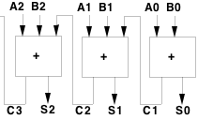
Process Example: 2’s Comp Adder Break problem down
Pieces I already know how to make:
Overflow detect = XNOR
Repeated pieces:
Each bit is handled similarly

Slide 10
Process Example: 2’s Comp Adder Formulate a Solution
Generate a truth table
^{A}
^{B}
^{CI}
^{CO}
^{S}
⁰
⁰
⁰
⁰
⁰
¹
⁰
¹
⁰
⁰
¹
¹
¹
⁰
⁰
¹
⁰
¹
¹
¹
⁰
¹
¹
¹

Slide 11
Process Example: 2’s Comp Adder Formulate a Solution
Generate a truth table
Generate Equation
Simplify
Create Circuit
^{A}
^{B}
^{CI}
^{CO}
^{S}
⁰
⁰
⁰
⁰
⁰
⁰
⁰
¹
⁰
¹
⁰
¹
⁰
⁰
¹
⁰
¹
¹
¹
⁰
¹
⁰
⁰
⁰
¹
¹
⁰
¹
¹
⁰
¹
¹
⁰
¹
⁰
¹
¹
¹
¹
¹

Slide 12
Combinational vs. Sequential Logic
X
Z
Network implemented from logic gates.
The presence of feedback
distinguishes between sequential
and combinational networks.
1
1
X
Logic
Z
2
2
-
-
-
Network
-
X
-
-
Z
n
m
Combinational logic
no feedback among inputs and outputs
outputs are a pure function of the inputs
e.g., seat belt light:
(Dbelt, Pbelt, Passenger) mapped into (Light)
Driver_belt
Logic Circuit
Passenger_belt
Seat Belt Light
Passenger

Slide 13
Circuit Timing Behavior
Simple model: gates react after fixed delay
A
D
E
B
C
F
A
B
C
D
E
F
0
1
1
0

Slide 14
Circuit Timing Behavior
Simple model: gates react after fixed delay
A
D
E
B
C
F
A
B
C
D
E
F
0
1
1
0

Slide 15
Hazards/Glitches
Circuit can temporarily go to incorrect states
Copilot Autopilot Request
B
A
Pilot in Charge?
Autopilot Engaged
Pilot Autopilot Request
C
CAR
PIC
PAR
A
B
C
AE
Must filter out temporary states

Slide 16
Hazards/Glitches
Circuit can temporarily go to incorrect states
Copilot Autopilot Request
B
A
Pilot in Charge?
Autopilot Engaged
Pilot Autopilot Request
C
CAR
PIC
PAR
A
B
C
AE
OH NO
Must filter out temporary states

Slide 17
Safe Sequential Circuits
Clocked elements on feedback, perhaps outputs
Clock signal synchronizes operation
Clocked elements hide glitches/hazards
X
Z
1
1
X
Logic
Z
2
2
-
-
-
Network
-
X
-
-
Z
n
m
Clock
Clock
Data
Compute
Valid
Compute
Valid
Compute

Slide 18
Safe Sequential Circuits
Clocked elements on feedback, perhaps outputs
Clock signal synchronizes operation
Clocked elements hide glitches/hazards
X
Z
1
1
X
Logic
Z
2
2
-
-
-
Network
-
X
-
-
Z
n
m
Clock
Clock
Data
GLITCHES
Stable
GLITCHES
Stable
GLITCHES

Slide 19
A what-ed wholement?
Clocked or Enabled Elements
Flip Flops and Latches
“Hold on” to state until triggered to update.
Many kinds

Slide 20
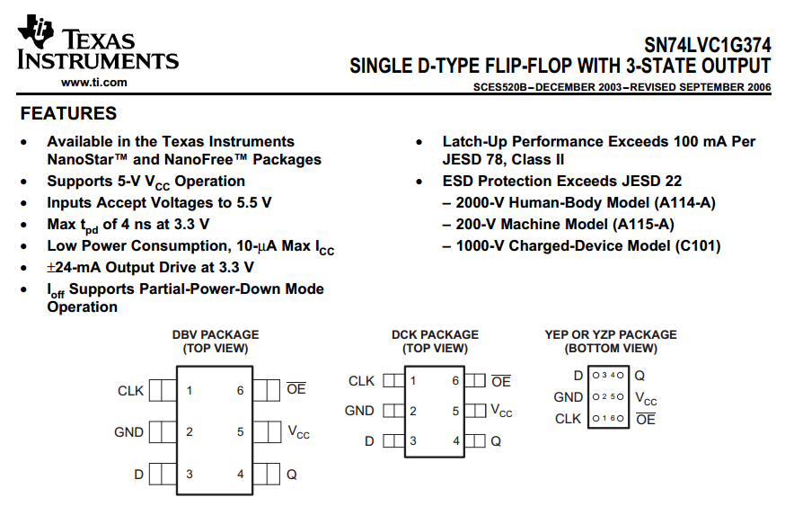
http://www.ti.com/lit/ds/symlink/sn74lvc1g374.pdf

Slide 21
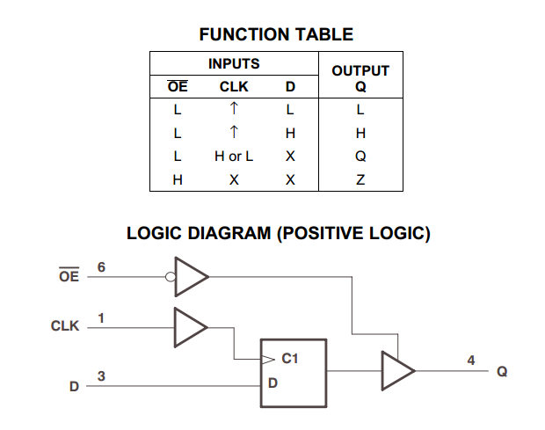
http://www.ti.com/lit/ds/symlink/sn74lvc1g374.pdf

Slide 22
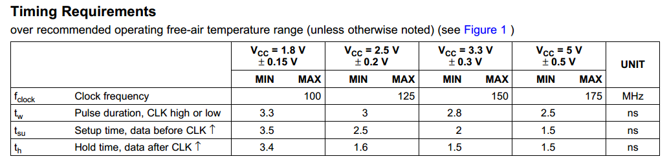
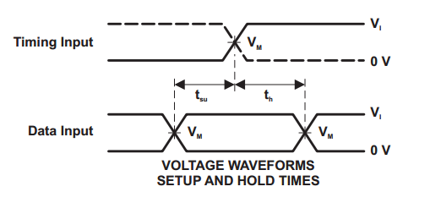
http://www.ti.com/lit/ds/symlink/sn74lvc1g374.pdf

Slide 23
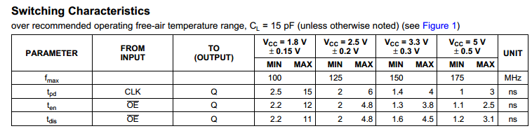
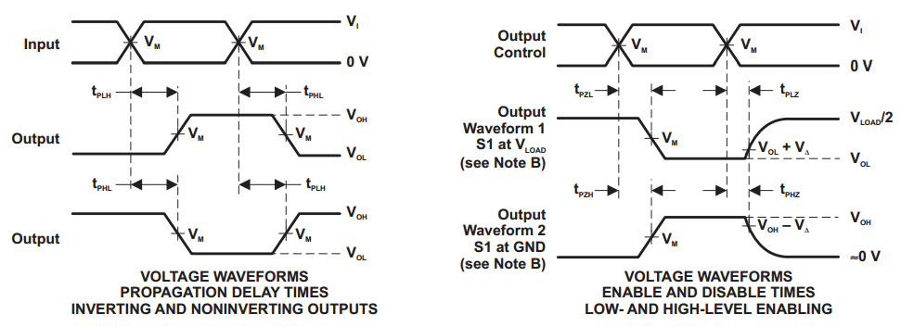
http://www.ti.com/lit/ds/symlink/sn74lvc1g374.pdf

Slide 24
Vocab!
Setup – Required stability before
Hold – Required stability after
Propagation Delay – Until outputs update

Slide 25
Reinventing the SR Latch
“SR” for “Set Reset”
Cross-coupled NOR/NAND
S | R | Q Next
0 | 0
0 | 1
1 | 0
1 | 1
http://en.wikipedia.org/wiki/File:R-S_mk2.gif

Slide 26
Reinventing the SR Latch
“SR” for “Set Reset”
Cross-coupled NOR/NAND
S | R | Q Next
0 | 0 | Q
0 | 1 | 0
1 | 0 | 1
1 | 1 | X
http://en.wikipedia.org/wiki/File:R-S_mk2.gif

Slide 27

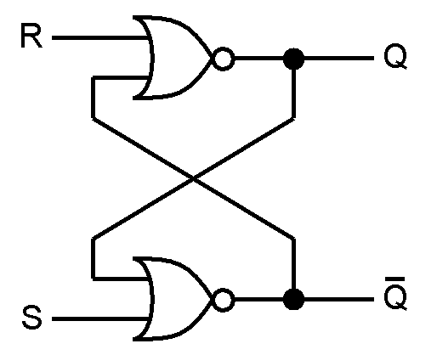
SR Latch Timing
S
R
Q
Q ̅

Slide 28
Design Time!
Invent new types of latches by adding control logic around a SR or S ̅R̅ latch
Treat the SR as a magic box
Create a truth table to translate your requirements to the SR’s inputs
Use to make a complete circuit

Slide 29
Boreds
Gated SR latch
Inputs “work” only while Enable is True
When Enable is false, S/R have no effect
Design a Gated D Latch
One Data input instead of Set Reset.
Output follows input while enabled
When Enable is false, Output holds last value
Smallest design? Fastest? Weirdest?

Slide 30
You promised a Flop
Confusing vocab – they are similar
A latch is typically Enabled
A Flip Flop is typically Clocked
All are forms of ‘Bistable Multivibrators’

Slide 31

Master Slave D-Flip Flop
Two D-Latches in series with opposite polarity Enable lines
Pulse Triggered
Capture on one edge
Display on the other
http://en.wikipedia.org/wiki/File:Negative-edge_triggered_master_slave_D_flip-flop.svg

Slide 32
Edge Triggered D-Flip Flop
Functionally similar to Master Slave
Edge Triggered, not Pulse
Don’t waste half your clock period!
Construction highly process dependent
Can be roughly three SR Latches
Can be “Dynamic Logic” – Learn in VLSI

Slide 33
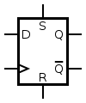
Edge Triggered D-Flip Flop
Clk | D | Q
↑ | 0 | 0
↑ | 1 | 1
Other | X | Q
Always has:
Clk, D, Q
May also have:
S, R, ~Q
Set and Reset are asynchronous (ignore clock)
http://en.wikipedia.org/wiki/File:D-Type_Flip-flop.svg

Slide 34
Common Uses
In between processing stages
“Debounce” inputs
Hide external noise / uncertainty from the inputs
Synchronization

Slide 35
Other Flops
Ternary: Flip-Flap-Flop.
T Flip Flop
Toggles on each clock strobe
Good for cutting frequency in half
JK Flip Flop
Clocked SR flip flop that also supports toggling

Slide 36
Final Bord
Create a T Flip Flop from an D Flip Flop
Create 16x frequency divider from T Flip Flops
Create 10x frequency divider from ???

Slide 37
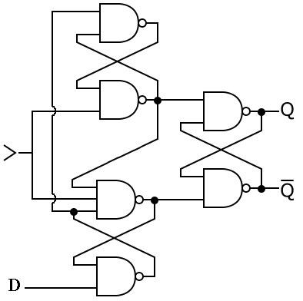
Edge Triggered D-Flip Flop

