Slide 1
b0110 Fabric and Trust
ENGR xD52
Eric VanWyk
Fall 2013

Slide 2
Acknowlegements
ARM Holdings: M3 Cortex Instruction Set
Addison Wesley Longman: Figures
Wikipedia: Figures
Asic World

Slide 3
Today
Decoders , Muxes, LUTs, Oh My
My PALs, CPLDs and FPGAs
Do a Barrel Roll
Trust Issues
Preparation for your first Lab

Slide 4
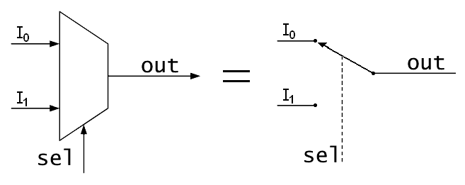
Muxes, AKA Multiplexor
Select or switch between inputs
Has one output, two types of inputs
‘Input’
‘Select’
#‘Select’ >= log2(# ‘Input’)
8 inputs needs 3 select (address) bits
Notes:
Figure Credit: Wikipedia

Slide 5
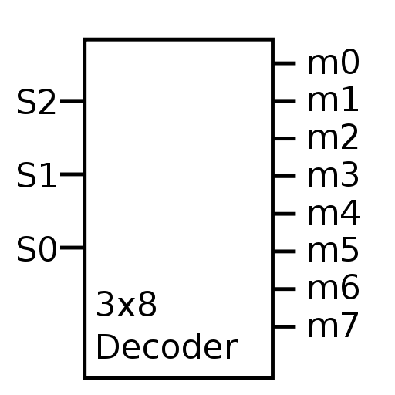
(Binary) Decoder
Also called a ‘demux’
Because it is the exact opposite.
Only one output is active at once
Usually has 2^inputs number of outputs
Sometimes has an enable input
All Low or All Hi-Z
Notes:
Figure Credit: Wikipedia

Slide 6
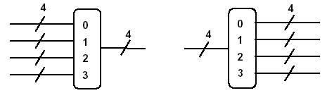
Width
The width of a bus is how many bits are in that signal.
A wire is a bus with width = 1
Width of I4Q4?

Slide 7
Look Up Tables
A form of Read Only Memory
Defined by Width and Depth
Width = How many bits per word
Depth = How many words available
Constructed as Muxes with constant inputs
Use Select to look up the table entry

Slide 8
Designing from Documentation
Clone the following parts from basic gates:
DigiKey Part No NC7SZ157P6XTR-ND
568-4448-2-ND
568-8857-1-ND
MC74HC164ADR2GOSTR-ND (Optional)
Hint: Use D-Flip-Flops as a black box
Do your solutions match theirs?
Notes:
1x 2:1
1x 3:8

Slide 9
Programmable Logic
1969: XC157
Mask Programmed, 12 gates 30 pins
1978: Programmable Logic Arrays
Field Programmed by burning fuses
Sum of Products
Equivalent to “Dozens” of gates
1985: Generic Array Logic
Field reprogammable

Slide 10
Programmable Logic
Complex Programmable Logic Device:
1000s to 10ks of Gates equivalent
Non-volatile (typically)
Sum of Products (typically)

Slide 11
Field Programmable Gate Array
1985: Xilinx releases the XC2064
Equivalent to 1000 gates
Typical Features:
Volatile (Reprogram every time power is applied)
Sea of Gates (Look Up Tables + Routing)
Programmable Logic Blocks
“Hard” Features – RAM, Multipliers, CPUs

Slide 12
Xilinx Zynq 7000
Up to 6.6 Million Gates Equivalent
277,400 Look Up Tables
554,800 Flip Flops
>2 Trillion Multiply Accumulates per second
Dual Core 1GHz ARM Cortex A9
2.5 DMIPS/MHz
$5,401.26

Slide 13
Fabric Design
FPGA ‘Fabric’ is a sea of reconfigurable logic blocks embedded in reconfigurable routing logic.
The reconfigurable logic used to be mostly look up tables with configurable constants.
Now it is LUTs + other stuff too

Slide 14
Fabric Design
Design a small piece of an FPGA using:
Decoders
Muxes
Basic Gates
Programmable Bits (Ignore Construction for now)
Use your FPGA cell to create:
AND
XOR
Adder (Half? Full?)
Start by figuring out your requirements:
Width? Depth?

Slide 15
Do a Barrel Roll
We can multiply or divide a number by 2 by moving it left or right one position
This is called a “shift”

Slide 16
Do a Barrel Roll
“Arithmetic” shifts obey 2’s complement
Sign extension
“Logical” shifts do not
Assume unsigned
Pad zeros
Barrel Rotate “wraps” around

Slide 17
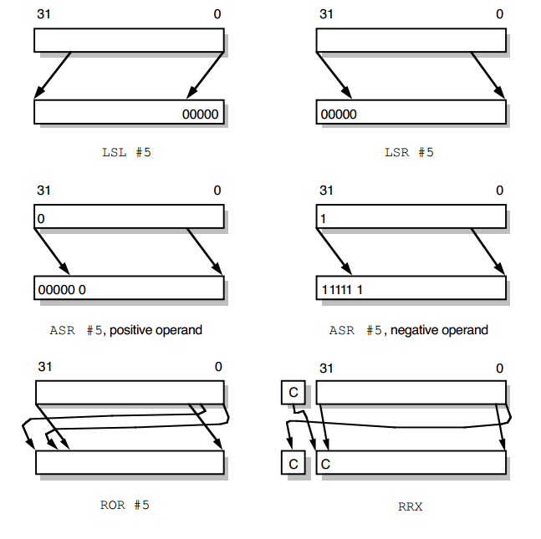
http://bwrc.eecs.berkeley.edu/research/pico_radio/Test_Bed/Hardware/Documentation/ARM/chap3.pdf

Slide 18
What could possibly go wrong?
Sketch a shifter to do at least one type of shift
Hint: Layers of Muxes
List possible ways it could be busted
Specific errors in the design of the component
Come up with a test plan for your shifter
How can you achieve full coverage without exhaustion?

Slide 19
Intro to Verilog
Verilog is a Hardware Description Language
Describes a digital logic circuit
Syntax is like C
Writing in verilog is not at all like writing in C
Synthesized to create:
FPGA bitstreams
ASICs

Slide 20
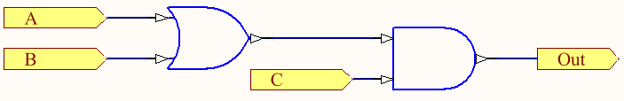
Structural Verilog Design Flow
Start with a circuit diagram
Give names to all wires and gates

Slide 21
Structural Verilog Design Flow
Start with a circuit diagram

Slide 22
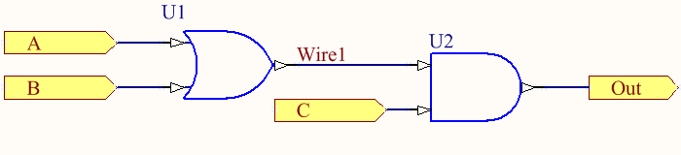
Structural Verilog Design Flow
Start with a circuit diagram
Give names to all wires and gates

Slide 23
Structural Verilog Design Flow
Start with a circuit diagram
Give names to all wires and gates
List wires and gates in code
wire wire1, A, B, C, Out;
or U1
and U2

Slide 24
Structural Verilog Design Flow
Start with a circuit diagram
Give names to all wires and gates
List wires and gates in code
Connect gates to wires, Outputs first
wire wire1, A, B, C, Out;
or U1(wire1, A, B);
and U2(Out, wire1, C);

Slide 25
Structural Verilog Design Flow
Start with a circuit diagram
Give names to all wires and gates
List wires and gates in code
Connect gates to wires, Outputs first
Add Delays
wire wire1, A, B, C, Out;
or U1 #(50) (wire1, A, B);
and U2 #(50) (Out, wire1, C);

Slide 26
Lab Preparation
Select 1 or 2 partners
Read through MP0.pdf
Questions?
Begin paper&pencil sketching of modules
You have the rest of class to begin work
Start Installing ModelSim Student Edition

