Slide 1
b0111 Performance Anxiety
ENGR xD52
Eric VanWyk
Fall 2012

Slide 2
Today
Lab Check-In
Floating Point Failure
What is “Performance”
Measuring Performance
Amdahl’s Law

Slide 3
Lab Check In

Slide 4
FPGA Building Blocks Review
FPGA is made of Look Up Tables (LUTs)
LUTs are muxes with fixed inputs
Muxes are made from Decoders
Plus lots of AND gates
Plus one OR gate per bit of width
Fixed Inputs are provided by Shift Registers
Shift Registers are chained D-Flip Flops
DFF are chained D Latches
D Latches are SR Latches plus

Slide 5
Floating Point Failure
float sum, sumsqs, sample = 0;
for(int i=0; i < N; i++){
sample = readSensor();
sum += sample;
sumsqs += sample * sample;
}
sigma = sqrt(N* sumsqs – sum * sum)/ N;
Why is sigma NaN?
Noticed on sensors that don’t change quickly
Notes:
For (relatively) constant sample, the correct answer is (very close to) zero. Catastrophic Cancellation may cause the term inside sqrt to be negative, which is undefined.

Slide 6
Computer “Performance”
MIPS (Million Instructions Per Second) vs. MHz (Million Cycles Per Second)
Throughput (jobs/seconds) vs. Latency (time to complete a job)
Measuring, Metrics, Evaluation – what is “best”?
Hyper
Pipelined
Technology
3.09 GHz
Pentium 4
The PowerBook G4 outguns Pentium
III-based notebooks by up to 30 percent.*
* Based on Adobe Photoshop tests
comparing a 500MHz PowerBook G4 to
850MHz Pentium III-based portable computers

Slide 7
Performance Example: Planes
Airplane | Passenger Capacity | Cruising Range (miles) | Cruising Speed (mph) | Passenger Throughput (passengermile/hour)
Boeing 777 | 375 | 4630 | 610 | 228,750
Boeing 747 | 470 | 4150 | 610 | 286,700
Concorde | 132 | 4000 | 1350 | 178,200
Douglas DC8 | 146 | 8720 | 544 | 79,424
Which is the “best” plane?
Which gets one passenger to the destination first?
Which moves the most passengers?
Which goes the furthest?
Which is the “speediest” plane (between Seattle and NY)?
Latency: how fast is one person moved?
Throughput: number of people per time moved?

Slide 8
Computer Performance
Primary goal: execution time (time from program start to program completion)
To compare machines, we say “X is n times faster than Y”
Example: Machine Orange and Grape run a program Orange takes 5 seconds, Grape takes 10 seconds
Orange is _____ times faster than Grape

Slide 9
Execution Time
Elapsed Time
counts everything (disk and memory accesses, I/O , etc.)
a useful number, but often not good for comparison purposes
CPU time
doesn't count I/O or time spent running other programs
can be broken up into system time, and user time
Example: Unix “time” command fpga.olin.edu> time javac CircuitViewer.java 3.370u 0.570s 0:12.44 31.6%
Our focus: user CPU time
time spent executing the lines of code that are "in" our program

Slide 10
CPU Time
Application example: A program takes 10 seconds on computer Orange, with a 400MHz clock. Our design team is developing a machine Grape with a much higher clock rate, but it will require 1.2 times as many clock cycles. If we want to be able to run the program in 6 second, how fast must the clock rate be?
CPU execution time
for a program
=
CPU clock cycles
for a program
*
Clock period
CPU execution time
for a program
=
CPU clock cycles
for a program
*
1
Clock rate

Slide 11
CPI
How do the # of instructions in a program relate to the execution time?
CPU clock cycles
for a program
Instructions
for a program
Average Clock
Cycles per Instruction
(CPI)
=
*
CPU execution time
for a program
=
Instructions
for a program
*
CPI
*
1
Clock rate

Slide 12
CPI Example
Suppose we have two implementations of the same instruction set (ISA).
For some program Machine A has a clock cycle time of 10 ns. and a CPI of 2.0 Machine B has a clock cycle time of 20 ns. and a CPI of 1.2
What machine is faster for this program, and by how much?
Notes:
A = 20ns / instruction
B = 24ns / instruction

Slide 13
Computing CPI
Different types of instructions can take very different amounts of cycles
Memory accesses, integer math, floating point, control flow
Instruction Type | Type Cycles | Type Frequency | Cycles * Freq
ALU | 1 | 50%
Load | 5 | 20%
Store | 3 | 10%
Branch | 2 | 20%
 |  | CPI:
Notes:
CPI = .5 + 1 + .3 + .4 = 2.2

Slide 14
CPI & Processor Tradeoffs
Instruction Type | Type Cycles | Type Frequency
ALU | 1 | 50%
Load | 5 | 20%
Store | 3 | 10%
Branch | 2 | 20%
How much faster would the machine be if:
A data cache reduced the average load time to 2 cycles?
Branch prediction shaved a cycle off the branch time?
Two ALU instructions could be executed at once?
Notes:
CPI = .5 + .4 + .3 + .4 = 1.6 -> 2.2 / 1.6 = 1.375x
CPI = .5 + 1 + .3 + .2 = 2.0 -> 2.2 / 2.0 = 1.1x
CPI = .25 + 1 + .3 + .4 = 1.95 -> 2.2 / 1.95 = 1.22x

Slide 15
Warning 1: Amdahl’s Law
The impact of a performance improvement is limited by what is NOT improved:
Example: Assume a program runs in 100 seconds on a machine, with multiply responsible for 80 seconds of this time. How much do we have to speed up multiply to make the program run 4 times faster?
5 times faster?
Execution time
after improvement
=
Execution time
of unaffected
+
Execution time affected
*
1
Amount of improvement
Notes:
100/4 = 25
25 – 20 = 5
80/5 = 16 times faster
INFINITY

Slide 16
Warning 2: MIPs, MHz ≠ Performance
Higher MHz (clock rate) doesn’t always mean better CPU
Orange computer: 1000 MHz, CPI: 2.5, 1 billion instruction program
Grape computer: 500MHz, CPI: 1.1, 1 billion instruction program
Higher MIPs (million instructions per second) doesn’t always mean better CPU
1 MHz machine, with two different compilers/instruction sets
Compiler A on program X: 10M ALU, 1M Load
Compiler B on program X: 5M ALU, 1M Load
Execution Time: A ____ B ____
MIPS: A ____ B ____
Instruction Type | Type Cycles
ALU | 1
Load | 5
Store | 3
Branch | 2

Slide 17
Processor Performance Summary
Machine performance:
Better performance:
_____ number of instructions to implement computations
_____ CPI
_____ Clock rate
Improving performance must balance each constraint
Example: RISC vs. CISC
CPU execution time
for a program
=
Instructions
for a program
*
CPI
*
1
Clock rate
Notes:
Lower is better
Lower is better
Higher is better

Slide 18
Common Comparison Metrics
Whetstone MWIPS
Specific program profile stressing Floating Point
Minimal memory stress
AM386 developed 5.68MWIPS @ 40MHz (1991)
I7 930 develops 2496MWIPS @ 2800MHz

Slide 19
Common Comparison Metrics
Dhrystone
Specific program stressing integer and string ops
LINPACK
Solve linear equation Ax=b
Common calculation in engineering

Slide 20
Common Comparison Metrics: The Gibson Mix
Gibson Mix
Fixed Point Add/Subtract | 0.330
Fixed Point Multiply | 0.006
Fixed Point Divide | 0.002
Branch | 0.065
Compare | 0.040
Transfer 8 characters | 0.175
Shift | 0.046
Logical | 0.017
Modification | 0.190
Floating Point Add | 0.073
Floating Point Multiply | 0.040
Floating Point Divide | 0.016

Slide 21
Do a Barrel Roll
We can multiply or divide a number by 2 by moving it left or right one position
This is called a “shift”

Slide 22
Do a Barrel Roll
“Arithmetic” shifts obey 2’s complement
Sign extension
“Logical” shifts do not
Assume unsigned
Pad zeros
Barrel Rotate “wraps” around

Slide 23
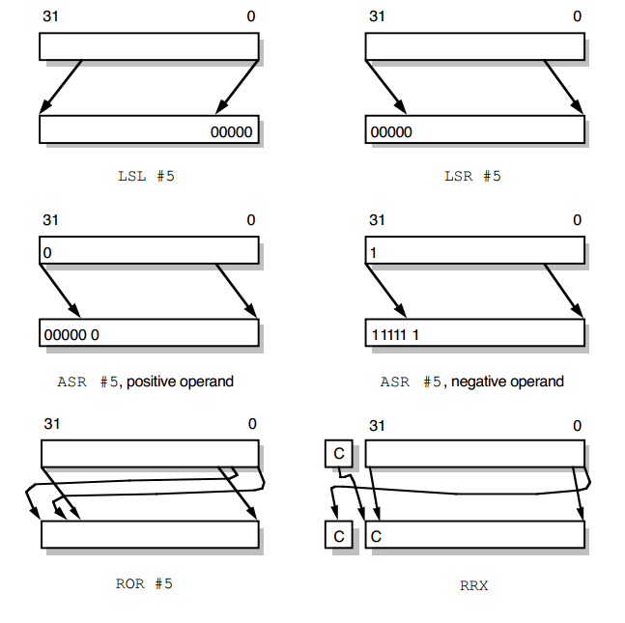
http://bwrc.eecs.berkeley.edu/research/pico_radio/Test_Bed/Hardware/Documentation/ARM/chap3.pdf

Slide 24
Board Work
Construct two different 8-bit Shifters
One that takes one cycle
Hint – Layers of Muxes
One that take more than one cycle
Estimate
Propagation Delays
Relative Speeds
Relative Sizes

