Slide 1
b1000 Single Cycle CPU
ENGR xD52
Eric VanWyk
Fall 2013

Slide 2
Acknowledgements
Alyssa Bawgus
Orion Taylor

Slide 3
Today
Review Growth Characteristics
Intro to Memory and Assembly
The Execution of an Instruction
Intro to Simple CPU Design
Assign Homework & Lab

Slide 4
Decoder Growth Review
For a decoder with S select bits and D outputs
D = 2^S
Need
S Inverters
D AND Gates with S inputs
Total Size:

Slide 5
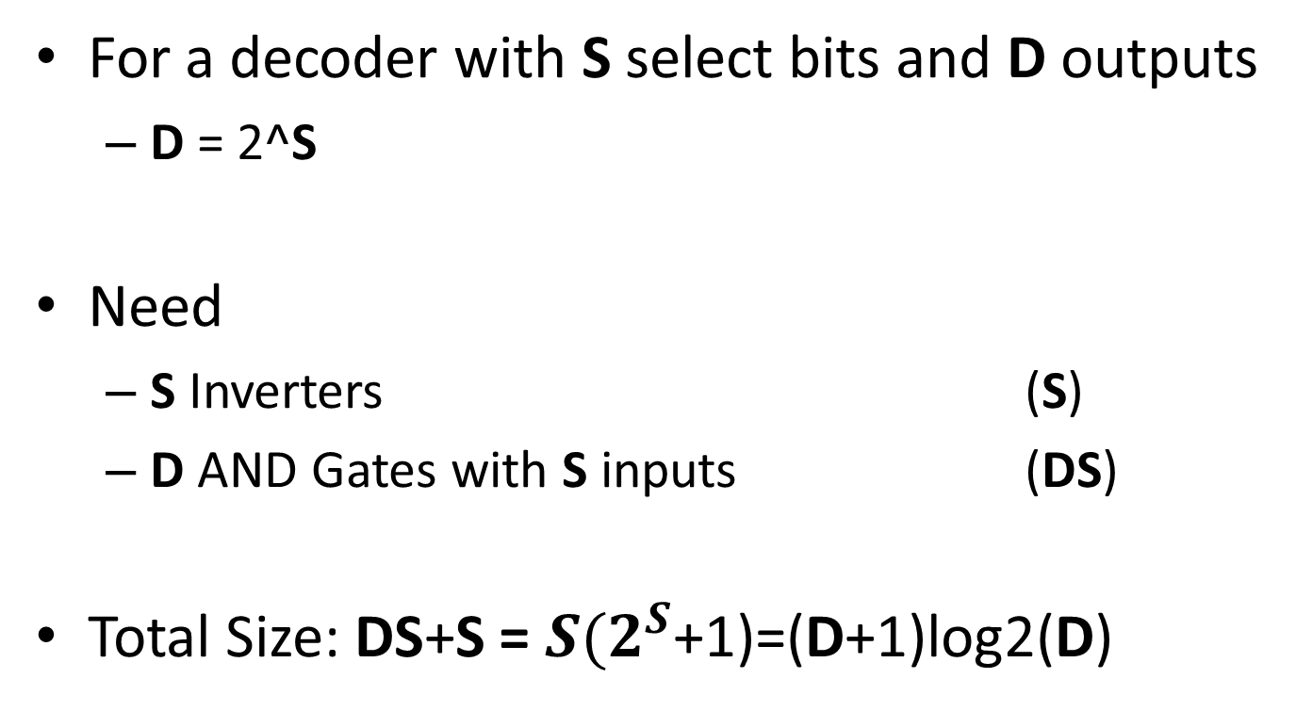
Decoder Growth Review
For a decoder with S select bits and D outputs
D = 2^S
Need
S Inverters (S)
D AND Gates with S inputs (DS)
Total Size: DS+S = $S{(2}^{S}$+1)=(D+1)log2(D)

Slide 6
Look Up Table w/Decoder

Slide 7
Look Up Table w/Decoder

Slide 8
Growth Characteristics
This has 12 Gate Inputs
4 AND2 (8)
1 OR4 (4)
Per decode line:
1 AND2
1 input of the OR
(#Decode Lines)*3

Slide 9
LUT Growth Review
For a LUT with Depth D and Output Width W
Need
1 Decoder
W Output Structures
Total Size:

Slide 10
LUT Growth Review
For a LUT with Depth D and Output Width W
Need
1 Decoder (D+1)log2(D)
W Output Structures W(3D)
Total Size: (D+1)log2(D) + W(3D)

Slide 11
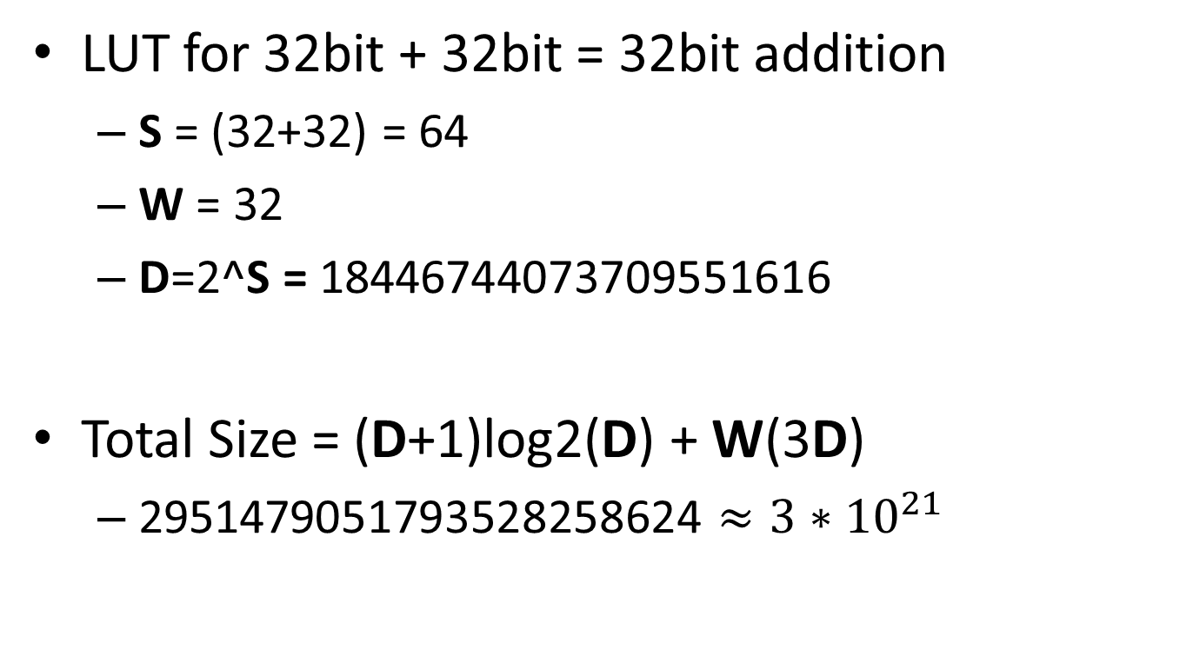
Adder Comparison
LUT for 32bit + 32bit = 32bit addition
S = (32+32) = 64
W = 32
D=2^S = 18446744073709551616
Total Size = (D+1)log2(D) + W(3D)
2951479051793528258624 $≈3∗{10}^{21}$

Slide 12
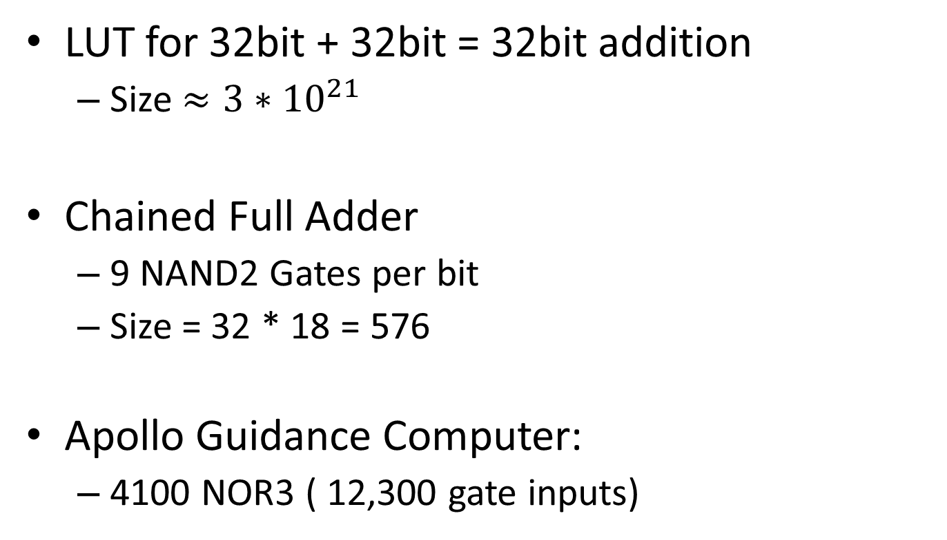
Adder Comparison
LUT for 32bit + 32bit = 32bit addition
Size $≈3∗{10}^{21}$
Chained Full Adder
9 NAND2 Gates per bit
Size = 32 * 18 = 576
Apollo Guidance Computer:
4100 NOR3 ( 12,300 gate inputs)

Slide 13
Context
We now have almost all of the building blocks of a computer!
Nearing completion of our first “spiral”
Today we will glance at the important ones
Moving forward we will dive deeper into each of these building blocks to expand capabilities

Slide 14
Context
You will learn the dark arts of box opacity
Practice thinking hierarchically
So… what does a CPU do?

Slide 15
CPU Execution Overview
Instruction
Fetch
Fetch instruction from memory
Decode instruction into actions/controls
Fetch/Decode operands
Compute result value or status
Push result(s) to storage
Determine next instruction
Instruction
Decode
Operand
Fetch
Execute
Result
Store
Next
Instruction

Slide 16
What boxes do we need?
Instruction
Fetch
Memory for Instructions
Something to “unpack” instructions
Memory for data
Something to compute stuff
Instruction
Decode
Operand
Fetch
Execute
Result
Store
Next
Instruction

Slide 17
What boxes do we need?
Instruction
Fetch
Memory for Instructions
Something to “unpack” instructions
Memory for data
Something to compute stuff
Instruction
Decode
Operand
Fetch
Execute
Result
Store
Next
Instruction

Slide 18
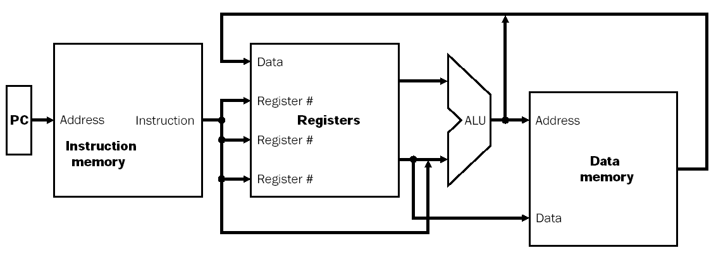
Processor Overview
Overall Dataflow
PC fetches instructions
Instructions select operand registers, ALU immediate values
ALU computes values
Load/Store addresses computed in ALU
Result goes to register file or Data memory

Slide 19
Memory
Look Up Table is a very simple memory
Read One thing at a time
Write nothing ever
Generically, a memory is defined by:
Width & Depth
Number and Type of Ports
How many simultaneous read / write operations
Speed (access time)

Slide 20
Memories
We will devote several lectures entirely to memory
I will treat it as an opaque black box for this lecture, and open it in much more detail later
Your lab is all about one type of memory

Slide 21
Register File
Very small, very fast multi-ported memory
Small depth, large silicon area
Each cycle reads 2 words, optionally writes 1
This is the “scratch space” for the processor
This is your lab
Aw Aa Ab Da
Dw Db
Register
WrEn File

Slide 22
Program/Instruction Memory
Large, single ported read-only memory
For today
Stores the program the processor executes
Instructions are 4 bytes wide
For today

Slide 23
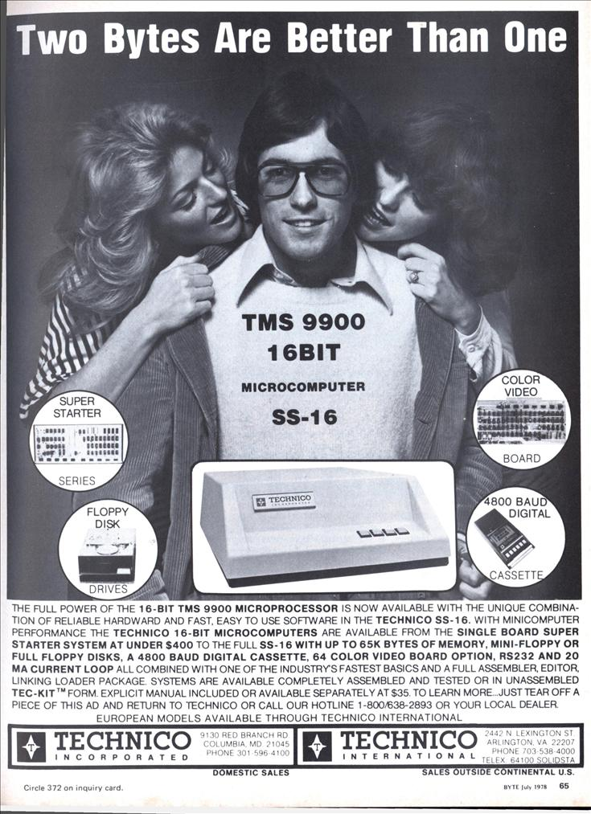
Why 4?
Today we are assuming 4 byte instructions
Why? This is hilarious and I needed an excuse to show it to you.
Notes:
Actual Best Slide Ever

Slide 24
Assembly
The human readable version of the instructions the machine executes
Closely related to “Op Codes” and Instructions
We will go over this in detail next week.

Slide 25
Instruction Decode
Today we are “black boxing” instructions
Blue Wires come from the Instruction Decoder
Control signals that tell the CPU what to do
E.g. ALU Control Lines
Addresses

Slide 26
Instruction RTL
RTL is Register Transfer Level
Short Hand for what the instruction should do
Reg[Rd] = Reg[Rs] & Reg[Rt]
Set the memory at location Rd equal to the data at location Rs boolean anded with the data at location Rt.

Slide 27
Fetch Operands
Get Operand Addresses
Pull from Register File
Rd Rs Rt
ALUcntrl
Aw Aa Ab Da
Dw Db
Register
WrEn File
RegWr

Slide 28
Execute
ALU controls from Instruction Fetch/Decode
Perform actual computation in ALU
Rd Rs Rt
ALUcntrl
Aw Aa Ab Da
Dw Db
Register
WrEn File
Result
RegWr

Slide 29
Execute
ALU controls from Instruction Fetch/Decode
Perform actual computation in ALU
Rd Rs Rt
ALUcntrl
Aw Aa Ab Da
Dw Db
Register
WrEn File
RegWr

Slide 30
Store Results
Most Instructions store the result back to the register file
Others have other effects
Instruction
Fetch
Unit
Rs
Rt
Rd
Rd Rs Rt
ALUcntrl
Aw Aa Ab Da
Dw Db
Register
WrEn File
RegWr

Slide 31
Using Constants
Sometimes we want to use a constant as an operand instead of a Register.
How do you encode a 32 bit constant AND control signals into a 32 bit instruction?
Side Note: The Cortex has interesting options
any constant produced by shifting an 8-bit value
any constant of the form 0x00XY00XY
any constant of the form 0xXY00XY00
any constant of the form 0xXYXYXYXY
Side Note: MIPS only has boring 16 bit constants

Slide 32
Using Constants (Immediates)
Reg[rt] = Reg[rs] + SignExtend(imm);
Instruction
Fetch
Unit
Rs
Rt
Rd
Imm16
Rt
Rs
ALUcntrl
Aw Aa Ab Da
Dw Db
Register
WrEn File
RegWr
SignExtnd
Imm16
Notes:
Note that Aw is now connected to Rt instead of Rd. This is not an error – Rd occupies the same space as part of the immediate in the instruction, and is therefore not available for this instruction. This is resolved soon!

Slide 33
Data Memory
WrEn Addr
Din Dout
Data
Memory
Big Giant Slow Memory
Gigabytes!
Read and Write, but only single port
Write Enable (WrEn) switches between the two modes
Pulling from Data Memory to Register
Load
Push from Register to Data Memory
Store

Slide 34
Hook Up On The Boards
Create simple CPU with 4 types of instructions
Listed on next Slide
Use the following Components
ALU, Register File, Data Memory, Sign Extender
Use another marker color for control signals
To make a decision, use a MUX

Slide 35
Hook Up On The Boards
Math with 2 Variables
Reg[rd] = Reg[rs] op Reg[rt];
Math with 1 variable and 1 constant
Reg[rt] = Reg[rs] op SignExtend(imm);
Load from data memory
Addr = Reg[rs] + SignExtend(imm);
Reg[rt] = Mem[Addr];
Store to data memory
Addr = Reg[rs] + SignExtend(imm);
Mem[Addr] = Reg[rt];

Slide 36
One Possible Complete Datapath
Rd
Rt
RegDst
Rs
Rt
ALUcntrl
MemWr
MemToReg
Aw Aa Ab Da
Dw Db
Register
WrEn File
RegWr
WrEn Addr
Din Dout
Data
Memory
SignExtnd
imm16
ALUSrc

Slide 37
Lets Talk Labs
It is all about the process
Please do not make this an ugly competition
Cleverness and Realism!

Slide 38
With the remaining time
Begin Work on Lab

Slide 39
Using Constants (Immediates)
Instruction
Fetch
Unit
Rd
Rt
RegDst
Rs
Rt
Rd
Imm16
Rs
Rt
ALUcntrl
Aw Aa Ab Da
Dw Db
Register
WrEn File
RegWr
WrEn Addr
Din Dout
Data
Memory
SignExtnd
imm16
ALUSrc

Slide 40
Datapath + Load
Addr = Reg[rs] + SignExtend(imm);
Reg[rt] = Mem[Addr];
Instruction
Fetch
Unit
Rd
Rt
RegDst
Rs
Rt
Rd
Imm16
Rs
Rt
ALUcntrl
MemWr
Aw Aa Ab Da
Dw Db
Register
WrEn File
RegWr
WrEn Addr
Din Dout
Data
Memory
SignExtnd
imm16
ALUSrc

Slide 41
Datapath + Store
Addr = Reg[rs] + SignExtend(imm);
Mem[Addr] = Reg[rt];
Note: State of RegWr, MemToReg?
Instruction
Fetch
Unit
Rd
Rt
Rs
Rt
Rd
Imm16
RegDst
Rs
Rt
ALUcntrl
MemWr
MemToReg
Aw Aa Ab Da
Dw Db
Register
WrEn File
RegWr
WrEn Addr
Din Dout
Data
Memory
SignExtnd
imm16
ALUSrc

