Slide 1
Unsupervised Learning Reading: Chapter 8 from Introduction to Data Mining by Tan, Steinbach, and Kumar, pp. 489-518, 532-544, 548-552

Slide 2
Supervised learning vs. unsupervised learning

Slide 3
Unsupervised Classification of Optdigits
Attribute 1
Attribute 2
Attribute 3
64-dimensional space

Slide 4
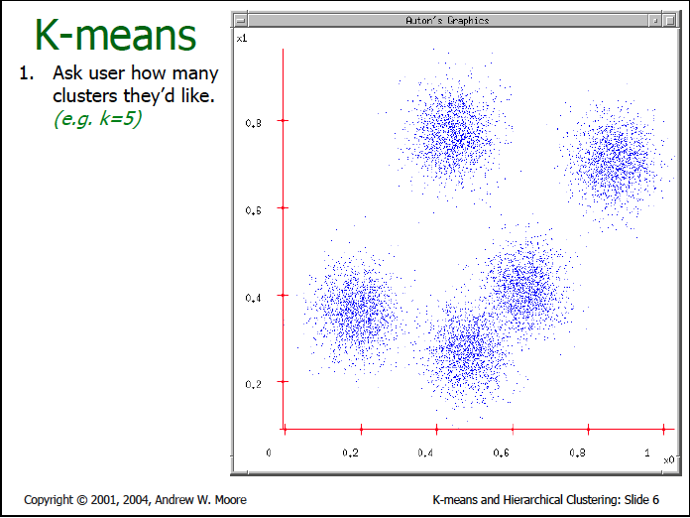
Adapted from Andrew Moore, http://www.cs.cmu.edu/~awm/tutorials

Slide 5
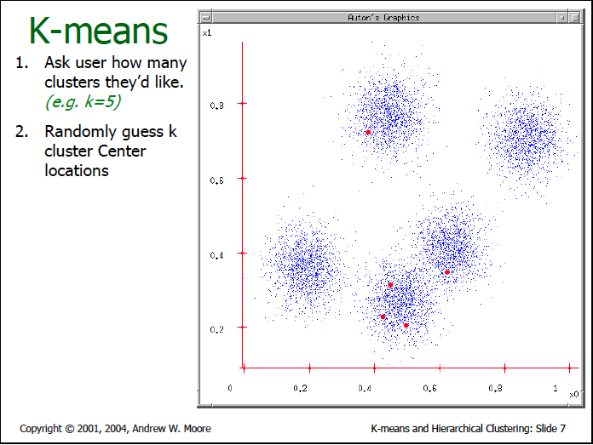
Adapted from Andrew Moore, http://www.cs.cmu.edu/~awm/tutorials

Slide 6
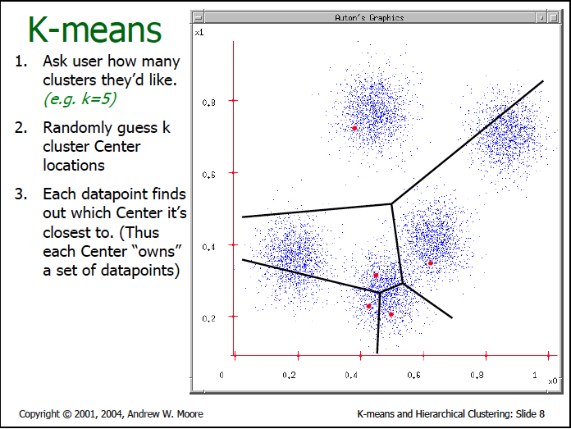
Adapted from Andrew Moore, http://www.cs.cmu.edu/~awm/tutorials

Slide 7
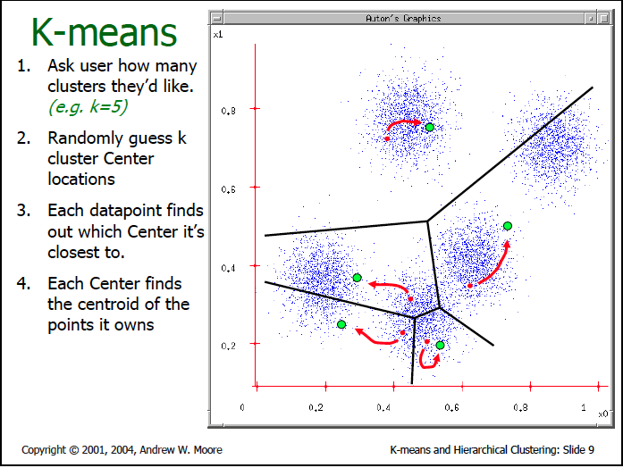
Adapted from Andrew Moore, http://www.cs.cmu.edu/~awm/tutorials

Slide 8
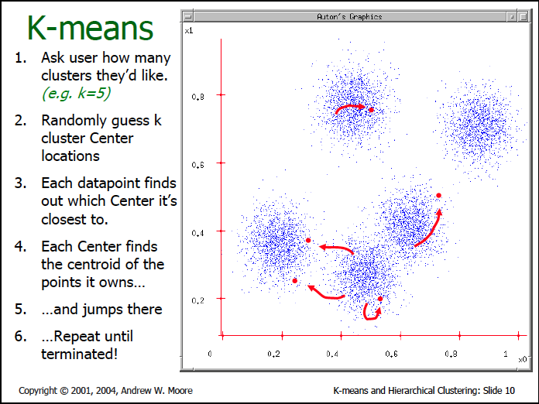

Slide 9
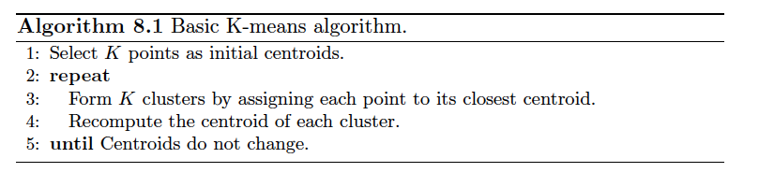
K-means clustering algorithm

Slide 10
K-means clustering algorithm
Typically, use mean of points in cluster as centroid

Slide 11
K-means clustering algorithm
Distance metric: Chosen by user.
For numerical attributes, often use L₂ (Euclidean) distance.

Slide 12
Demo
http://www.rob.cs.tu-bs.de/content/04-teaching/06-interactive/Kmeans/Kmeans.html

Slide 13
Stopping/convergence criteria
No change of centroids (or minimum change)
No (or minimum) decrease in the sum squared error (SSE),
where C_{i} is the jth cluster, m_{j} is the centroid of cluster C_{j} (the mean vector of all the data points in C_{j}), and d(x, m_{j}) is the distance between data point x and centroid m_{j}.

Slide 14
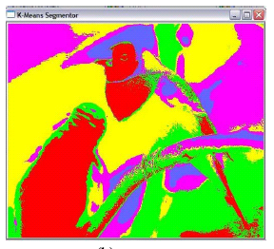
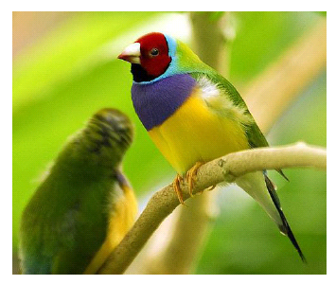
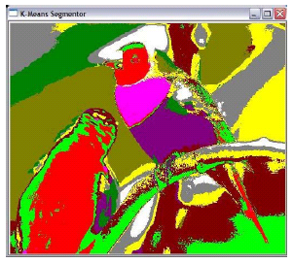
Example: Image segmentation by K-means clustering by color
From http://vitroz.com/Documents/Image%20Segmentation.pdf
K=5, RGB space
K=10, RGB space

Slide 15
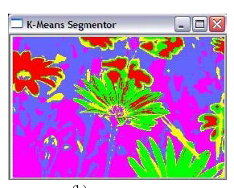

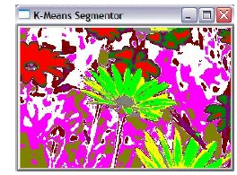
K=5, RGB space
K=10, RGB space

Slide 16
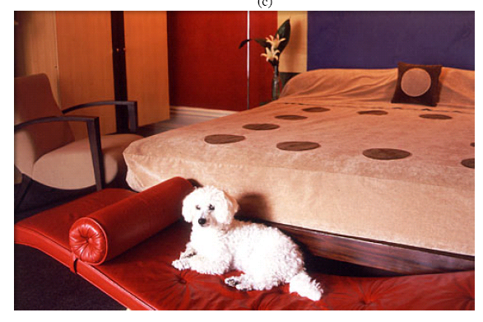
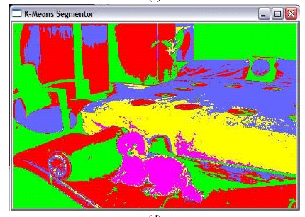
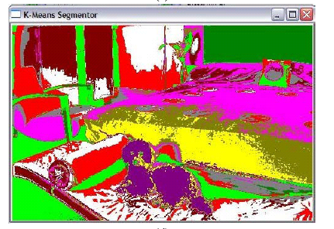
K=5, RGB space
K=10, RGB space

Slide 17
Clustering text documents
A text document is represented as a feature vector of word frequencies
Distance between two documents is the cosine of the angle between their corresponding feature vectors.

Slide 18
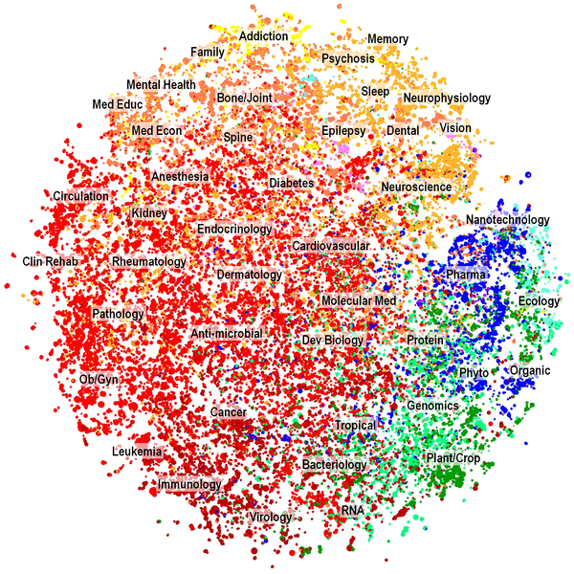

Figure 4. Two-dimensional map of the PMRA cluster solution, representing nearly 29,000 clusters and over two million articles.
Boyack KW, Newman D, Duhon RJ, Klavans R, et al. (2011) Clustering More than Two Million Biomedical Publications: Comparing the Accuracies of Nine Text-Based Similarity Approaches. PLoS ONE 6(3): e18029. doi:10.1371/journal.pone.0018029
http://www.plosone.org/article/info:doi/10.1371/journal.pone.0018029

Slide 19
K-means clustering example
Consider the following five two-dimensional data points,
x₁ = (1,1), x₂ = (0,3), x₃ = (2,2), x₄ = (4,3), x₅ = (4,4)
and the following two initial cluster centers,
m₁= (0,0), m₂= (1,4)
Simulate the K-means algorithm by hand on this data and these initial centers, using Euclidean distance.
Give the SSE of the clustering.

Slide 20
Weaknesses of K-means
Adapted from Bing Liu, UIC
http://www.cs.uic.edu/~liub/teach/cs583-fall-05/CS583-unsupervised-learning.ppt

Slide 21
Weaknesses of K-means
Adapted from Bing Liu, UIC
http://www.cs.uic.edu/~liub/teach/cs583-fall-05/CS583-unsupervised-learning.ppt
The algorithm is only applicable if the mean is defined.
For categorical data, k-mode - the centroid is represented by most frequent values.

Slide 22
Weaknesses of K-means
Adapted from Bing Liu, UIC
http://www.cs.uic.edu/~liub/teach/cs583-fall-05/CS583-unsupervised-learning.ppt
The algorithm is only applicable if the mean is defined.
For categorical data, k-mode - the centroid is represented by most frequent values.
The user needs to specify K.

Slide 23
Weaknesses of K-means
Adapted from Bing Liu, UIC
http://www.cs.uic.edu/~liub/teach/cs583-fall-05/CS583-unsupervised-learning.ppt
The algorithm is only applicable if the mean is defined.
For categorical data, k-mode - the centroid is represented by most frequent values.
The user needs to specify K.
The algorithm is sensitive to outliers
Outliers are data points that are very far away from other data points.
Outliers could be errors in the data recording or some special data points with very different values.

Slide 24
Weaknesses of K-means
Adapted from Bing Liu, UIC
http://www.cs.uic.edu/~liub/teach/cs583-fall-05/CS583-unsupervised-learning.ppt
The algorithm is only applicable if the mean is defined.
For categorical data, k-mode - the centroid is represented by most frequent values.
The user needs to specify K.
The algorithm is sensitive to outliers
Outliers are data points that are very far away from other data points.
Outliers could be errors in the data recording or some special data points with very different values.
K-means is sensitive to initial random centroids

Slide 25
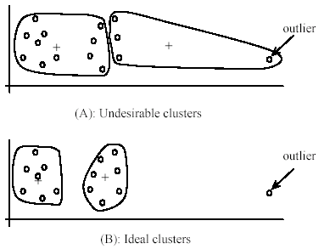
Weaknesses of K-means: Problems with outliers
Adapted from Bing Liu, UIC
http://www.cs.uic.edu/~liub/teach/cs583-fall-05/CS583-unsupervised-learning.ppt

Slide 26
Dealing with outliers
Adapted from Bing Liu, UIC
http://www.cs.uic.edu/~liub/teach/cs583-fall-05/CS583-unsupervised-learning.ppt
One method is to remove some data points in the clustering process that are much further away from the centroids than other data points.
Expensive
Not always a good idea!
Another method is to perform random sampling. Since in sampling we only choose a small subset of the data points, the chance of selecting an outlier is very small.
Assign the rest of the data points to the clusters by distance or similarity comparison, or classification

Slide 27
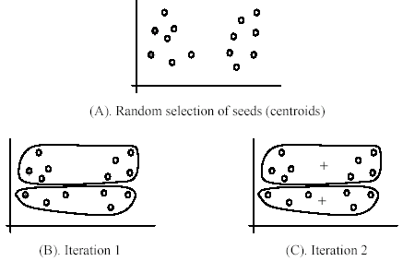
Weaknesses of K-means (cont …)
Adapted from Bing Liu, UIC
http://www.cs.uic.edu/~liub/teach/cs583-fall-05/CS583-unsupervised-learning.ppt
The algorithm is sensitive to initial seeds.
+
+

Slide 28
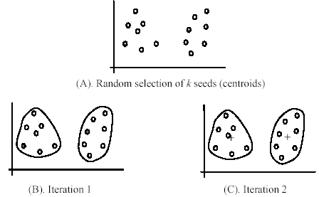
Weaknesses of K-means (cont …)
Adapted from Bing Liu, UIC
http://www.cs.uic.edu/~liub/teach/cs583-fall-05/CS583-unsupervised-learning.ppt
If we use different seeds: good results
+
+

Slide 29
Weaknesses of K-means (cont …)
Adapted from Bing Liu, UIC
http://www.cs.uic.edu/~liub/teach/cs583-fall-05/CS583-unsupervised-learning.ppt
Often can improve K-means results by doing several random restarts.
See assigned reading for methods to help choose good seeds
If we use different seeds: good results
+
+

Slide 30
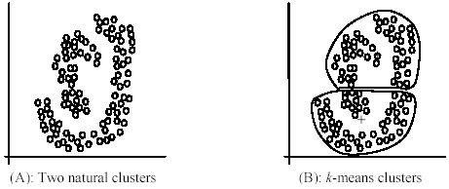
Adapted from Bing Liu, UIC
http://www.cs.uic.edu/~liub/teach/cs583-fall-05/CS583-unsupervised-learning.ppt
Weaknesses of K-means (cont …)
The K-means algorithm is not suitable for discovering clusters that are not hyper-ellipsoids (or hyper-spheres).
+

Slide 31
Other Issues
What if a cluster is empty?
Choose a replacement centroid
At random, or
From cluster that has highest SSE
How to choose K ?

Slide 32
How to evaluate clusters produced by K-means?
Unsupervised evaluation
Supervised evaluation

Slide 33
Unsupervised Cluster Evaluation We don’t know the classes of the data instances

Slide 34
Unsupervised Cluster Evaluation We don’t know the classes of the data instances

Slide 35
Supervised Cluster Evaluation We know the classes of the data instances

Slide 36
Supervised Cluster Evaluation We know the classes of the data instances
Entropy: The degree to which each cluster consists of objects of a single class.
See assigned reading for other measures

Slide 37
Supervised Cluster Evaluation We know the classes of the data instances
Entropy: The degree to which each cluster consists of objects of a single class.
See assigned reading for other measures
What is the entropy of our earlier clustering,
given class assignments?

Slide 38
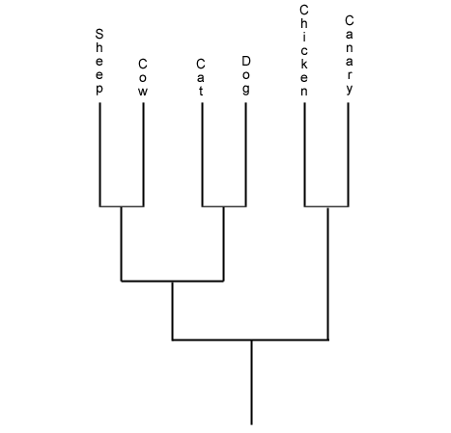
Hierarchical clustering
http://painconsortium.nih.gov/symptomresearch/chapter_23/sec27/cahs27pg1.htm

Slide 39
Discriminative vs. Generative Clustering
Discriminative:
Cluster data points by similarities
Example: K-means and hierarchical clustering
Generative
Generate models to describe different clusters, and use these models to classify points
Example: Clustering via finite Gaussian mixture models

Slide 40
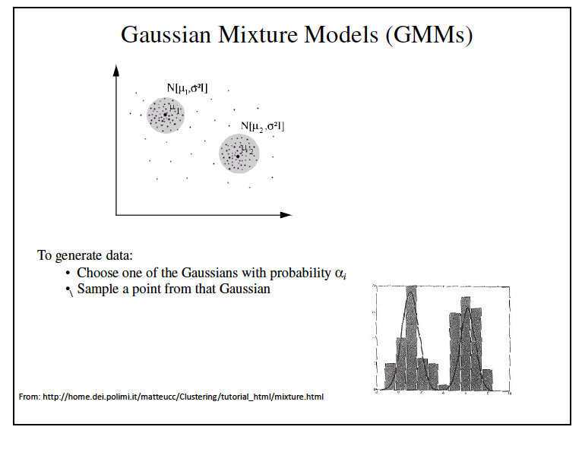

Slide 41
Homework 5

