Slide 1
Binary Logistic Regression:
One Dichotomous Independent Variable
Adapted from John Whitehead
Department of Economics
East Carolina University
http://personal.ecu.edu/whiteheadj/data/logit/logit.ppt
And from notes from Kimberly Maier, Michigan State University

Slide 2
Why use logistic regression?
There are many important research topics for which the dependent variable is "limited."
For example: whether or not a person smokes, or drinks, or skips class, or takes advanced mathematics. For these the outcome is not continuous or distributed normally.
Example: Are mother’s who have high school education less likely to have children with IEP’s (individualized plans, indicating cognitive or emotional disabilities
Binary logistic regression is a type of regression analysis where the dependent variable is a dummy variable: coded 0 (did not smoke) or 1(did smoke)

Slide 3
A Problem with Linear Regression (slides 3-6 from Kim Maier)
However, transforming the independent variables does not remedy all of the potential problems. What if we have a non-normally distributed dependent variable? The following example depicts the problem of fitting a regular regression line to a non-normal dependent variable).
Suppose you have a binary outcome variable. The problem of having a non-continuous dependent variable becomes apparent when you create a scatterplot of the relationship. Here, we see that it is very difficult to decipher a relationship among these variables.

Slide 4
A Problem with Linear Regression
We could severely simplify the plot by drawing a line between the means for the two dependent variable levels, but this is problematic in two ways: (a) the line seems to oversimplify the relationship and (b) it gives predictions that cannot be observable values of Y for extreme values of X.
The reason this doesn’t work is
because the approach is analogous to
fitting a linear model to the probability
of the event. As you know,
probabilities can only take values
between 0 and 1. Hence, we need a
different approach to ensure that our
model is appropriate for the data.

Slide 5
A Problem with Linear Regression
The mean of a binomial variable coded as (1,0) is a proportion. We could plot conditional probabilities as Y for each level of X. Of course, we could fit a linear model to these conditional probabilities, but (as shown) the linear model does not predict the maximum likelihood estimates for each group (the mean—shown by the circles) and it still produces unobservable predictions for extreme values of the dependent variable.
This plot gives us a better picture of the relationship between X and Y. It is clear that the relationship is non-linear. In fact, the shape of the curve is sigmoid.

Slide 6
The Linear Probability Model
In the OLS regression:
Y = β₀ + β₁X + e ; where Y = (0, 1)
The error terms are heteroskedastic
e is not normally distributed because Y takes on only two values
The predicted probabilities can be greater than 1 or less than 0

Slide 7
A Problem with Linear Regression
If you think about the shape of this distribution, you may posit that the function is a cumulative probability distribution. As stated previously, we can model the nonlinear relationship
between X and Y by transforming one of the variables. Two common transformations that result in sigmoid functions are probit and logit transformations. In short, a probit
transformation imposes a cumulative normal function on the data. But, probit functions are difficult to work with because they require integration. Logit transformations, on the other hand, give nearly identical values as a probit function, but they are much easier to work with because the function can be simplified to a linear equation.

Slide 8
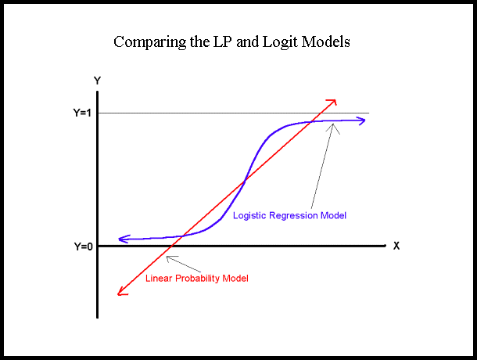

Slide 9
The Logistic Regression Model
The "logit" model solves these problems: ln[p/(1-p)] = β₀ + β₁X
p is the probability that the event Y occurs, p(Y=1)
[range=0 to 1]
p/(1-p) is the "odds ratio"
[range=0 to ∞]
ln[p/(1-p)]: log odds ratio, or "logit“
[range=-∞ to +∞]

Slide 10
Odds & Odds Ratios
Recall the definitions of an odds:
The odds has a range of 0 to ∞ with values greater than 1 associated with an event being more likely to occur than to not occur and values less than 1 associated with an event that is less likely to occur than not occur.
The logit is defined as the log of the odds:
This transformation is useful because it creates a variable with a range from -∞ to +∞. Hence, this transformation solves the problem we encountered in fitting a linear model to probabilities. Because probabilities (the dependent variable) only range from 0 to 1, we can get linear predictions that are outside of this range. If we transform our probabilities to logits, then we do not have this problem because the range of the logit is not restricted. In addition, the interpretation of logits is simple—take the exponential of the logit and you have the odds for the two groups in question.

Slide 11
Interpretation of Ogive
The logistic distribution constrains the estimated probabilities to lie between 0 and 1.
The estimated probability is: p = 1/[1 + e^{(β0 + β1X )}]
if you let β₀ + β₁X =0, then p = .50
as β₀ + β₁X gets really big, p approaches 1
as β₀ + β₁X gets really small, p approaches 0

Slide 13
Introducing the Odds Ratio for the Logistic Transformation
If there is a 75% chance that it will rain tomorrow, then 3 out of 4 times we say this it will rain. That means for every three times it rains once it will not. The odds of it raining tomorrow are 3 to 1. This can also be understood as (¾)/¼=3/1.
If the odds that my pony will win the race is 1 to 3, that means for every 4 races it runs, it will win 1 and lose 3. Therefore I should be paid $3 for every dollar I bet.

Slide 14
Example Interpretation of coefficient β₁
p/(1-p)=odds 5% / 95% =.5/.95=.056
Odds in IEP in with HS = (33/623)/(590/623)= 33/590=.056
8% / 92% =.8/.92 =.089
Odds in IEP, No HS = (45/553)/(508/553) =45/508=.089
Change in odds due to HS =.056/.089=.63
The odds that the child of a mother with high school education has an IEP is .63 that of other mothers – it is lower because they are less likely.
Logistic regression coefficient=LN(.63)= -.46
Change in odds =e ^{β0 + β1}/e ^{β0}=e^{β1} e^{-.46} =.63

Slide 15
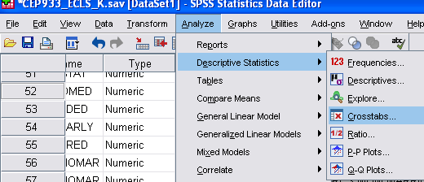
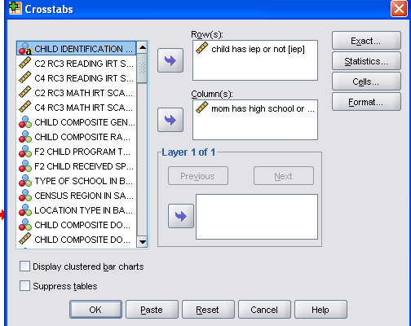
Running logistic in spss

Slide 16
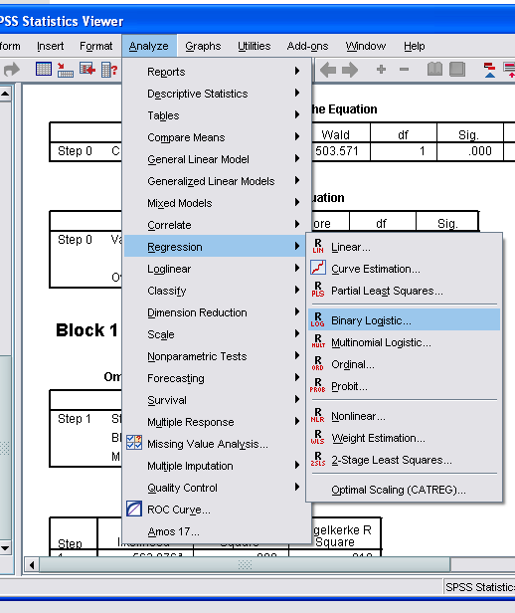
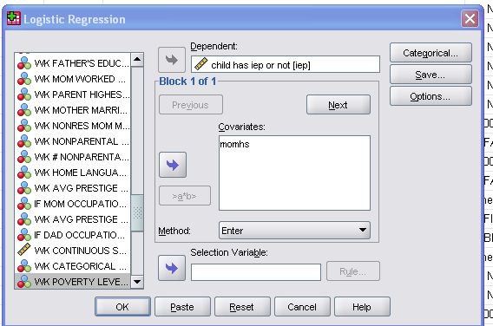
Running logistic in SPSS for child has IEP or not in ECLS-K
ln[p/(1-p)] = β₀ + β₁X= ln[p/(1-p)] = -2.424 -.46X
Change in odds =e ^{β0 + β1}/e ^{β0}=e^{β1} e^{-.46} =.63

Slide 17
Hypothesis Testing
The Wald statistic for the β coefficient is: Wald = [β /s.e._{B}]² which is distributed chi-square with 1 degree of freedom.

Slide 18
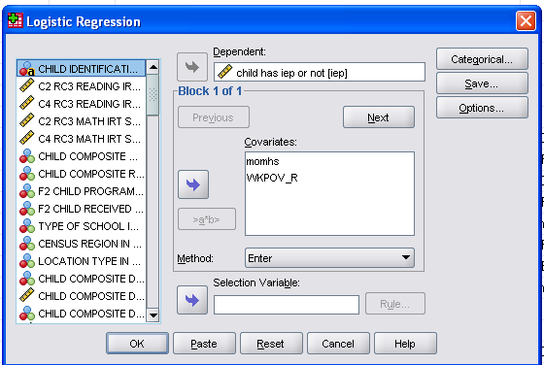
Running logistic in SPSS for child has IEP or not in ECLS-K

Slide 19
Logistic Regression Reflection
What part is most confusing to you?
What are the possible interpretations for the part that is confusing?
Find a partner or two and share your questions

Slide 20
References
http://personal.ecu.edu/whiteheadj/data/logit/
Video for running logistic in spss
http://www.youtube.com/watch?v=ICN6CMDxHwg&noredirect=1
power points
http://personal.ecu.edu/whiteheadj/data/logit/logit.ppt
http://www.google.com/search?q=logistic+regression+ppt&ie=utf-8&oe=utf-8&aq=t&rls=org.mozilla:en-US:official&client=firefox-a
http://www.google.com/search?q=logistic+regression+ppt&ie=utf-8&oe=utf-8&aq=t&rls=org.mozilla:en-US:official&client=firefox-a
with sas:
http://www.math.yorku.ca/SCS/Courses/grcat/grc6.html
http://www.ats.ucla.edu/stat/sas/seminars/sas_logistic/logistic1.htm
http://www.pauldickman.com/teaching/sas/sas_logistic_seminar8.pdf
for poisson
http://www.uwm.edu/IMT/Computing/sasdoc8/sashtml/insight/chap17/sect1.htm
In stata
http://psg_mac43.ucsf.edu/ticr/syllabus/courses/38/2004/11/02/Lecture/notes/Session%204%20lecture%20slides.ppt

