Slide 1
DATA MINING LECTURE 5
Similarity and Distance
Sketching, Locality Sensitive Hashing

Slide 2
SIMILARITY AND DISTANCE
Thanks to:
Tan, Steinbach, and Kumar, “Introduction to Data Mining”
Rajaraman and Ullman, “Mining Massive Datasets”

Slide 3
Similarity and Distance
For many different problems we need to quantify how close two objects are.
Examples:
For an item bought by a customer, find other similar items
Group together the customers of a site so that similar customers are shown the same ad.
Group together web documents so that you can separate the ones that talk about politics and the ones that talk about sports.
Find all the near-duplicate mirrored web documents.
Find credit card transactions that are very different from previous transactions.
To solve these problems we need a definition of similarity, or distance.
The definition depends on the type of data that we have

Slide 4
Similarity
Numerical measure of how alike two data objects are.
A function that maps pairs of objects to real values
Higher when objects are more alike.
Often falls in the range [0,1], sometimes in [-1,1]
Desirable properties for similarity
s(p, q) = 1 (or maximum similarity) only if p = q. (Identity)
s(p, q) = s(q, p) for all p and q. (Symmetry)

Slide 5
Similarity between sets
Consider the following documents
Which ones are more similar?
How would you quantify their similarity?
apple releases new ipod
apple releases new ipad
new apple pie recipe

Slide 6
Similarity: Intersection
Number of words in common
Sim(D,D) = 3, Sim(D,D) = Sim(D,D) =2
What about this document?
Sim(D,D) = Sim(D,D) = 3
apple releases new ipod
apple releases new ipad
new apple pie recipe
Vefa rereases new book with apple pie recipes

Slide 7
Jaccard Similarity
The Jaccard similarity (Jaccard coefficient) of two sets S₁, S₂ is the size of their intersection divided by the size of their union.
JSim (C₁, C₂) = |C₁∩C₂| / |C₁∪C₂|.
Extreme behavior:
Jsim(X,Y) = 1, iff X = Y
Jsim(X,Y) = 0 iff X,Y have no elements in common
JSim is symmetric
3 in intersection.
8 in union.
Jaccard similarity
= 3/8

Slide 8
Jaccard Similarity between sets
The distance for the documents
JSim(D,D) = 3/5
JSim(D,D) = JSim(D,D) = 2/6
JSim(D,D) = JSim(D,D) = 3/9
apple releases new ipod
apple releases new ipad
new apple pie recipe
Vefa rereases new book with apple pie recipes

Slide 9
Similarity between vectors
Documents (and sets in general) can also be represented as vectors
document | Apple | Microsoft | Obama | Election
D1 | 10 | 20 | 0 | 0
D2 | 30 | 60 | 0 | 0
D3 | 60 | 30 | 0 | 0
D4 | 0 | 0 | 10 | 20
How do we measure the similarity of two vectors?
We could view them as sets of words. Jaccard Similarity will show that D4 is different form the rest
But all pairs of the other three documents are equally similar
We want to capture how well the two vectors are aligned

Slide 10
Example
document | Apple | Microsoft | Obama | Election
D1 | 10 | 20 | 0 | 0
D2 | 30 | 60 | 0 | 0
D3 | 60 | 30 | 0 | 0
D4 | 0 | 0 | 10 | 20
apple
Documents D1, D2 are in the “same direction”
Document D3 is on the same plane as D1, D2
Document D3 is orthogonal to the rest
microsoft
{Obama, election}

Slide 11
Example
document | Apple | Microsoft | Obama | Election
D1 | 1/3 | 2/3 | 0 | 0
D2 | 1/3 | 2/3 | 0 | 0
D3 | 2/3 | 1/3 | 0 | 0
D4 | 0 | 0 | 1/3 | 2/3
apple
Documents D1, D2 are in the “same direction”
Document D3 is on the same plane as D1, D2
Document D4 is orthogonal to the rest
microsoft
{Obama, election}

Slide 12
Cosine Similarity
Sim(X,Y) = cos(X,Y)
The cosine of the angle between X and Y
If the vectors are aligned (correlated) angle is zero degrees and cos(X,Y)=1
If the vectors are orthogonal (no common coordinates) angle is 90 degrees and cos(X,Y) = 0
Cosine is commonly used for comparing documents, where we assume that the vectors are normalized by the document length.

Slide 13
Cosine Similarity - math
If d₁ and d₂ are two vectors, then
cos( d₁, d₂ ) = (d₁ • d₂) / ||d₁|| ||d₂|| ,
where • indicates vector dot product and || d || is the length of vector d.
Example:
d₁ = 3 2 0 5 0 0 0 2 0 0
d₂ = 1 0 0 0 0 0 0 1 0 2
d₁ • d₂= 3*1 + 2*0 + 0*0 + 5*0 + 0*0 + 0*0 + 0*0 + 2*1 + 0*0 + 0*2 = 5
||d₁|| = (3*3+2*2+0*0+5*5+0*0+0*0+0*0+2*2+0*0+0*0)^{0.5} = (42) ^{0.5} = 6.481
||d₂|| = (1*1+0*0+0*0+0*0+0*0+0*0+0*0+1*1+0*0+2*2) ^{0.5} = (6) ^{0.5} = 2.245
cos( d₁, d₂ ) = .3150

Slide 14
Example
document | Apple | Microsoft | Obama | Election
D1 | 10 | 20 | 0 | 0
D2 | 30 | 60 | 0 | 0
D3 | 60 | 30 | 0 | 0
D4 | 0 | 0 | 10 | 20
apple
Cos(D1,D2) = 1
Cos (D3,D1) = Cos(D3,D2) = 4/5
Cos(D4,D1) = Cos(D4,D2) = Cos(D4,D3) = 0
microsoft
{Obama, election}

Slide 15
Distance
Numerical measure of how different two data objects are
A function that maps pairs of objects to real values
Lower when objects are more alike
Higher when two objects are different
Minimum distance is 0, when comparing an object with itself.
Upper limit varies

Slide 16
Distance Metric
A distance function d is a distance metric if it is a function from pairs of objects to real numbers such that:
d(x,y) > 0. (non-negativity)
d(x,y) = 0 iff x = y. (identity)
d(x,y) = d(y,x). (symmetry)
d(x,y) < d(x,z) + d(z,y) (triangle inequality ).

Slide 17
Triangle Inequality
Triangle inequality guarantees that the distance function is well-behaved.
The direct connection is the shortest distance
It is useful also for proving useful properties about the data.

Slide 18
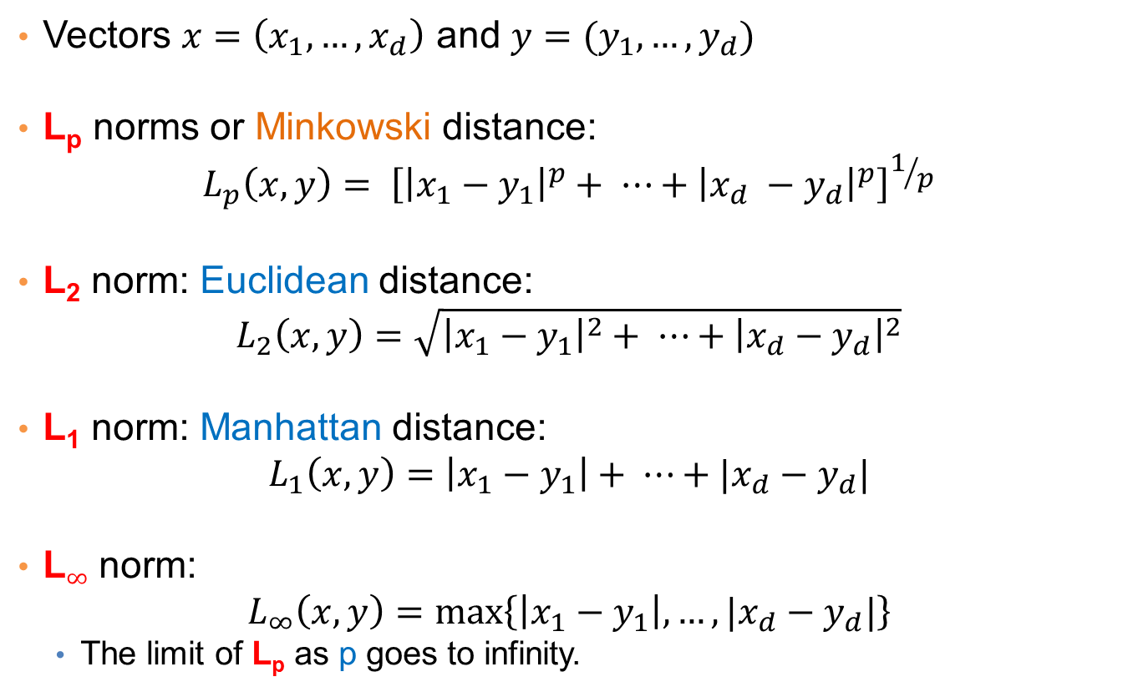
Distances for real vectors
Vectors $x=\left(x_{1},…,x_{d}\right)$ and $y=(y_{1},…,y_{d})$
L_{p} norms or Minkowski distance:
$$L_{p}\left(x,y\right)= {\left[{\left|x_{1}−y_{1}\right|}^{p}+ ⋯+{\left|x_{d} −y_{d}\right|}^{p}\right]}^{1/p}$$
L₂ norm: Euclidean distance:
$$L_{2}\left(x,y\right)=\sqrt{{\left|x_{1}−y_{1}\right|}^{2}+ ⋯+{\left|x_{d}−y_{d}\right|}^{2}}$$
L₁ norm: Manhattan distance:
$$L_{1}\left(x,y\right)=\left|x_{1}−y_{1}\right|+ ⋯+|x_{d}−y_{d}|$$
L$∞$ norm:
$$L_{∞}\left(x,y\right)=\max\left\{\left|x_{1}−y_{1}\right|,…,|x_{d}−y_{d}|\right\}$$
The limit of L_{p} as p goes to infinity.
L_{p} norms are known to be distance metrics

Slide 19
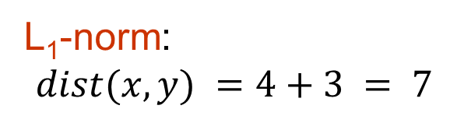
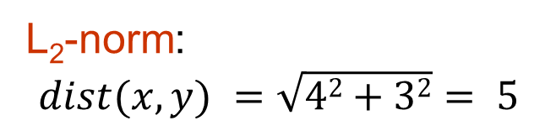
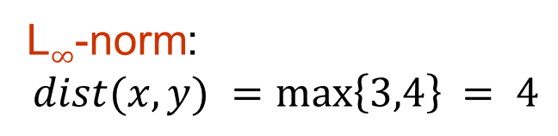
Example of Distances
y = (9,8)
L₂-norm:
$$dist(x,y) =\sqrt{42+32}= 5$$
5
3
L₁-norm:
$$dist(x,y) =4+3 = 7$$
4
x = (5,5)
L$∞$-norm:
$$dist(x,y) =\max\left\{3,4\right\}⁡= 4$$

Slide 20

Example
r
$$x= (x_{1},…,x_{n})$$
Green: All points y at distance L₁(x,y) = r from point x
Blue: All points y at distance L₂(x,y) = r from point x
Red: All points y at distance L$∞$(x,y) = r from point x

Slide 21
L_{p} distances for sets
We can apply all the L_{p} distances to the cases of sets of attributes, with or without counts, if we represent the sets as vectors
E.g., a transaction is a 0/1 vector
E.g., a document is a vector of counts.

Slide 22
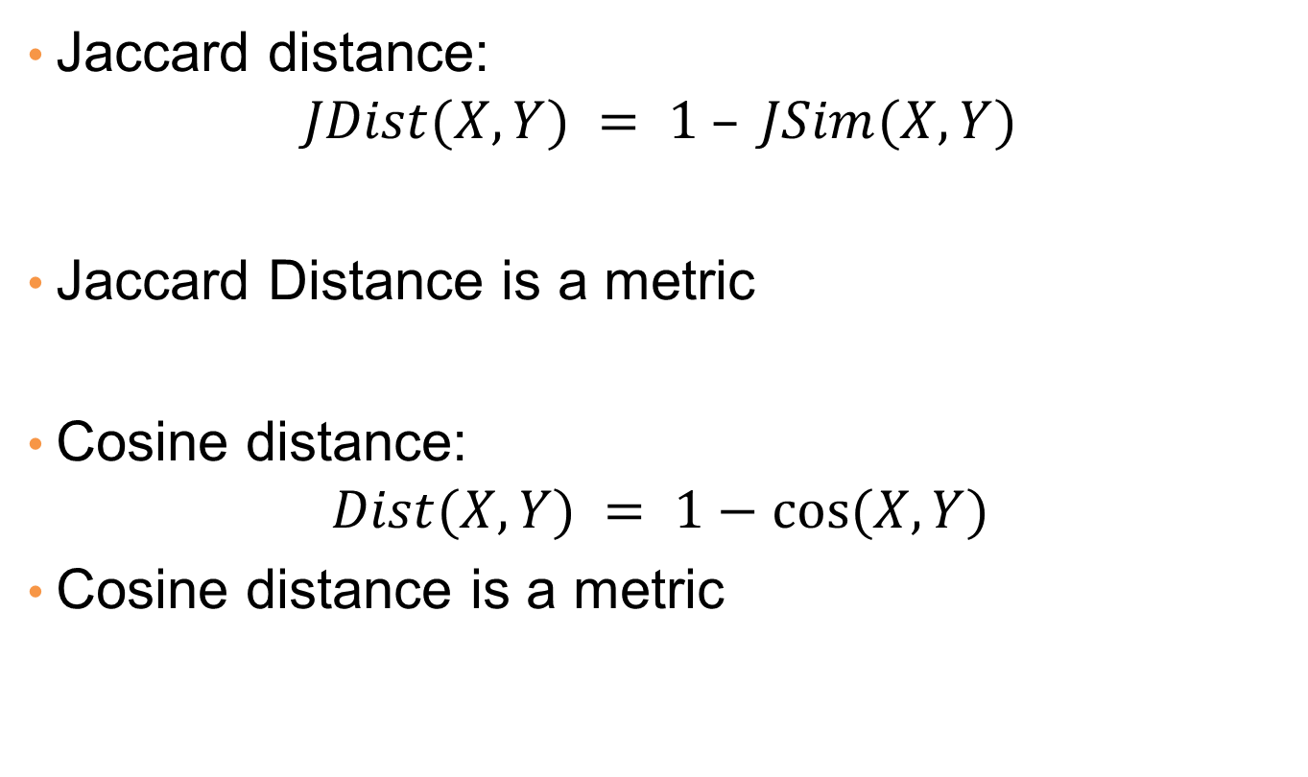
Similarities into distances
Jaccard distance:
$$JDist(X,Y) = 1 – JSim(X,Y)$$
Jaccard Distance is a metric
Cosine distance:
$$Dist(X,Y) = 1−cos⁡(X,Y)$$
Cosine distance is a metric

Slide 23
Why Jaccard Distance Is a Distance Metric
JDist(x,x) = 0
since JSim(x,x) = 1
JDist(x,y) = JDist(y,x)
by symmetry of intersection
JDist(x,y) > 0
since intersection of X,Y cannot be bigger than the union.
Triangle inequality:
Follows from the fact that JSim(X,Y) is the probability of randomly selected element from the union of X and Y to belong to the intersection

Slide 24
Hamming Distance
Hamming distance is the number of positions in which bit-vectors differ.
Example: p₁ = 10101 p₂ = 10011.
d(p₁, p₂) = 2 because the bit-vectors differ in the 3rd and 4th positions.
The L₁ norm for the binary vectors
Hamming distance between two vectors of categorical attributes is the number of positions in which they differ.
Example: x = (married, low income, cheat), y = (single, low income, not cheat)
d(x,y) = 2

Slide 25
Why Hamming Distance Is a Distance Metric
d(x,x) = 0 since no positions differ.
d(x,y) = d(y,x) by symmetry of “different from.”
d(x,y) > 0 since strings cannot differ in a negative number of positions.
Triangle inequality: changing x to z and then to y is one way to change x to y.
For binary vectors if follows from the fact that L₁ norm is a metric

Slide 26
Distance between strings
How do we define similarity between strings?
Important for recognizing and correcting typing errors and analyzing DNA sequences.
weird wierd
intelligent unintelligent
Athena Athina

Slide 27
Edit Distance for strings
The edit distance of two strings is the number of inserts and deletes of characters needed to turn one into the other.
Example: x = abcde ; y = bcduve.
Turn x into y by deleting a, then inserting u and v after d.
Edit distance = 3.
Minimum number of operations can be computed using dynamic programming
Common distance measure for comparing DNA sequences

Slide 28
Why Edit Distance Is a Distance Metric
d(x,x) = 0 because 0 edits suffice.
d(x,y) = d(y,x) because insert/delete are inverses of each other.
d(x,y) > 0: no notion of negative edits.
Triangle inequality: changing x to z and then to y is one way to change x to y. The minimum is no more than that

Slide 29
Variant Edit Distances
Allow insert, delete, and mutate.
Change one character into another.
Minimum number of inserts, deletes, and mutates also forms a distance measure.
Same for any set of operations on strings.
Example: substring reversal or block transposition OK for DNA sequences
Example: character transposition is used for spelling

Slide 30
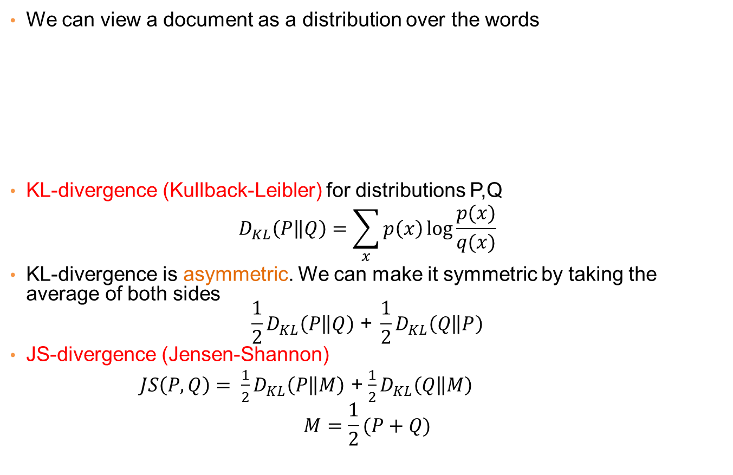
Distances between distributions
We can view a document as a distribution over the words
KL-divergence (Kullback-Leibler) for distributions P,Q
$$D_{KL}\left(P\left\|Q\right.\right)=\sum_{x}{p\left(x\right)\log{\frac{p(x)}{q(x)}}}$$
KL-divergence is asymmetric. We can make it symmetric by taking the average of both sides
$$\frac{1}{2}D_{KL}\left(P\left\|Q\right.\right)\text{ + }\frac{1}{2}D_{KL}\left(Q\left\|P\right.\right)$$
JS-divergence (Jensen-Shannon)
$JS\left(P,Q\right)= \frac{1}{2}D_{KL}\left(P\left\|M\right.\right)$ + $\frac{1}{2}D_{KL}\left(Q\left\|M\right.\right)$
$$M=\frac{1}{2}(P+Q)$$
document | Apple | Microsoft | Obama | Election
D1 | 0.35 | 0.5 | 0.1 | 0.05
D2 | 0.4 | 0.4 | 0.1 | 0.1
D2 | 0.05 | 0.05 | 0.6 | 0.3
Average distribution

Slide 31
Why is similarity important?
We saw many definitions of similarity and distance
How do we make use of similarity in practice?
What issues do we have to deal with?

Slide 32
Applications of Similarity: Recommendation Systems

Slide 33
An important problem
Recommendation systems
When a user buys an item (initially books) we want to recommend other items that the user may like
When a user rates a movie, we want to recommend movies that the user may like
When a user likes a song, we want to recommend other songs that they may like
A big success of data mining
Exploits the long tail
How Into Thin Air made Touching the Void popular

Slide 34
Utility (Preference) Matrix
 | Harry Potter 1 | Harry Potter 2 | Harry Potter 3 | Twilight | Star Wars 1 | Star Wars 2 | Star Wars 3
A | 4 |  |  | 5 | 1
B | 5 | 5 | 4
C |  |  |  | 2 | 4 | 5
D |  | 3 |  |  |  |  | 3
How can we fill the empty entries of the matrix?

Slide 35
Recommendation Systems
Content-based:
Represent the items into a feature space and recommend items to customer C similar to previous items rated highly by C
Movie recommendations: recommend movies with same actor(s), director, genre, …
Websites, blogs, news: recommend other sites with “similar” content

Slide 36
Content-based prediction
 | Harry Potter 1 | Harry Potter 2 | Harry Potter 3 | Twilight | Star Wars 1 | Star Wars 2 | Star Wars 3
A | 4 |  |  | 5 | 1
B | 5 | 5 | 4
C |  |  |  | 2 | 4 | 5
D |  | 3 |  |  |  |  | 3
Someone who likes one of the Harry Potter (or Star Wars)
movies is likely to like the rest
Same actors, similar story, same genre

Slide 37
Intuition
Item profiles
likes
build
recommend
match
Red
Circles
Triangles
User profile

Slide 38
Approach
Map items into a feature space:
For movies:
Actors, directors, genre, rating, year,…
Challenge: make all features compatible.
For documents?
To compare items with users we need to map users to the same feature space. How?
Take all the movies that the user has seen and take the average vector
Other aggregation functions are also possible.
Recommend to user C the most similar item i computing similarity in the common feature space
Distributional distance measures also work well.

Slide 39
Limitations of content-based approach
Finding the appropriate features
e.g., images, movies, music
Overspecialization
Never recommends items outside user’s content profile
People might have multiple interests
Recommendations for new users
How to build a profile?

Slide 40
Collaborative filtering
 | Harry Potter 1 | Harry Potter 2 | Harry Potter 3 | Twilight | Star Wars 1 | Star Wars 2 | Star Wars 3
A | 4 |  |  | 5 | 1
B | 5 | 5 | 4
C |  |  |  | 2 | 4 | 5
D |  | 3 |  |  |  |  | 3
Two users are similar if they rate the same items in a similar way
Recommend to user C, the items
liked by many of the most similar users.

Slide 41
User Similarity
 | Harry Potter 1 | Harry Potter 2 | Harry Potter 3 | Twilight | Star Wars 1 | Star Wars 2 | Star Wars 3
A | 4 |  |  | 5 | 1
B | 5 | 5 | 4
C |  |  |  | 2 | 4 | 5
D |  | 3 |  |  |  |  | 3
Which pair of users do you consider as the most similar?
What is the right definition of similarity?

Slide 42
User Similarity
 | Harry Potter 1 | Harry Potter 2 | Harry Potter 3 | Twilight | Star Wars 1 | Star Wars 2 | Star Wars 3
A | 1 |  |  | 1 | 1
B | 1 | 1 | 1
C |  |  |  | 1 | 1 | 1
D |  | 1 |  |  |  |  | 1
Jaccard Similarity: users are sets of movies
Disregards the ratings.
Jsim(A,B) = 1/5
Jsim(A,C) = Jsim(B,D) = 1/2

Slide 43
User Similarity
 | Harry Potter 1 | Harry Potter 2 | Harry Potter 3 | Twilight | Star Wars 1 | Star Wars 2 | Star Wars 3
A | 4 |  |  | 5 | 1
B | 5 | 5 | 4
C |  |  |  | 2 | 4 | 5
D |  | 3 |  |  |  |  | 3
Cosine Similarity:
Assumes zero entries are negatives:
Cos(A,B) = 0.38
Cos(A,C) = 0.32

Slide 44
User Similarity
 | Harry Potter 1 | Harry Potter 2 | Harry Potter 3 | Twilight | Star Wars 1 | Star Wars 2 | Star Wars 3
A | 2/3 |  |  | 5/3 | -7/3
B | 1/3 | 1/3 | -2/3
C |  |  |  | -5/3 | 1/3 | 4/3
D |  | 0 |  |  |  |  | 0
Normalized Cosine Similarity:
Subtract the mean rating per user and then compute Cosine (correlation coefficient)
Corr(A,B) = 0.092
Cos(A,C) = -0.559

Slide 45
User-User Collaborative Filtering
Consider user c
Find set D of other users whose ratings are most “similar” to c’s ratings
Estimate user’s ratings based on ratings of users in D using some aggregation function
Advantage: for each user we have small amount of computation.

Slide 46
Item-Item Collaborative Filtering
We can transpose (flip) the matrix and perform the same computation as before to define similarity between items
Intuition: Two items are similar if they are rated in the same way by many users.
Better defined similarity since it captures the notion of genre of an item
Users may have multiple interests.
Algorithm: For each user c and item i
Find the set D of most similar items to item i that have been rated by user c.
Aggregate their ratings to predict the rating for item i.
Disadvantage: we need to consider each user-item pair separately

Slide 47
Pros and cons of collaborative filtering
Works for any kind of item
No feature selection needed
New user problem
New item problem
Sparsity of rating matrix
Cluster-based smoothing?

