Slide 1




Introduction to Apache Lucene/Solr April 2014 HDSG Meetup
Rahul Jain
@rahuldausa

Slide 2
Who am I?
Software Engineer @ IVY Comptech, Hyderabad
7 years of programming learning experience
Built a platform to search logs in Near real time with volume of 1TB/day#
Worked on a Solr search based SEO/SEM software with 40 billion records/month (Topic of next talk?)
Areas of expertise/interest
High traffic web applications
JAVA/J2EE
Big data, NoSQL
Information-Retrieval, Machine learning
# http://www.slideshare.net/lucenerevolution/building-a-near-real-time-search-engine-analytics-for-logs-using-solr

Slide 3
Agenda
IR Overview
Basic Concepts
Lucene
Solr
Use-cases
Solr In Action (demo)
Q&A

Slide 4
Information Retrieval (IR)
”Information retrieval is the activity of obtaining information resources (in the form of documents) relevant to an information need from a collection of information resources. Searches can be based on metadata or on full-text (or other content-based) indexing”
- Wikipedia

Slide 5
Basic Concepts
tf (t in d) : term frequency in a document
measure of how often a term appears in the document
the number of times term t appears in the currently scored document d
idf (t) : inverse document frequency
measure of whether the term is common or rare across all documents, i.e. how often the term appears across the index
obtained by dividing the total number of documents by the number of documents containing the term, and then taking the logarithm of that quotient.
boost (index) : boost of the field at index-time
boost (query) : boost of the field at query-time

Slide 6
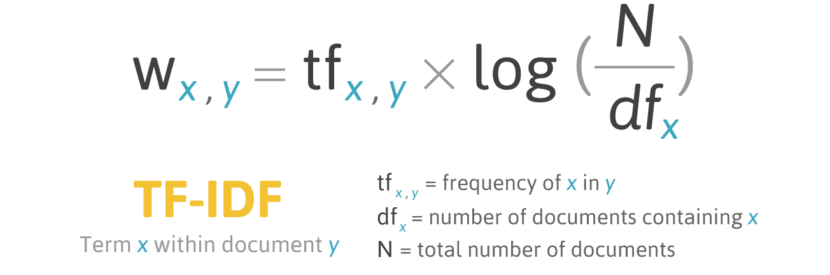
Basic Concepts TF - IDF
TF - IDF = Term Frequency X Inverse Document Frequency
Credit: http://http://whatisgraphsearch.com/

Slide 7
Apache Lucene

Slide 8
Apache Lucene
Fast, high performance, scalable search/IR library
Open source
Initially developed by Doug Cutting (Also author of Hadoop)
Indexing and Searching
Inverted Index of documents
Provides advanced Search options like synonyms, stopwords, based on similarity, proximity.
http://lucene.apache.org/

Slide 9
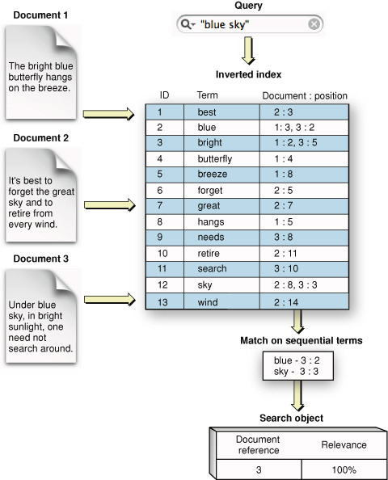
Lucene Internals - Inverted Index
Credit: https://developer.apple.com/library/mac/documentation/userexperience/conceptual/SearchKitConcepts/searchKit_basics/searchKit_basics.html

Slide 10
Lucene Internals (Contd.)
Defines documents Model
Index contains documents.
Each document consist of fields.
Each Field has attributes.
What is the data type (FieldType)
How to handle the content (Analyzers, Filters)
Is it a stored field (stored="true") or Index field (indexed="true")

Slide 11
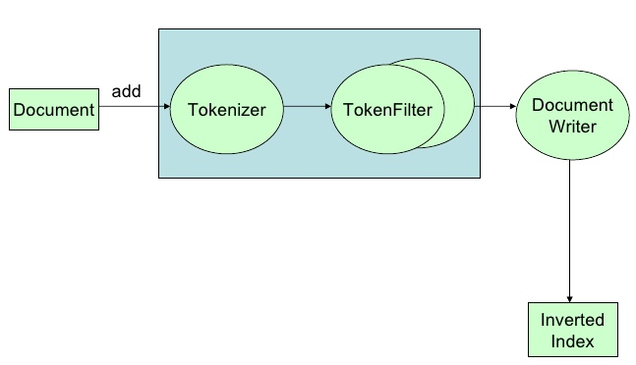
Indexing Pipeline
Analyzer : create tokens using a Tokenizer and/or applying Filters (Token Filters)
Each field can define an Analyzer at index time/query time or the both at same time.
Credit : http://www.slideshare.net/otisg/lucene-introduction

Slide 12
Analysis Process - Tokenizer
WhitespaceAnalyzer
Simplest built-in analyzer
The quick brown fox jumps over the lazy dog.
[The] [quick] [brown] [fox] [jumps] [over] [the] [lazy] [dog.]
Tokens

Slide 13
Analysis Process - Tokenizer
SimpleAnalyzer
Lowercases, split at non-letter boundaries
The quick brown fox jumps over the lazy dog.
[the] [quick] [brown] [fox] [jumps] [over] [the] [lazy] [dog]
Tokens

Slide 14
Apache Solr

Slide 15
Apache Solr
Created by Yonik Seeley for CNET
Enterprise Search platform for Apache Lucene
Open source
Highly reliable, scalable, fault tolerant
Support distributed Indexing (SolrCloud), Replication, and load balanced querying
http://lucene.apache.org/solr

Slide 16
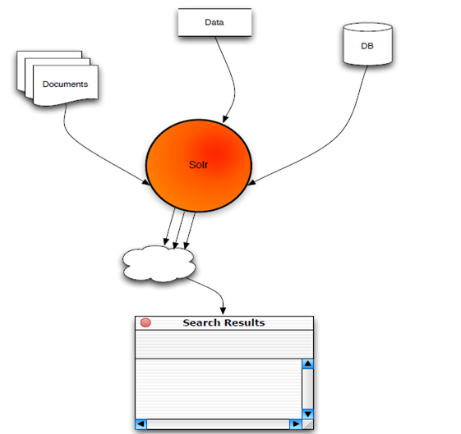
High level overview
Source: http://www.slideshare.net/erikhatcher/solr-search-at-the-speed-of-light

Slide 17
Apache Solr - Features
full-text search
faceted search (similar to GroupBy clause in RDBMS)
scalability
caching
replication
distributed search
near real-time indexing
geospatial search
and many more : highlighting, database integration, rich document (e.g., Word, PDF) handling

Slide 18
How to start It’s very Easy.
1. Start Solr
java -jar start.jar
2. Index your data
java -jar post.jar *.xml
3. Search
http://localhost:8983/solr

Slide 19
Solr APIs
HTTP GET/POST
JSON/XML
Clients
SolrJ (embedded or HTTP)
solr-ruby
python, PHP, solrsharp

Slide 20
Solr – schema.xml
Types with index and query Analyzers - similar to data type
Fields with name, type and options
Unique Key : Unique Identifier of a document. For e.g. “id”
Dynamic Fields : Dynamic fields allow Solr to index fields that you did not explicitly define in your schema. For e.g. fieldName: *_i or *_txts
Copy Fields : Solr has a mechanism for making copies of fields so that you can apply several distinct field types to a single piece of incoming information. field ‘a‘ populates field ‘b’ with its value before tokenizing (having different analyzer/filter).

Slide 21
Solr – Content Analysis
Field Attributes
Name : Name of the field
Type : Data-type (FieldType) of the field
Indexed : Should it be indexed (indexed="true/false")
Stored : Should it be stored (stored="true/false")
Required : is it a mandatory field (required="true/false")
Multi-Valued : Would it will contains multiple values e.g. text: pizza, food (multiValued="true/false")
e.g. <field name="id" type="string" indexed="true" stored="true" required="true" multiValued="false" />

Slide 22
Solr – solrconfig.xml
Data dir: where all index data will be stored
Index configuration
Cache configurations
Request Handler configuration
Search components, response writers, query parsers

Slide 23
Query Types
Single and multi term queries
ex fieldname:value or title: software engineer
+, -, AND, OR NOT operators.
ex. title: (software AND engineer)
Range queries on date or numeric fields,
ex: timestamp: [ * TO NOW ] or price: [ 1 TO 100 ]
Boost queries:
e.g. title:Engineer ^1.5 OR text:Engineer
Fuzzy search : is a search for words that are similar in spelling
e.g. roam~0.8 => noam
Proximity Search : with a sloppy phrase query. The close together the two terms appear, higher the score.
ex “apache lucene”~20 : will look for all documents where “apache” word occurs within 20 words of “lucene”

Slide 24
Solr/Lucene Use-cases
Search
Analytics
NoSQL datastore
Auto-suggestion / Auto-correction
Recommendation Engine (MoreLikeThis)
Relevancy Engine (Feedback to other applications)
Solr as a White-List
GeoSpatial based Search

Slide 25
Search
Application
Eclipse, Hibernate search
E-Commerce :
Flipkart.com, Infibeam.com, Buy.com, Netflix.com, ebay.com
Jobs
Indeed.com, Simplyhired.com, Naukri.com
Auto
AOL.com
Travel
Cleartrip.com
Social Network
Twitter.com, LinkedIn.com, mylife.com
Source: http://www.quora.com/Which-major-companies-are-using-Solr-for-search

Slide 26
Search (Contd.)
Search Engine
Yandex.ru, DuckDuckGo.com
News Paper
Guardian.co.uk
Music/Movies
Apple.com, Netflix.com
Events
Stubhub.com, Eventbrite.com
Cloud Log Management
Loggly.com
Others
Whitehouse.gov

Slide 27
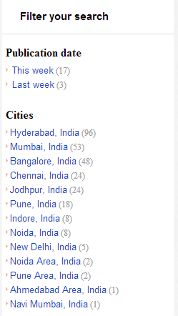
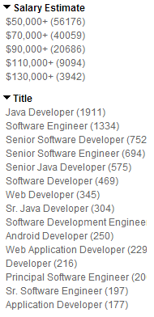
Faceting
Grouping results based on field value
Facet on: field terms, queries, date ranges
&facet=on &facet.field=job_title
&facet.query=salary:[30000 TO 100000]
http://wiki.apache.org/solr/SimpleFacetParameters
Source: www.career9.com, www.indeed.com

Slide 28
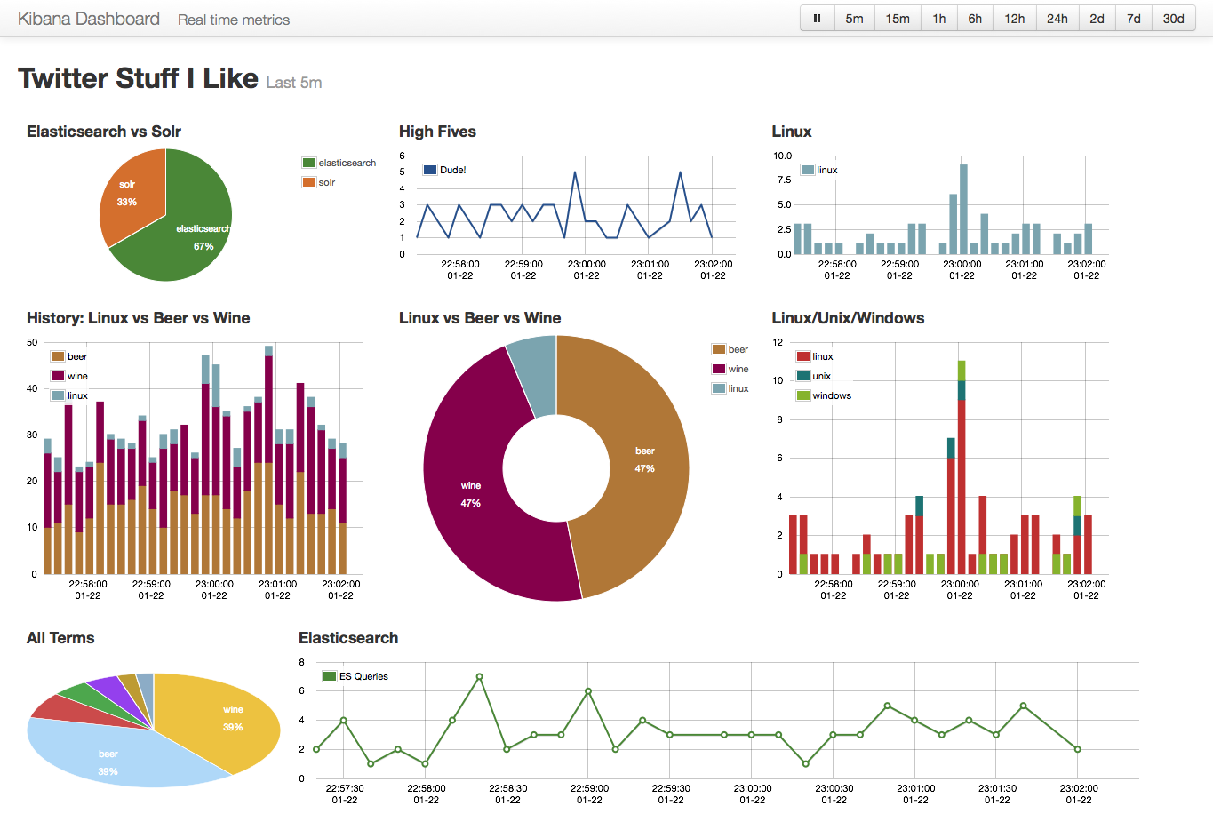
Analytics
Analytics source : Kibana.org based on ElasticSearch and Logstash
Image Source : http://semicomplete.com/presentations/logstash-monitorama-2013/#/8

Slide 29
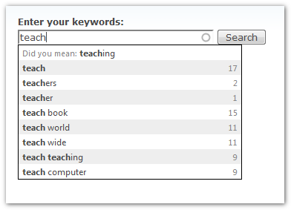
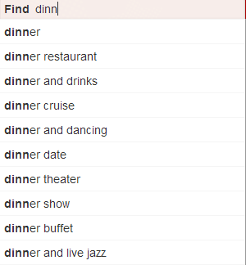
Autosuggestion
Source: www.drupal.org , www.yelp.com

Slide 30
Integration
Clustering (Solr-Carrot2)
Named Entity extraction (Solr-UIMA)
SolrCloud (Solr-Zookeeper)
Parsing of many Different File Formats (Solr-Tika)
Machine Learning/Data Mining (Apache Mahout)
Large scale Indexing (Hadoop)

Slide 31
References
http://en.wikipedia.org/wiki/Tf%E2%80%93idf
http://lucene.apache.org/core/4_5_0/core/org/apache/lucene/search/similarities/TFIDFSimilarity.html
http://www.quora.com/Which-major-companies-are-using-Solr-for-search
http://marc.info/?l=solr-user&m=137271228610366&w=2
http://java.dzone.com/articles/apache-solr-get-started-get

Slide 32
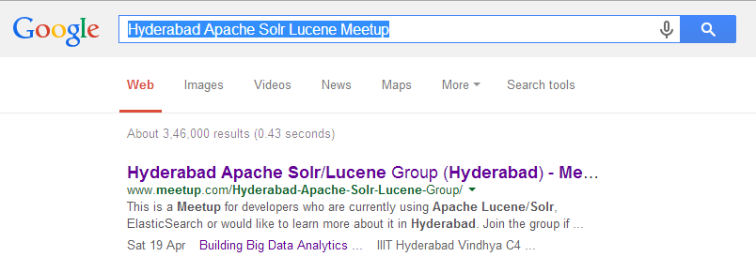
Solr/Lucene Meetup
Building Big Data Analytics Platforms using Elasticsearch (Kibana)
Saturday, April 19, 2014 10:00 AM
IIIT Hyderabad
URL: http://www.meetup.com/Hyderabad-Apache-Solr-Lucene-Group/events/150134392/
OR
Search on Google …

Slide 33
Thanks! @rahuldausa on twitter and slideshare http://www.linkedin.com/in/rahuldausa
Find Interesting ?
Join us @ http://www.meetup.com/Hyderabad-Apache-Solr-Lucene-Group/

