Slide 1

Introduction to
Mahmoud Parsian
Lead Big Data Team
Ph.D. Computer Science
March 17, 2015

Slide 2
What is
Fast and expressive cluster computing system
Compatible with Hadoop File System
HDFS
S3 (Simple Storage System)
SequenceFile (Binary K-V Files)
Text File

Slide 3
What is
Improves efficiency through in-memory computing
General computation graphs (DAG)
As much as 30x faster

Slide 4
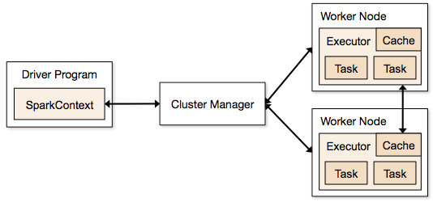
Architecture of

Slide 5
What is
Improves usability by rich API
Scala
Java
Python
PySpark (interactive shell)
Often 2-10x less code

Slide 6
Language Support
Python
lines = sc.textFile(...) lines.filter(lambda s: “ERROR” in s).count()
Standalone Programs
Python, Scala, & Java
Interactive Shells
Python & Scala
Performance
Java & Scala are faster due to static typing
…but Python is often fine
Scala
val lines = sc.textFile(...) lines.filter(x => x.contains(“ERROR”)).count()
Java
JavaRDD<String> lines = sc.textFile(...); lines.filter(new Function<String, Boolean>(){ Boolean call(String s) { return s.contains(“ERROR”); } }).count();

Slide 7
RDDs in
Resilient Distributed Datasets
Immutable, partitioned collection of objects
Basic mechanism for distributed and parallel processing
JavaRDD<String>
JavaPairRDD<Integer, String>
JavaPairRDD<String, Tuple2<Integer, Integer>>
JavaPairRDD<Tuple2<String,Integer>,
Tuple2<Integer,Integer>
>

Slide 8
Operations in
Transformations
map
filter
groupBy
Join
…
Actions
count
collect
save
…

Slide 9
Working With RDDs
textFile = sc.textFile(”SomeFile.txt”)
RDD
RDD
Action
RDD
Transformations
RDD
Value
linesWithSpark.count()
74
linesWithSpark.first()
# Apache Spark
linesWithSpark = textFile.filter(lambda line: "Spark” in line)

Slide 10
Key Concepts in Spark
Write programs in terms of transformations on distributed datasets
Resilient Distributed Datasets
Collections of objects spread across a cluster, stored in RAM or on Disk
Built through parallel transformations
Automatically rebuilt on failure
Operations
Transformations (e.g. map, filter, groupBy)
Actions (e.g. count, collect, save)
Notes:
RDD ➔ Colloquially referred to as RDDs
(e.g. caching in RAM)
Lazy operations to build RDDs from other RDDs
Return a result or write it to storage

Slide 11
New DataFrame API
DataFrames evolve Spark’s RDD model, making operations with structured datasets even faster and easier.
# Constructs a DataFrame from a JSON dataset.
users = context.load("s3n://path/to/users.json", "json")
# Create a new DataFrame that contains “young users” only
young = users.filter(users.age < 21)
# Alternatively, using Pandas-like syntax
young = users[users.age < 21]
# DataFrame's support existing RDD operators
print("Young users: " + young.count())

Slide 12
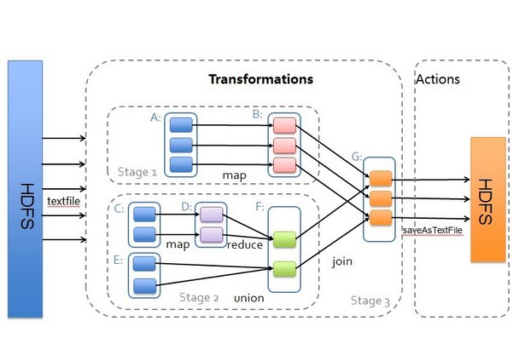
Transformations & Actions

Slide 13

Example: Log Mining
Load error messages from a log into memory, then interactively search for various patterns
Base RDD
Transformed RDD
Cache 1
lines = spark.textFile(“hdfs://...”)
errors = lines.filter(lambda s: s.startswith(“ERROR”))
messages = errors.map(lambda s: s.split(“\t”)[2])
messages.cache()
results
Worker
tasks
Block 1
Driver
Action
messages.filter(lambda s: “mysql” in s).count()
Cache 2
messages.filter(lambda s: “php” in s).count()
Worker
Cache 3
. . .
Full-text search of Wikipedia
60GB on 20 EC2 machine
0.5 sec vs. 20s for on-disk
Worker
Block 2
Block 3
Notes:
Add “variables” to the “functions” in functional programming

Slide 14
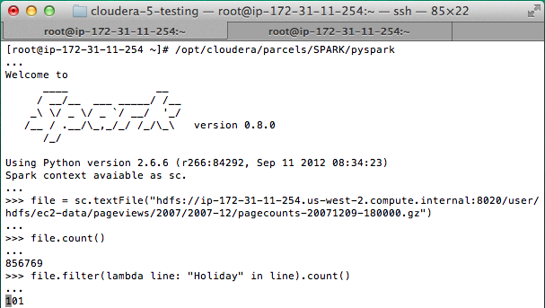
Interactive Shell
The Fastest Way to Learn Spark
Available in Python and Scala
Runs as an application on an existing Spark Cluster…
OR Can run locally

Slide 15
PySpark: interactive shell
Write Spark jobs in Python
Run interactive jobs in the shell
# cat data.txt
fox jumped high
fox is crazy
crazy fox is here
fox is red
./pyspark
Python 2.6.9 …
rdd1 = sc.textFile("data.txt")
rdd1.collect();
[u'fox jumped high',
u'fox is crazy',
u'crazy fox is here',
u'fox is red']

Slide 16
SparkContext (sc)
Main entry point to Spark functionality
Available in shell as variable sc
In standalone programs, you’d make your own:
JavaSparkConext sc = new JavaSparkContect();

Slide 17
Creating RDDs
# Turn a Python collection into an RDD
sc.parallelize([1, 2, 3])
# Load text file from local FS, HDFS, or S3
sc.textFile(“file.txt”)
sc.textFile(“directory/*.txt”)
sc.textFile(“hdfs://namenode:9000/path/file”)
# Use existing Hadoop InputFormat (Java/Scala only)
sc.hadoopFile(keyClass, valClass, inputFmt, conf)

Slide 18
Basic Transformations
nums = sc.parallelize([1, 2, 3])
# Pass each element through a function
squares = nums.map(lambda x: x*x) // {1, 4, 9}
# Keep elements passing a predicate
even = squares.filter(lambda x: x % 2 == 0) // {4}
# Map each element to zero or more others
nums.flatMap(lambda x: => range(x))
# => {0, 0, 1, 0, 1, 2}
Range object (sequence of numbers 0, 1, …, x-1)
Notes:
All lazy

Slide 19
Basic Actions
nums = sc.parallelize([1, 2, 3])
# Retrieve RDD contents as a local collection
nums.collect() # => [1, 2, 3]
# Return first K elements
nums.take(2) # => [1, 2]
# Count number of elements
nums.count() # => 3
# Merge elements with an associative function
nums.reduce(lambda x, y: x + y) # => 6
# Write elements to a text file
nums.saveAsTextFile(“hdfs://file.txt”)
Notes:
Launch computations

Slide 20
Working with Key-Value Pairs
Spark’s “distributed reduce” transformations operate on RDDs of key-value pairs
Python: pair = (a, b) pair[0] # => a pair[1] # => b
Scala: val pair = (a, b) pair._1 // => a pair._2 // => b
Java: Tuple2 pair = new Tuple2(a, b); pair._1 // => a pair._2 // => b

Slide 21
Some Key-Value Operations
pets = sc.parallelize( [(“cat”, 1), (“dog”, 1), (“cat”, 2)])
pets.reduceByKey(lambda x, y: x + y) # => {(cat, 3), (dog, 1)}
pets.groupByKey() # => {(cat, [1, 2]), (dog, [1])}
pets.sortByKey() # => {(cat, 1), (cat, 2), (dog, 1)}
reduceByKey also automatically implements combiners on the map side

Slide 22
Example: Word Count
lines = sc.textFile(“hamlet.txt”)
counts = lines.flatMap(lambda line: line.split(“ ”)) .map(lambda word => (word, 1)) .reduceByKey(lambda x, y: x + y)
“to” “be” “or”
(to, 1) (be, 1) (or, 1)
(be, 2) (not, 1)
“to be or”
“not” “to” “be”
(not, 1) (to, 1) (be, 1)
(or, 1)
(to, 2)
“not to be”

Slide 23
Word Count in JDK8
JavaSparkContext sc = new JavaSparkContext();
JavaRDD<String> rdd = sc.textFile(inputPath);
// counts = (word: K, frequencey: V)
JavaPairRDD<String, Integer> counts = rdd
.flatMap(x -> Arrays.asList(x.split(" ")))
.mapToPair(x -> new Tuple2<String, Integer>(x, 1))
.reduceByKey((x, y) -> x + y);
counts.saveAsTextFile(outputPath);

Slide 24
Other Key-Value Operations
visits = sc.parallelize([ (“index.html”, “1.2.3.4”), (“about.html”, “3.4.5.6”), (“index.html”, “1.3.3.1”) ])
pageNames = sc.parallelize([ (“index.html”, “Home”), (“about.html”, “About”) ])
visits.join(pageNames) # (“index.html”, (“1.2.3.4”, “Home”)) # (“index.html”, (“1.3.3.1”, “Home”)) # (“about.html”, (“3.4.5.6”, “About”))
visits.cogroup(pageNames) # (“index.html”, ([“1.2.3.4”, “1.3.3.1”], [“Home”])) # (“about.html”, ([“3.4.5.6”], [“About”]))

Slide 25
PageRank Performance
Notes:
54 GB Wikipedia dataset

Slide 26
Other Iterative Algorithms
Time per Iteration (s)
Notes:
100 GB datasets

Slide 27
Conclusion
Spark offers a rich API to make data analytics fast: both fast to write and fast to run
Achieves 100x speedups in real applications
Growing community with 25+ companies contributing

Slide 28
SUMMARY: What is Spark?
Fast and Expressive Cluster Computing System Compatible with Apache Hadoop
Up to 10× faster on disk, 100× in memory
2-5× less code
Efficient
Usable
General execution graphs
In-memory storage
Rich APIs in Java, Scala, Python
Interactive shell
Notes:
Generalize the map/reduce framework

Slide 29
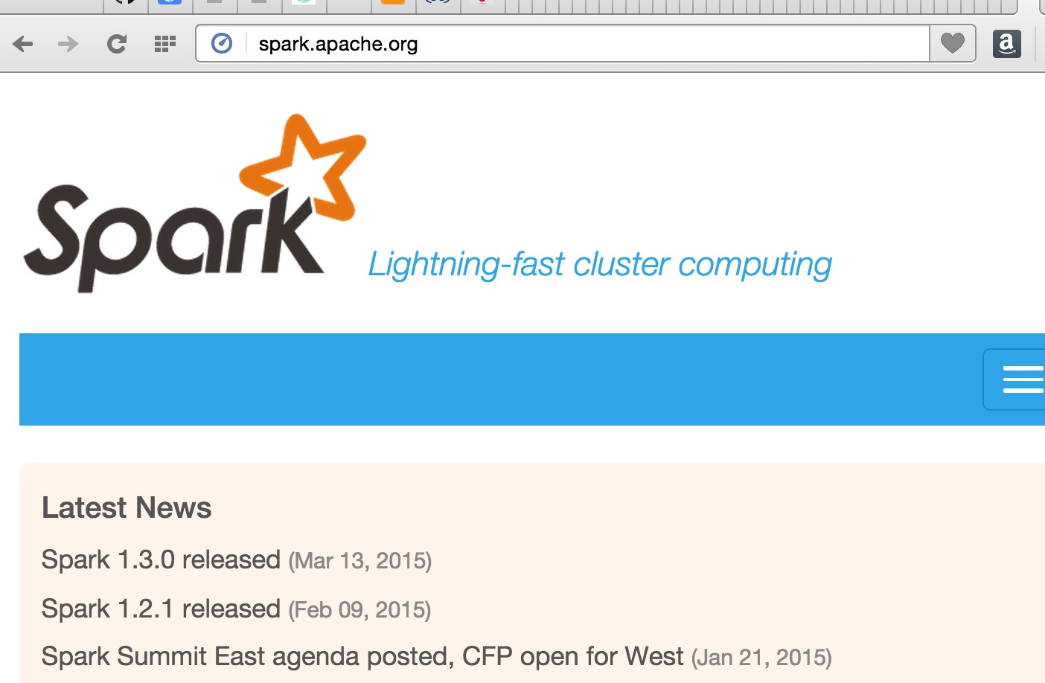
Get Started on Spark
Up and Running in a Few Steps
Download
Unzip
Shell
Project Resources
Examples on the Project Site
Examples in the Distribution
Documentation
http://spark.apache.org

Slide 30
Demo of PySpark

