Slide 1
Using Apache Spark
Pat McDonough - Databricks
Notes:
Preamble:
* Excited to kick off first day of training
* This first tutorial is about using Spark CORE
* We’ve got a curriculum jammed packed with material, so let’s go ahead and get started

Slide 2
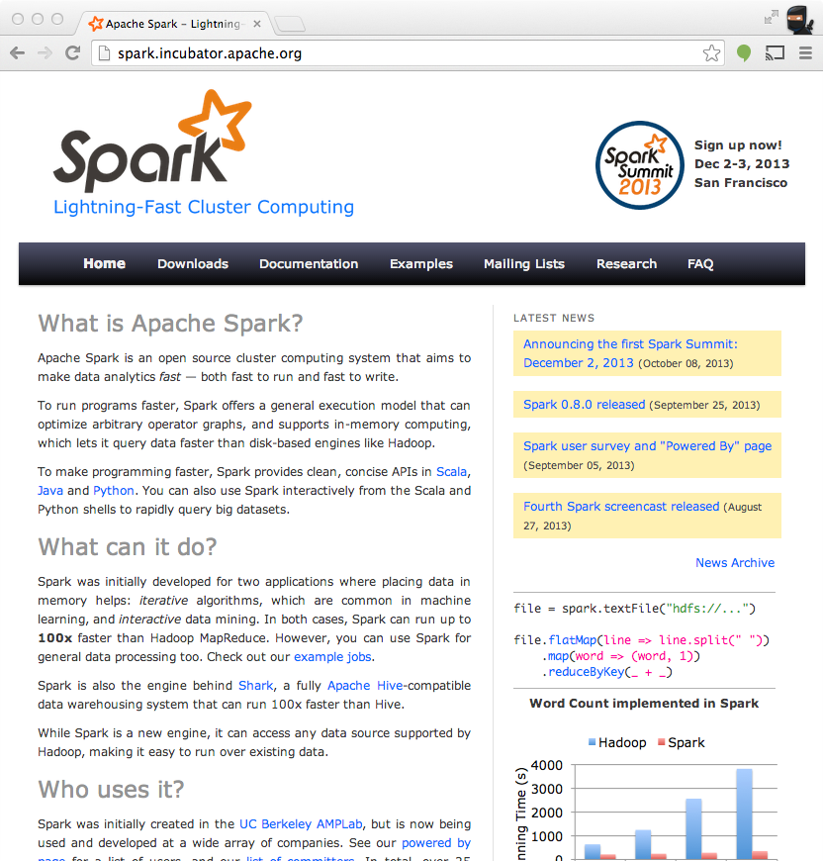

Apache Spark
spark.incubator.apache.org
github.com/apache/incubator-spark
user@spark.incubator.apache.org
Notes:
You can find Project Resources on the Apache Incubator site
You’ll also find information about the mailing list there (including archives)

Slide 3
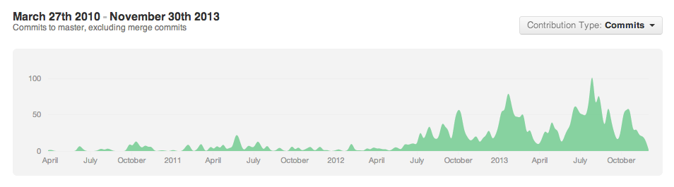



























The Spark Community
+You!
Notes:
One of the most exciting things you’ll find
Growing all the time
NASCAR slide
Including several sponsors of this event are just starting to get involved…
If your logo is not up here, forgive us – it’s hard to keep up!

Slide 4
Introduction to Apache Spark
Notes:
You saw several excellent stories yesterday about how people are using Spark.
Today, we are going to give a number of tutorial talks and hands-on exercises so you can go out and build your own Spark-based applications
We’ll start from the basics, and hopefully by the end of the day, you will be well on your way

Slide 5
What is Spark?
Fast and Expressive Cluster Computing System Compatible with Apache Hadoop
Up to 10× faster on disk, 100× in memory
2-5× less code
Efficient
Usable
General execution graphs
In-memory storage
Rich APIs in Java, Scala, Python
Interactive shell
Notes:
Generalize the map/reduce framework

Slide 6
Key Concepts
Write programs in terms of transformations on distributed datasets
Resilient Distributed Datasets
Collections of objects spread across a cluster, stored in RAM or on Disk
Built through parallel transformations
Automatically rebuilt on failure
Operations
Transformations (e.g. map, filter, groupBy)
Actions (e.g. count, collect, save)
Notes:
RDD ➔ Colloquially referred to as RDDs
(e.g. caching in RAM)
Lazy operations to build RDDs from other RDDs
Return a result or write it to storage

Slide 7
Working With RDDs
textFile = sc.textFile(”SomeFile.txt”)
RDD
RDD
Action
RDD
Transformations
RDD
Value
linesWithSpark.count()
74
linesWithSpark.first()
# Apache Spark
linesWithSpark = textFile.filter(lambda line: "Spark” in line)
Notes:
Let me illustrate this with some bad powerpoint diagrams and animations
This diagram is LOGICAL,

Slide 8

Example: Log Mining
Load error messages from a log into memory, then interactively search for various patterns
Base RDD
Transformed RDD
Cache 1
lines = spark.textFile(“hdfs://...”)
errors = lines.filter(lambda s: s.startswith(“ERROR”))
messages = errors.map(lambda s: s.split(“\t”)[2])
messages.cache()
results
Worker
tasks
Block 1
Driver
Action
messages.filter(lambda s: “mysql” in s).count()
Cache 2
messages.filter(lambda s: “php” in s).count()
Worker
Cache 3
. . .
Full-text search of Wikipedia
60GB on 20 EC2 machine
0.5 sec vs. 20s for on-disk
Worker
Block 2
Block 3
Notes:
Add “variables” to the “functions” in functional programming

Slide 9
Scaling Down
Notes:
Gracefully

Slide 10
Fault Recovery
RDDs track lineage information that can be used to efficiently recompute lost data
msgs = textFile.filter(lambda s: s.startsWith(“ERROR”))
.map(lambda s: s.split(“\t”)[2])
HDFS File
Filtered RDD
Mapped RDD
filter (func = startsWith(…))
map (func = split(...))

Slide 11
Language Support
Python
lines = sc.textFile(...) lines.filter(lambda s: “ERROR” in s).count()
Standalone Programs
Python, Scala, & Java
Interactive Shells
Python & Scala
Performance
Java & Scala are faster due to static typing
…but Python is often fine
Scala
val lines = sc.textFile(...) lines.filter(x => x.contains(“ERROR”)).count()
Java
JavaRDD<String> lines = sc.textFile(...); lines.filter(new Function<String, Boolean>() { Boolean call(String s) { return s.contains(“error”); } }).count();

Slide 12
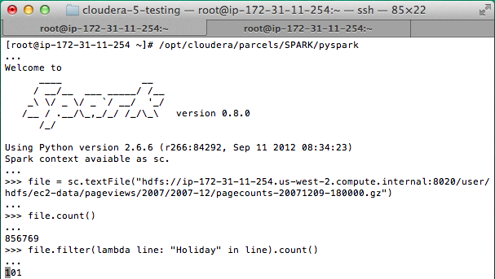
Interactive Shell
The Fastest Way to Learn Spark
Available in Python and Scala
Runs as an application on an existing Spark Cluster…
OR Can run locally
Notes:
The barrier to entry for working with the spark API is minimal

Slide 13
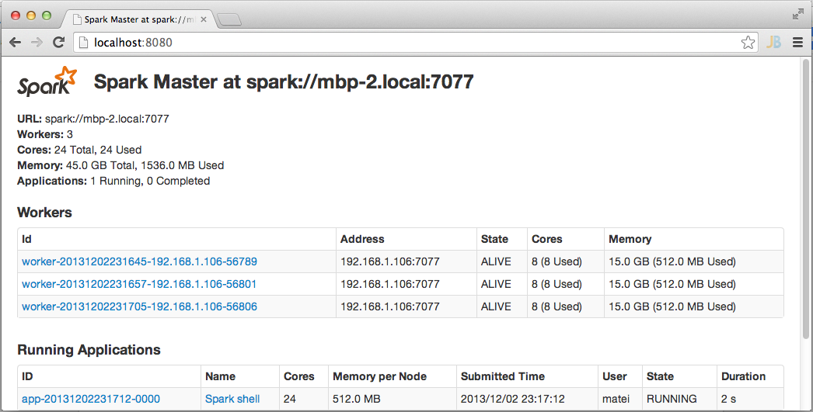
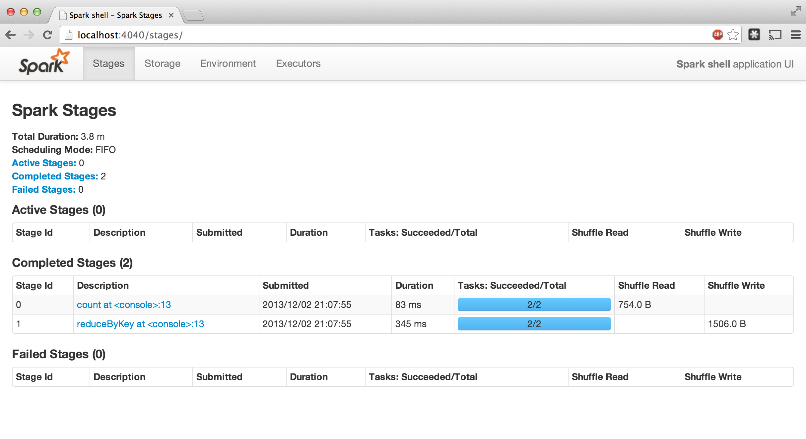
Administrative GUIs
http://<Standalone Master>:8080 (by default)

Slide 14
Job Execution

Slide 15
Software Components
Spark runs as a library in your program (1 instance per app)
Runs tasks locally or on cluster
Mesos, YARN or standalone mode
Accesses storage systems via Hadoop InputFormat API
Can use HBase, HDFS, S3, …
Your application
SparkContext
Cluster manager
Local threads
Worker
Worker
Spark executor
Spark executor
HDFS or other storage

Slide 16
Task Scheduler
General task graphs
Automatically pipelines functions
Data locality aware
Partitioning aware to avoid shuffles
B:
A:
F:
Stage 1
groupBy
C:
D:
E:
join
Stage 2
map
filter
Stage 3
= RDD
= cached partition
Notes:
NOT a modified version of Hadoop

Slide 17
Advanced Features
Controllable partitioning
Speed up joins against a dataset
Controllable storage formats
Keep data serialized for efficiency, replicate to multiple nodes, cache on disk
Shared variables: broadcasts, accumulators
See online docs for details!

Slide 18
Local Execution
Just pass local or local[k] as master URL
Debug using local debuggers
For Java / Scala, just run your program in a debugger
For Python, use an attachable debugger (e.g. PyDev)
Great for development & unit tests

Slide 19
Cluster Execution
Easiest way to launch is EC2: ./spark-ec2 -k keypair –i id_rsa.pem –s slaves \ [launch|stop|start|destroy] clusterName
Several options for private clusters:
Standalone mode (similar to Hadoop’s deploy scripts)
Mesos
Hadoop YARN
Amazon EMR: tinyurl.com/spark-emr

Slide 20
Working With Spark

Slide 21
Using the Shell
Launching:
Modes:
spark-shell
pyspark (IPYTHON=1)
MASTER=local ./spark-shell # local, 1 thread MASTER=local[2] ./spark-shell # local, 2 threads MASTER=spark://host:port ./spark-shell # cluster

Slide 22
SparkContext
Main entry point to Spark functionality
Available in shell as variable sc
In standalone programs, you’d make your own (see later for details)

Slide 23
Creating RDDs
# Turn a Python collection into an RDD
sc.parallelize([1, 2, 3])
# Load text file from local FS, HDFS, or S3
sc.textFile(“file.txt”)
sc.textFile(“directory/*.txt”)
sc.textFile(“hdfs://namenode:9000/path/file”)
# Use existing Hadoop InputFormat (Java/Scala only)
sc.hadoopFile(keyClass, valClass, inputFmt, conf)

Slide 24
Basic Transformations
nums = sc.parallelize([1, 2, 3])
# Pass each element through a function
squares = nums.map(lambda x: x*x) // {1, 4, 9}
# Keep elements passing a predicate
even = squares.filter(lambda x: x % 2 == 0) // {4}
# Map each element to zero or more others
nums.flatMap(lambda x: => range(x))
# => {0, 0, 1, 0, 1, 2}
Range object (sequence of numbers 0, 1, …, x-1)
Notes:
All lazy

Slide 25
Basic Actions
nums = sc.parallelize([1, 2, 3])
# Retrieve RDD contents as a local collection
nums.collect() # => [1, 2, 3]
# Return first K elements
nums.take(2) # => [1, 2]
# Count number of elements
nums.count() # => 3
# Merge elements with an associative function
nums.reduce(lambda x, y: x + y) # => 6
# Write elements to a text file
nums.saveAsTextFile(“hdfs://file.txt”)
Notes:
Launch computations

Slide 26
Working with Key-Value Pairs
Spark’s “distributed reduce” transformations operate on RDDs of key-value pairs
Python: pair = (a, b) pair[0] # => a pair[1] # => b
Scala: val pair = (a, b) pair._1 // => a pair._2 // => b
Java: Tuple2 pair = new Tuple2(a, b); pair._1 // => a pair._2 // => b

Slide 27
Some Key-Value Operations
pets = sc.parallelize( [(“cat”, 1), (“dog”, 1), (“cat”, 2)])
pets.reduceByKey(lambda x, y: x + y) # => {(cat, 3), (dog, 1)}
pets.groupByKey() # => {(cat, [1, 2]), (dog, [1])}
pets.sortByKey() # => {(cat, 1), (cat, 2), (dog, 1)}
reduceByKey also automatically implements combiners on the map side

Slide 28
Example: Word Count
lines = sc.textFile(“hamlet.txt”)
counts = lines.flatMap(lambda line: line.split(“ ”)) .map(lambda word => (word, 1)) .reduceByKey(lambda x, y: x + y)
“to” “be” “or”
(to, 1) (be, 1) (or, 1)
(be, 2) (not, 1)
“to be or”
“not” “to” “be”
(not, 1) (to, 1) (be, 1)
(or, 1)
(to, 2)
“not to be”

Slide 29
Other Key-Value Operations
visits = sc.parallelize([ (“index.html”, “1.2.3.4”), (“about.html”, “3.4.5.6”), (“index.html”, “1.3.3.1”) ])
pageNames = sc.parallelize([ (“index.html”, “Home”), (“about.html”, “About”) ])
visits.join(pageNames) # (“index.html”, (“1.2.3.4”, “Home”)) # (“index.html”, (“1.3.3.1”, “Home”)) # (“about.html”, (“3.4.5.6”, “About”))
visits.cogroup(pageNames) # (“index.html”, ([“1.2.3.4”, “1.3.3.1”], [“Home”])) # (“about.html”, ([“3.4.5.6”], [“About”]))

Slide 30
Setting the Level of Parallelism
All the pair RDD operations take an optional second parameter for number of tasks
words.reduceByKey(lambda x, y: x + y, 5)
words.groupByKey(5)
visits.join(pageViews, 5)

Slide 31
Using Local Variables
Any external variables you use in a closure will automatically be shipped to the cluster:
query = sys.stdin.readline()
pages.filter(lambda x: query in x).count()
Some caveats:
Each task gets a new copy (updates aren’t sent back)
Variable must be Serializable / Pickle-able
Don’t use fields of an outer object (ships all of it!)

Slide 32
Closure Mishap Example
This is a problem:
class MyCoolRddApp { val param = 3.14 val log = new Log(...) ... def work(rdd: RDD[Int]) { rdd.map(x => x + param) .reduce(...) } }
How to get around it:
class MyCoolRddApp { ... ...
def work(rdd: RDD[Int]) { val param_ = param rdd.map(x => x + param_) .reduce(...) } }
NotSerializableException: MyCoolRddApp (or Log)
References only local variable instead of this.param

Slide 33
More RDD Operators
map
filter
groupBy
sort
union
join
leftOuterJoin
rightOuterJoin
reduce
count
fold
reduceByKey
groupByKey
cogroup
cross
zip
sample
take
first
partitionBy
mapWith
pipe
save ...

Slide 34
Creating Spark Applications

Slide 35
Add Spark to Your Project
Scala / Java: add a Maven dependency on
groupId: org.spark-project artifactId: spark-core_2.9.3 version: 0.8.0
Python: run program with our pyspark script

Slide 36
Create a SparkContext
import org.apache.spark.SparkContext
import org.apache.spark.SparkContext._
val sc = new SparkContext(“url”, “name”, “sparkHome”, Seq(“app.jar”))
Scala
Cluster URL, or local / local[N]
App name
Spark install path on cluster
List of JARs with app code (to ship)
import org.apache.spark.api.java.JavaSparkContext;
JavaSparkContext sc = new JavaSparkContext(
“masterUrl”, “name”, “sparkHome”, new String[] {“app.jar”}));
Java
from pyspark import SparkContext
sc = SparkContext(“masterUrl”, “name”, “sparkHome”, [“library.py”]))
Python
Notes:
Mention assembly JAR in Maven etc
Use the shell with your own JAR`

Slide 37
Complete App
import sys
from pyspark import SparkContext
if __name__ == "__main__":
sc = SparkContext( “local”, “WordCount”, sys.argv[0], None) lines = sc.textFile(sys.argv[1])
counts = lines.flatMap(lambda s: s.split(“ ”)) \ .map(lambda word: (word, 1)) \ .reduceByKey(lambda x, y: x + y) counts.saveAsTextFile(sys.argv[2])

Slide 38
Example Application: PageRank
Notes:
To Skip to the next section, go to slide 51

Slide 39
Example: PageRank
Good example of a more complex algorithm
Multiple stages of map & reduce
Benefits from Spark’s in-memory caching
Multiple iterations over the same data

Slide 40
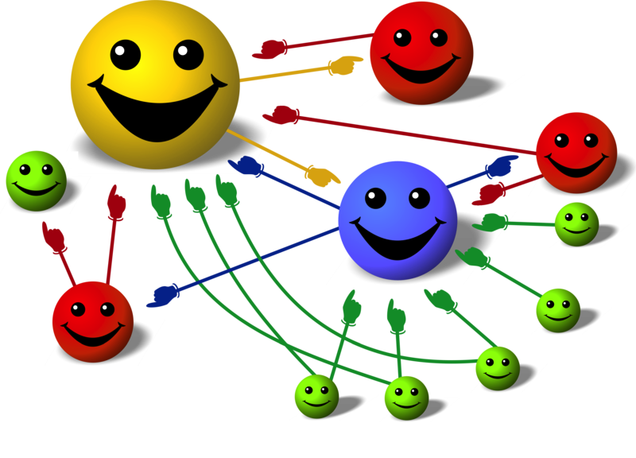
Basic Idea
Give pages ranks (scores) based on links to them
Links from many pages ➔ high rank
Link from a high-rank page ➔ high rank
Image: en.wikipedia.org/wiki/File:PageRank-hi-res-2.png

Slide 41
Algorithm
Start each page at a rank of 1
On each iteration, have page p contribute rank_{p} / |neighbors_{p}| to its neighbors
Set each page’s rank to 0.15 + 0.85 × contribs
1.0
1.0
1.0
1.0

Slide 42
Algorithm
Start each page at a rank of 1
On each iteration, have page p contribute rank_{p} / |neighbors_{p}| to its neighbors
Set each page’s rank to 0.15 + 0.85 × contribs
1.0
1
0.5
1
1.0
0.5
1.0
0.5
0.5
1.0

Slide 43
Algorithm
Start each page at a rank of 1
On each iteration, have page p contribute rank_{p} / |neighbors_{p}| to its neighbors
Set each page’s rank to 0.15 + 0.85 × contribs
1.85
0.58
1.0
0.58

Slide 44
Algorithm
Start each page at a rank of 1
On each iteration, have page p contribute rank_{p} / |neighbors_{p}| to its neighbors
Set each page’s rank to 0.15 + 0.85 × contribs
1.85
0.58
0.5
1.85
0.58
0.29
1.0
0.5
0.29
0.58

Slide 45
Algorithm
Start each page at a rank of 1
On each iteration, have page p contribute rank_{p} / |neighbors_{p}| to its neighbors
Set each page’s rank to 0.15 + 0.85 × contribs
1.31
0.39
. . .
1.72
0.58

Slide 46
Algorithm
Start each page at a rank of 1
On each iteration, have page p contribute rank_{p} / |neighbors_{p}| to its neighbors
Set each page’s rank to 0.15 + 0.85 × contribs
Final state:
1.44
0.46
1.37
0.73

Slide 47
Scala Implementation
val links = // load RDD of (url, neighbors) pairs
var ranks = // load RDD of (url, rank) pairs
for (i <- 1 to ITERATIONS) {
val contribs = links.join(ranks).flatMap {
case (url, (links, rank)) =>
links.map(dest => (dest, rank/links.size))
} ranks = contribs.reduceByKey(_ + _) .mapValues(0.15 + 0.85 * _)
} ranks.saveAsTextFile(...)

Slide 48
PageRank Performance
Notes:
54 GB Wikipedia dataset

Slide 49
Other Iterative Algorithms
Time per Iteration (s)
Notes:
100 GB datasets

Slide 50
Conclusion

Slide 51
Conclusion
Spark offers a rich API to make data analytics fast: both fast to write and fast to run
Achieves 100x speedups in real applications
Growing community with 25+ companies contributing

Slide 52
Get Started
Up and Running in a Few Steps
Download
Unzip
Shell
Project Resources
Examples on the Project Site
Examples in the Distribution
Documentation
http://spark.incubator.apache.org

