Slide 1
Kakao Shopping Classification
CoE 202. Term Project
Fall, 2019
TA: Kiwon Lee (kaiser5072@kaist.ac.kr)
Professor: Yong Hoon Lee
Notes:
Hello, I’m Kiwon Lee, Ph.D student. I introduce a term project and simple baseline code.

Slide 2
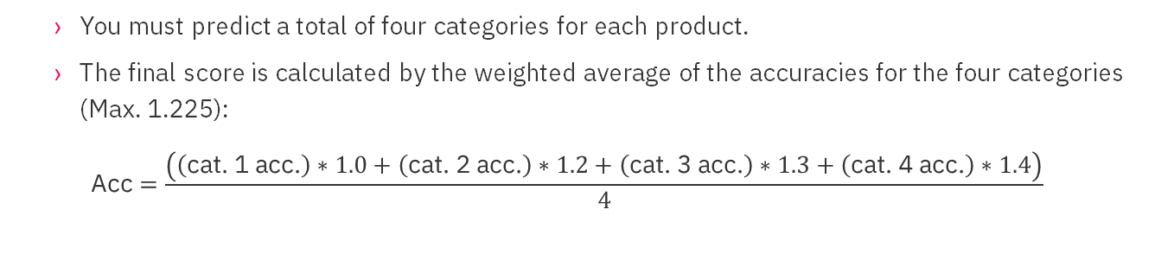


Overview
Objective: The goal of this project is to design a product classifier that predicts categories of each product. A product belongs to a maximum of 4 categories, having each of which is a hierarchical structure.
Product name
Category 1
Category 2
Category 3
Category 4
“맛있는 제주차
3종세트＂
음료/생수/커피
차/티백
차 선물세트
X
“애플 맥북＂
노트북/태블릿PC
노트북
휴대용 (10~13인치형)
X
$$⋮$$
$$⋮$$
You must predict a total of four categories for each product.
The final score is calculated by the weighted average of the accuracies for the four categories (Max. 1.225):
$$\text{Acc}=\frac{\left(\left(\text{cat}\text{. 1 }\text{acc}\text{.}\right)∗1.0+\left(\text{cat}\text{. 2 }\text{acc}\text{.}\right)∗1.2+\left(\text{cat}\text{. 3 }\text{acc}\text{.}\right)∗1.3+\left(\text{cat}\text{. 4 }\text{acc}\text{.}\right)∗1.4\right)}{4}$$
Notes:
First, in this project, our objective is to design a product classifier that predicts categories of each product given its name, image and price. Each product belongs to maximum 4 categories. For example, the products named “맛있는 제주차 3종세트“ belongs to “음료/생수/커피“ as big category, belongs to “차/티백“ as middle category, belongs to “차 선물세트” as small category.
The final score is calculated by considering the weighting of the accuracy for each category.

Slide 3
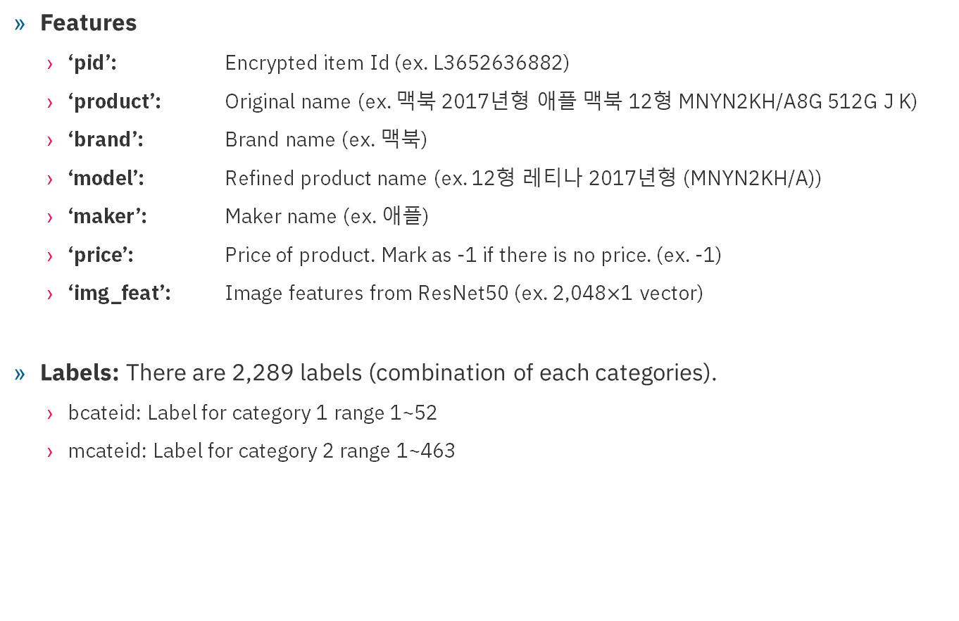
Dataset (I)
Features
‘pid’: Encrypted item Id (ex. L3652636882)
‘product’: Original name (ex. 맥북 2017년형 애플 맥북 12형 MNYN2KH/A8G 512G J K)
‘brand’: Brand name (ex. 맥북)
‘model’: Refined product name (ex. 12형 레티나 2017년형 (MNYN2KH/A))
‘maker’: Maker name (ex. 애플)
‘price’: Price of product. Mark as -1 if there is no price. (ex. -1)
‘img_feat’: Image features from ResNet50 (ex. 2,048$×$1 vector)
Labels: There are 2,289 labels (combination of each categories).
bcateid: Label for category 1 range 1~52
mcateid: Label for category 2 range 1~463
scateid: Label for category 3 range 1~2070
dcateid: Label for category 4 range 1~183
Notes:
Each product has 7 input features. First, ‘pid’ is encrypted item Id. It is only used, when you submit the final results on test data.
‘model’: It’s short version of product.
‘price’: If there is no price, it is marked as -1.
‘img_feat’ means the image feature vectors from ResNet50. Its dimension is 2,048.
And each product also have labels corresponding big category, middle category, small category and detailed category. There are total of 2,289 combinations of categories.

Slide 4
Dataset (II)
We provide 6 dataset files (Download #1, #2): The first 3 files contain all features with the exception of “img_feat”
‘train.chunk.csv’ : 800,000 sets of features for training
‘valid.chunk.csv’ : 178,830 sets of features for validation
‘test.chunk.csv’ : 178,830 sets of features without labels for submission
‘train.image.feats.pickle’ : 800,000 sets of features from ResNet for training
‘valid.image.feats.pickle’ : 178,830 sets of features from ResNet for validation
‘test.image.feats.pickle’ : 178,830 sets of features from ResNet for test
Notes:
We provide the 6 dataset files. You can find these files in KLMS. Download two files and unzip the compressed file.

Slide 5
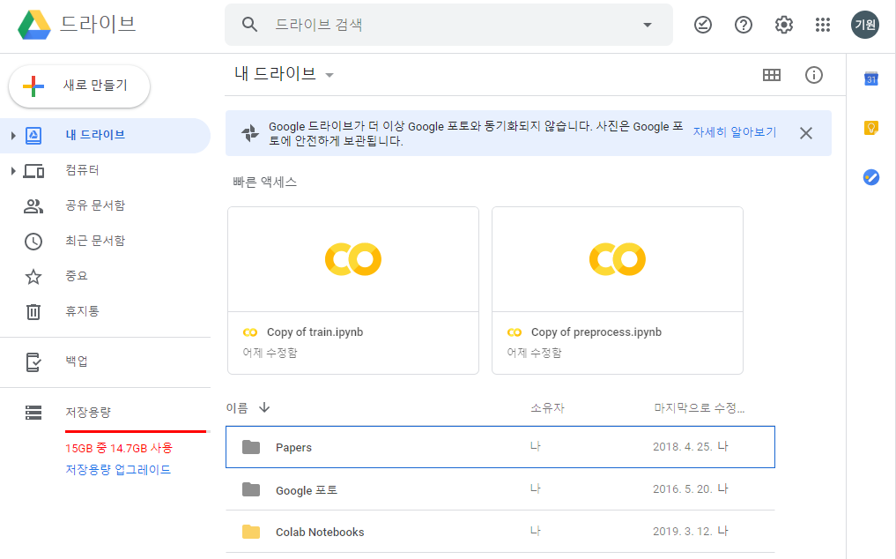
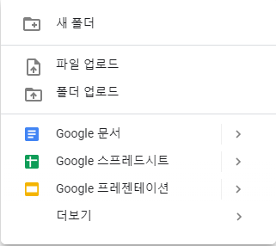
Prerequisite (I)
Download the datasets
Find the datasets in KLMS, and download the datasets to your computer
Upload the datasets to Google drive
You need 10GB of free space in your Google drive
② Create a new folder named “CoE202_KakaoArena”
① Move to “Colab Notebooks” folder
Notes:
We will use Google Colab and Google Drive together. You need 10GB of free space in your Google Drive.
First, access your google drive, and move to “Colab Notebooks” folder.
Second, create a new folder named “CoE202_KakaoArena”

Slide 6
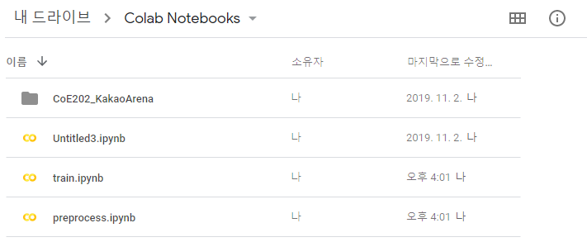
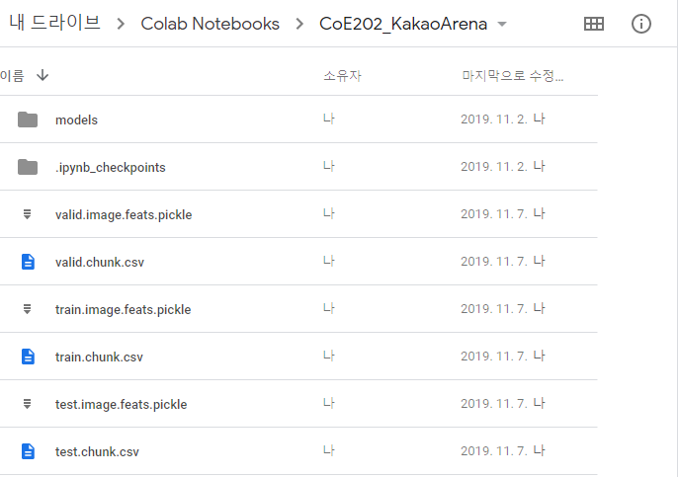
Prerequisite (II)
④ Create a new folder named “models”
in “CoE202_KakaoArena” folder
③ Upload jupyter file to “Colab Notebooks” folder
⑤ Upload the datasets to “CoE202_KakaoArena” folder
Link in colab
Run the following code in the jupyter file and enter the url that comes out
Log in your google Id, check the authorization code and enter it in colab
from google.colab import drive
drive.mount('/content/drive')
Notes:
Third, upload the jupyter files to “Colab Notebooks” folder. Jupyter files are also uploaded in KLMS.
Crate a new folder named “models” in “CoE202_KakaoArena” folder. The trained parameters of neural network are saved in this folder.
Upload the 6 dataset files to “CoE202_KakaoArena” folder.
The process of preparing the dataset is over. Then, you should mount Google drive in Colab to use the uploaded files. You execute this code in Colab.

Slide 7
Baselines
We provide a baseline solution to help you perform the project. This baseline solution uses only the ‘product’ feature.
Preprocessing
Preprocessing includes 3 steps (indexing labels, parsing text, building bag of words)
First, load the datasets using pandas framework
df = pd.read_csv('./drive/My Drive/Colab Notebooks/CoE202_KakaoArena/train.chunk.csv')
Notes:
We provide a baseline solution to help you do this project. This baseline solution uses only ‘product’ features.
Before training, we preprocess the datasets. Preprocessing includes 3 steps. (indexing labels, parsing text, building bag of words).
First, load the training dataset using pandas like this. This code loads the train.chunk.csv file in your Google drive.

Slide 8


Preprocessing (I)
Indexing labels:
The label of an item is a $4×1$ vector. For simplicity, we use “item index” instead of the label
bcateid: 49
mcateid: 261
scateid: 1287
dcateid: -1
Index of this $4×1$ vector is “1650”
Indexing the label
vector
y_vocab = {} # Define dictionary for labels
sz = df['pid'].shape[0] # The number of data, 800,000 for training data
for i in tqdm.tqdm(range(sz), mininterval=1): # tqdm predict the remaining time during for loop
b = df['bcateid'][i] # Get category 1
m = df['mcateid'][i] # Get category 2
s = df['scateid'][i] # Get category 3
d = df['dcateid'][i] # Get category 4
class_name = '{}>{}>{}>{}'.format(b, m ,s, d) # Combine four categories
if class_name not in y_vocab: # If the combination of categories isn't in dictionary, add it to dictionary.
y_vocab[class_name] = len(y_vocab)
y_dict = {y: idx for idx, y in enumerate(y_vocab)}
pickle.dump(y_dict, open('./drive/My Drive/Colab Notebooks/CoE202_KakaoArena/y_vocab.pickle', 'wb'), 2)
Notes:
For simplicity, we use “item index”, which includes combination of four categories. You can change this process in your project.
After this process, labels are combined and indexed in the order.
The code below is a code representation for indexing.
Define a dictionary to store the item index.
Using for loop, we get the big, middle, small, and detailed categories, and combine them. Then, check that this combined name is in the dictionary. If the combined name is not in dictionary, we add it to dictionary and index it.
Finally, this dictionary is saved in your google drive.

Slide 9
Preprocessing (II)
Parsing texts
“맥북”
“2017년형”
“애플 “
“12형”
“MNYN2KH/A8G”
“512G”
“맥북 2017년형 애플 맥북 12형 MNYN2KH/A8G 512G J K”
Parsing text
feature = df['product'][i] # Get the product name
if isinstance(feature, str) and feature != 'nan': # Check the product name is string or empty
feature = re_sc.sub(' ', feature).strip().split() # re_sc eliminate the special symbols (!@#$"...)
# strip() is a function to remove blank before and after of strings
# split() is the function of separating strings based on spaces.
words = [w.strip() for w in feature] # Make separated words to list
words = [w for w in words
if len(w) >= 2 and len(w) < 31] # If each word is less than 2 and more than 31 is discarded.
Notes:
Second, we parse the input texts by word unit. For example, this given text is separated by each word as follows.
This process is simply implemented as a Python internal function.
Get the product name and check the product name is string of empty
re_sc function remove the special symbols.
Strip() function remove blanks before and after strings.
Split() function separate the strings based on blanks.
Each word is stored in list named feature.
Then we discard the word which has the length less than 2 and more than 31.

Slide 10
Preprocessing (III)
Building the bag of words using a hash function
“맥북”
“2017년형”
“애플”
“맥북”
“12형”
“MNYN2KH/A8G”
“512G”
50239
67893
20399
50239
9486
89705
12309
2
1
1
2
1
1
1
Build bag of words
There are 100,000 words and the corresponding indices.
x = [hash(w) % 100000 + 1 for w in words] # Mapping words to integer using hash function
xv = Counter(x).most_common(32) # Count the number of words in a string
x = np.zeros(32, dtype=np.int32)
v = np.zeros(32, dtype=np.int8)
for j in range(len(xv)):
x[j] = xv[j][0] # Mapped integers of words
v[j] = xv[j][1] # Counts of words
Notes:
Each word is mapped to integer using hash function. Here, hundred thousand mean the maximum size of the bag of the words.
We count the number of each word in a string. In this case, “맥북” appear twice, so weight is 2.

Slide 11
Preprocessing (IV)
Save the preprocessed data
Continue preprocessing for validation and test datasets.
train_dset = {'product': np.asarray(products), 'w_product': np.asarray(w_products), 'label': np.asarray(labels)}
with gzip.open('./drive/My Drive/Colab Notebooks/CoE202_KakaoArena/train.chunk.pickle', 'wb') as f:
pickle.dump(train_dset, f)
Notes:
We save preprocessed data to Google drive without having to preprocess each time you train.
This preprocessing is applied equally to validation sets and test sets.

Slide 12
Training process (I)
Load the training and validation data
# training data
with gzip.open('./drive/My Drive/Colab Notebooks/CoE202_KakaoArena/train.chunk.pickle', 'rb') as f:
traindata = pickle.load(f)
train_product = traindata['product'][:]
train_wproduct = traindata['w_product'][:]
train_label = traindata['label'][:]
# validation data with gzip.open('./drive/My Drive/Colab Notebooks/CoE202_KakaoArena/valid.chunk.pickle', 'rb') as f:
validdata = pickle.load(f)
valid_product = validdata['product'][:]
valid_wproduct = validdata['w_product'][:]
valid_label = validdata['label'][:]
Notes:
In the training process, first we load the preprocess data in your google drive.

Slide 13




Training process (II)
Word embedding: We learn 1,024$×$1 vectors representing the word indices.
Embedding size (=1024)
$$x_{20399}$$
50239
67893
20399
“맥북”
“2017년형”
“애플 “
1
1
2
$$x_{50239}$$
$$x=2⋅x_{20399}+1⋅x_{50239}+1⋅x_{67893}$$
$$x_{67893}$$
Voca size (=100,000)
Embedding matrix
# Define embedding
embd = Embedding(voca_size, embd_size, name='product_embd') # Define embedding function
# Product embedding
t_product_embd = embd(products) # Get the embedding vector of products
# Multiply the weights of product vectors
w_product_mat = tf.reshape(w_products, [-1, max_len, 1])
product_embd_mat = tf.keras.layers.dot([t_product_embd, w_product_mat], axes=1) # Multiply the counts of products to the corresponding embedding vectors
product_embd = tf.reshape(product_embd_mat, [-1, embd_size])
Notes:
We vectorize the pre-defined integers using embedding matrix.
For example, when the product name includes these words, corresponding integers and weights, the corresponding row vectors in embedding matrix are selected.

Slide 14
Training process (III)
Fully-connected layers (1 hidden layer)
# Non-linear activations
embd_out = tf.layers.dropout(product_embd, training=is_train) # Dropout
bn = tf.layers.batch_normalization(embd_out, training=is_train) # Batch normalization
relu = tf.nn.relu(bn) # ReLU function
# logits
logits = tf.layers.dense(relu, n_classes) # Fully-connected layer
# Softmax
preds = tf.nn.softmax(logits, name='predictions')
Loss function & Optimizer
# Softmax cross entropy loss
loss = tf.losses.softmax_cross_entropy(onehot_labels=tf.one_hot(labels, n_classes), logits=logits)
# Weight decay
reg_losses = tf.get_collection(tf.GraphKeys.REGULARIZATION_LOSSES)
loss = tf.add_n([loss] + reg_losses, name='total_loss')
# Optimizer
optm = tf.train.AdamOptimizer(lr)
train_op = optm.minimize(loss, global_step=tf.train.get_global_step(), name='step_update')
update_ops = tf.get_collection(tf.GraphKeys.UPDATE_OPS)
train_op = tf.group([train_op, update_ops])
Notes:
Embedding vector pass through the dropout, batch normalization, relu function, and fully-connected layer.
After the softmax, we can get the probabilities for each label.
We use the cross-entropy loss and minimize it with adam optimize.
The l2 norm of weight parameters is added to loss function to regularize.

Slide 15
Test process
Load the test datasets
# test data
with gzip.open('./drive/My Drive/Colab Notebooks/CoE202_KakaoArena/test.chunk.pickle', 'rb') as f:
testdata = pickle.load(f)
test_product = testdata['product'][:]
test_wproduct = testdata['w_product'][:]
pids = testdata['pids'][:]
Save the predictions for submission
# Indexing of predictions
argpreds = np.argmax(preds, axis=1)
# Load label dictionary
y_dict = cPickle.loads(open('./drive/My Drive/Colab Notebooks/CoE202_KakaoArena/y_vocab.cPickle').read())
# Inverse label dictionary
inv_y_dict = dict((y,x) for x,y in y_dict.iteritems())
submissions = [inv_y_dict[argpred] for argpred in argpreds]
# Write the results to 'submissions.csv'
f = open('./drive/My Drive/Colab Notebooks/CoE202_KakaoArena/submissions.csv', 'w')
for i, j in zip(pids, submissions):
line = '{},{}\n'.format(i,j)
f.write(line)
f.close()
Notes:
Finally, we load the test dataset and pass it through the network.
Your final results is saved to ‘submissions.csv’ file in your google drive.
Download this file. This file is organized like this.

Slide 16
Submissions (I)
Final reports
Use 'brand', 'maker' and 'model' features in addition to ‘product’ features for training. Report your results.
Change the model to use ‘image’ features and ‘price’ features for training. Report your results.
Change the model and tune the hyperparameters to increase the score as much as possible.
Submissions
Due date: 12/17
email to kaiser5072@kaist.ac.kr
Final submissions must include the ‘submissions.csv’ file and model save file in Colab (‘checkpoint’, ‘dnn_models.data’, ‘dnn_models.index’, ‘dnn_models.meta’).
Reference (Do not copy the reference code)
https://github.com/yookyungKoh/kakao_challenge
https://github.com/ywkim/kakao-arena-shopping
https://github.com/tantara/kakao-arena-product-classification
Notes:
In the final reports, you must include these contents.

Slide 17
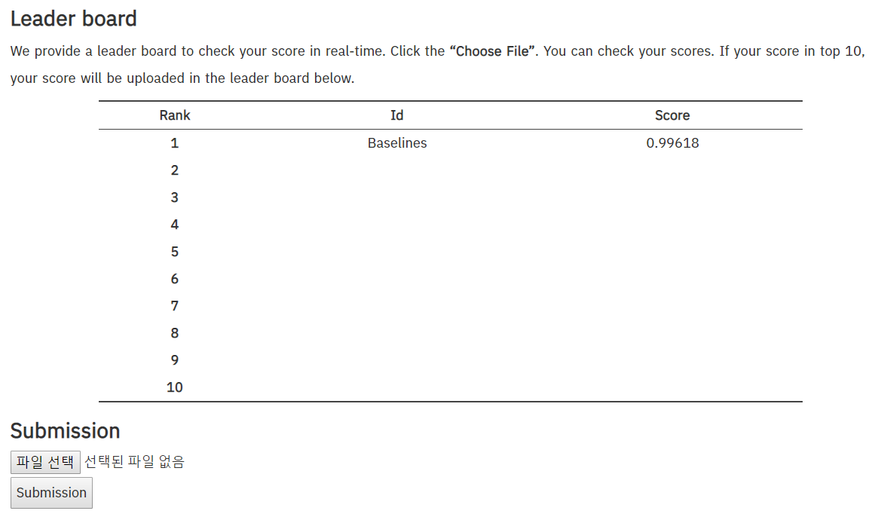
Submissions (II)
Leader board
We provide a leader board to check your score in real time. (Access with Google Chrome)
http://kalman.kaist.ac.kr/coe202
Click the “Choose File” and submit your “submissions.csv” file. You can check your scores. If your score in top 10, your score will be uploaded in the leader board.
Notes:
We provide a leader board to check your score in real time.

