Slide 2
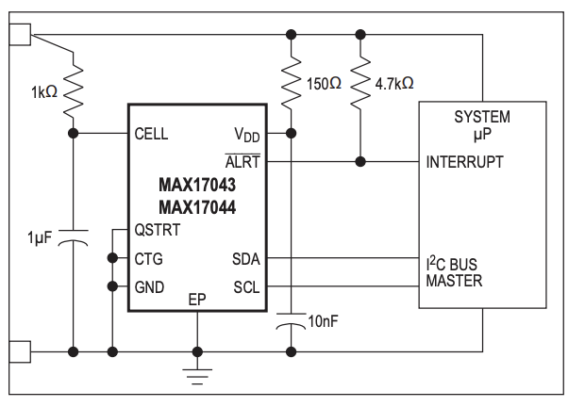
Pi
Pi Pin 27
Pi Pin 28
Pi Pin 6

