Slide 1
Esp32 BLE trick

Slide 2
// GATT Characteristics
attributes.put("00002a00-0000-1000-8000-00805f9b34fb", "Device Name");
attributes.put("00002a01-0000-1000-8000-00805f9b34fb", "Appearance");
attributes.put("00002a02-0000-1000-8000-00805f9b34fb", "Peripheral Privacy Flag");
attributes.put("00002a03-0000-1000-8000-00805f9b34fb", "Reconnection Address");
attributes.put("00002a04-0000-1000-8000-00805f9b34fb", "PPCP");
attributes.put("00002a05-0000-1000-8000-00805f9b34fb", "Service Changed");
---------------------
作者：一光年lost
来源：CSDN
原文：https://blog.csdn.net/zjy323520/article/details/52164025
版权声明：本文为博主原创文章，转载请附上博文链接！

Slide 3
5、手机的BLE默认有2个服务
（1）Service 通用属性规范 00001801-0000-1000-8000-00805f9b34fb （null）
a）Characteristic 服务改变 00002a05-0000-1000-8000-00805f9b34fb
（2）Service 通用接入规范 00001800-0000-1000-8000-00805f9b34fb
a）Characteristic 设备名称 00002a00-0000-1000-8000-00805f9b34fb
b）Characteristic 设备外观 00002a01-0000-1000-8000-00805f9b34fb （00 00）
c）Characteristic 设备外观 00002aa6-0000-1000-8000-00805f9b34fb （01）
注意：因为00002aa6不在定义中，因此可以认为是厂商或者用户自定义的特征（或服务）

Slide 4
This demo creates a custom UART service, with one characteristic for TX and one for RX using the following UUIDs:
6E400001-B5A3-F393-E0A9-E50E24DCCA9E for the Service
6E400002-B5A3-F393-E0A9-E50E24DCCA9E for the TX Characteristic (Property = Notify)
6E400003-B5A3-F393-E0A9-E50E24DCCA9E for the RX Characteristic (Property = Write without response)

Slide 5
[3C:71:BF:D1:9C:66][LE]> characteristics
handle: 0x0002, char properties: 0x20, char value handle: 0x0003, uuid: 00002a05-0000-1000-8000-00805f9b34fb
handle: 0x0015, char properties: 0x02, char value handle: 0x0016, uuid: 00002a00-0000-1000-8000-00805f9b34fb "Device Name"
handle: 0x0017, char properties: 0x02, char value handle: 0x0018, uuid: 00002a01-0000-1000-8000-00805f9b34fb
handle: 0x0019, char properties: 0x02, char value handle: 0x001a, uuid: 00002aa6-0000-1000-8000-00805f9b34fb
handle: 0x0029, char properties: 0x10, char value handle: 0x002a, uuid: 6e400003-b5a3-f393-e0a9-e50e24dcca9e RX
handle: 0x002c, char properties: 0x08, char value handle: 0x002d, uuid: 6e400002-b5a3-f393-e0a9-e50e24dcca9e

Slide 6
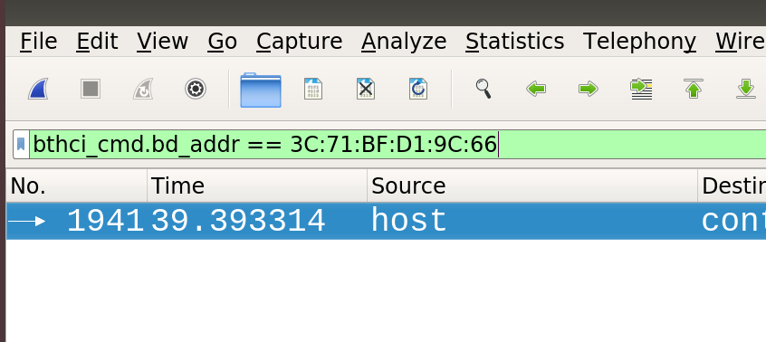
bthci_cmd.bd_addr == 3C:71:BF:D1:9C:66

Slide 7
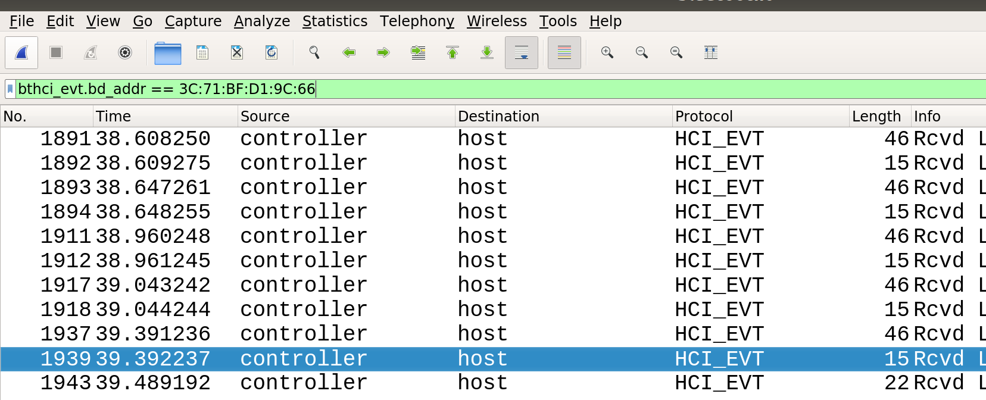
bthci_evt.bd_addr == 3C:71:BF:D1:9C:66

Slide 8
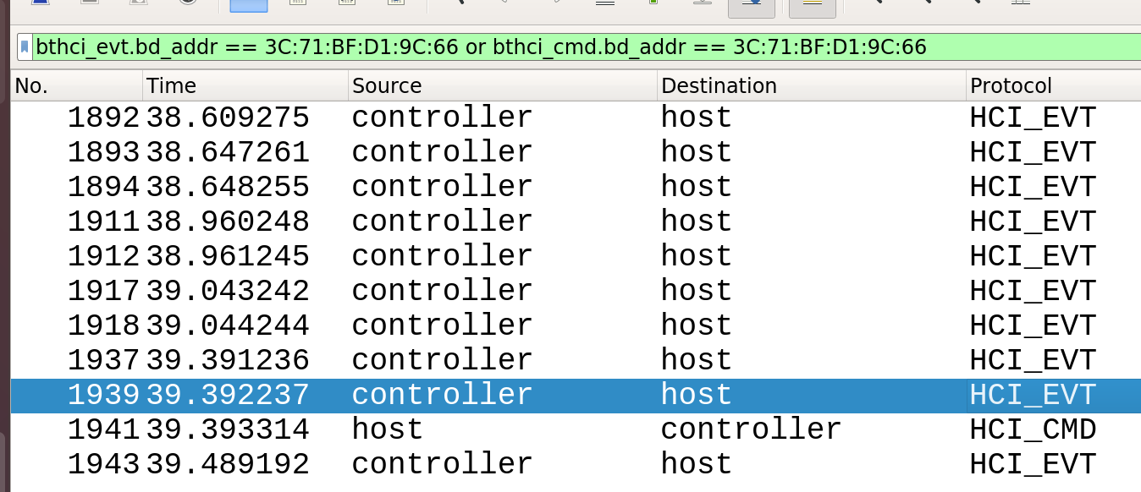

Slide 9
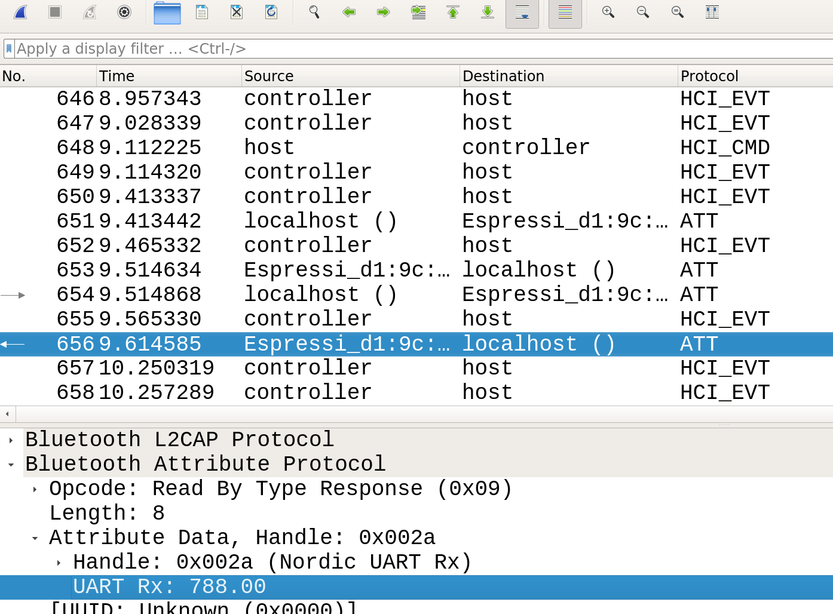
安裝hcidump之後可以看到att封包

Slide 10
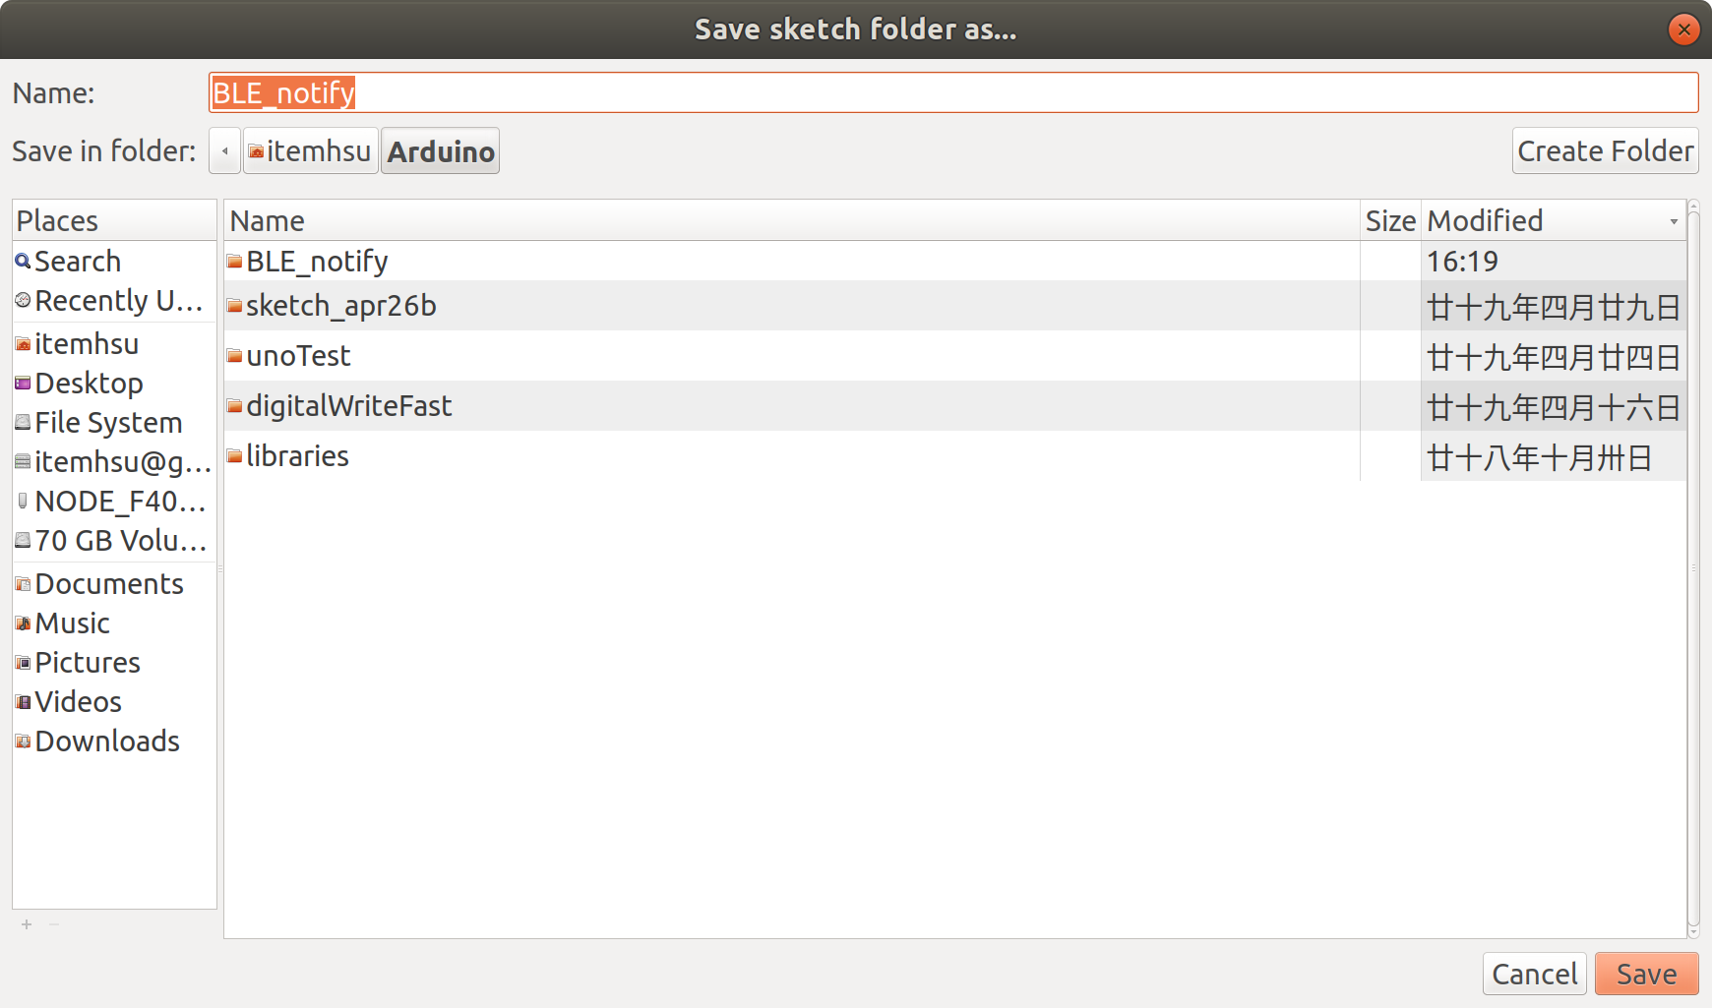
可以看到notify att封包
Basically its sample code with 1 change:
BLE2902* p2902Descriptor = new BLE2902(); p2902Descriptor->setNotifications(true);
in line 95
pCharacteristic->addDescriptor(p2902Descriptor);

