Slide 1
How to Simulate with Docker Containers

Slide 2
Purpose & Assumptions
Purpose
Install Docker based Network Simulator
Audience
Well versed with Linux/Ubuntu
Capable of running CLI commands
Capable of deploying VMs using Virtual Box or KVM
Assumptions
Openstack, ODL and the Virtual Computes (i.e., docker containers) run on the same node
Devstack is used as Openstack
The VM used by XFT11 is used as base
Stack is running
The VM has Internet connectivity
VM needs to have the following resources
BARE MINIMUM (Suitable for unit testing workloads)
vCPU: 4
Memory: 6GB
Possible to run on a new Laptop.
Recommended (Run Baremetal, not as a VM):
CPU: 16-32
Memory: 32-64 GB

Slide 3
Contents of the package
Python Files
Test-bed
Stateless_testbed.py
Dockernet.py
Neutron Driver
StatelessEventDriverForNeutron.py
Docker Files
Tenant VM Container
Tenant VM as a container: built from the file Inside_Dockerfile
Needs inside_script.sh to be in the same folder as Inside_Dockerfile
Virtual Compute Container
Virtual Compute as a container: Built from the file Dockerfile
Needs the start_script.py and create_containers.py files to be in the same folder as Dockerfile
Post Install test scripts
Create.sh: Creates a ELAN with 2 ports
Delete.sh: Deletes the ELAN with 2 ports

Slide 4
Preparation
Install Docker: https://docs.docker.com/install/linux/docker-ce/ubuntu/
Add stack user to the docker group
This will enable running docker commands without root privileges
Build the Virtual Compute docker image using the file Dockerfile
Assumptions: The Virtual Compute docker image is named “dind:bionic”
Build the tenant VM docker image using the file Inside_Dockerfile
Assumptions: The tenant VM docker image is named “base_image:bionic”
Run a unsecure docker registry service:
Instructions: https://docs.docker.com/registry/insecure/
Push the base_image:bionic to the registry as localhost:5000/base_image:bionic
Create a underlay network called “csc_underlay”
Command: docker network create csc_underlay

Slide 5
Preparation
In the /home/stack/devstack folder
Execute ./unstack.sh
In the local.conf change the username: password of ml2_odl to admin:admin
Run: ./stack.sh

Slide 6
Preparation
Install Kafka on a server (ideally in the VM with devstack)
Installation Instructions: https://kafka.apache.org/quickstart
Install thrift API for python on the VM with devstack
Installation command: pip install thrift
This is a unnecessary legacy dependency, that will be removed later
Install kafka-python on the VM with devstack
Install command: pip install kafka-python
Install kafka-python on the server hosting the simulator
Install command: pip install kafka-python

Slide 7
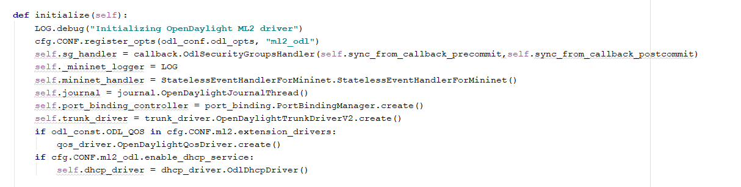
Neutron Driver for the Simulator
Create folder Maxinet under /opt/stack/networking-odl/networking_odl
Copy StatelessEventHandlerForMininet.py to Maxinet
Copy stateless folder to Maxinet
Edit the mech_driver_v2.py and add the following lines

Slide 8
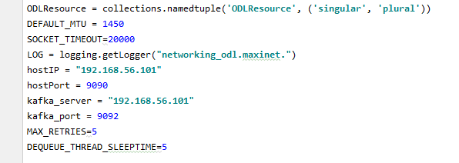
Neutron Driver for the Simulator
Edit the StatelessEventHandlerForMininet.py and update with Kafka Server information

Slide 9
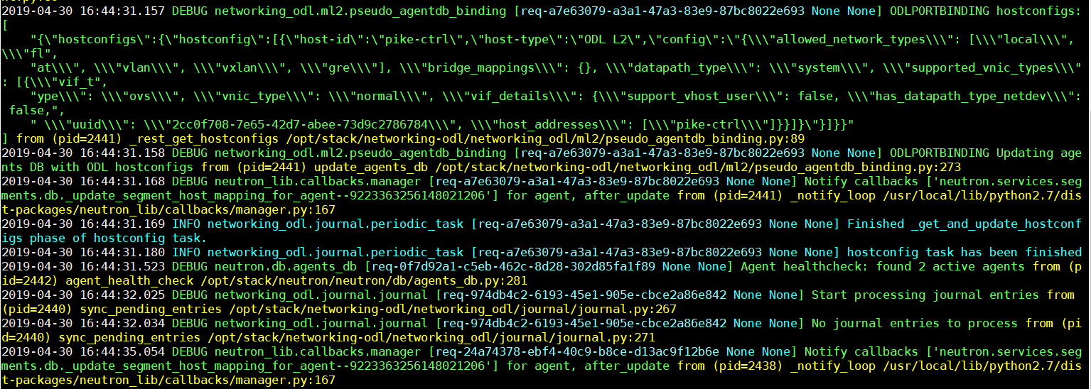
Restart Neutron
In devstack, the Openstack services are accessed using screen –r
Link for details: http://www.rushiagr.com/blog/2013/06/05/linux-screens-in-devstack/
In screen, navigate to the neutron service by using CTRL-A+P or CTRL-A+N repeatedly
You have reached the Neutron service, if the logs on the screen are about ml2 driver
Press CTRL-C to kill the process
Press up arrow to get to the last command executed and then press enter
Neutron services are started
You should see errors on the screen pertaining to
Unable to reach the port 9090
Unable to access the ODL

Slide 10
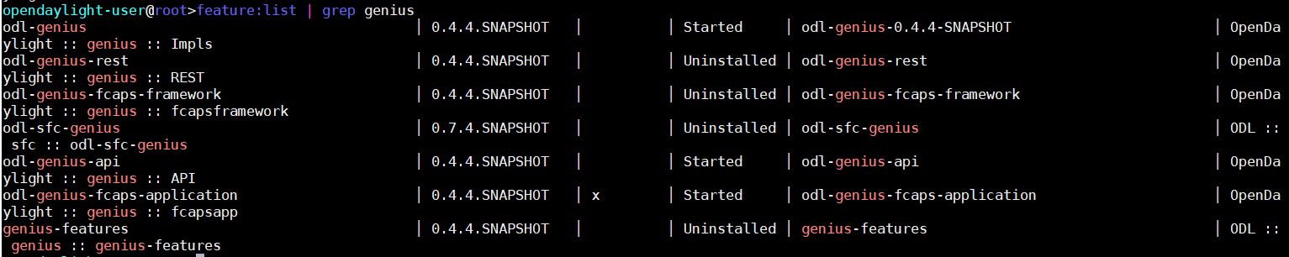
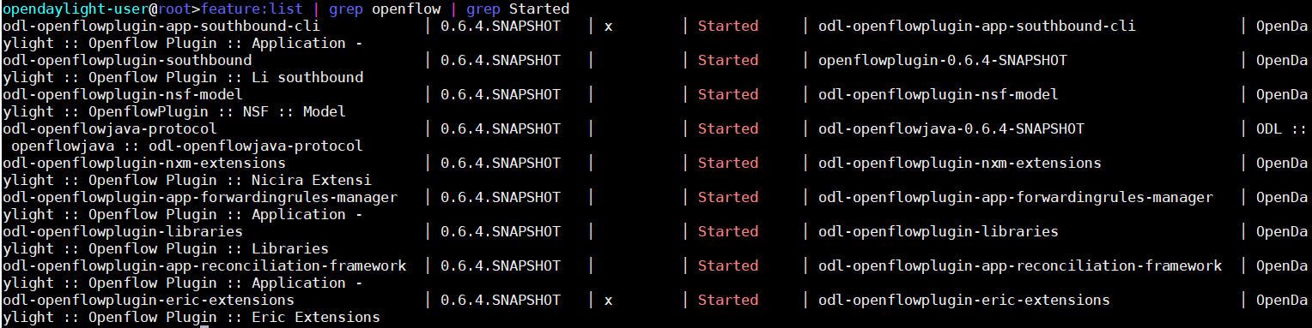
DeployODL
Netvirt
Genius
Openflow

Slide 11
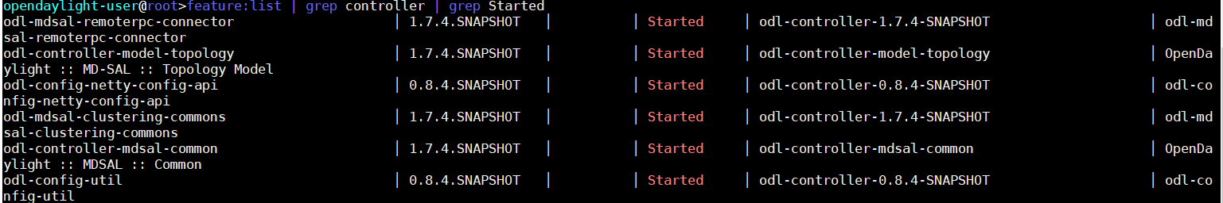
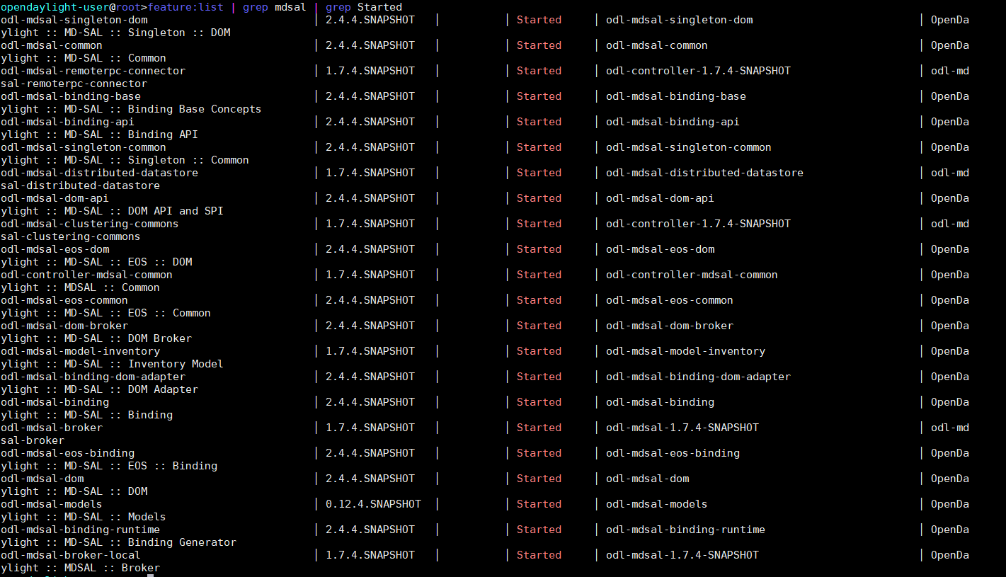
Deploy ODL
Controller
MD-SAL

Slide 12
Preparing the Simulator
Install plyvel
Pip install plyvel json telnetsrv gevent PrettyTable
Create a folder /home/stack/mininet_handler
Create a folder /home/stack/mininet_handler/logs
Create a folder /home/stack/mininet_handler/db
Copy stateless_testbed.py & dockernet.py to /opt/stack/networking-odl/networking_odl/maxinet/

Slide 13
Start the Simulator
Go to <Folder_Containing_stateless_simulator>
Execute: python stateless_simulator.py <Kafka Server IP> <Kafka Port>
This might complain about lack of some python dependencies
You can install these dependencies, by typing pip install <dependency>
The logs will be at DEBUG level and should be accessible by executing:
tail –f /home/stack/mininet_handler/mininet_handler.log

Slide 14
Post Install Testing
Assumption:
It is possible for the docker0 bridge to reach the ODL SBI
Log in to the simulator by
telnet localhost 55555
Start 2 virtual computes using:
Start_computes <ODL CTRL IP> 2
You can check that the connectivity to ODL is established by typing get_compute_status
This should return 4 connections in ESTABLISHED state.
Run the post-install test script: create.sh
This should create a ELAN with 2 ports.
From the telnet CLI run start_elan_test
If everything is programmed correctly, the ping test should succeed as reported in the logs
You can also get the status from the Telnet CLI using elan_test_status command
From the Telnet CLI run stop_elan_test
This should stop the ping tests
Run the post-install script: delete.sh
This should delete the ELAN and the 2 ports

