Slide 1

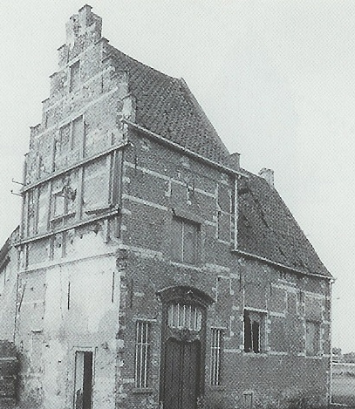
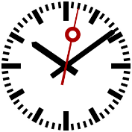



60min
Dockerfiles
docker-compose
Demos
Code-Show
Theoretical
Introduction
CloudTrack

