Slide 1


Frontend Unit Testing
120min
Hands-On
Theoretical
Introduction
FrontendTrack

Slide 2
Part 1 Jasmine & Jest
Development Setup
Jest Syntax
Matchers
Spies
Async
Time Travel
Exercises

Slide 3

JASMINE
You can never go wrong with Jasmine

Slide 4
JASMINE
Angular testing is typically done using Jasmine
React testing is typically done using Jest

Slide 5

Jest
Jest syntax is largely the same as Jasmine

Slide 6
Development Setup
Node v16.10 (use nvm)
Visual Studio Code (guide)
Jest VSCode extension : debug in VSC (see .vscode/launch.json)
Node.js V8 – inspector Manager : debug in chrome
Note: the .vscode has to be a top directory in your workspace
for debugging to work!

Slide 7
Jest examples REPO: jasmine-tut
Open the « Jest » folder from jasmine-tut in VSC
There are examples for pretty much everything
Notes:
https://github.com/itenium-be/jasmine-tut

Slide 8
BASIC Example Spec
describe('basic example', () => {
beforeEach(() => { this.result = 1 })
it('can hardly fail', () => {
// toBe() uses ===
expect(this.result).toBe(1)
expect({a: {}}).toEqual({a: {}})
expect([0, {a: 1}]).toEqual([0, {a: 1}])
});
// it.only(…) // describe.skip(…)
afterAll(() => {})
})
Notes:
https://itenium.be/blog/javascript/javascript-testing-jasmine-syntax/#matchers
it & test are aliases

Slide 9
Jest examples REPO: jasmine-tut
1.MatchersSpec.js
expect([0, {a: 1}]) .toEqual([0, {a: 1}])
expect(1) .toBeTruthy()
expect('some bar’) .toMatch(/bar$/)
expect(['a', {b: {}}]).toContainEqual({b: {}})
expect(foo) .not.toThrow()
expect({}) .toEqual(expect.any(Object))

Slide 10
Jest examples REPO: jasmine-tut
2.SpiesSpec.js Mocks a.k.a. Spies
// setup spy
jest.spyOn(obj, 'fnName’)
// something invokes the function
obj.fnName('p1’)
// verify it has been called
expect(obj.fnName).toHaveBeenCalled()

Slide 11
Jest examples REPO: jasmine-tut
2.SpiesSpec.js
jest.spyOn(obj, 'fnName')
obj.fnName('p1')
const ex = expect(obj.fnName)
ex.toHaveBeenCalled() ex.toHaveBeenCalledTimes(1) ex.toHaveBeenCalledWith('p1’)
Also: obj.fnName.mock → calls, results, …

Slide 12
Jest examples
2.SpiesSpec.js
// replace native function with a mock implementation
jest.spyOn(obj, ‘fn').mockImplementation(x => x + 1)
// or return canned value(s)
jest.spyOn(obj, ‘fn’)
.mockReturnValueOnce(1)
.mockReturnValueOnce(2)
.mockReturnValue(‘all further calls return value’)
// or throw
jest.spyOn(obj, ‘fn').mockImplementation(() => { throw new Error(‘oh noes!')})

Slide 13
Jest examples
2.SpiesSpec.js
// replace a property of an object
const obj = { value: 3 }
const prop = jest.replaceProperty(obj, 'value', 8)
// restore original value
prop.restore()
// spy on a property (get/set overload)
jest.spyOn(obj, ‘propName', 'get').mockReturnValue(1)

Slide 14
Jest examples
3.AsyncSpec.js
describe('async’, () => {
beforeEach(async () => {})
it('awaits', async () => {
const mock = jest.fn().mockResolvedValue(43)
const result = await mock()
expect(result).toBe(43)
})
test(‘callbacks’, done => { Promise.resolve().then(() => done())
})
})

Slide 15
Jest examples
3.AsyncSpec.js
describe(‘Time Travel’, () => {
beforeEach(() => jest.useFakeTimers())
it('can hijack new Date', () => {
const baseTime = new Date(2013, 9, 23)
jest.setSystemTime(baseTime)
jest.advanceTimersByTime(50) const newDate = new Date().getTime()
expect(newDate).toEqual(baseTime.getTime() + 50)
})
afterEach(() => jest.useRealTimers())
})

Slide 16





Jest Exercises

Slide 17
Jest Exercises
Confac/backend
git clone confac
cd backend git checkout jest-start npm install

Slide 18
Jest Exercises
Confac/backend
Open confac/backend in VSC (launch.json!)
Exercises are in src/controllers/tests

Slide 19
Jest Exercises
EASY
0-config-templates.test.ts
Mocking the FileSystem
See TODOs, need to do some refactoring

Slide 20
Jest Exercises
EASY
0-user-verify.test.ts
Mocking google-auth-library
Need to manipulate ../../config.ts

Slide 21
Jest Exercises
Medium
1-clients.test.ts
Test an express route
Using manual mocks for:
fakeUser: the user (jwt)
fakeClient: the client being added
fakeDb: poor man mongodb

Slide 22
Jest Exercises
Medium
2-consultants.test.ts
Our fakeDb replaced with an in-memory mongo

Slide 23
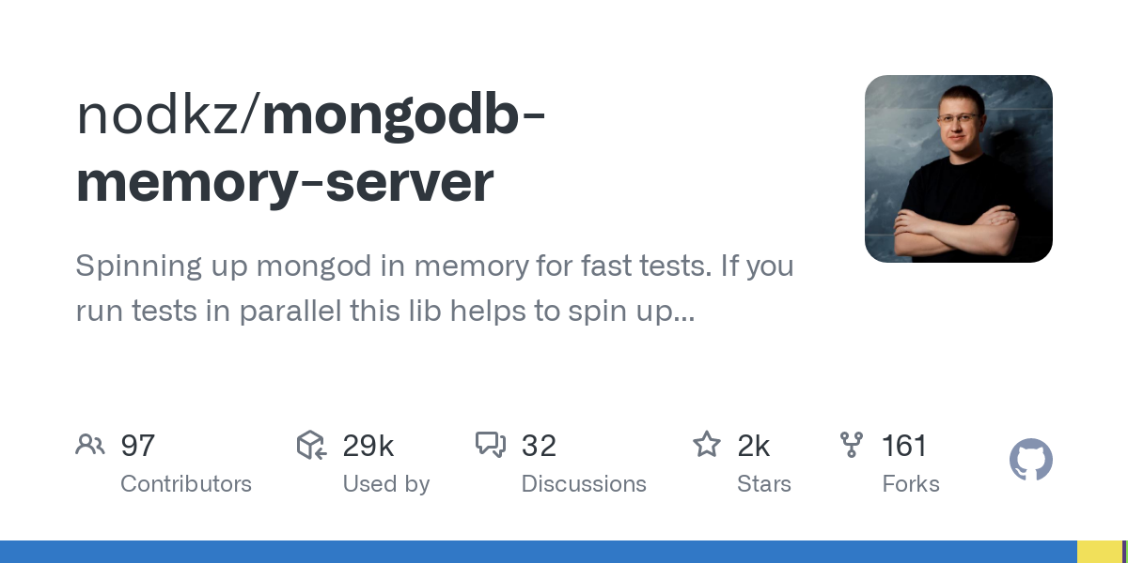
Jest Exercises
Medium

Slide 24
Jest Exercises
Medium
3-projectsMonth.test.ts
Setup and test an actual Express with supertest
supertest was created alongside superagent
superagent is package to « fetch »
supertest is often used to test expressjs apps
These exercises require some mongo queries

Slide 25
Jest Exercises
Medium
4-projectsMonth.test.ts
Bringing all the setup from the previous exercises together
Start here if you feel comfortable with Jest
There are no example test implementations here

Slide 26
Jest Exercises
HARD
7/8/9-invoice tests
Completely bare exercise skeletons
Think about a setup that does not require copying 20+ lines of code each time?
Exercises
7-deleteInvoice
8-createInvoice: lots of mocking needed
9-emailInvoice: sending emails, creating & merging attachments, …

Slide 27
Infos
WiFi: itenium-guest / Wifi4Ufree

