Slide 1

Microkernel
aka Plugin Architecture aka µ-kernel
Notes:
Those who have looked it up already: The term Microkernel was originally used for an OS with a small core in kernel mode (elevated privileges) while most of the OS runs in user-mode.

Slide 2
MENU
OS Origins
What
Where
Examples

Slide 3
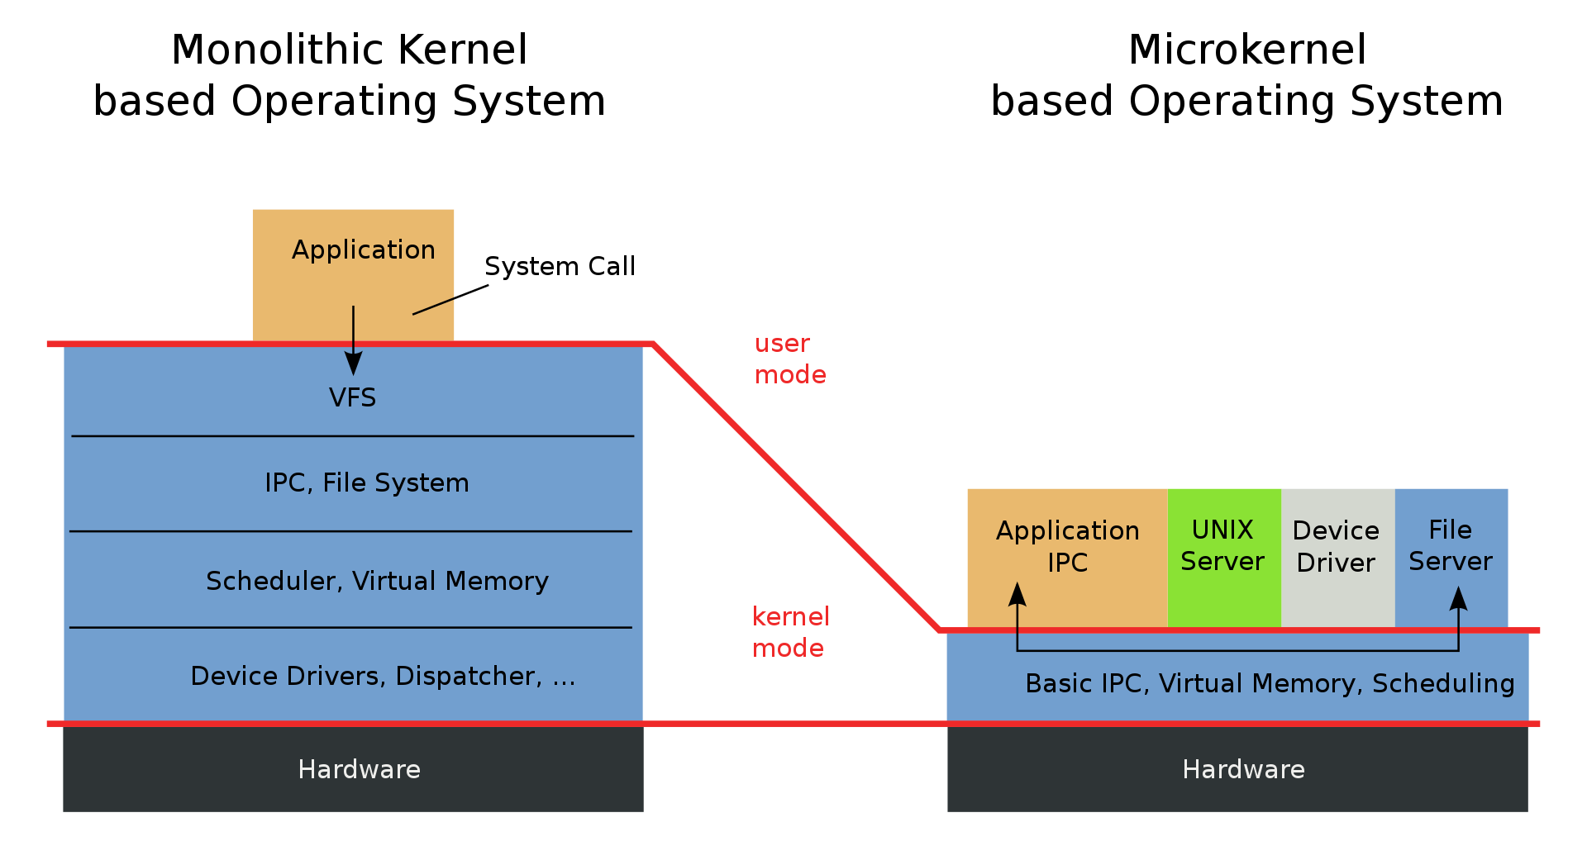
Notes:
Monolithic: MS-DOS, Unix, Linux
Microkernel: Minix
Hybrid kernel: MacOSX, Windows NT
VFS: VirtualFileSystem
IPC: Inter-Process Communication
Monolithic: Slightly better performance. A crash in a driver could crash the entire system (BSOD)
Micro: Better security (only very little code is executed in privileged mode of the hardware) + more crash resistant: if one server crashes, the others are not impacted
In Microkernel communication between user-mode & kernel-mode is expensive
This is a problem only present in a Microkernel OS
Of all published critical Linux CVEs (Common Vulnerabilities & Exposures) → 40% would not have happened; only 4% would remain unmitigated

Slide 4
what
Entire System?
Contract Governance
Small Core System
Plugin Registry
Stable & Robust
Building Blocks
Plugin Modules
Independent
Easy deployment
Easy testing
Notes:
Microkernel could be an entire system but very often it is a (small) part inside a different architecture.
Contract Governance:
The hardest part of the Microkernel architecture: The contract between the Core System & the Plugins: How do we hook a plugin into the main system
Needs to stabilize quickly!
It should be broad enough so that the plugins can actually achieve their goals
It should be detailed enough so that writing a plugin is a straightforward process and you do not have to jump through hoops to get basic things done
If you need to change the core for pretty much every plugin, the contract is probably wrong!
Think about versioning: how to replace a plugin v1 with a v2
Plugin Registry: (or Plug-In Manager)
- Drop some files in a folder – picked up at startup or during runtime
Add a record to a database table
Call an endpoint to add a plugin
Message/Event: Could contain the location of the source code for truly dynamic systems
Independent:
A plugin is an isolated piece of functionality. It should not communicate with other plugins.
Could be implemented by a Third Party
Easy Deployment:
Could be as easy as dropping a file somewhere.

Slide 5
what
Extend the core with
Skins & Themes
Additional Features
Business Capabilities
Different Ruleset based on
Tenant
Location
User Preference
…
Notes:
Skins & Themes: WinAmp, alternative look for specific websites, …
Rulesets
Tenant: Different plugins could be made active based on the Client or even different rules for different departments of the same client. Load the app with the plugins the Client has paid for.
Location: Implement Country-specific changes with plugins. For example when different implementations are needed based on the legislation of the country

Slide 6
where
Browsers – Chrome Web Store
IDE – Visual Studio Code Marketplace
Photoshop, Paint.NET, …
Squirrel SQL Client: Db Driver jar
Games – Levels, Skins, Mods, …
CLI
WebServers – IIS, Express
Business Applications
Mi-Ke
MGT-X
Notes:
Chrome Web Store:
Browsers: Netscape Plugin Application Programming Interface (NPAPI) (being deprecated)
Starify Github Links: https://chrome.google.com/webstore/detail/starify-github-repo-links/kpficnopciffopkhjpckhkgmnlakcmig?hl=nl
Mi-Ke:
https://github.com/itenium-be/Mi-Ke
Mike.ahk & Include.ahk & includes.txt
→ Plugins based on Code – there is not really a contract
MGT-X:
Processing files & events from different teams:
Parse & Validate the « clockfile » into Timesheet & Advantages. Inform MicroServices when the file has been processed.
Listen to a folder for incoming Isabel payment files, then based on the bank, process in a certain way
Each team is responsible for their own plugins. The core system has no functional or business knowledge.
So PRs for functional changes in a Plugin are developed, code reviewed and tested not by the MGT-X people but by the responsible/knowledgable team itself
MGT-X offers often used functionality out of the box:
Listen/Dispatch events
SFTP to get/put files
Validation
Tracing, Monitoring, Logging

Slide 7
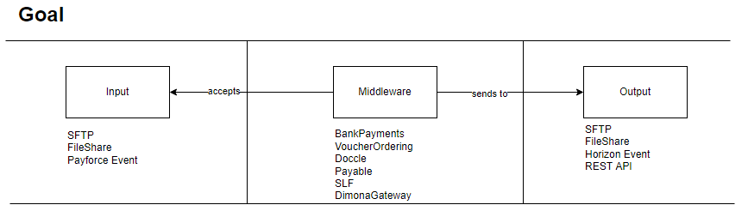
MGT-X

Slide 8
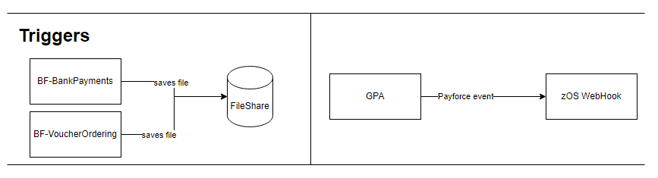
MGT-X - Inputs

Slide 9
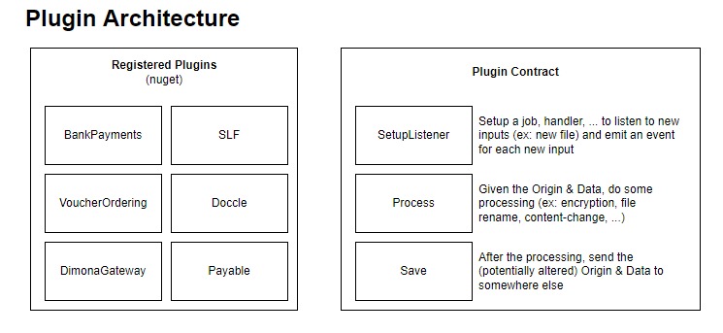
MGT-X

Slide 10
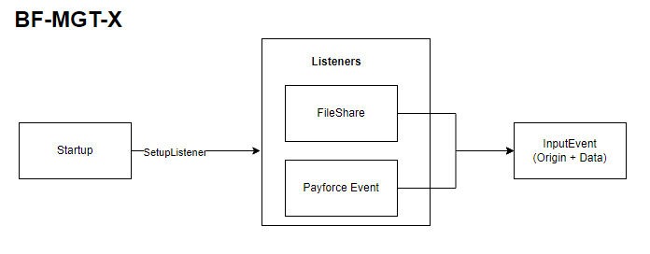
MGT-X - Startup

Slide 11
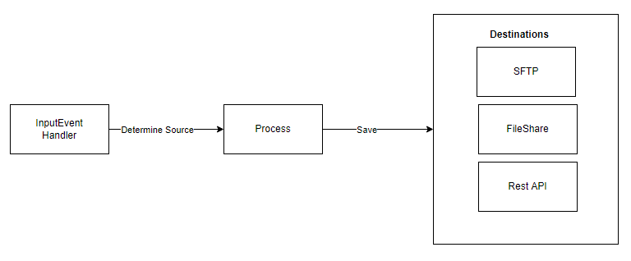
MGT-X

Slide 12
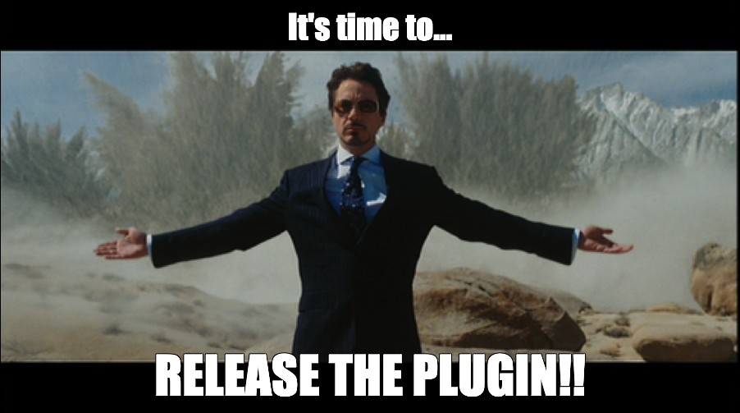
MGT-X

Slide 13
Next
Your standard architectures (Layered, Hex, …)
Event Driven
MicroServices
Event Sourcing & CQRS
Blockchain?
RXJS?
Don’t forget the Doodle!!

Slide 14
Questions?

Slide 15
resources
What Is Microkernel Architecture Design?
Chromium Plugin Architecture
Example NodeJS Plugin System
SAP – Microkernel Architecture

