Slide 1






60min
MODERN
JS
Code-Show
Intermediate
FrontendTrack

Slide 2



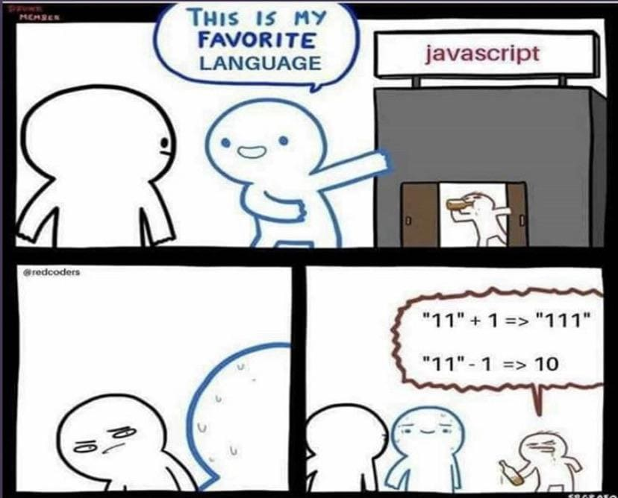

JavaScript?

Slide 3

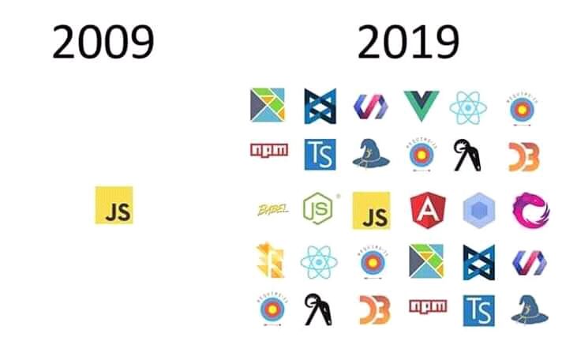

ModernJS?

Slide 4

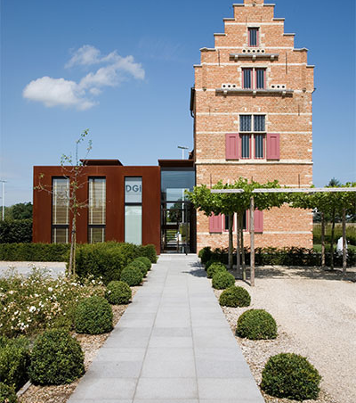

Menu
ECMAScript
TypeScript

Slide 5

ECMAScript 2023
and earlier…
Code-Show

Slide 6


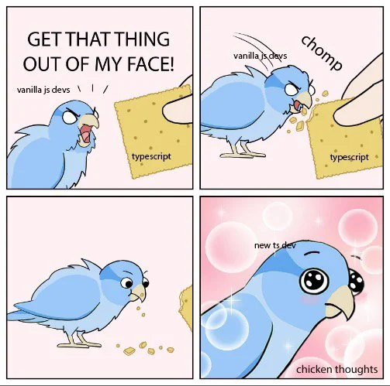
TypeScript

Slide 7


Other JS Sessions?
Separate “JS Basics” session?
Function Fundamentals
Closures
Prototype
…

Slide 8
ModernJS Setup Session?
Node & NVM
Prettier & ESLint
Husky & Nodemon
package.json Scripts
Modules

Slide 9

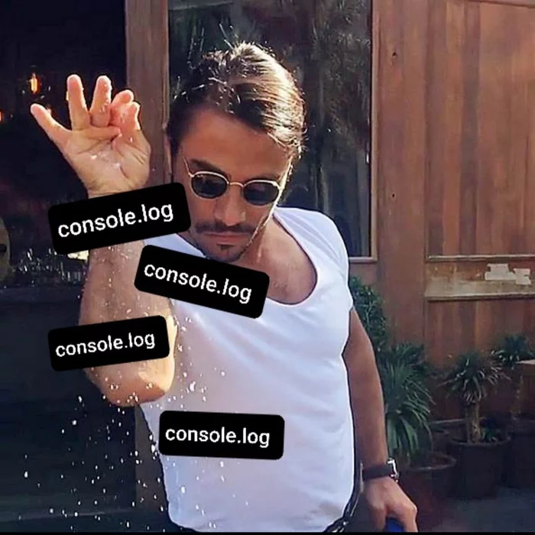
Debugging JS

Slide 10
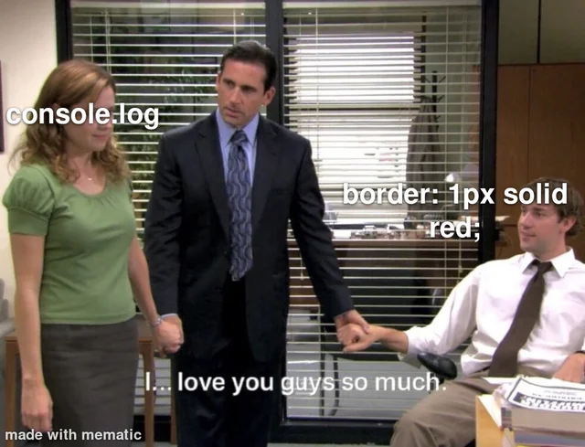
More Debugging

Slide 11
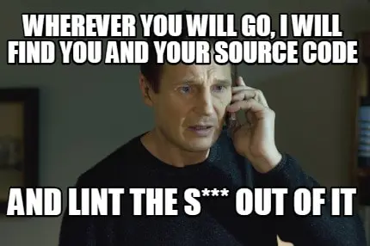

Linting

Slide 12
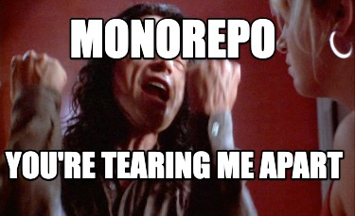
Monorepos

Slide 13



Let’s Start!

