Slide 1

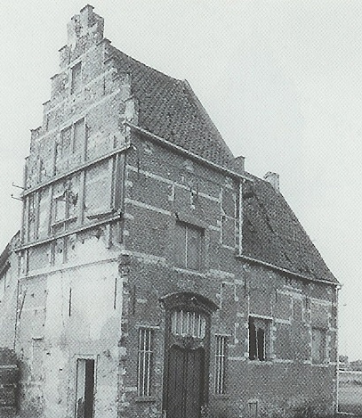





60min
MongoDB
much web scale
Hands-On
Introduction
TechEvent

Slide 2




Menu
DB: Customers
What
MQL & BSON

Slide 3



DB: Customers
docker compose up -d
Mongo: localhost:27017
Clients:
Mongoclient: localhost:27018
Compass
Studio 3T

Slide 4

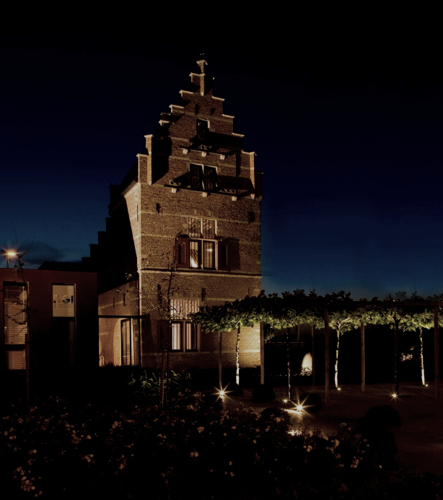

What - NoSQL
Key-value pair: Redis
Column-oriented: Cassandra
Graph-based: Neo4j
Time series: Influx
Document-oriented: Mongo
Notes:
Column-oriented: Cassandra → Wide-Column

Slide 5




What
Databases → Collections → Documents
Collections instead of Tables
BSON Documents
_id: ObjectId()
No schema
Embed vs Reference
MQL vs SQL
Mongo Shell
Horizontal Scaling
Replication: same data
Sharding: split data
Notes:
Collections
BSON:
Extra types over JSON, like Date
Max 16MB.
Binary Data: User → Store profile picture along with the document
Embed vs Reference:
Can not peformantly search in nested data
Mongo Shell:
Used in GUIs as well. JS-like syntax.
Other:
Inserting a document creates the collection if it not yet exists

Slide 6
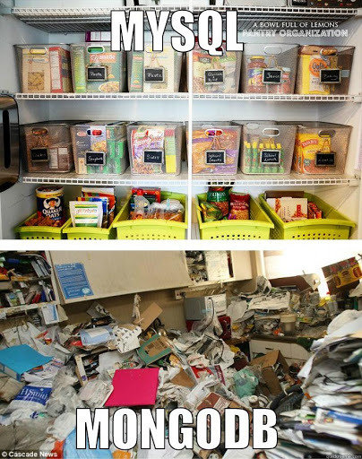
No Schema?

Slide 7
MQL & BSON
use crm
db.customers.insertOne({
_id: ObjectId("5099803df3f4948bd2f98391"), active: true,
name: 'Tomas',
audit: {
createdOn: ISODate("2024-01-01T00:00:00Z"),
modifiedBy: [{
by: 'admin',
on: new Date()
}]
},
profileViews: NumberLong(1250000)
})
Notes:
use crm → set « db »
audit.modifiedBy.0 → access first element of array in a query

Slide 8
MQL & BSON
What can one do with a db
See README-CLI.md
See Cheat Sheet links in README.md
See MongoDBShell-CheatSheet.pdf
use crm
db.customers.help()

Slide 9
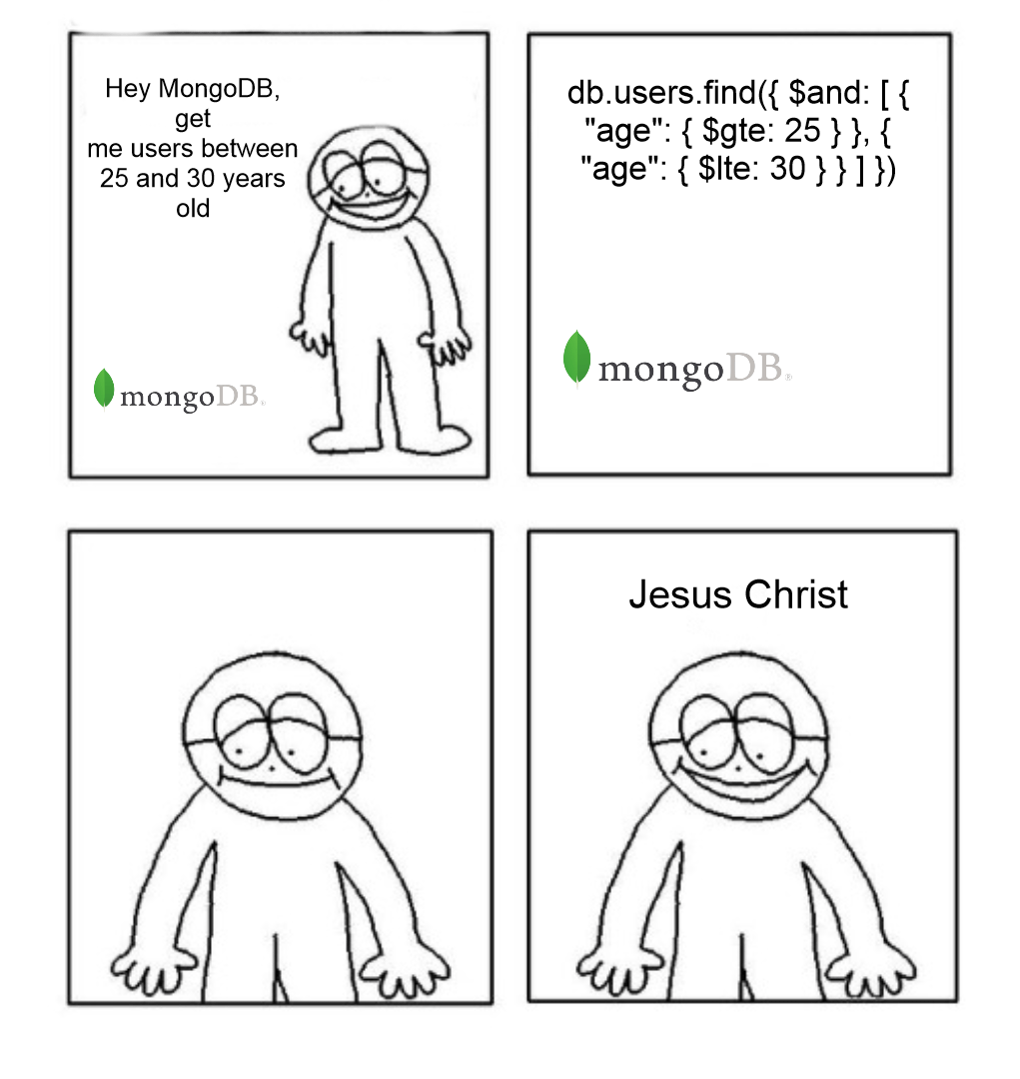
MQL & BSON

Slide 10
MQL & BSON
README-CLI-Basic.md

Slide 11



LET’S GO!

Slide 12



WiFi: itenium-guest / Wifi4Ufree
New WiFi: ITENIUM_GAST / FreeWifi

